Slide 1
Mobile Communications
Chapter 6: Broadcast Systems
Unidirectional distribution systems
DAB
  architecture
DVB
  Container
  High-speed Internet

Slide 2
Unidirectional distribution systems
Asymmetric communication environments
  bandwidth limitations of the transmission medium
  depends on applications, type of information
  examples
    wireless networks with base station and mobile terminals
    client-server environments (diskless terminal)
    cable TV with set-top box
    information services (pager, SMS)
Special case: unidirectional distribution systems
  high bandwidth from server to client (downstream), but no bandwidth vice versa (upstream)
  problems of unidirectional broadcast systems
    a sender can optimize transmitted information only for one group of users/terminals
    functions needed to individualize personal requirements/applications

Slide 3
Unidirectional distribution
service provider
service user
A
receiver
B
A
unidirectional
distribution
medium
A
B
receiver
A
sender
A
B
.
.
.
A
B
A
receiver
optimized for expected
access pattern
of all users
≠
individual access
pattern of one user

Slide 4
Structuring transmissions - broadcast disks
Sender
  cyclic repetition of data blocks
  different patterns possible (optimization possible only if the content is known)
Receiver
  use of caching
    cost-based strategy: what are the costs for a user (waiting time) if a data block has been requested but is currently not cached
    application and cache have to know content of data blocks
    and access patterns of user to optimize
flat disk
A
B
C
A
B
C
skewed disk
A
A
B
C
A
A
multi-disk
A
B
A
C
A
B

Slide 5
DAB: Digital Audio Broadcasting
Media access
  COFDM (Coded Orthogonal Frequency Division Multiplex)
  SFN (Single Frequency Network)
  192 to 1536 subcarriers within a 1.5 MHz frequency band
Frequencies
  first phase: one out of 32 frequency blocks for terrestrial TV channels 5 to 12 (174 - 230 MHz, 5A - 12D)
  second phase: one out of 9 frequency blocks in the L-band
  (1452- 1467.5 MHz, LA - LI)
Sending power: 6.1 kW (VHF, Ø 120 km) or
4 kW (L-band, Ø 30 km)
Date-rates: 2.304 Mbit/s (net 1.2 to 1.536 Mbit/s)
Modulation: Differential 4-phase modulation (D-QPSK)
Audio channels per frequency block: typ. 6, max. 192 kbit/s
Digital services: 0.6 - 16 kbit/s (PAD), 24 kbit/s (NPAD)

Slide 6
Orthogonal Frequency Division Multiplex (OFDM)
Parallel data transmission on several orthogonal subcarriers with lower rate
c
k₃
f
t
Maximum of one subcarrier frequency appears exactly at a frequency where all other subcarriers equal zero
  superposition of frequencies in the same frequency range
Amplitude
subcarrier:
SI function=
sin(x)
x
f

Slide 7
OFDM II
Properties
  Lower data rate on each subcarrier ➔ less ISI
  interference on one frequency results in interference of one subcarrier only
  no guard space necessary
  orthogonality allows for signal separation via inverse FFT on receiver side
  precise synchronization necessary (sender/receiver)
Advantages
  no equalizer necessary
  no expensive filters with sharp edges necessary
  better spectral efficiency (compared to CDM)
Application
  802.11a, HiperLAN2, DAB, DVB, ADSL

Slide 8
Real environments
ISI of subsequent symbols due to multipath propagation
Symbol has to be stable during analysis for at least T_{data}
Guard-Intervall (T_{G}) prepends each symbnol
(HIPERLAN/2: T_{G}= 0.8 µs; T_{data}= 3.2 µs; 52 subcarriers)
(DAB: T_{data}= 1 ms; up to 1536 subcarriers)
impulse response
fade out
OFDM symbol
fade in
OFDM symbol
OFDM symbol
OFDM symbol
OFDM symbol
OFDM symbol
analysis window
t
T_{G}
T_{data}
T_{G}
T_{data}
T_{G}

Slide 9
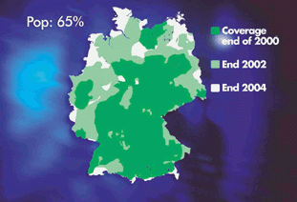
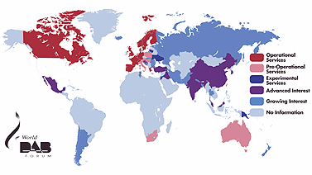
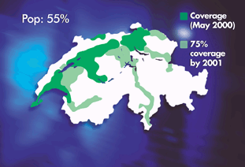
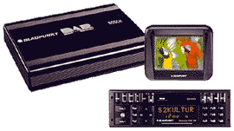
Examples for DAB coverage

Slide 10
DAB transport mechanisms
MSC (Main Service Channel)
  carries all user data (audio, multimedia, ...)
  consists of CIF (Common Interleaved Frames)
  each CIF 55296 bit, every 24 ms (depends on transmission mode)
  CIF contains CU (Capacity Units), 64 bit each
FIC (Fast Information Channel)
  carries control information
  consists of FIB (Fast Information Block)
  each FIB 256 bit (incl. 16 bit checksum)
  defines configuration and content of MSC
Stream mode
  transparent data transmission with a fixed bit rate
Packet mode
  transfer addressable packets

Slide 11
Transmission frame
frame duration T_{F}
guard interval T_{d}
symbol
T_{u}
L
0
1
2
. . . . . .
L-1
L
1
0
null
symbol
phase
reference
symbol
data
symbol
data
symbol
data
symbol
synchronization
channel
fast information
channel
FIC
main service
channel
SC
FIC
MSC

Slide 12
DAB sender
DAB Signal
Service
Information
FIC
Trans-
mission
Multi-
plexer
Multiplex
Information
carriers
ODFM
Trans-
mitter
MSC
Multi-
plexer
f
1.5 MHz
Audio
Services
Audio
Encoder
Channel
Coder
Radio Frequency
Data
Services
Packet
Mux
Channel
Coder
FIC: Fast Information Channel
MSC: Main Service Channel
OFDM: Orthogonal Frequency Division Multiplexing

Slide 13
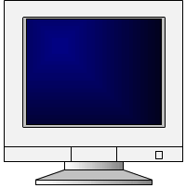
DAB receiver
(partial)
MSC
Tuner
ODFM
Demodulator
Channel
Decoder
Audio
Decoder
Audio
Service
FIC
Independent
Data
Service
Packet
Demux
Control Bus
Controller
User Interface

Slide 14
Audio coding
Goal
  audio transmission almost with CD quality
  robust against multipath propagation
  minimal distortion of audio signals during signal fading
Mechanisms
  fully digital audio signals (PCM, 16 Bit, 48 kHz, stereo)
  MPEG compression of audio signals, compression ratio 1:10
  redundancy bits for error detection and correction
  burst errors typical for radio transmissions, therefore signal interleaving - receivers can now correct single bit errors resulting from interference
  low symbol-rate, many symbols
    transmission of digital data using long symbol sequences, separated by guard spaces
    delayed symbols, e.g., reflection, still remain within the guard space

Slide 15
Bit rate management
a DAB ensemble combines audio programs and data services with different requirements for transmission quality and bit rates
the standard allows dynamic reconfiguration of the DAB multiplexing scheme (i.e., during transmission)
data rates can be variable, DAB can use free capacities for other services
the multiplexer performs this kind of bit rate management, therefore, additional services can come from different providers

Slide 16
Example of a reconfiguration
DAB - Multiplex
Audio 1
192 kbit/s
Audio 2
192 kbit/s
Audio 3
192 kbit/s
Audio 4
160 kbit/s
Audio 5
160 kbit/s
Audio 6
128 kbit/s
PAD
PAD
PAD
PAD
PAD
PAD
D1
D2
D3
D4
D5
D6
D7
D8
D9
DAB - Multiplex - reconfigured
Audio 1
192 kbit/s
Audio 2
192 kbit/s
Audio 3
128 kbit/s
Audio 4
160 kbit/s
Audio 5
160 kbit/s
Audio 7
96 kbit/s
Audio 8
96 kbit/s
PAD
PAD
PAD
D10
D11
PAD
PAD
PAD
PAD
D1
D2
D3
D4
D5
D6
D7
D8
D9

Slide 17
Multimedia Object Transfer Protocol (MOT)
Problem
  broad range of receiver capabilities
  audio-only devices with single/multiple line text display, additional color graphic display, PC adapters etc.
  different types of receivers should at least be able to recognize all kinds of program associated and program independent data and process some of it
Solution
  common standard for data transmission: MOT
  important for MOT is the support of data formats used in other multimedia systems (e.g., online services, Internet, CD-ROM)
  DAB can therefore transmit HTML documents from the WWW with very little additional effort

Slide 18
MOT structure
MOT formats
  MHEG, Java, JPEG, ASCII, MPEG, HTML, HTTP, BMP, GIF, ...
Header core
  size of header and body, content type
Header extension
  handling information, e.g., repetition distance, segmentation, priority
  information supports caching mechanisms
Body
  arbitrary data
DAB allows for many repetition schemes
  objects, segments, headers
7 byte
header
core
header
extension
body

Slide 19

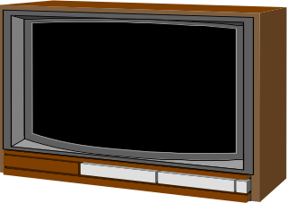






Digital Video Broadcasting
1991 foundation of the ELG (European Launching Group)
goal: development of digital television in Europe
1993 renaming into DVB (Digital Video Broadcasting)
goal: introduction of digital television based on
  satellite transmission
  cable network technology
  later also terrestrial transmission
DVB-S
Satellites
SDTV
EDTV
HDTV
DVB
Digital Video
Broadcasting
Multipoint
Distribution
System
Integrated
Receiver-Decoder
DVB-C
Cable
Multimedia PC
Terrestrial
Receiver
DVB-T
B-ISDN, ADSL,etc.
DVD, etc.

Slide 20
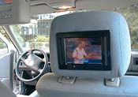





DVB Container
DVB transmits MPEG-2 container
  high flexibility for the transmission of digital data
  no restrictions regarding the type of information
  DVB Service Information specifies the content of a container
    NIT (Network Information Table): lists the services of a provider, contains additional information for set-top boxes
    SDT (Service Description Table): list of names and parameters for each service within a MPEG multiplex channel
    EIT (Event Information Table): status information about the current transmission, additional information for set-top boxes
    TDT (Time and Date Table): Update information for set-top boxes
MPEG-2/DVB
container
MPEG-2/DVB
container
MPEG-2/DVB
container
MPEG-2/DVB
container
HDTV
SDTV
EDTV
single channel
high definition television
multiple channels
enhanced definition
multiple channels
standard definition
multimedia
data broadcasting

Slide 21
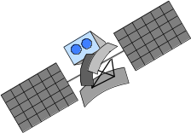
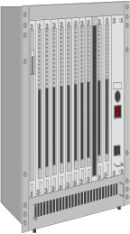
Example: high-speed Internet access
Asymmetric data exchange
  downlink: DVB receiver, data rate per user 6-38 Mbit/s
  return channel from user to service provider: e.g., modem with 33 kbit/s, ISDN with 64 kbit/s, DSL with several 100 kbit/s etc.
DVB/MPEG2 multiplex
simultaneous to digital TV
satellite receiver
satellite
provider
PC
leased line
Internet
DVB-S adapter
TCP/IP
information
provider
service
provider

Slide 22
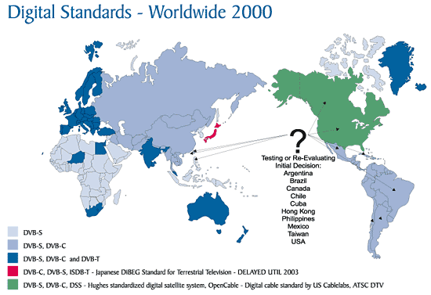
DVB worldwide

Slide 23
Convergence of broadcasting and mobile comm.
Definition of interaction channels
Interacting/controlling broadcast via GSM, UMTS, DECT, PSTN, …
Example: mobile Internet services using IP over GSM/GPRS or UMTS as interaction channel for DAB/DVB
DVB-T, DAB
(TV plus IP data)
TV
TV broadcaster
MUX
broadcast
data
channels
Internet
interaction
mobile
terminal
ISP
GSM/GPRS,
UMTS
(IP data)
mobile operator

Slide 24
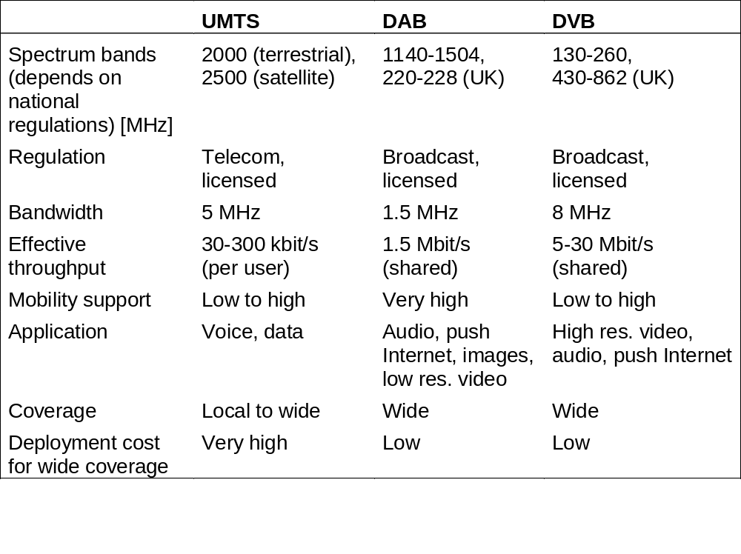
Comparison of UMTS, DAB and DVB

