Slide 1
Speech Coding

Slide 2
Speech Compression
Handling speech with other media information such as text, images, video, and data is the essential part of multimedia applications
The ideal speech coder has a low bit-rate, high perceived quality, low signal delay, and low complexity.
Delay
  Less than 150 ms one-way end-to-end delay for a conversation
  Processing (coding) delay, network delay
  Over Internet, ISDN, PSTN, ATM, …
Complexity
  Computational complexity of speech coders depends on algorithms
  Contributes to achievable bit-rate and processing delay

Slide 3
Speech coding
Standard voice channel:
  analog: 4 kHz slot (~ 40 dB SNR)
  digital: 64 Kbps = 8 bit µ-law x 8 kHz
How to compress?
  Exploit redundancy
    signal assumed to be a single voice, not any waveform
  Code only what is needed
    intelligibility
    speaker identification
Source-filter decomposition
  vocal tract shape & fundamental frequency change slowly

Slide 4
Taxonomy of Speech Coders
Speech Coders
Waveform Coders
Source Coders
Time Domain:
PCM, ADPCM
Frequency Domain:
e.g. Sub-band coder,
Adaptive transform
coder
Linear
Predictive
Coder
Vocoder

Slide 5
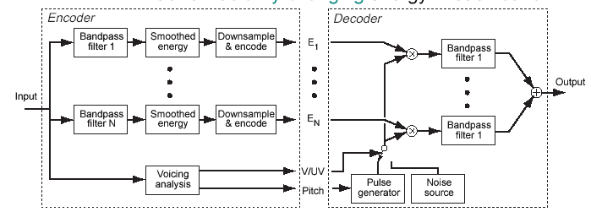
The ancestor: Channel Vocoder (1940s-1960s)
Source-filter decomposition
  filterbank breaks into spectral bands
  transmit slowly-changing energy in each band
  10-20 bands, perceptually spaced
Downsampling
Excitation with a pitch / noise model

Slide 6
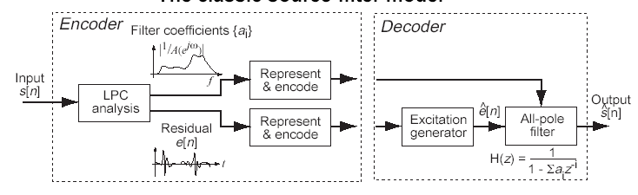
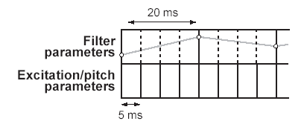
LPC encoding
The classic source-filter model
Compression gains:
  filter parameters are ~slowly changing
  excitation can be represented many ways

Slide 7
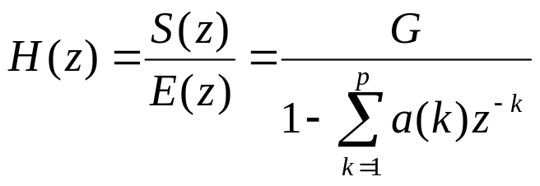
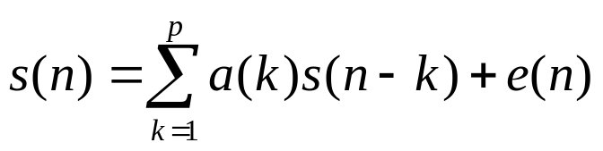
Linear Predictive Code
Model speech production system as an auto-regressive model:
Model parameters are computed for speech segment (~30 ms).
Parameters {a(k); k=1:p} are found by solving a Toeplitz system of equations.
Transfer function
To encode speech, one may transmit the quantized parameters {a(k)} and G or equivalent parameter set.
The model order is 8-10 in most speech coding standards.
unvoiced
G
v/u
voiced
N
random
sequence
generator
u[n]
H(z) =
1
1− ∑ a_{k}z^{-k}
×
P
k = 1
periodic pulse train
generator
Vocal Tract Model

Slide 8
LPC Speech Coder
LPC
filter
Synthesizer
Voice/
Un-voice
Encoder
Channel
Buffer
Decoder
Pitch
Analysis
Excitation

Slide 9
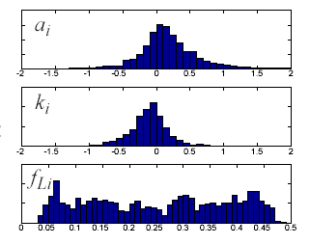
Encoding LPC filter parameters
For ‘communications quality’:
  8 kHz sampling (4 kHz bandwidth)
  ~10th order LPC (up to 5 pole pairs)
  update every 20-30 ms → 300 - 500 param/s
Representation & quantization
  {ai} - poor distribution,
  can’t interpolate
  reflection coefficients {ki}:
  guaranteed stable
  log area ratios (LAR) - stable
Bit allocation (filter):
  GSM (13 kbps):
  8 LARs x 3-6 bits / 20 ms = 1.8 Kbps

Slide 10
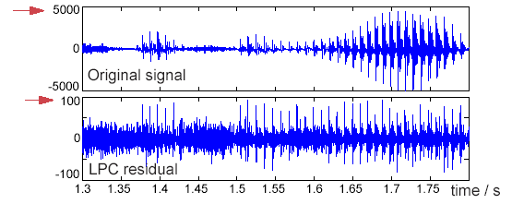
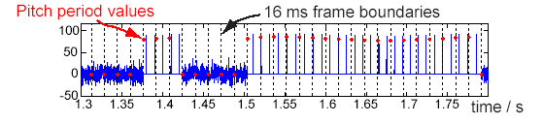
Excitation
Excitation as LPC residual is already better than raw signal:
  save several bits/sample, still > 32 Kbps
Crude model: U/V flag + pitch period
  ~ 7 bits / 5 ms = 1.4 Kbps → LPC10 @ 2.4 Kbps

Slide 11
CELP
Code excited linear predictive (CELP) speech coding.
White noise input does not give satisfactory results:
  the residue sequence still contains important information for speech synthesis
  it is necessary to send the residue to receiving end too.
To save space, use vector quantization (VQ) technique to encode the residue sequence
  Hence the name “code excited”.
In CELP, each code book is a linear vector containing 0 or ±1
  each code word length is 60 samples
  successive code words are overlapped by 58 samples
  a linear search is performed to find the best code words as input to the LPC model.

Slide 12
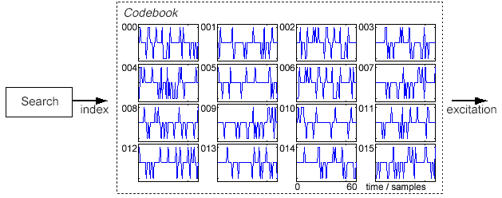
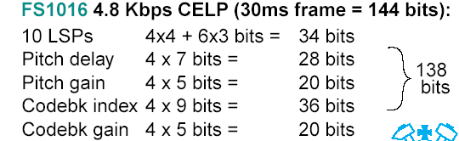
CELP
Represent excitation with codebook
e.g. 512 sparse excitation vectors
  linear search for minimum weighted error?

Slide 13
GSM Speech Encoder
Pre-processing
STP
LTP
Regular pulse excitation
(RPE)
Order = 8
LAR coefficients
Hamming
Window
Short
Term
Prediction
MUX
Long
Term
Prediction
Gain, pitch
Segmentation
20ms
LPC
Inverse
Filter
+
Grid
Selection
Pre-emphasis
LPF
Speech
input

Slide 14
GSM Decoding
De-Mux
RPE
Decoding
LTP
Synthesis
STP
Synthesis
Post-
Processing
Pitch, gain
LAR Coefficients

Slide 15
Implementation Issues
Tasks:
  LPC analysis filter to calculate the coefficients
  Long term prediction for pitch analysis need to find delay D and gain
  VQ search during CELP encoding – Most time consuming
  FIR filtering for pre- and post processing
Often implemented in DSP chips for embedded applications (e.g. cell phone).
The parameter quantization part needs bit-level operation.

Slide 16
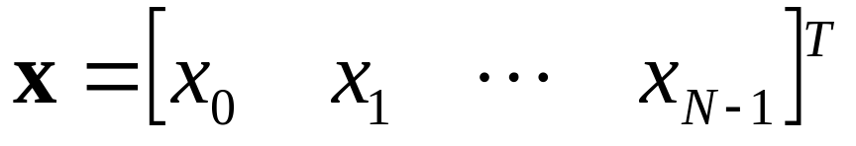

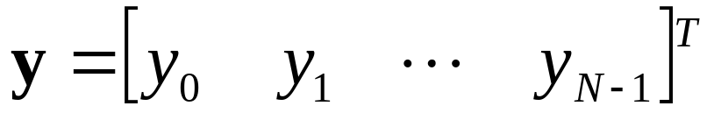



Vector Quantization: Definition
Blocks: form vectors
  A sequence of audio
  A block of image pixels
A vector quantizer maps k-dimensional vectors in the vector space R ^{k} into a finite set of vectors
  Unquantized vector:
  Quantized vector:
  Reconstruction vector (codeword):
  Codebook: the set of all the codewords:
  Voronoi region: nearest neighbor region

Slide 17
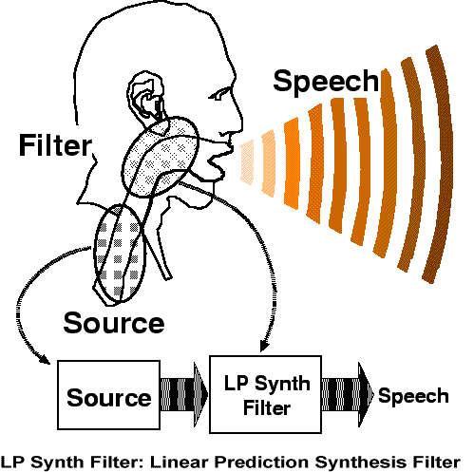
Vocal Tract Model

Slide 18
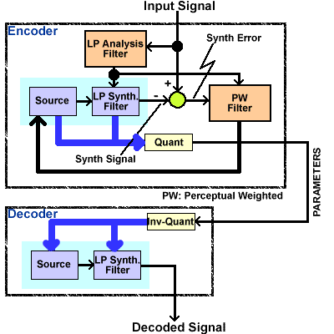
Hybrid Speech Coding

Slide 19
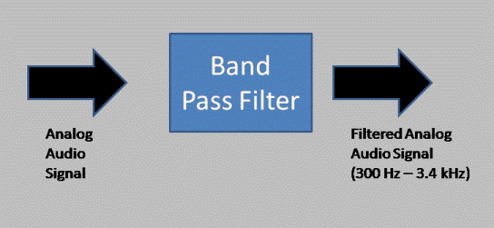
Band Pass Filter

Slide 20
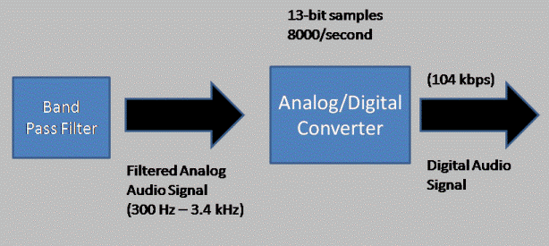
A/D converter
Analog/Digital Converter

Slide 21
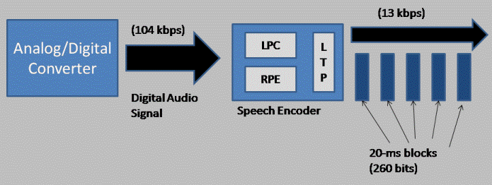
LPC

Slide 22
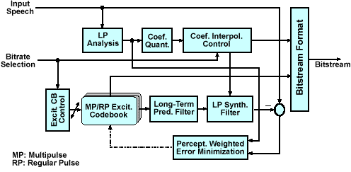
CELP

Slide 23
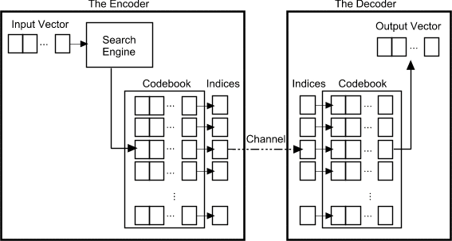
Vector Quantization Procedure

