Slide 1




Introduction to Mobile Computing
Dr.G.NANTHA KUMAR M.E.,Ph.D.,
Associate Professor
Dept of CSE
AAMEC-KOVILVENNI
website: www.aamec.edu.in
Objective: To learn about Mobile Computing &Different Types of wireless networks
        DATE: 19.12.2018

Slide 2
Our ultimate goal is to communicate with any type of information with anyone, at anytime, from anywhere. This is possible with the aid of WIRELESS TECHNOLOGY

Slide 3
What is Wireless?
Now the term is used to describe modern wireless connections such as those in cellular networks and wireless broadband Internet. In modern usage, wireless is a method of communication that uses low-powered radio waves to transmit data between devices.
  Wireless refers to communication without cables or cords, chiefly using radio frequency and infrared waves.
  Common uses include the various communications defined by the IrDA, the wireless networking of computers and cellular mobile phones.

Slide 4
Wireless?
A wireless LAN or WLAN is a wireless local area network that uses radio waves as its carrier.
The last link with the users is wireless, to give a network connection to all users in a building or campus.
The backbone network usually uses cables

Slide 5
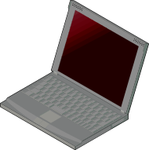

Infrastructure vs Ad-hoc networks
infrastructure
network
AP: Access Point
AP
AP
wired network
AP
ad-hoc network

Slide 6
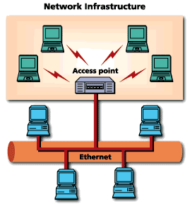
Common Topologies
The wireless LAN connects to a wired LAN
There is a need of an access point that bridges wireless LAN traffic into the wired LAN.
The access point (AP) can also act as a repeater for wireless nodes, effectively doubling the maximum possible distance between nodes.

Slide 7

Common Topologies
Complete Wireless Networks
The physical size of the network is determined by the maximum reliable propagation range of the radio signals.
Referred to as ad hoc networks
Are self-organizing networks without any centralized control
Suited for temporary situations such as meetings and conferences.

Slide 8
How do wireless LANs work?
Wireless LANs operate in almost the same way as
wired LANs, using the same networking protocols
and supporting the most of the same
applications.

Slide 9
How are WLANs Different?
They use specialized physical and data link protocols
They integrate into existing networks through access points which provide a bridging function
They let you stay connected as you roam from one coverage area to another
They have unique security considerations
They have specific interoperability requirements
They require different hardware
They offer performance that differs from wired LANs.

Slide 10
Physical and Data Link Layers
Physical Layer:
The wireless NIC takes frames of data from the link layer, scrambles the data in a predetermined way, then uses the modified data stream to modulate a radio carrier signal.
Data Link Layer:
Uses Carriers-Sense-Multiple-Access with Collision Avoidance (CSMA/CA).

Slide 11
Integration With Existing Networks
Wireless Access Points (APs) - a small device that bridges wireless traffic to your network.
Most access points bridge wireless LANs into Ethernet networks, but Token-Ring options are available as well.

Slide 12
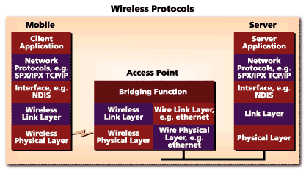
Integration With Existing Networks

Slide 13
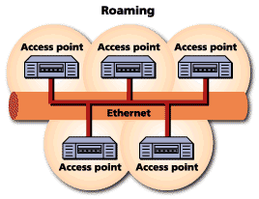
Roaming
Users maintain a continuous connection as they roam from one physical area to another
Mobile nodes automatically register with the new access point.
Methods: DHCP, Mobile IP
IEEE 802.11 standard does not
address roaming, you may need
to purchase equipment from one
vendor if your users need to roam
from one access point to another.

Slide 14


Why Mobile Computing ?
People are mobile
Devices are mobile

Slide 15
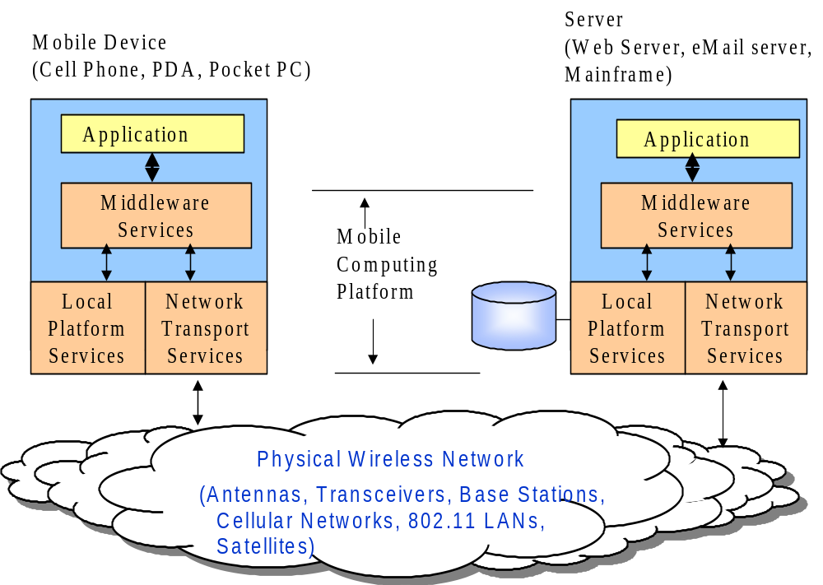
Supporting M-Apps: Mobile Computing Platforms

Slide 16
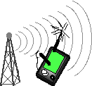
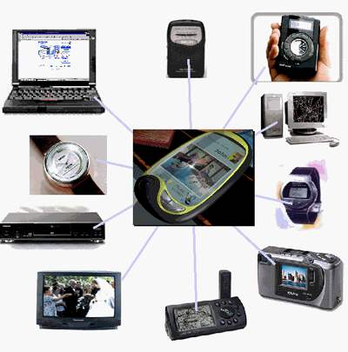
Wireless Networks

Slide 17
Mobile Communication Technology according to IEEE (examples)
WiFi
Local wireless networks
WLAN 802.11
802.11a
802.11h
802.11i/e/…/n/…/z
802.11b
802.11g
ZigBee
Personal wireless nw
WPAN 802.15
802.15.4
802.15.4a/b/c/d/e
802.15.5, .6 (WBAN)
802.15.2
802.15.3
802.15.3b/c
802.15.1
Bluetooth
Wireless distribution networks
WMAN 802.16 (Broadband Wireless Access)
WiMAX
+ Mobility
[802.20 (Mobile Broadband Wireless Access)]
802.16e (addition to .16 for mobile devices)

Slide 18
Wireless Networks
Different type of wireless networks support mobile computing applications and platforms
Wireless Personal Area Networks (Bluetooth, Sensors, UWB, Zigbees)
Wireless LANs (802.11 family)
Fixed Wireless Local loops
Cellular networks
  1G to 5G
Satellite systems
Many Research Issues: short list
Lower level issues (e.g., signaling, error correction, smart antennas)
Mobile Adhoc Networks
Voice over 802.11

Slide 19
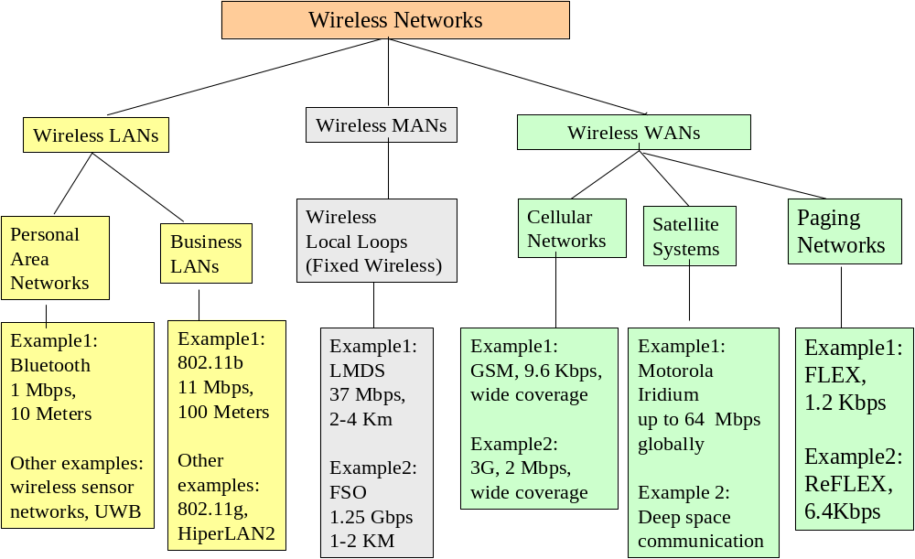

Slide 20
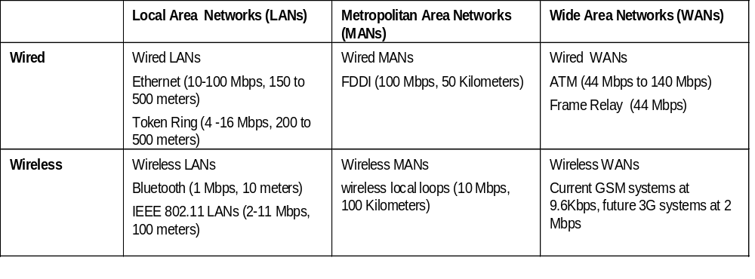
Research and Development issues unique to wireless
Frequency allocation (efficient frequency utilization)
Multiple Access (CDMA vs TDMA)
Location services (Data rate versus speed of mobile devices)
Error correction (e.g., Turbo codes)
Signalling and encoding (PCM versus Delta code modulation)
Antenna design (smart antennas)

Slide 21
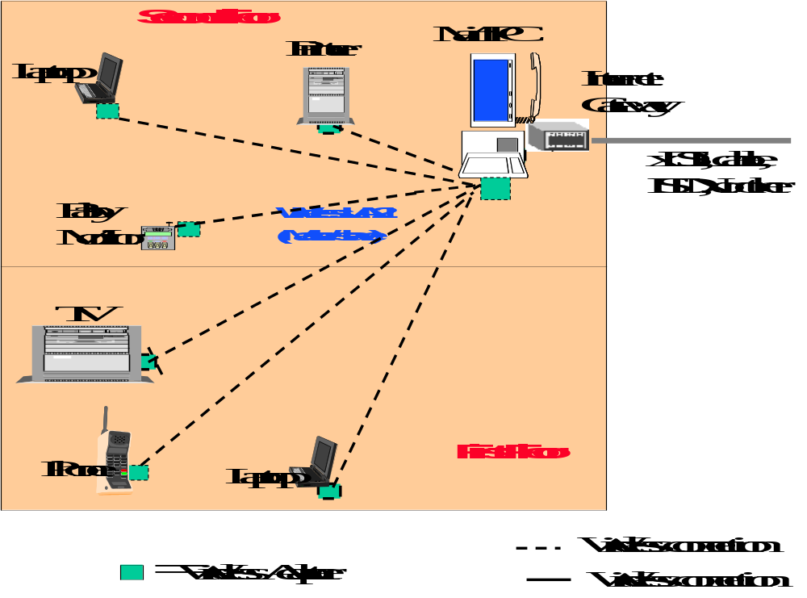
Wireless PANs: Home Networking
Players:
Bluetooth
Sensor networks
UWB
802.11
Zigbees
HomeR/F (dead)

Slide 22

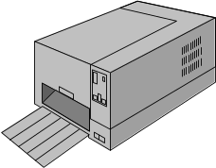
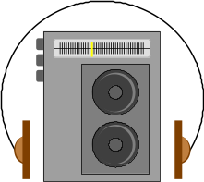
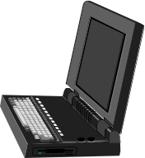

Bluetooth
PSTN
Access
Point
Cellular
Network
Wired
LAN
Bluetooth Piconet
(1 Mbps, 10 meters, mobile adhoc network)

Slide 23
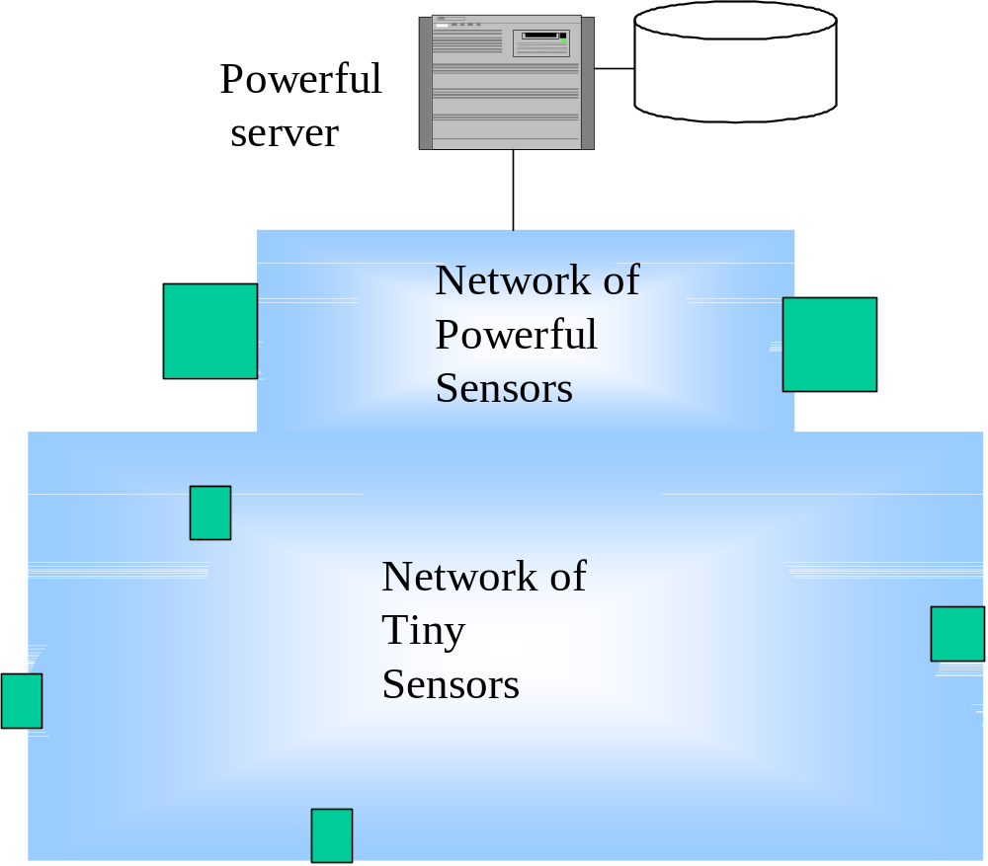
Wireless Sensor Networks
Sensor
Many R&D
efforts

Slide 24
Sensor nodes (SN) monitor and control the environment
Nodes process data and forward data via radio
Integration into the environment, typically attached to other networks over a gateway (GW)
Network is self-organizing and energy efficient
Potentially high number of nodes at very low cost per node
GW
Bluetooth, TETRA, …
SN
SN
SN
SN
SN
SN
GW
ALARM!
SN
SN
SN
ALARM!
SN
ALARM!
GW
SN
GW
Ethernet
SN
GPRS
WLAN
ALARM!

Slide 25
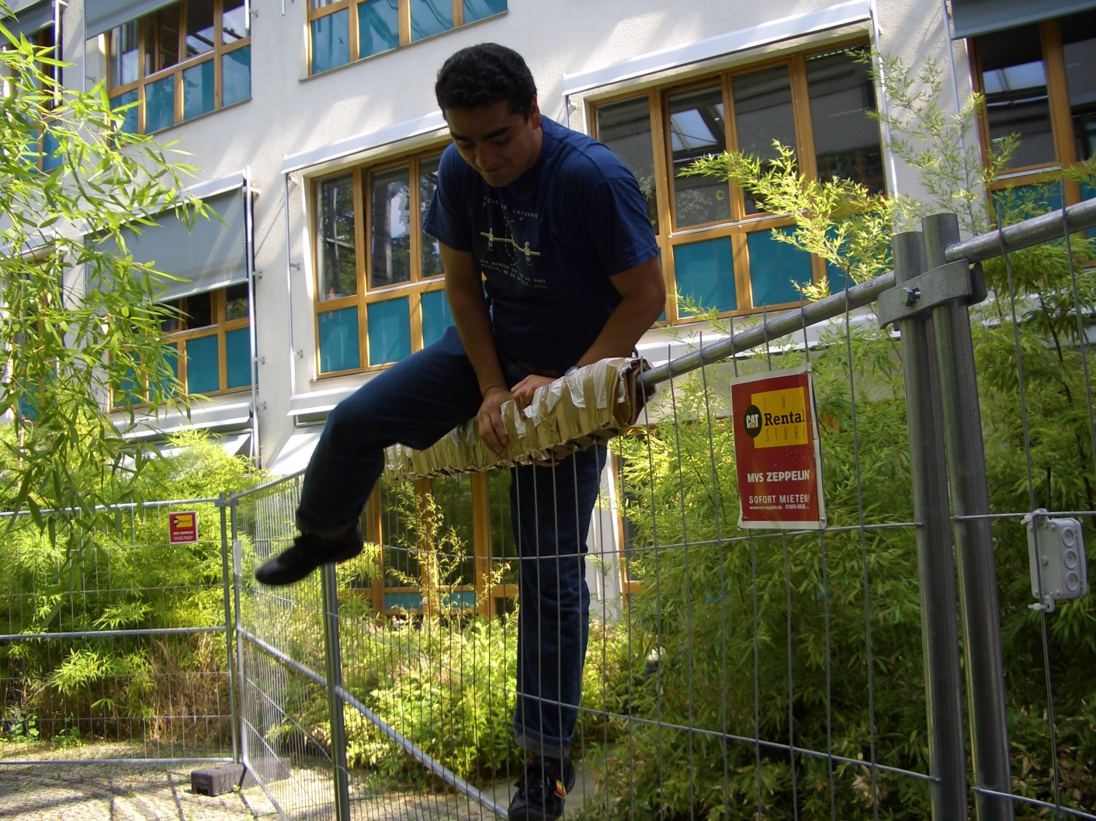

Fence monitoring
The Future of WSNs
ALARM!
ALARM!
ALARM!

Slide 26
Characteristics of wireless LANs
Advantages-Flexibility:
  very flexible within the reception area
  Planning:
  Ad-hoc networks without previous planning possible
  Design:
  (almost) no wiring difficulties (e.g. historic buildings, firewalls)
  Robust:
  more robust against disasters like, e.g., earthquakes, fire - or users pulling a plug...
  Cost:
  Adding additional users to a wireless network will be increase the cost
Disadvantages
  QoS:
  typically very low bandwidth compared to wired networks
  (1-10 Mbit/s) due to shared medium
  Proprietary solution:
  many proprietary solutions, especially for higher bit-rates, standards take their time (e.g. IEEE 802.11n)
  Restriction:
  products have to follow many national restrictions if working wireless, it takes a vary long time to establish global solutions like, e.g., IMT-2000

Slide 27

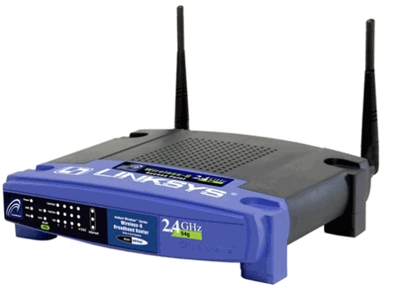
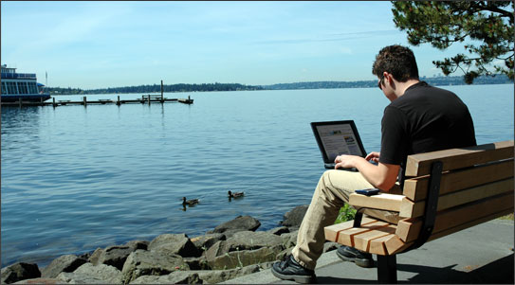
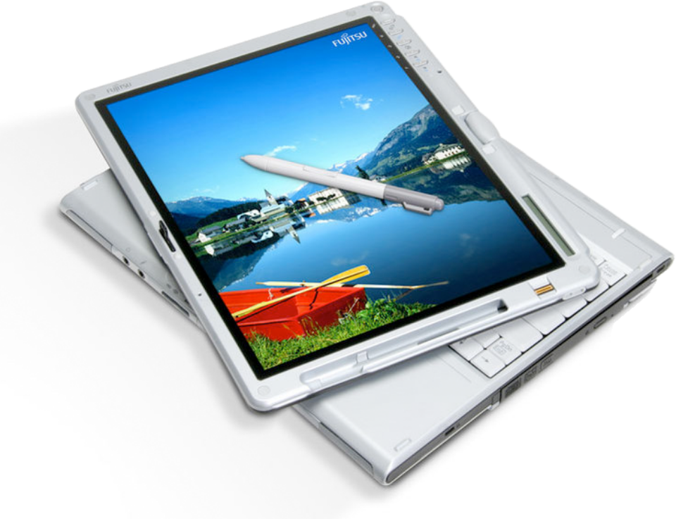
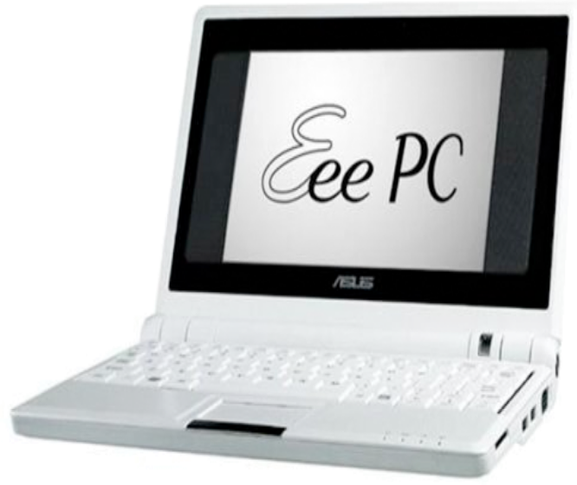

Slide 28
The 802.11 family of radio protocols are commonly referred to as WiFi
  802.11a supports up to 54 Mbps using the 5 GHz ISM and UNII bands.
  802.11b supports up to 11 Mbps using the 2.4 GHz ISM band.
  802.11g supports up to 54 Mbps using the 2.4 GHz ISM band.
  802.11n (draft) supports up to 300 Mbps using the 2.4 GHz and 5 GHz ISM and UNII bands.
  802.16 (WiMAX) is not 802.11 WiFi! It is a much more complex technology that uses a variety of licensed and unlicensed frequencies.

Slide 29






WMAN 802.16 (Broadband Wireless Access)
WiMAX : Technology
Wide
Coverage
QoS
Mobility
Quick
Deployment
SLA
WiMAX
High
Security
Portable
High
Capacity
Flexible
Architecture
Low Cost

Slide 30

Cellular Networks
Cell 1
Mobile
Telephone
Switching
Center
(MTSC)
Public
Switched
Telephone
Network
(PSTN)
Cell 2
HLR
VLR
Mobile User
Base Transceiver Station (BTS)
Cordless connection
HLR = Home Location Register
VLR = Visitor Location Register
Wired connection

Slide 31
Cell structure
Implements space division multiplex
  base station covers a certain transmission area (cell)
Mobile stations communicate only via the base station
Advantages of cell structures
  higher capacity, higher number of users
  less transmission power needed
  more robust, decentralized
  base station deals with interference, transmission area etc. locally
Problems
  fixed network needed for the base stations
  handover (changing from one cell to another) necessary
  interference with other cells
Cell sizes from some 100 m in cities to, e.g., 35 km on the country side (GSM) - even less for higher frequencies

Slide 32
Frequency planning
f₃
f₃
f₃
f₂
f₂
f₁
f₁
f₁
f₂
f₃
f₇
f₃
f₃
3 cell cluster
f₅
f₂
f₂
f₂
f₂
f₄
f₆
f₅
f₁
f₁
f₁
f₄
f₃
f₃
f₃
f₃
f₇
f₁
f₂
f₃
f₆
f₅
f₂
7 cell cluster
f₁
f₂
f₁
f₂
f₁
f₂
f₃
h₁
h₂
f₃
h₁
h₂
f₃
3 cell cluster
with 3 sector antennas
g₁
g₂
h₃
g₁
g₂
h₃
g₁
g₂
g₃
g₃
g₃

Slide 33
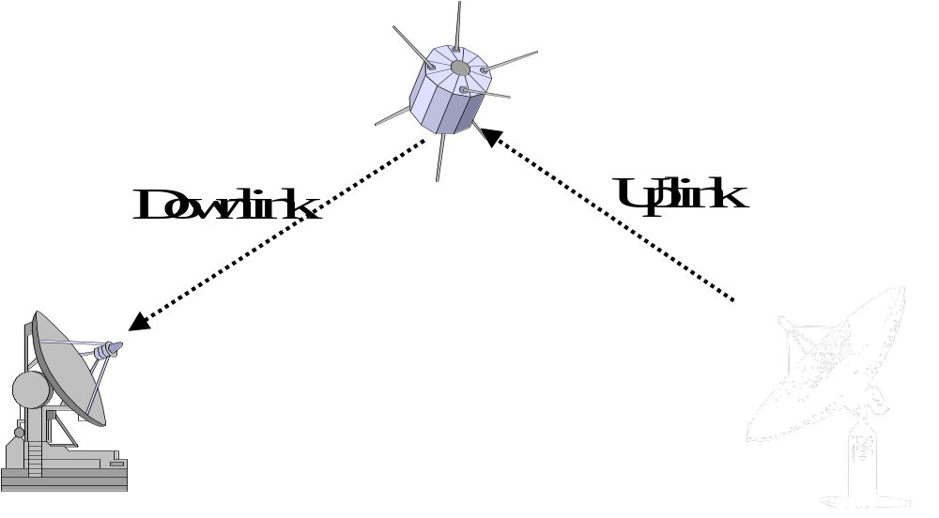
Satellite Communications
GEO= 35,000 km, 250 ms delay
LEO = 4,000 km, 20 ms delay
MEO = 10,000 km, 50 ms delay

Slide 34
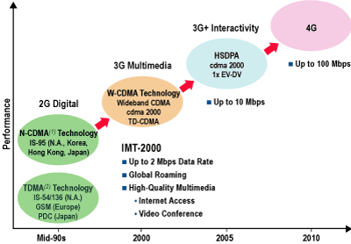
Generations Timeline

Slide 35
Evolution: 1G to 5G
4-5G
(10 Mbps+)
Data Rates
2 Mbps
1 Mbps
3G
(144Kbps to 2Mbps)
100 Kbps
2.5G
(10-150Kbps)
10 Kbps
2G
(9.6Kbps)
Research Issues
Mobility vs data rate
error correction
Intelligent Antennas
Intelligent radio
1 Kbps
1G
(<1Kbps)
1980
1990
2000
2010
Years

Slide 36
Wireless Network Evolution
First generation (1G): Analog voice systems
  No standardization
Second Generation (2G): Digital voice systems
  Currently deployed systems
  CDMA, GSM (Global System for Mobile communication), PDC (Japan) D-AMPS (Digital Advanced Mobile Phone System)
  PCS Systems
Second Generation – advanced (2.5G): Combining voice and data communications
  Providing enhanced data rate
  Two basic technologies:
    GSM-based (high baud rate)
    GPRS (General Packet Radio Service)
      Utilizes voice time slots to send packet traffic
      An overlay over the existing voice system
  Should really be called 2.1G!!
  Any standards?

Slide 37
Wireless Network Evolution
Third Generation (3G): Digital voice and data communications
  Developing a more general mobile network
    Handling Internet access, email, messaging, multimedia
    Access to any services (voice, video, data, etc.)
  Requires high quality transmission
Forth Generation (4G): All-IP mobile networks
  Ubiquitous wireless communications
  Transparent to any services
  Integrating multinetworks

Slide 38
Third Generation (3G)
Two basic proposals to handle voice and data
  Ericsson: Universal Mobile Telecommunications systems (UMTS)
    Compatible with European GSM
    Backed by ETSI and Japan
  Qualcom: CDMA2000
    Not compatible with GSM (cannot hand off called to GSM-based cells)
    Compatible for IS-95 (supported by U.S)
3G Standards
  1999 UMTS took over and an agreement was made over setting some standards
  A revolutionary technology with unlimited potential or not so great?
Major competing technologies
  Bluethooh
  Wireless LAN (IEEE 802.x standards) – also known as WiFi
    Short range wireless communications
    Highly utilized and very popular: offices, airports, coffee shops, universities and schools
    Two basic modes of operations:
      Ad-hoc networking: computers send data to one another
      Access point:: sending data to the base station

Slide 39
4G
4G is an Fourth-Generation Communications System.
A 4G system will provide an end-to-end IP solution where voice, data and streamed multimedia can be served to users on an "Anytime, Anywhere" basis at higher data rates than previous generations.
No formal definition is set as to what 4G is, but the objectives that are predicted for 4G can be summarized as follows:

Slide 40
4G will be a fully IP-based integrated system of systems and network of networks wired and wireless networks (e.g.: computer, consumer electronics, communication technology…)
Providing 100 Mbit/s and 1 Gbit/s, respectively, in outdoor and indoor environments
End-to-end QOS
High security
Offering any kind of services anytime, anywhere
Affordable cost and one billing

Slide 41
4G features
The following are some possible features of the 4G systems :
Support interactive multimedia, voice, video, wireless internet and other broadband services.
High speed, high capacity and low cost per bit.
Global mobility, service portability, scalable mobile networks.
Seamless switching, variety of services based on Quality of Service (QoS) requirements
Better scheduling and call admission control techniques.
Ad hoc networks and multi-hop networks.

Slide 42
The Next Generation Mobile Communication Systems Features
Seamless Access
Personalization
Quality of Service
4G
IP-based

Slide 43

What is 4G?
Higher bit rates
Cost reduction
User services
White space
Wireless Internet
Strict generation
Is that your final answer?
Service providers
Wireless wireline
Technology trends
New network
New air interface
4G will not exist

Slide 44
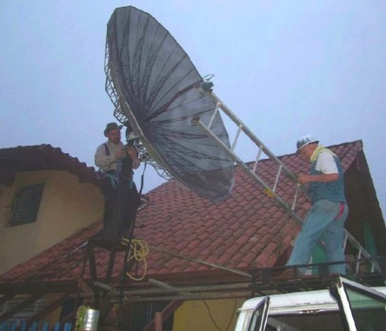
Anything is Possible

Slide 45

Thank you!

