Slide 1

Vehicle Service Management System
Guide: Dipali Jadhav
Group 11
Roll Number | Name | PRN. Number
DAC-07 | Amin Siddiqui | 230943020007
DAC-38 | Shreyash Jaygaonkar | 230943020038
DAC-42 | Ashutosh Kedari | 230943020042
DAC-84 | Saurabh Solanke | 230943020084

Slide 2
INTRODUCTION
Managing and servicing vehicles has become a hassle, and confusing with every Car Manufacturing company launching their own apps.
VSMS, a one stop platform for Customers and Service Centers.
No need of separate apps for your vehicles. Get available Service Centers around you according to your vehicle brand.

Slide 3
PROJECT OVERVIEW
Project Title : Vehicle Service Management System(VSMS)
Application : One stop Vehicle Servicing app, bridging the gap between Customers and Service Centers.
Need of the System : To help the customer find the Best Service Centers for servicing their vehicles without the hassle of handling multiple application.
Business And Use Cases : There are 3 Different Roles, each have various use cases.

Slide 4
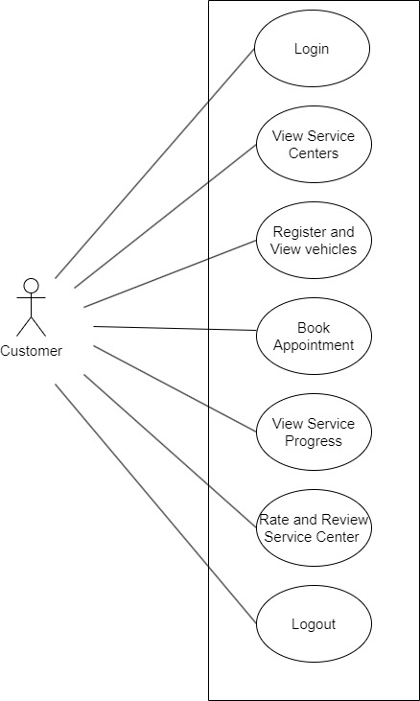
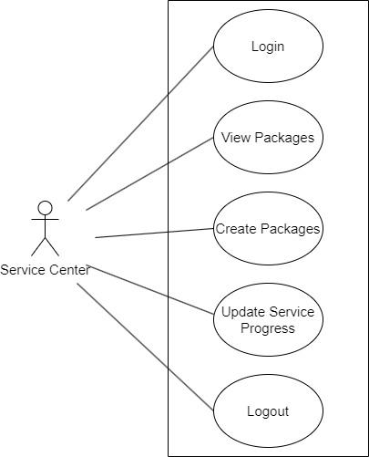
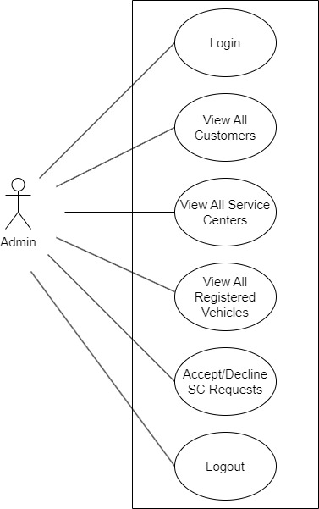
ACTORS AND USE CASES
CUSTOMER
SERVICE CENTER
ADMIN

Slide 5
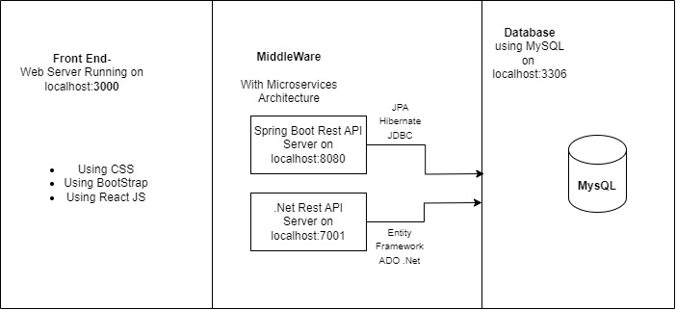
Project Architecture
fig. Project Architecture

Slide 6
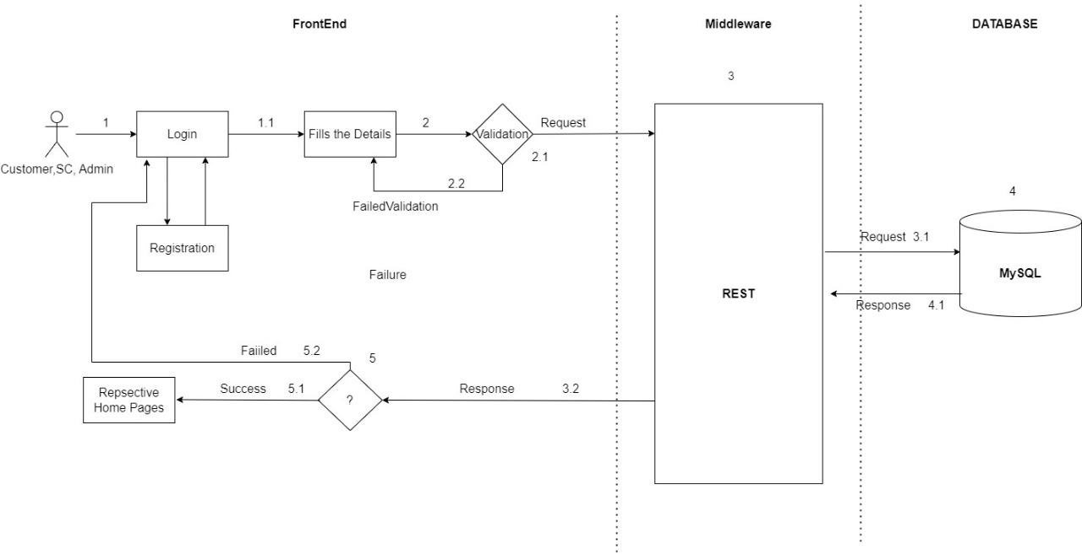
Login Workflow
fig. Login Workflow

Slide 7
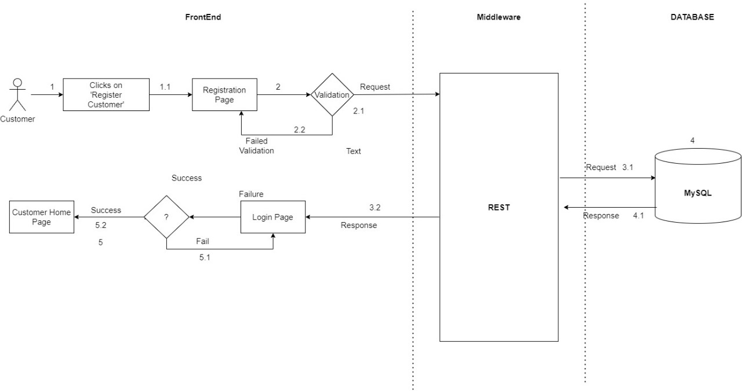
Registration Workflow
fig. User Registration

Slide 8
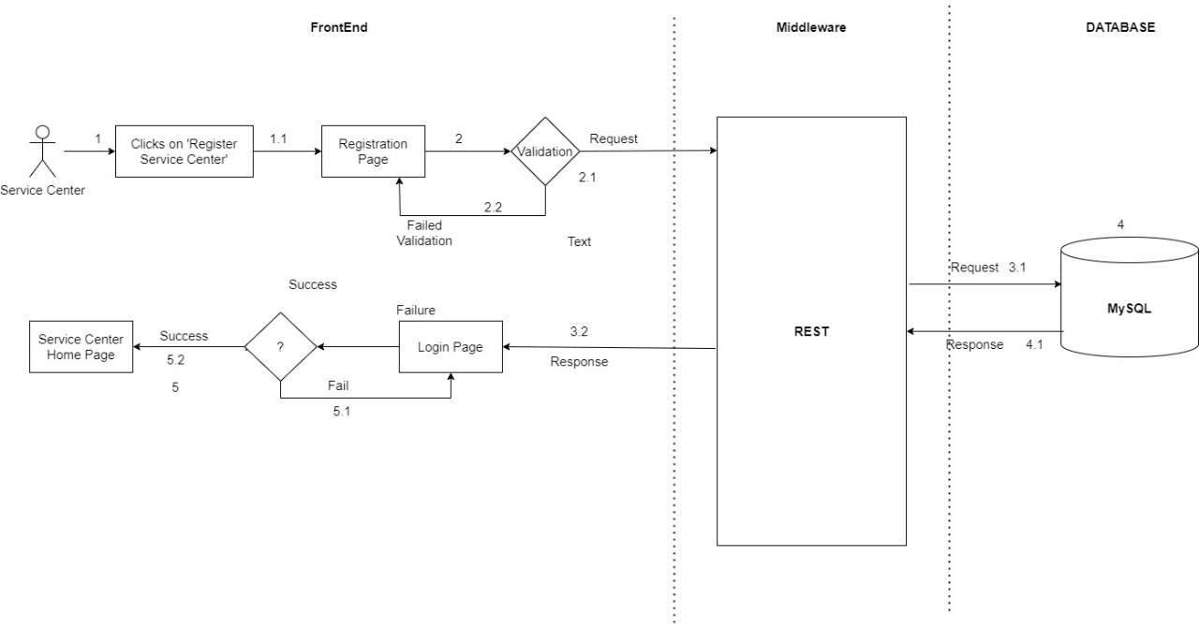
Registration Workflow
fig. Service Center Registration

Slide 9
PROJECT METHODOLOGY
3 Different phases using which we were able to apply AGILE Methodology.
Phase 1: Access and Validation of Different Roles(Login and Registration).
Phase 2: Using the Credentials, logging into the accounts and implementing use cases. This phase mainly consisted of performing CRUD (Creation, Removal, Update and Deletion) on different elements of roles.
Phase 3: Consisted of Transactions between client to middleware which accesses the Database to input or get the related information and showing them on the browser.

Slide 10
TESTING APPROACH
1] REST API Tests done using Postman to check working of every route.
2] Components: Manual Testing for React Components.
3] .Net API Tests done using Swagger to make sure the information being fetched was correct.

Slide 11
FUTURE SCOPE
1] A Payment Gateway that will be integrated in the application. It will help to make this application a more complete package.
2] User can have a few more use cases like an option to make their vehicle get routine check ups, to make the experience more seamless.
3] Customer will be able to get real time updates through SMS or Emails about the current of service stage their vehicles are in.

Slide 12
OUR LEARNINGS AND EXPERIENCE
Team Work and Collaboration: We learned that working together, every team member can have different ideas, approaches towards a problem, and each individual in this team has put in their best work to contribute in this project.
Upgrading Ourselves: Developing a web application from scratch was not easy, but as we progressed and made improvements, we had to Upskill ourselves and our tenacity towards creating this project shows that.
Working a Deadline: Developing this project taught us the importance of time and the saying, “A stitch in time saves nine” really set a real life example for us.

Slide 13

Thank You
Saurabh Solanke | 7770070411 | saurabh.ksolanke@gmail.com
Ashutosh Kedari | 8975889230 | kedariashutosh89@gmail.com
Shreyash Jaygaonkar | 8329330762 | shreyash111jaygaonkar@gmail.com
Amin Siddiqui | 9284760415 | aameensddq@gmail.com

