Slide 1
Accelerating trade cycles with open source technologies
Legend / Morphir / Delta Lake
Morgan Stanley, Goldman Sachs, Databricks

Slide 2
ACTION ITEMS
REMOVE FROM DECK
22/11/21
Stephen to provide Antoine with entry point for Morphir as well as data specifications required
Antoine to connect with Mao and provision FINOS hosted databricks environment with relevant data / tables / cluster
Antoine to provide Ephrim with input / output data model through PURE file
Ephrim to provide Ashley with namespace / service name to bring data through dataframe API

Slide 3
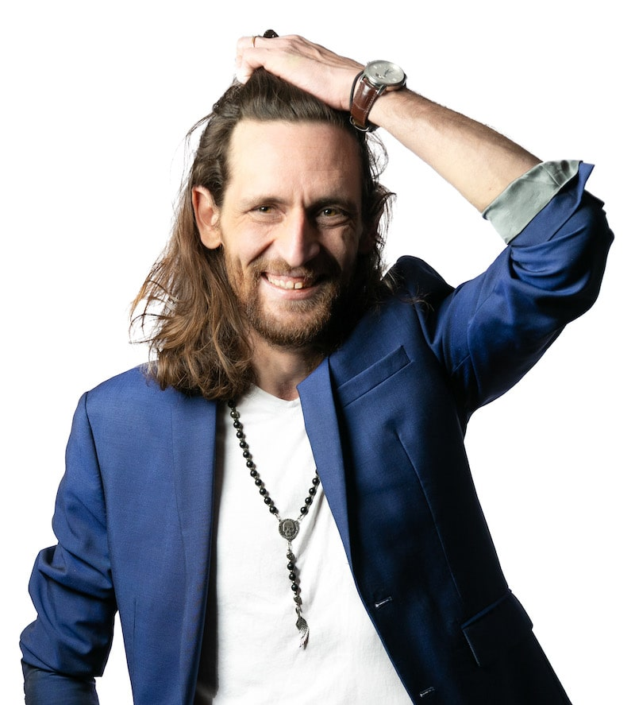

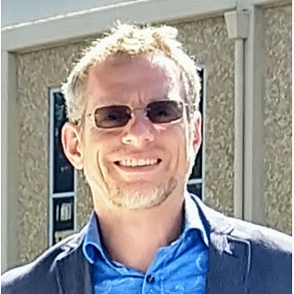

Speakers
Antoine Amend
Sr Technical Director - Databricks
Ashley Trainor
Sr Solution Architect - Databricks
Stephen Goldbaum
Distinguished Engineer - Morgan Stanley
Ephrim Stanley
Technology Fellow - Goldman Sachs

Slide 4
“Nothing Good Happens between Trade and Settle Date”
Notes:
More of an adage than a quote, we’ve seen that say in wall street when moving from T3 down to T2 back in … 2015. In 7 years, we’ve seen rise of geopolitical tensions, brexit, a global pandemic and with it the rise of retail investment, meme stocks and reddit posts, a frenzy across crypto markets.. And that explosion of data that exposed clear limitations of post trade systems to adapt, scale. Time equals risk, and reducing that time means reducing the number of trades that fall short and their associated margins.

Slide 5


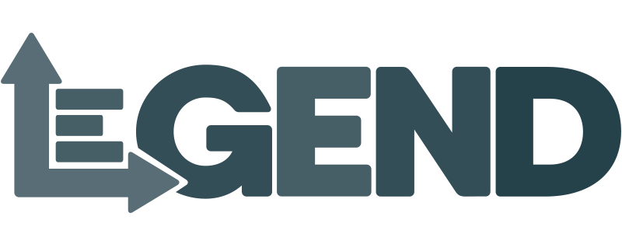
Shortening Settlements Cycles
Streamlining operations through open source initiatives
Motivations
Create a frictionless system between market participants
Reduce risks for periods of high volatility, hence margins
Standards
Challenges
Back offices are known for legacy systems and data silos
Transfer of information requires tedious reconciliation
Interoperability
Solutions
Machine interpretable data and calculation
Harmonization of data across organizations
Collaboration
Notes:
Suggested by DTCC, T1 now enforced by the SEC to take place by mid 2024. That leaves us with only a year to build, integrate and test, not 1, 2, 5 systems, but an ecosystem shared with each market participant, from buy side, sell sides, custodians, clearing houses. Back offices are notoriously known for silos across regions, trading desks, and asset classes, legacy technologies, manual processes. I would not be surprised to hear some teams running from one system to another with a floppy disk or sending the same via fedex courier. Simple, we ask them to run 2 times faster now. Or we can realize that it is not about running faster, but running smarter. It’s not about lifting and shifting the existing technology to faster horses, but adopting a new behavior, a new approach to data. Allowing data, processes and calculations to be machine interpreted through simple interfaces (i.e. contracts), by connecting data modelling to data pipelines, compliance requirements to data operations, connecting business with technology. This shift is exactly in line with the core principles behind open source technologies.

Slide 6
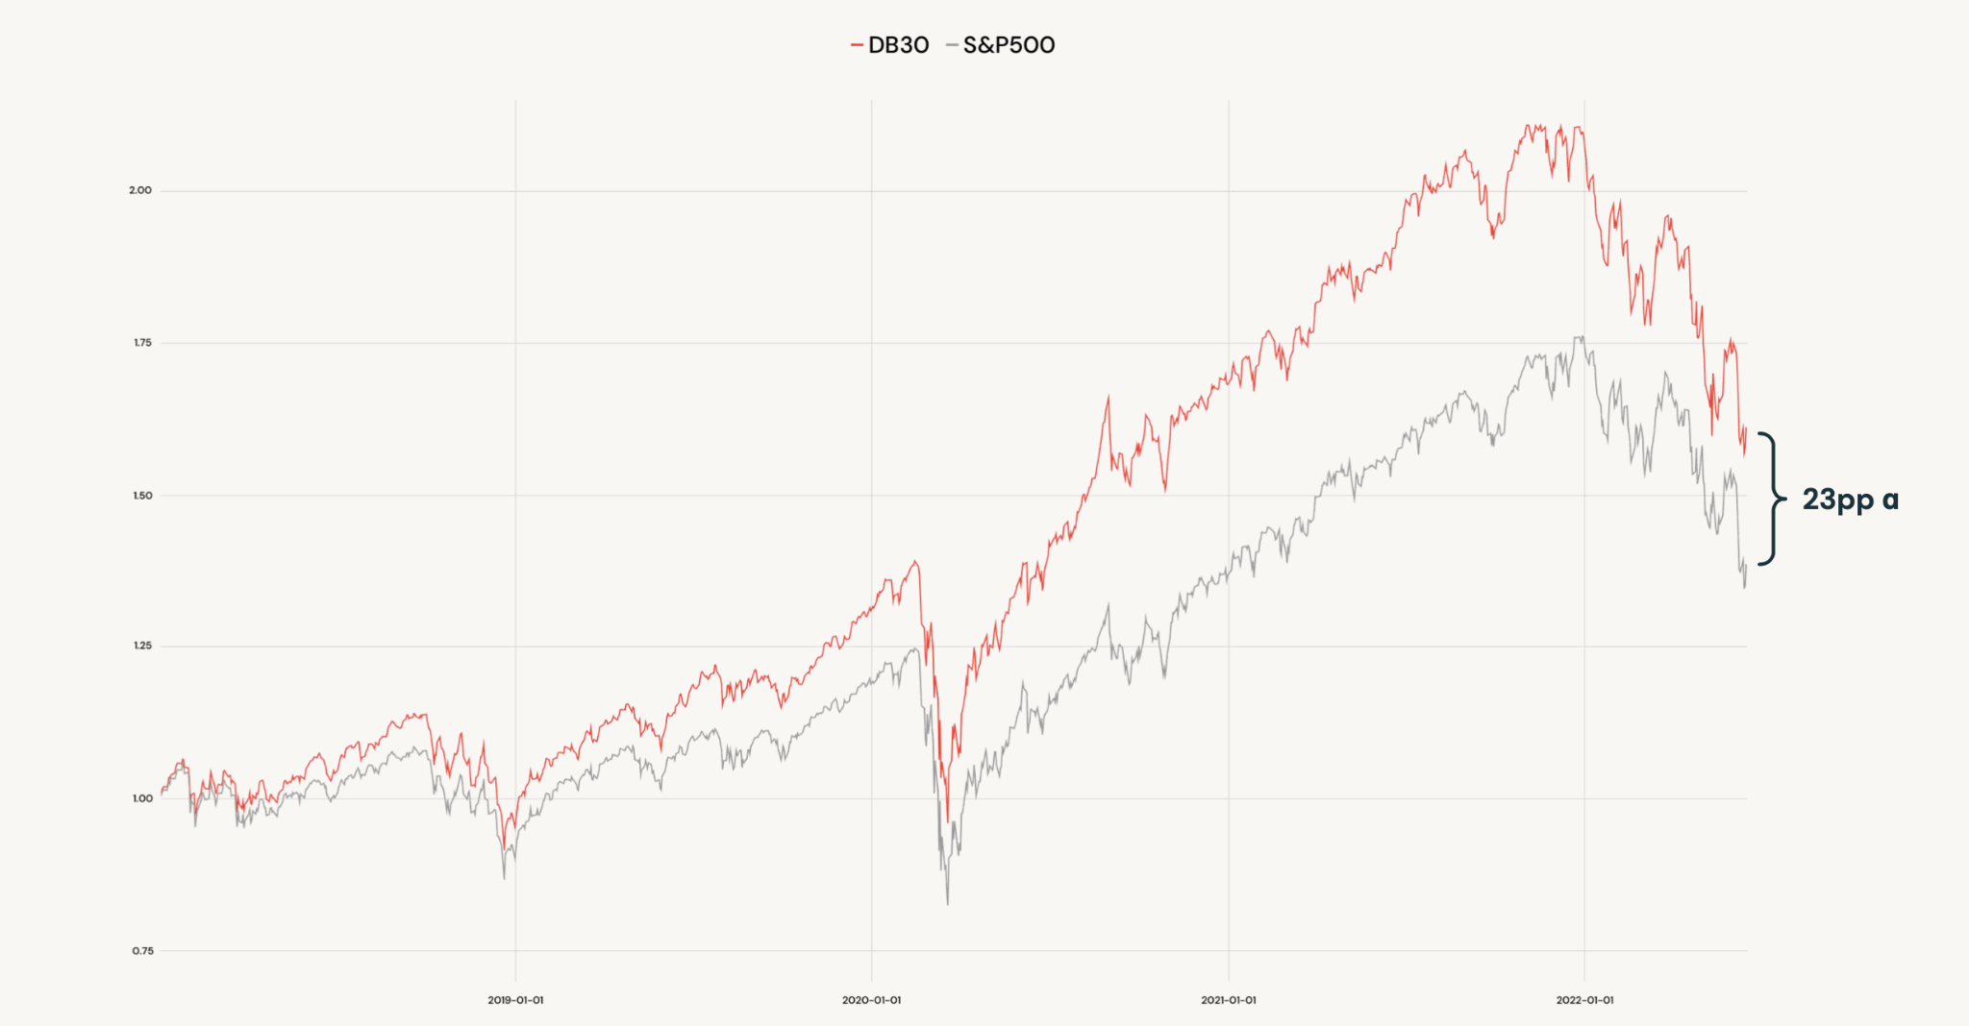
Data culture
Organizations that focus on open source do not “just comply”, they outperform their peers
Notes:
But modernizing does not just means complying. When NCC margin calls are estimated to be reduced by 40%, that’s billions of dollars that could be reinvested elsewhere should we streamline that process between back and front office. And we’ve seen that pattern over and over, open source create new opportunities. Data culture win. We’ve seen that from a MS report that stated that companies focusing on cloud, data and open source win. At databricks, being cloud, data, open source, our customers should win. And that gap widened in period of high economic volatility. Cloud, data and open source offers the opportunity to outperform, and technologies like DATABRICKS LAKEHOUSE, LEGEND, MORPHIR, contribute to that behavioral shift.

Slide 7
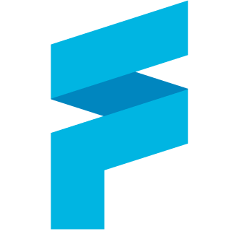
finos/legend
Data as a machine interpretable contract
EPHRIM STANLEY to add details around Legend, why it was built and how users can connect business and tech together. Introducing JDBC connection to Databricks endpoint through legend studio / query
Objective of the demo is to show a simple data model, generated execution plan to a databricks backend and creating a service against FINOS hosted databricks

Slide 8
finos/legend-delta-community
Machine executable data models
ASHLEY TRAINOR to quickly introduce Delta Lake as open source technology and the work done on legend integration through dataframe API
Objective of the demo would be to show how legend services can be ported out to dataframe API, how delta could guarantee traceability and schema evolution. Using notebook on FINOS hosted databricks instance

Slide 9
finos/morphir
Logic as a machine interpretable contract
STEPHEN GOLDBAUM to introduce morphir as a way to abstract complex decisioning processes into simple operations pipelines. Introducing LCR calculations as machine interpreted rules that can be executed on a spark / databricks backend
The objective of this demo will be to show how business logic can be unit tested, reviewed and compiled for execution, and how databricks hosted instance could map Legend Tables into Morphir Calculations

Slide 10

delta-io/delta-sharing
Enabling interoperability of data and models across systems
ANTOINE AMEND to introduce delta sharing as open protocol to guarantee interoperability across systems
The objective of this demo will be to show how data can be accessed seamlessly through XLS or programmatically through databricks hosted instance

Slide 11
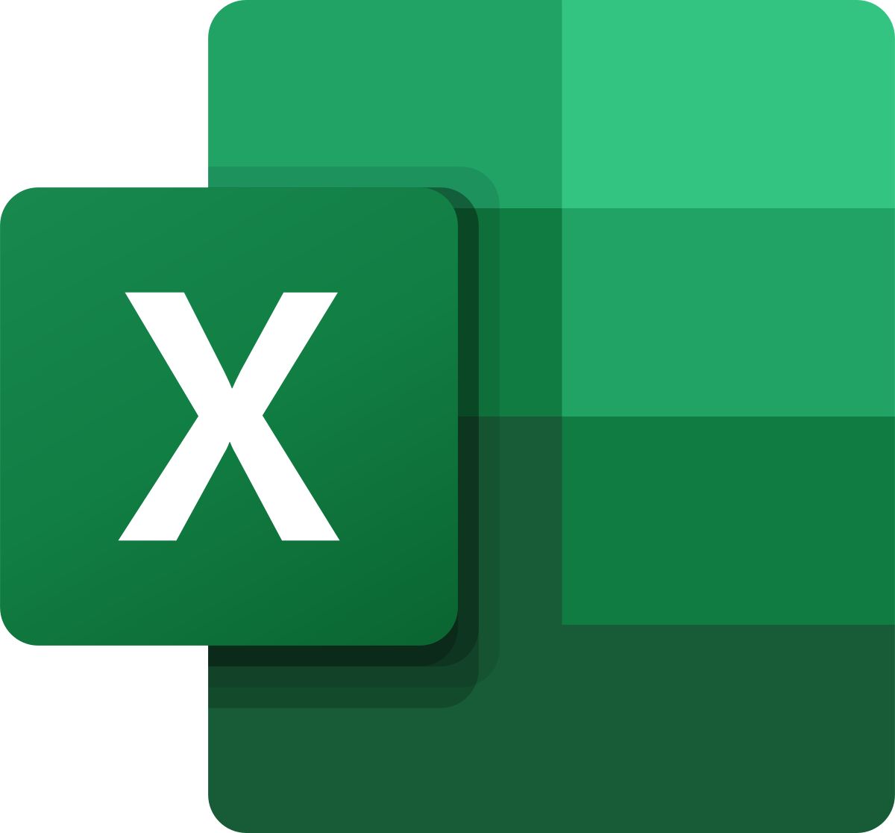

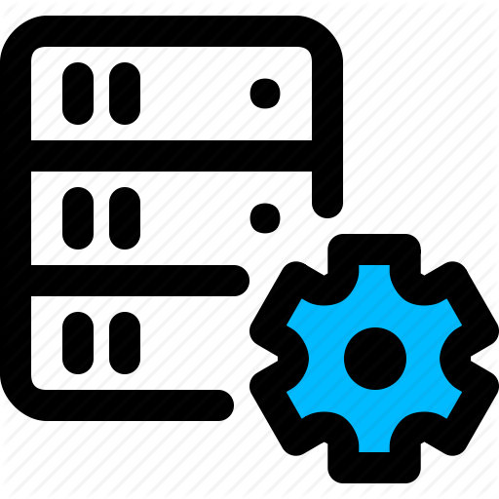
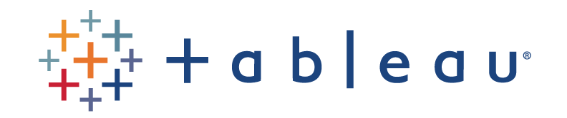



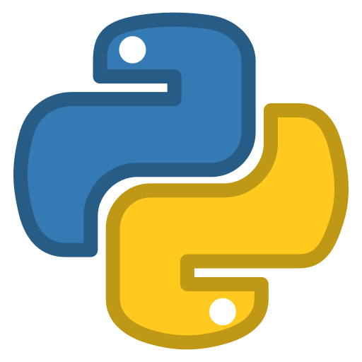
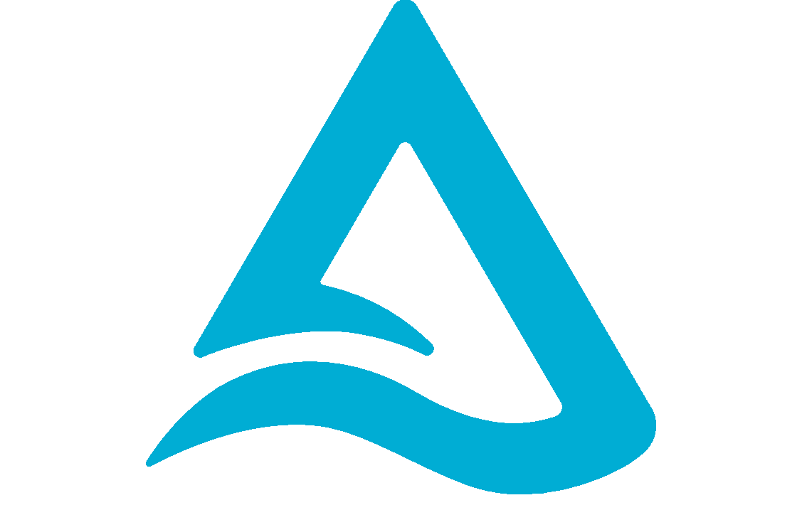
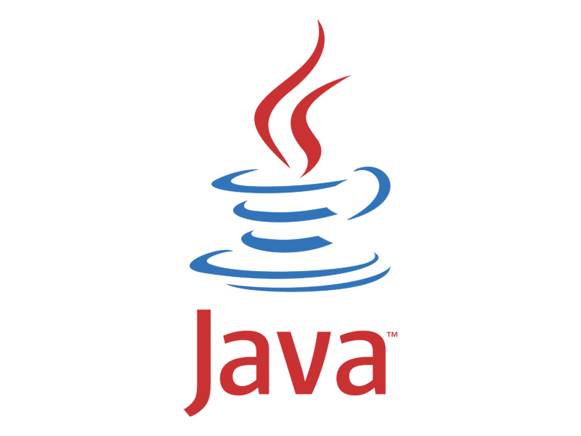
delta-io/delta-sharing
Enabling interoperability of data and models across systems
> CREATE RECIPIENT client
> CREATE SHARE reports
> ALTER SHARE reports ADD TABLE trade_reports
> GRANT SELECT
ON SHARE reports
TO client
Delta Sharing on
Unity Catalog
Delta Sharing Protocol
trades
ADLS/S3/GCS Objects

Slide 12
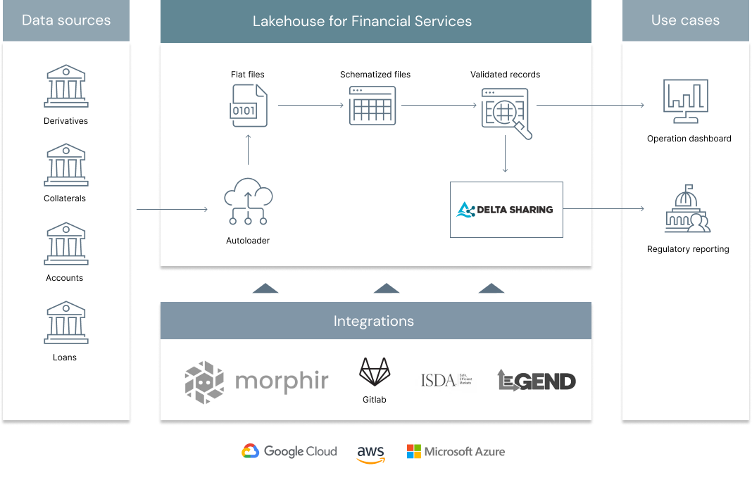
T+1 settlements
Streamline, Automate, Iterate

