Slide 1
John the Ripper
Password Cracking Workshop
By Lauren Eagan & Aaron Mendez

Slide 2
What is cryptography and What is it trying to solve?
Cryptography is the art and science of keeping information secure from unintended audiences, of encrypting it. Conversely, cryptanalysis is the art and science of breaking encoded data. The branch of mathematics encompassing both cryptography and cryptanalysis is cryptology.
A secure system should provide several assurances such as confidentiality, integrity, and availability of data as well as authenticity and non-repudiation. When used correctly, crypto helps to provide these assurances. Cryptography can ensure the confidentiality and integrity of both data in transit as well as data at rest. It can also authenticate senders and recipients to one another and protect against repudiation.

Slide 3
Why is it important?
Personal privacy
Credit card information
Company records
Personal records
Login information
Education Records

Slide 4
Famous Data breaches
Adobe Date: October 2013 Impact: 153 million user records
Details: As reported in early October of 2013 by security blogger Brian Krebs, Adobe originally reported that hackers had stolen nearly 3 million encrypted customer credit card records, plus login data for an undetermined number of user accounts.
eBay Date: May 2014 Impact: 145 million users
Details: eBay reported that an attack exposed its entire account list of 145 million users in May 2014, including names, addresses, dates of birth and encrypted passwords. The online auction giant said hackers used the credentials of three corporate employees to access its network and had complete access for 229 days—more than enough time to compromise the user database.
Yahoo Date: 2013-14 Impact: 3 billion user accounts
Details: Yahoo announced in September 2016 that in 2014 it had been the victim of what would be the biggest data breach in history. The attackers, which the company believed we “state-sponsored actors,” compromised the real names, email addresses, dates of birth and telephone numbers of 500 million users. Yahoo claimed that most of the compromised passwords were hashed.

Slide 5
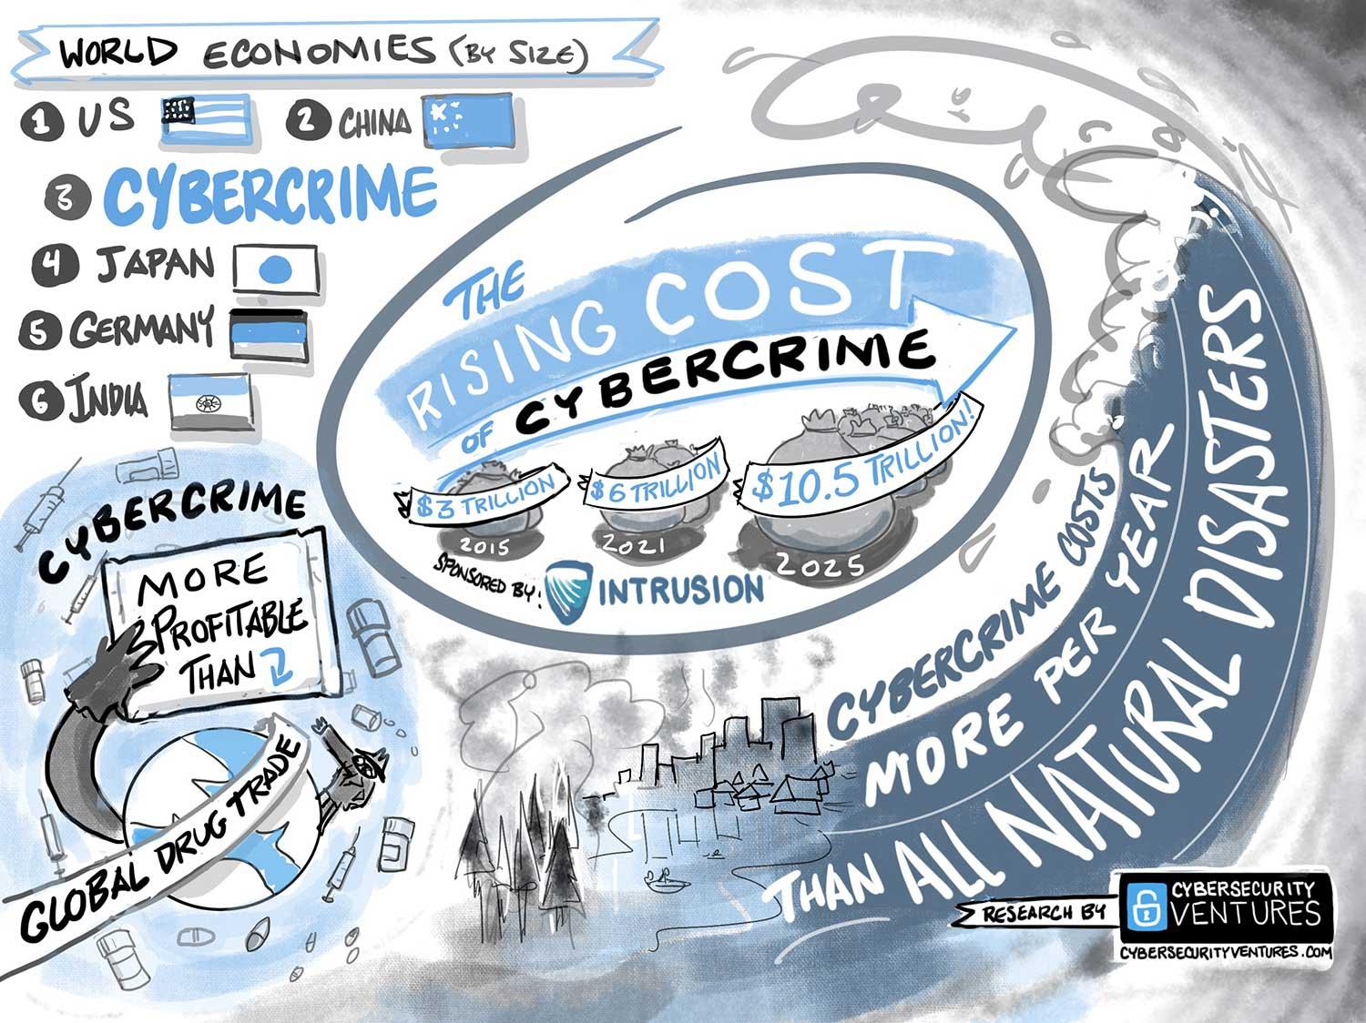
It is projected that the world cost of Cybercrime is $10.5 Trillion by 2025
Cybersecurity Ventures expects global cybercrime costs to grow by 15 percent per year over the next five years, reaching $10.5 trillion USD annually by 2025, up from $3 trillion USD in 2015. This represents the greatest transfer of economic wealth in history, risks the incentives for innovation and investment, is exponentially larger than the damage inflicted from natural disasters in a year, and will be more profitable than the global trade of all major illegal drugs combined.
Cybercrime costs include damage and destruction of data, stolen money, lost productivity, theft of intellectual property, theft of personal and financial data, embezzlement, fraud, post-attack disruption to the normal course of business, forensic investigation, restoration and deletion of hacked data and systems, and reputational harm.

Slide 6
Some cryptography attacks
Brute Force attacks
Frequency Analysis
Dictionary attacks

Slide 7
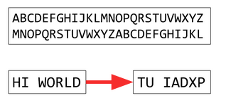
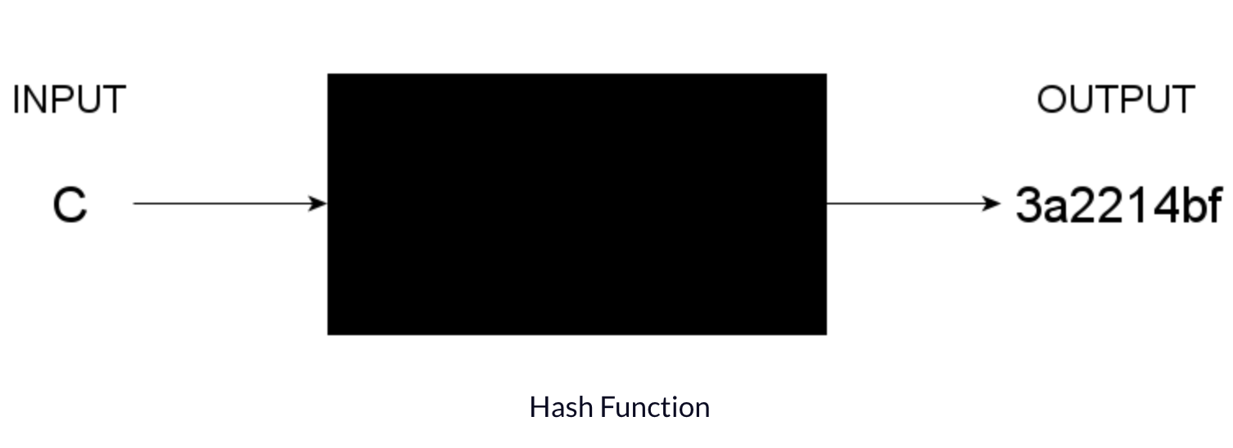
What are encryption and hash functions?
How are they different?
Encryption
Takes readable data and alters it so that it appears random
Requires the use of a cryptographic key
Two - way function
Hashes
Mathematical algorithm that maps data (message) to a bit array of fixed size
The same message always results in the same hash
One - way function
Hashes + salt

Slide 8
Workshop

