Slide 1
Introduction for cyber security

Slide 2
“In 2024 over 30 websites were hacked daily worldwide”

Slide 3
Cyber security
Cyber security is the practice of protecting various digital components , network , data and our computer systems from unauthorised digital assets

Slide 4
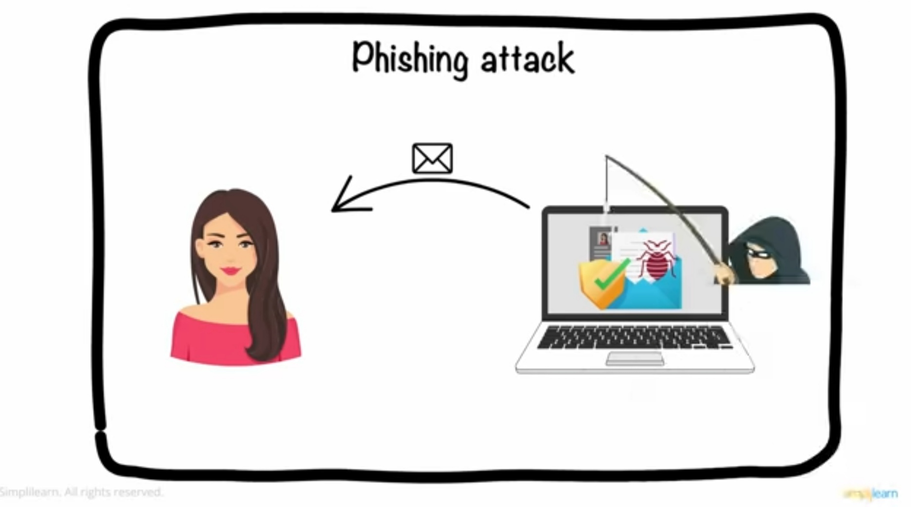
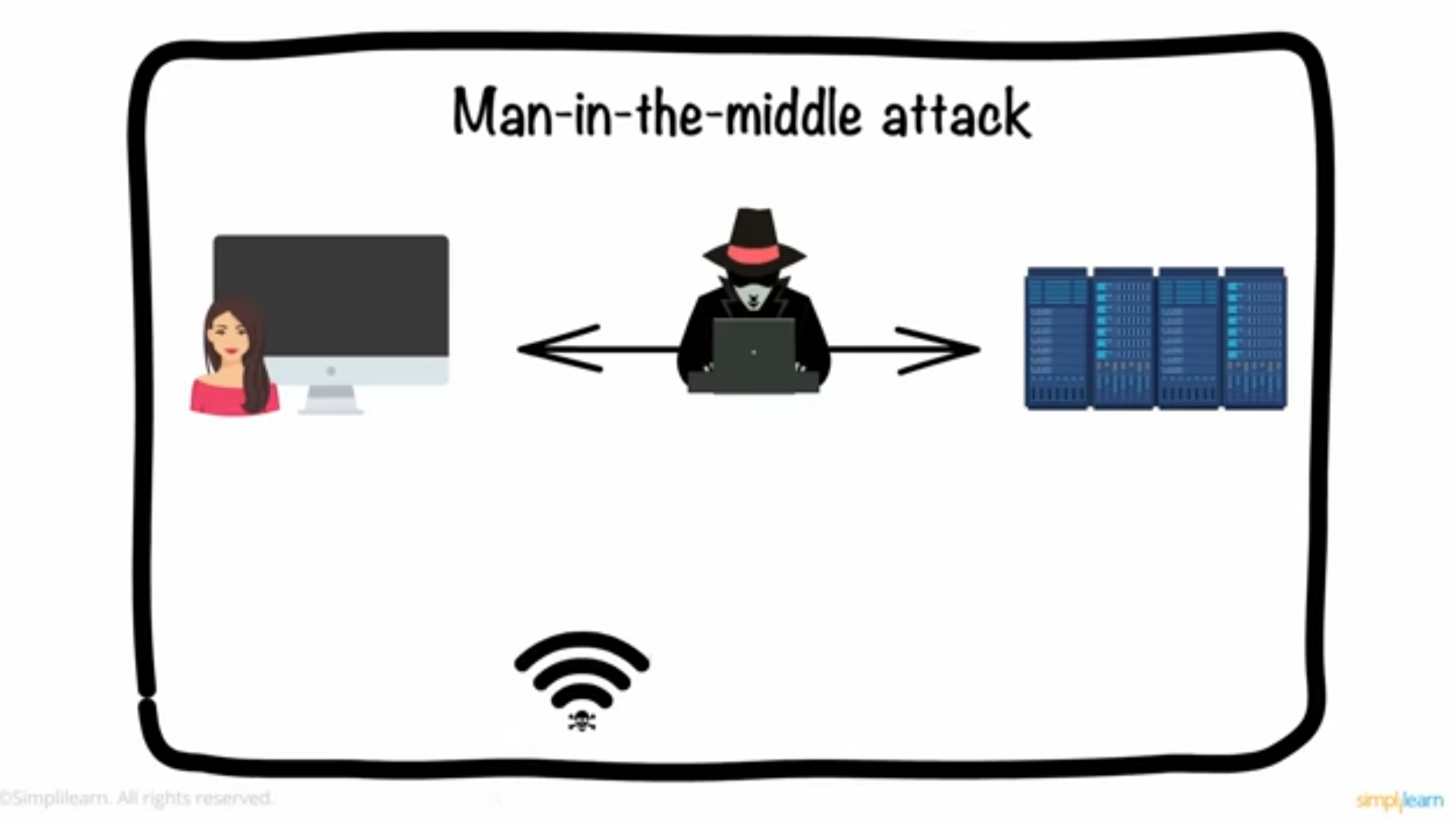
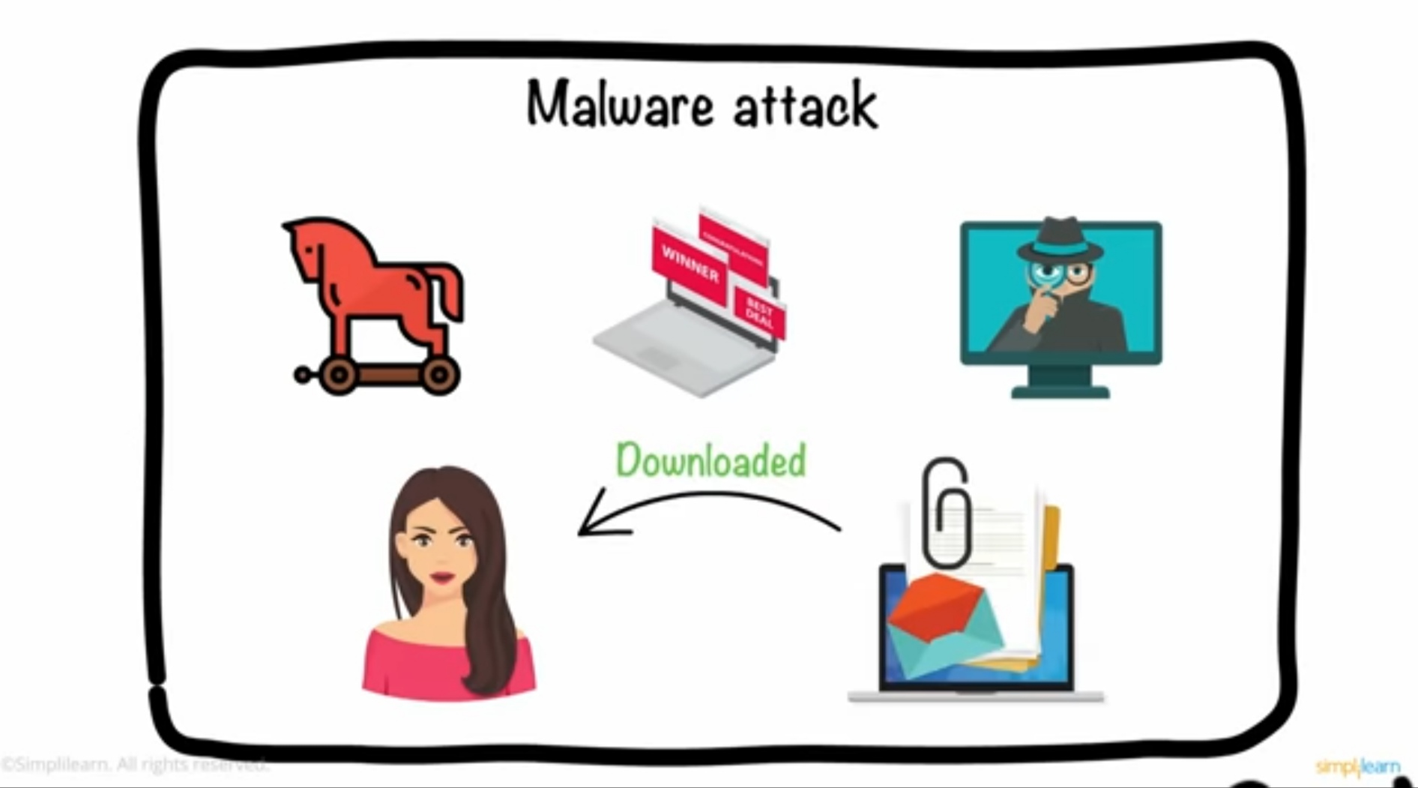
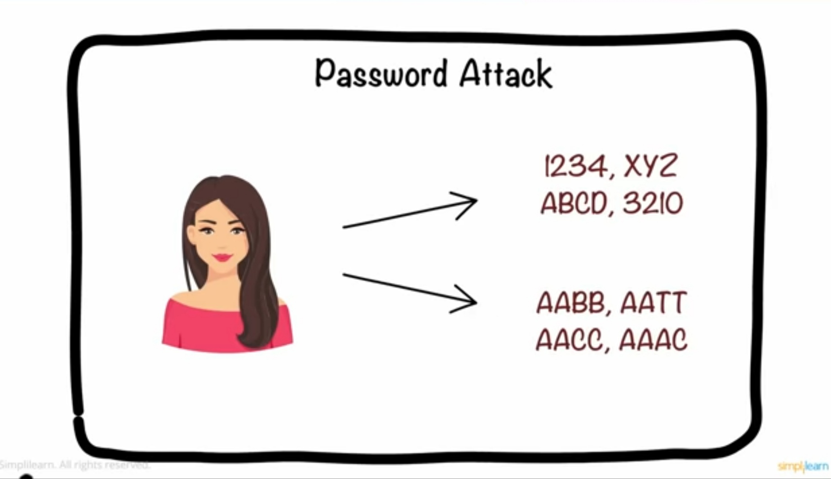
Cyber threats

Slide 5
Why cyber security is important?

Slide 6
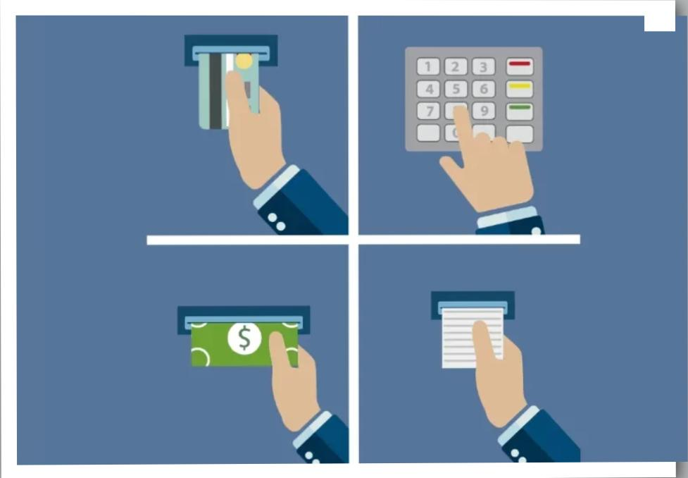
Date and Time
Transaction Type
Transaction Amount
Account Balance
Bank Name and Branch
ATM ID or Location
Account Number (Masked)
Contact Information

Slide 7
Growing digital age
- Identity theft
-Data breaches

Slide 8
Digital footprints
“Everything you do online leaves a trace – even deleted photos or posts.”

Slide 9
Cyber security
Confidentiality
Integrity
Availability

Slide 10
Cyber security domains
Network Security
Information Security
Application Security
Endpoint Security
Cloud Security

Slide 11
While the digital age offers immense benefits, it also demands greater vigilance. Safeguarding personal data is not just a matter of convenience but a necessity to protect our privacy, finances, and emotional well-being. By adopting secure practices and staying informed about potential risks, we can navigate the digital world more safely

