Slide 1
Happiness_report
File created on: 03/02/2022 21:59:14

Slide 2


Slide 3


Slide 4


Slide 5


Slide 6
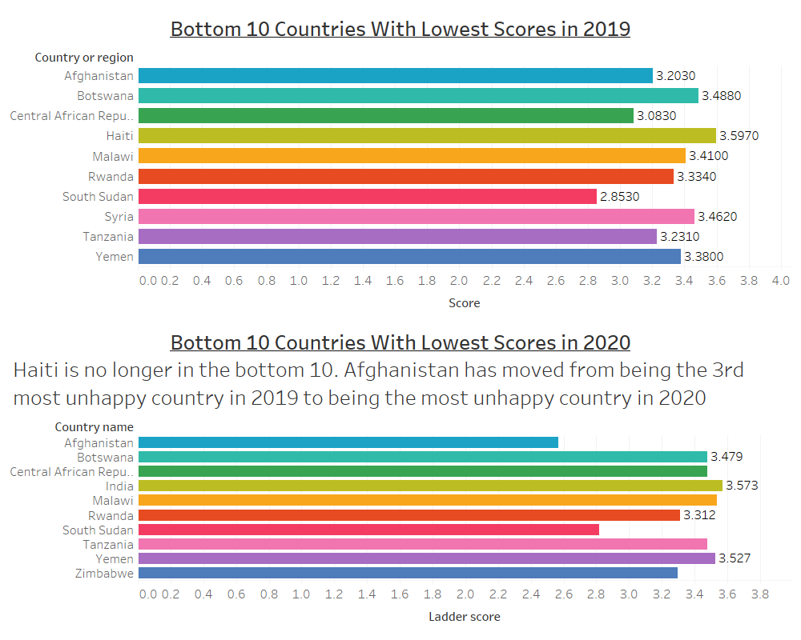

Slide 7
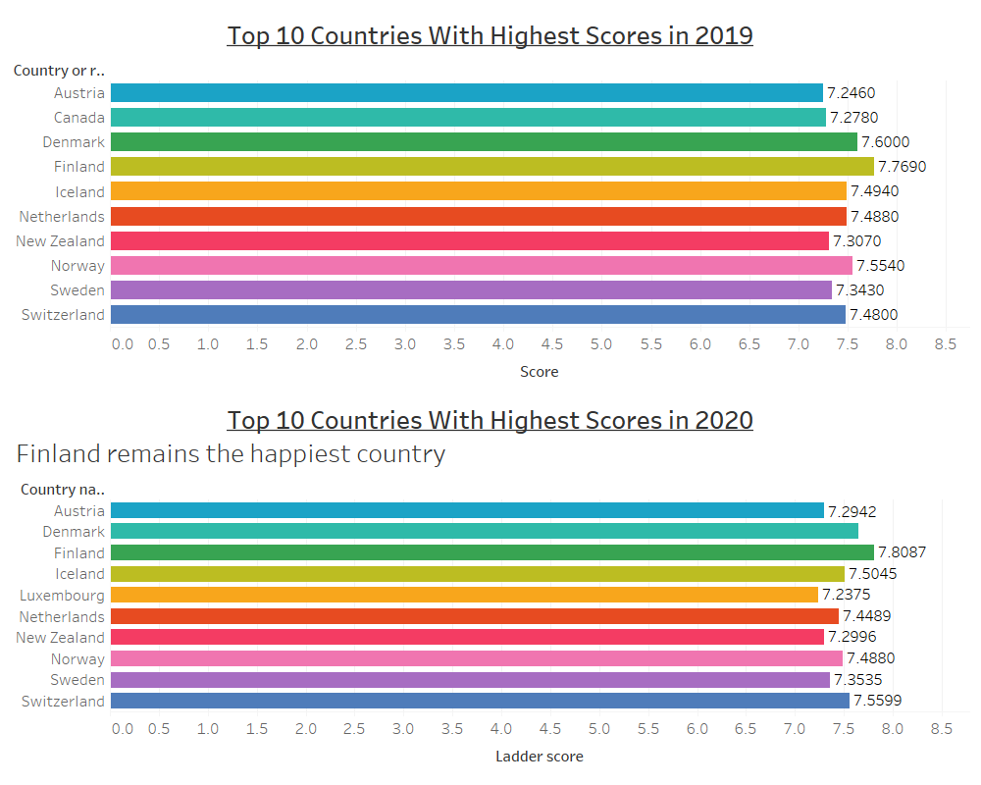

Slide 8
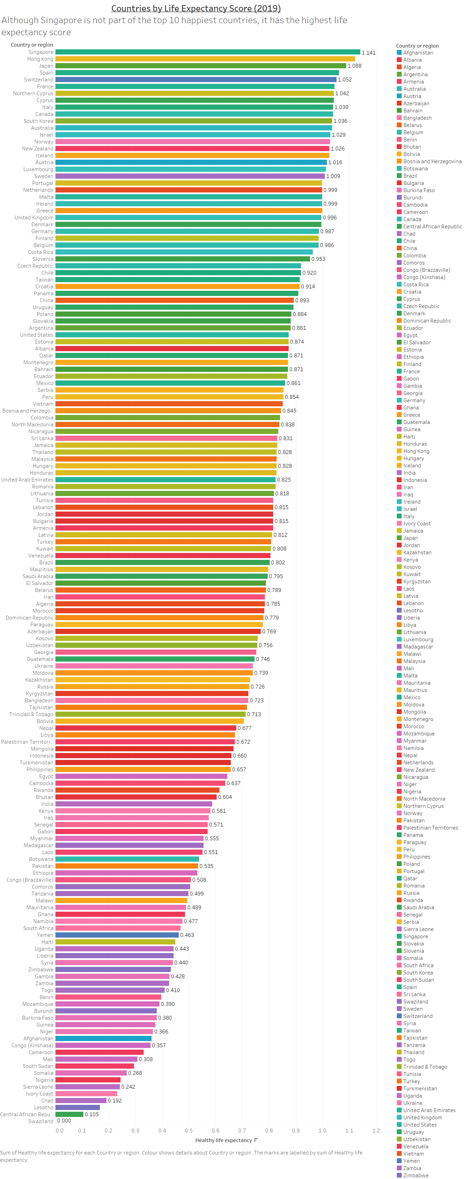

Slide 9
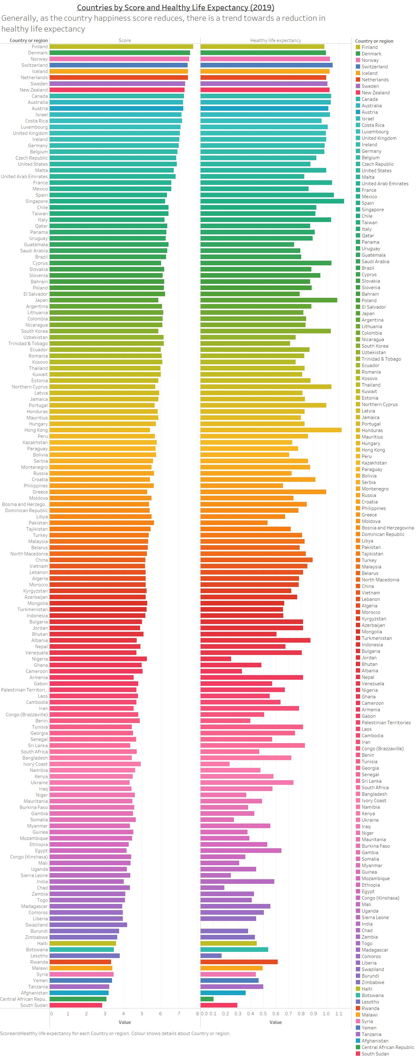

Slide 10
