Slide 1
Test Driven Development

Slide 2
Overview
Acconting System use double-entry book-keeping
Software development need same professionlism as accounting use.

Slide 3
Three Laws of TDD
Write no production code until you have first written a test that fails due to the lack of that production code.
Write no more of a test than is sufficient to fail or fail to compile. Resoleve the failure by writing some production code
Write no more production code than will resolve the currently failing test. Once the test passes write more test code.

Slide 4
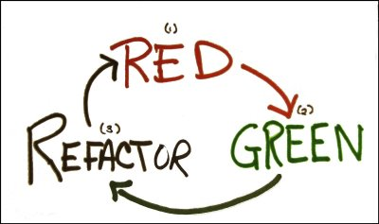

Slide 5
Benifits
Reduce debugging
Low level documentation
It is fun
Confidence to deploy
Less coupled design

