Slide 1

Hudson County, NJ
Analyzing the effects of COVID-19 Cases and Deaths
On the unemployment rate
DATA 516: Human-Centered Data Science
Aamir Darukhanawalla

Slide 2
Motivation
COVID → Uncertainty → Bear Markets → Layoffs → Unemployment
Most of us here know the pain of finding a job in a bear job market.
Two and half years back, we found ourselves in a similar situation.
However, at that time, the situation was unprecedented. It was due to the outbreak of the infamous COVID-19 pandemic.
Let’s have a look at how the COVID-19 cases and deaths have affected the employment rates in Hudson County, NJ.

Slide 3



Research Questions
How did the increase in COVID-19 cases in Hudson County affect its unemployment rate?
QUESTION 1
How did the increase in COVID-19 deaths in Hudson County affect its unemployment rate?
QUESTION 2
Does the employment rate in Hudson County depend more on the number of COVID cases or the number of deaths due to COVID-19?
QUESTION 3

Slide 4


Why is this problem Human Centered ?
Most humans are dependent on their employment for their livelihood.
Here, we’re trying to understand the trends on unemployment for the duration of the pandemic, and which metric is it more closely linked to.
Understanding the impact of the pandemic on employment is directly linked to the livelihood of humans in Hudson County.

Slide 5
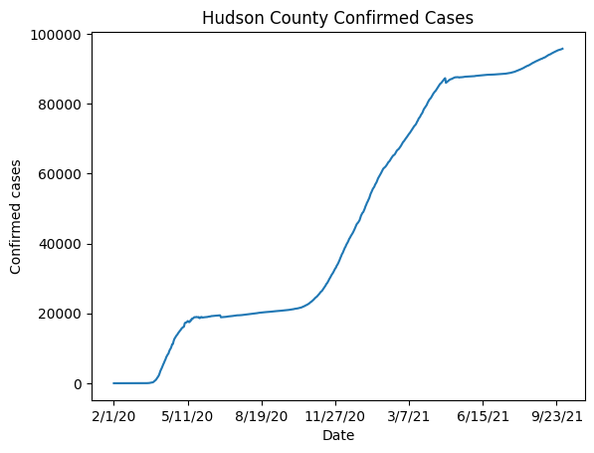
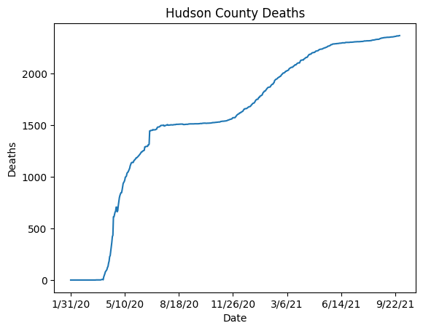
Data
COVID-19 data from John Hopkins University
RAW_us_confirmed_cases.csv
RAW_us_deaths.csv

Slide 6
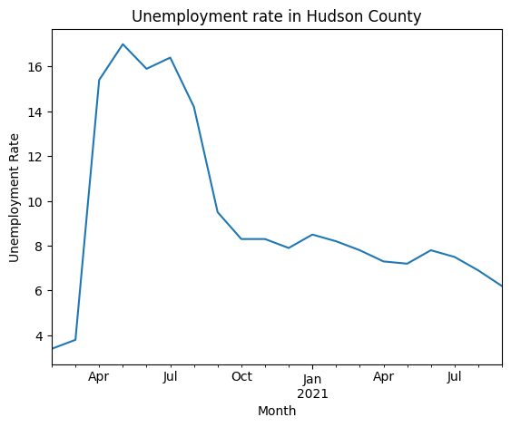
DATA
The unemployment rate in Hudson County, NJ - U.S. Bureau of Labor Statistics
unemployment-rate-hudson-nj.csv

Slide 7

Methods
Correlating the COVID-19 cases/deaths with the employment rate
I initially tried four methods:
Pearson correlation
Time Lagged Cross Correlation (TLCC)
Dynamic Time Warping (DTW)
Instantaneous phase synchrony

Slide 8
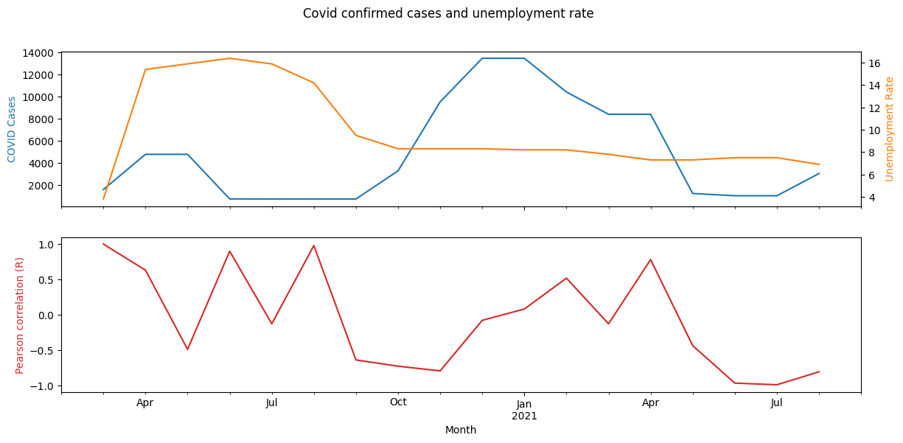
Is Unemployment related to Covid-19 cases?
Overall Pearson R = 0.024714571151235428
P-value = 0.917625354716538
Confidence Interval: low=-0.42242616402559624, high=0.46218061729684407)

Slide 9
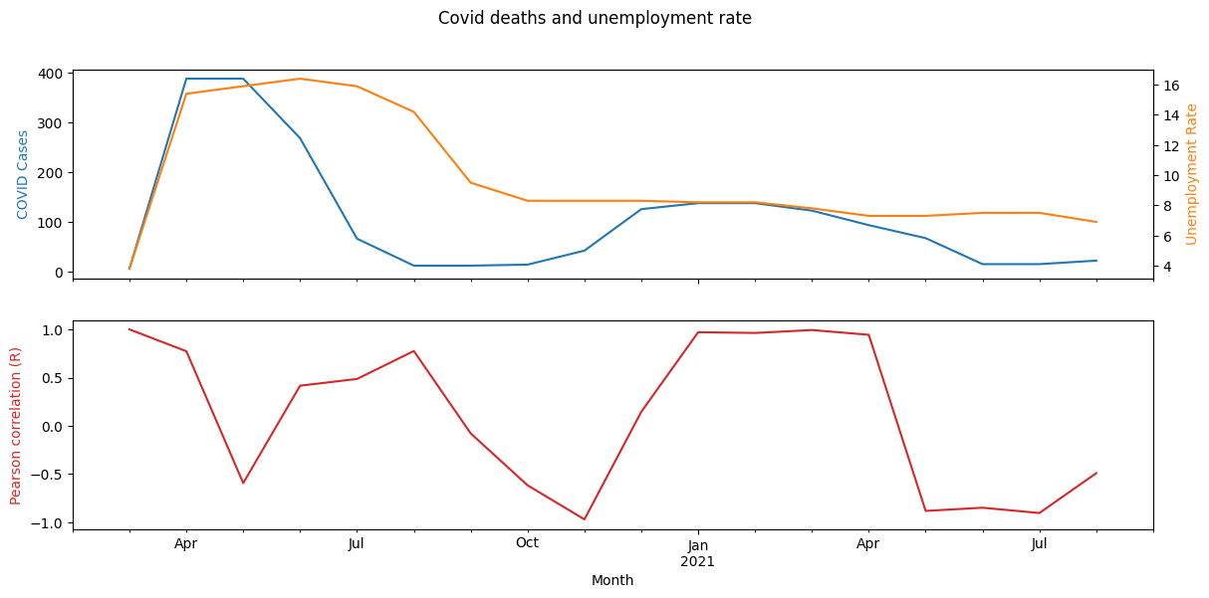
Or Is Unemployment related to Covid-19 deaths?
Overall Pearson R = 0.5901300165453667
P-value = 0.0061616943614491585
Confidence Interval: low=0.19978100403594903, high=0.8188201716160485)

Slide 10

findings
Pearson Correlation Method
Covid Confirmed Cases vs Unemployment Rate:
R = 0.024714571151235428
Covid Deaths vs Unemployment Rate:
R = 0.5901300165453667
Clearly, the unemployment rate is more closely corelated to the COVID deaths, rather than the COVID Cases.

Slide 11

Caveats
Small data size – Monthly data for 20 months, with a rolling average of 3 months.
Just two instances where we can visually see the correlation – First wave and second wave.

Slide 12
Thank you

