Slide 1
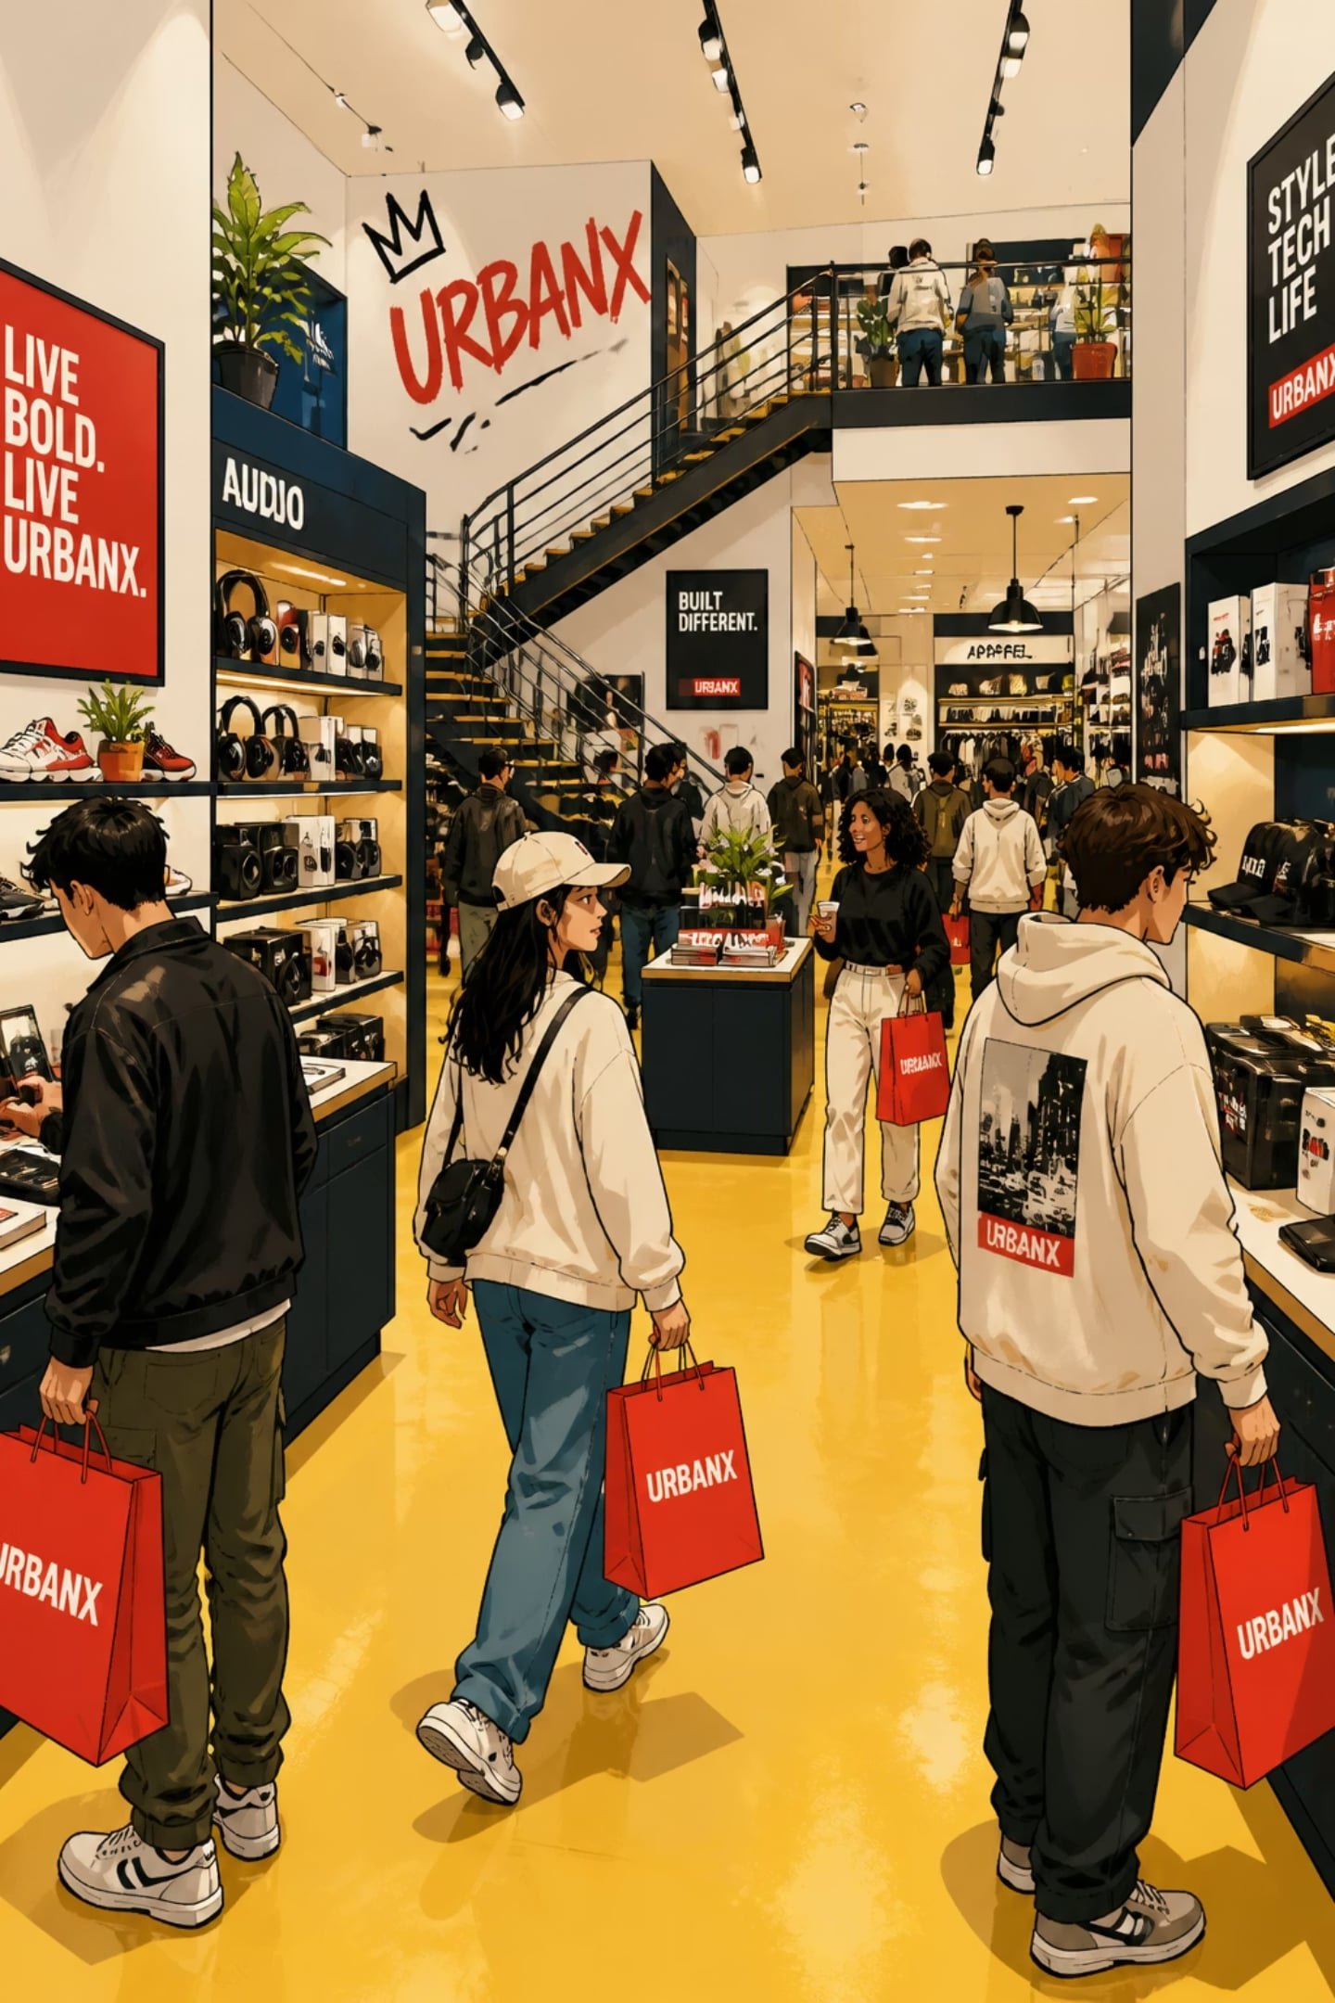
Customer Shopping Behavior Analysis
3,900 transactions · 18 features · 4 product categories

Slide 2

Dataset at a Glance
3,900
Purchases
18
Features
37
Missing Values
Review Rating column
$59.76
Avg Purchase

Slide 3

Data Preparation in Python
Load & Explore
Engineer Features
Clean Missing Values
Key steps: median imputation for Review Rating, snake_case standardization, age_group binning, dropped redundant promo_code_used column.

Slide 4
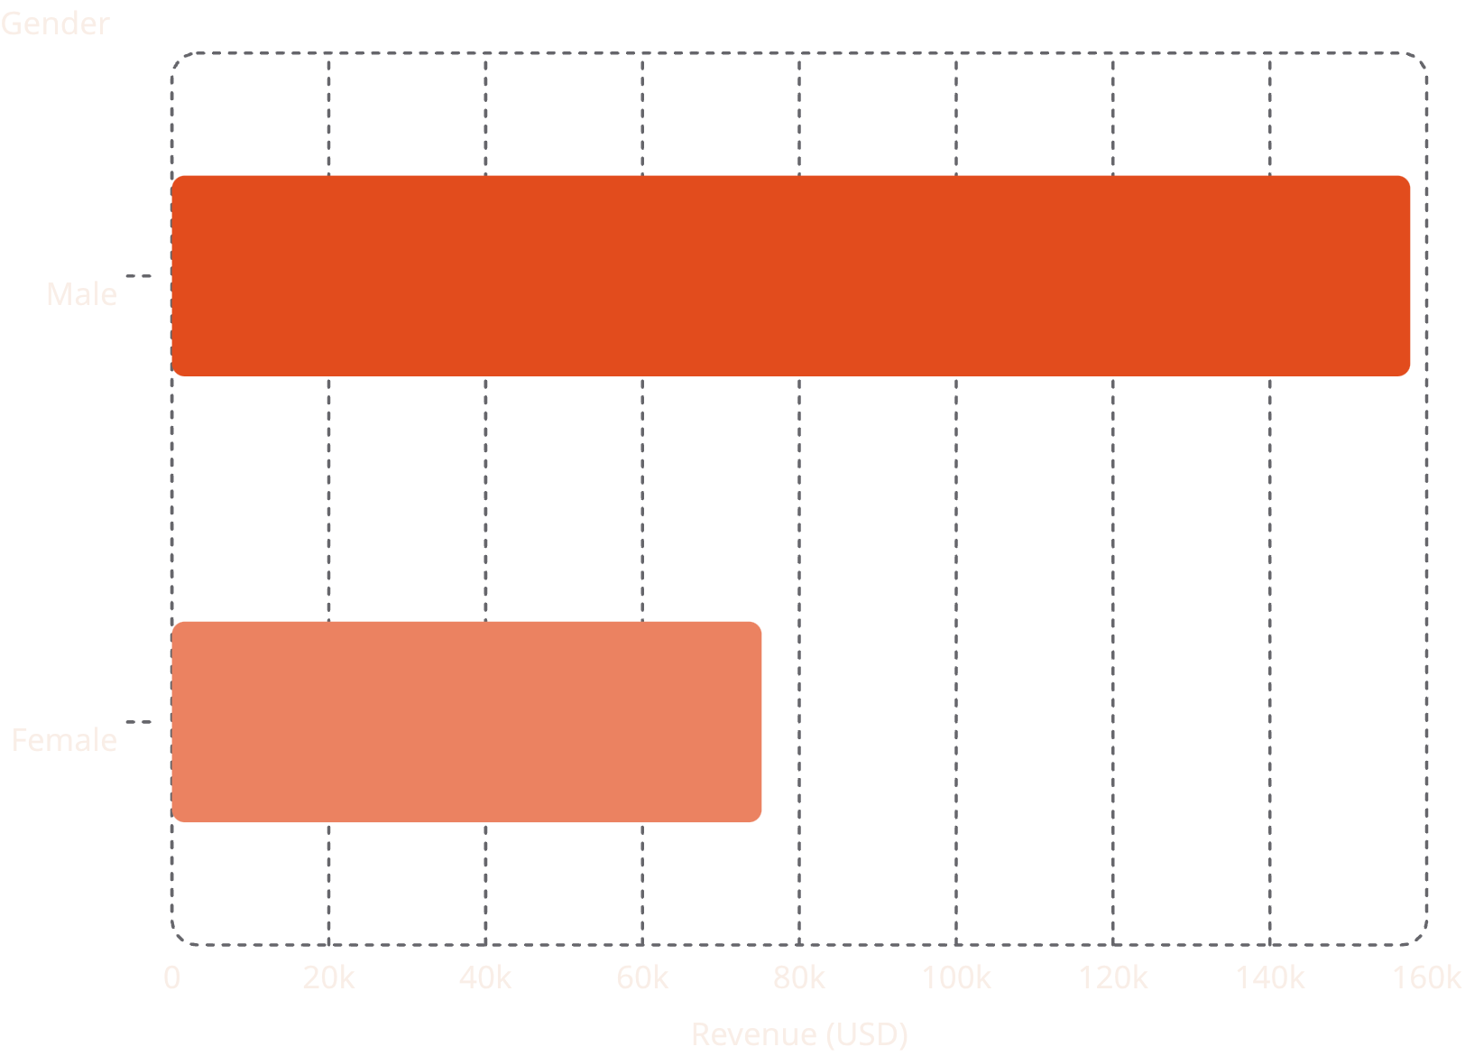

Revenue by Gender
Key Insight
Male customers generated 2.1× more revenue than female customers, despite females representing a significant portion of buyers.
Male revenue: $157,890 vs Female: $75,191

Slide 5

Top Products & Discount Patterns
Top 5 Products by Rating
Highest Discount Rates
Product
Avg Rating
Hat
Gloves
3.86
50.00% discounted
Sandals
3.84
Sneakers
Boots
3.82
49.66% discounted
Hat
3.80
Skirt
3.78
Coat
49.07% discounted

Slide 6
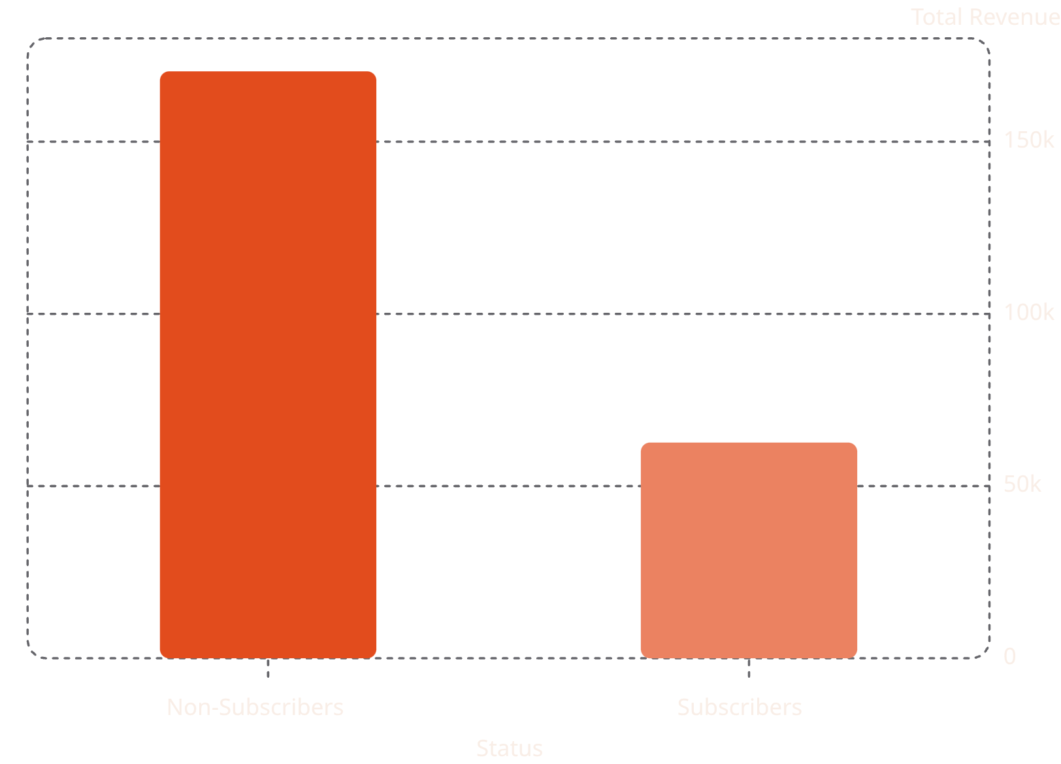
Subscribers vs. Non-Subscribers
Subscription Breakdown
73% non-subscribers · 27% subscribers
Avg spend is nearly identical: $59.87 vs $59.49
839 high-spenders used discounts yet exceeded avg purchase amount

Slide 7

Customer Segmentation
Loyal
Returning
3,116 customers
701 customers
New
83 customers
Repeat buyers (>5 purchases): 958 subscribed vs 2,518 did not

Slide 8
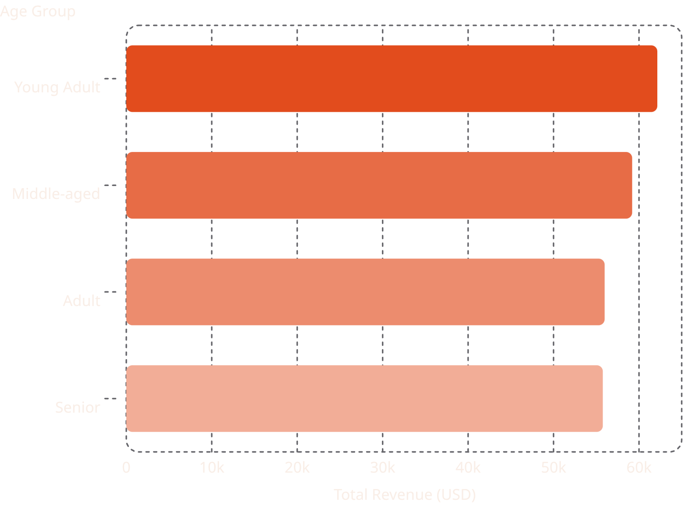

Revenue by Age Group
Sales by Age Group
Young Adults
Middle-aged
1,028 sales — highest
986 sales
Senior
Adult
944 sales
942 sales

Slide 9
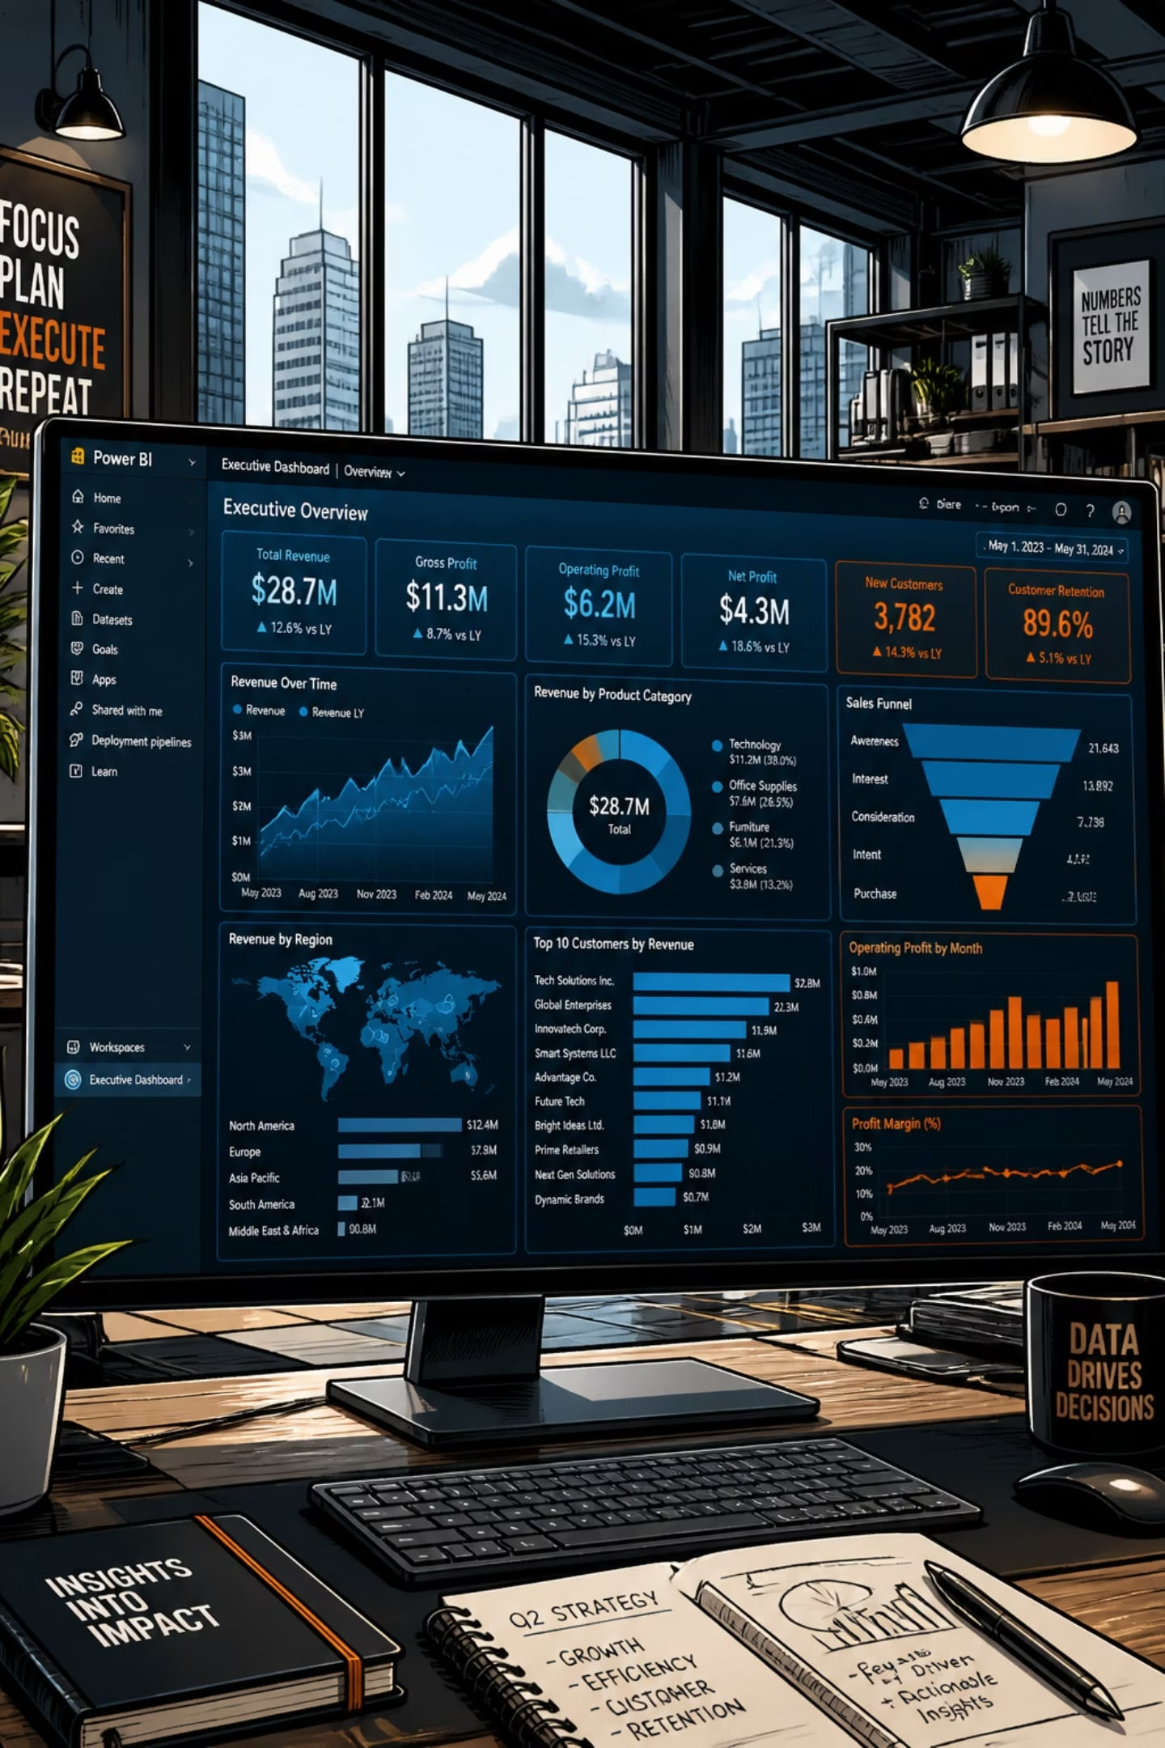



Power BI Dashboard
3.9K Customers
Interactive filters: Gender, Category, Subscription, Shipping
$233K Total Revenue
Clothing leads at $104K; Outerwear lowest at $19K
3.75 Avg Rating
Across all categories and age groups

Slide 10

Business Recommendations
Boost Subscriptions
Promote exclusive subscriber benefits
Loyalty Programs
Reward repeat buyers → Loyal segment
Review Discount Policy
Balance sales lift with margin control
Product Positioning
Highlight top-rated & best-sellers
Targeted Marketing
Focus on high-revenue age groups & express shipping users

