Slide 1
Experiment No. 3
Problem Definition: To interface 16x2 Liquid Crystal Display(LCD) to 8051 Microcontroller and write an 8051 ‘C’ code to display the message “GITCSE”

Slide 2
Objectives of the Experiment:
To demonstrate the interfacing of 16x2 LCD with 8051 Microcontroller.
To develop an 8051 ‘C’ code to display the message “GITCSE”

Slide 3
LCD Interfacing
LCD is very commonly used electronic display module and having a wide range of applications such as calculators, laptops, mobile phones etc.
16×2 character is very basic module which is commonly used in electronics devices and projects.
It can display 2 lines of 16 characters.
Each character is displayed using 5×7 or 5×10 pixel matrix.

Slide 4
LCD Interfacing
LCD can be interfaced with microcontroller in 4 Bit or 8 Bit mode.
These differs in how data is sent to LCD.
In 8 bit mode to write a character, 8 bit ASCII data is sent through the data lines D0 – D7 and data strobe is given through EN of the LCD.
LCD commands which are also 8 bit are written to LCD in similar way.

Slide 5
LCD interfacing
4 Bit Mode uses only 4 data lines D4 – D7.
In this mode 8 bit character ASCII data and command data are divided into two parts and send sequentially through data lines.
The idea of 4 bit communication is used save pins of microcontroller.
4 bit communication is a bit slower than 8 bit communication but this speed difference can be neglected since LCDs are slow speed devices.
Thus 4 bit mode data transfer is most commonly used.

Slide 6
LCD Interfacing
Lcd4_Init () : These function will initialize the LCD module which is connected to pins defined by following bit addressable variables.

Slide 7
LCD Initialization
//LCD Module Connections
sbit RS(Register Select) = P2^7;
sbit EN (Enable) = P2^6;
sbit R/W(Read/Write) = P2.5;
sbit Data D4 = P2^0;
sbit Data D5 = P2^1;
sbit Data D6 = P2^2;
sbit Data D7 = P2^3;
Data D0, D1, D2, D3 = No connection
//End LCD Module Connections

Slide 8
LCD Initialization
RS= 0 for sending Command to the LCD
RS=1 for sending Data to the LCD
R/W= 0 for reading from the LCD
R/W=1 for writing to the LCD
EN=0 for disabling the LCD
EN=1 for enabling the LCD

Slide 9
LCD Interfacing
Lcd4_Clear() : These functions will clear the LCD screen when interfaced with 8051 in 4 bit mode.
Lcd4_Set_Cursor() : These functions are used to set the cursor position on the LCD screen. By using this function we can change the position of character and string displayed by the following functions.
Lcd4_Write_Char() : These functions are used to write a character to the LCD screen.

Slide 10
LCD Interfacing
Lcd4_Shift_Left() : These functions are used to shift display left without changing the data in display RAM.
Lcd4_Shift_Right() : These functions are used to shift display right without changing the data in display RAM.

Slide 11
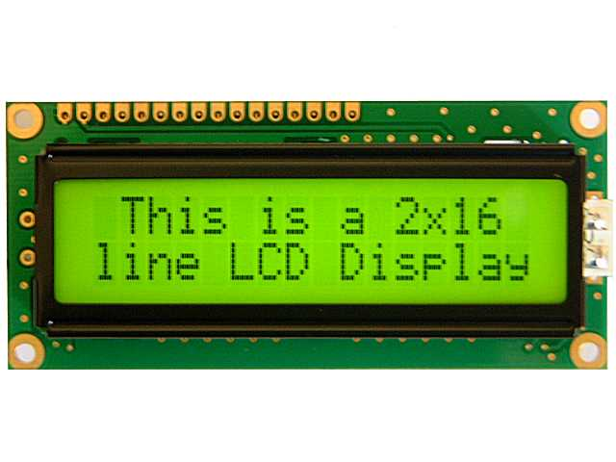
LCD Interfacing

Slide 12
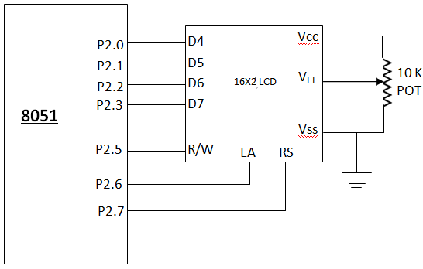
LCD (4-bit mode) interfacing diagram

Slide 13
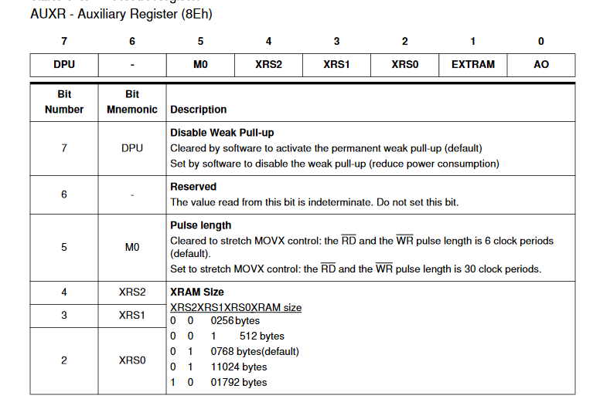

Slide 14
Algorithm for the experiment
STEP 1 : INCLUDE THE HEADER FILE ‘’at89c51ed2.h’’
STEP 2 : INCLUDE THE HEADER FILE <intrins.h> AND ADD LCD ROUTINE FILE IN THE
SOURCE GROUP (The INTRINS.H include file contains prototypes for routines that instruct the
compiler to generate in-line intrinsic code. )
STEP 3 : DECLARE LCD FUNCTION PROTOTYPES: INITIALIZATION, COMMAND,
AND DATA . lcd_init(), lcd_comm() AND lcd_data().
STEP 4 : DECLARE VARIABLES arr, temp1, temp2, i=0.
STEP 5 : BEGIN MAIN
STEP 6 : INITIALIZE AUXR=0x10 TO ACCESS FULL EXTERNAL RAM. lcd_init()
STEP 7: temp1=0X80; WRITE COMMAND; lcd_comm(); TO DISPLAY THE DATA
“GITCSE” FROM FIRST LINE.
STEP 8: INITIALIZE FOR LOOP TO DISPLAY 6 CHARACTERS. For(i=0; i<6; i++)
STEP 9: LOAD temp2 WITH CHARACTERS: arr[i]
STEP10: WRITE DATA; lcd_data
STEP11: TO DISPLAY ANOTHER STRING(EXAMPLE: MICROCONTROLLER) IN
SECOND LINE REPEAT STEPS 7 TO 10 WITH temp1=0XC0 AND FOR
LOOP INITIALIZED WITH 0 TO NUMBER OF CHARACTERS IN SECOND
STRING .
STEP12: REPEAT FOREVER; while(1)

Slide 15
#include "at89c51ed2.h"
#include <intrins.h>
// LCD FUNCTION PROTOTYPE
void lcd_init(void);
void lcd_comm(void);
void lcd_data(void);
unsigned char xdata arr[16]={“GITCSE"};
unsigned char temp1=0x00;
unsigned char temp2;
unsigned int i=0;

Slide 16
void main(void)
{
AUXR = 0x10; // Accessing Full XRAM
lcd_init();
temp1 = 0x80; // To display from the first line
lcd_comm(); // Command writing
for(i=0;i<6;i++)
{
temp2 = arr[i];
lcd_data(); // Data writing
}
while(1)
{
}
}

Slide 17
Connection Details
Port 2 to CN6 of Microcontroller Evaluation Board.

Slide 18
Learning Outcomes of the Experiment
At the end of the session, students should be able to :
Interface 16x2 LCD to 8051 Microcontroller
Write ‘C’ code to display the message “GITCSE” on LCD display.
Understand the applications of LCD for various purposes.

Slide 19
Inquiry based learning
To interface 16x2 Liquid Crystal Display(LCD) to 8051 Microcontroller and write an 8051 ‘C’ code to display the messages on both the lines of LCD

