Slide 1
Experiment 5: Title of the experiment: Develop an Embedded ‘C’ program to blink the LEDs connected to Arduino upon pressing push buttons.

Slide 2
Objectives of the Experiment:
To demonstrate the interfacing of push buttons and LEDs connected to Arduino uno.
To develop an Embedded ‘C’ program to blink the LEDs connected to Arduino upon pressing push buttons.

Slide 3
Arduino uno r3
Arduino is an open-source hardware, software and content platform with a global community.

Slide 4
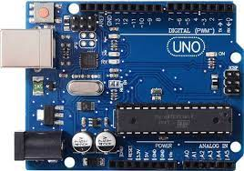
Specifications
Micro-controller: ATmega328.
Operating Voltage: 5V.
Input Voltage (recommended): 7-12V.
Input Voltage (limits): 6-20V.
Digital I/O Pins: 14 (of which 6 provide PWM output).
Analog Input Pins: 6.
DC Current per I/O Pin: 40 mA.
DC Current for 3.3V Pin: 50 mA.
Flash Memory: 32 KB of which 0.5 KB used by boot-loader.
SRAM: 2 KB (ATmega328).
EEPROM: 1 KB (ATmega328).
Clock Speed: 16 MHz

Slide 5
Arduino software ide on windows
For installation details, refer to the manual.
Getting Started with Sketch
Open the LED blink example sketch: File > Examples >01.Basics > Blink.

Slide 6
Arduino software ide on windows
Select the Board Type and Port
You'll need to select the entry in the Tools > Board menu that corresponds to your Arduino or Genuino board.

Slide 7
Arduino software ide on windows
Select the serial device of the board from the Tools → Serial Port menu.
This is likely to be COM3 or higher (COM1 and COM2 are usually reserved for hardware serial ports).
To find out, you can disconnect your board and re-open the menu; the entry that disappears should be the Arduino or Genuino board. Reconnect the board and select that serial port.

Slide 8
Arduino software ide on windows
Upload the Program
Now, simply click the "Upload" button in the environment. Wait for few seconds you should see the RX and TX LEDs on the board flashing. If the upload is successful, the message "Done uploading." will appear in the status bar.
A few seconds after the upload finishes, you should see the pin 13 LED on the board starts blinking (in orange).

Slide 9
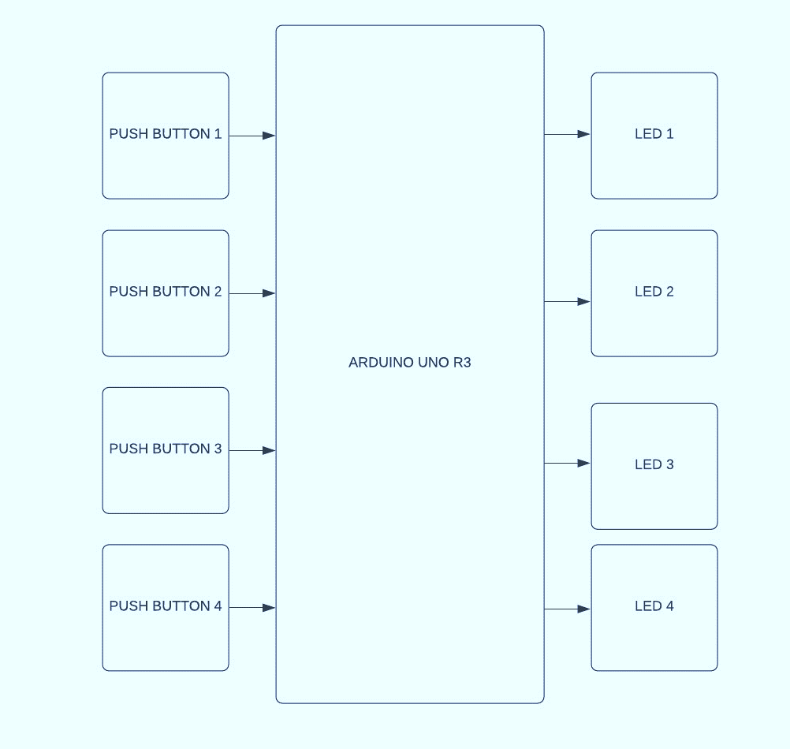
Interfacing block diagram
Switch and LED's are combination of 4 LED's and 4 switches which are programmed to operate LED's using the switches.

Slide 10
algorithm
Push buttons 1, 2, 3 and 4 are connected to Arduino pins 13,12,11,10 respectively.
Led 1, 2, 3 and 4 are connected to pins a5,a4, a3, a2 respectively.
Set Pins to Outputs Or Inputs
initialize the pushbutton pins as an inputs
initialize the LED pins as an outputs
read current states of the pushbutton value
check if the pushbutton is pressed buttonState# == HIGH/LOW
if pressed change buttonState == HIGH to turn on ledPin#
else if buttonState == LOW then digitalWrite(ledPin#, LOW) Keeps Led off.
Print buttonState to serial monitor

Slide 11
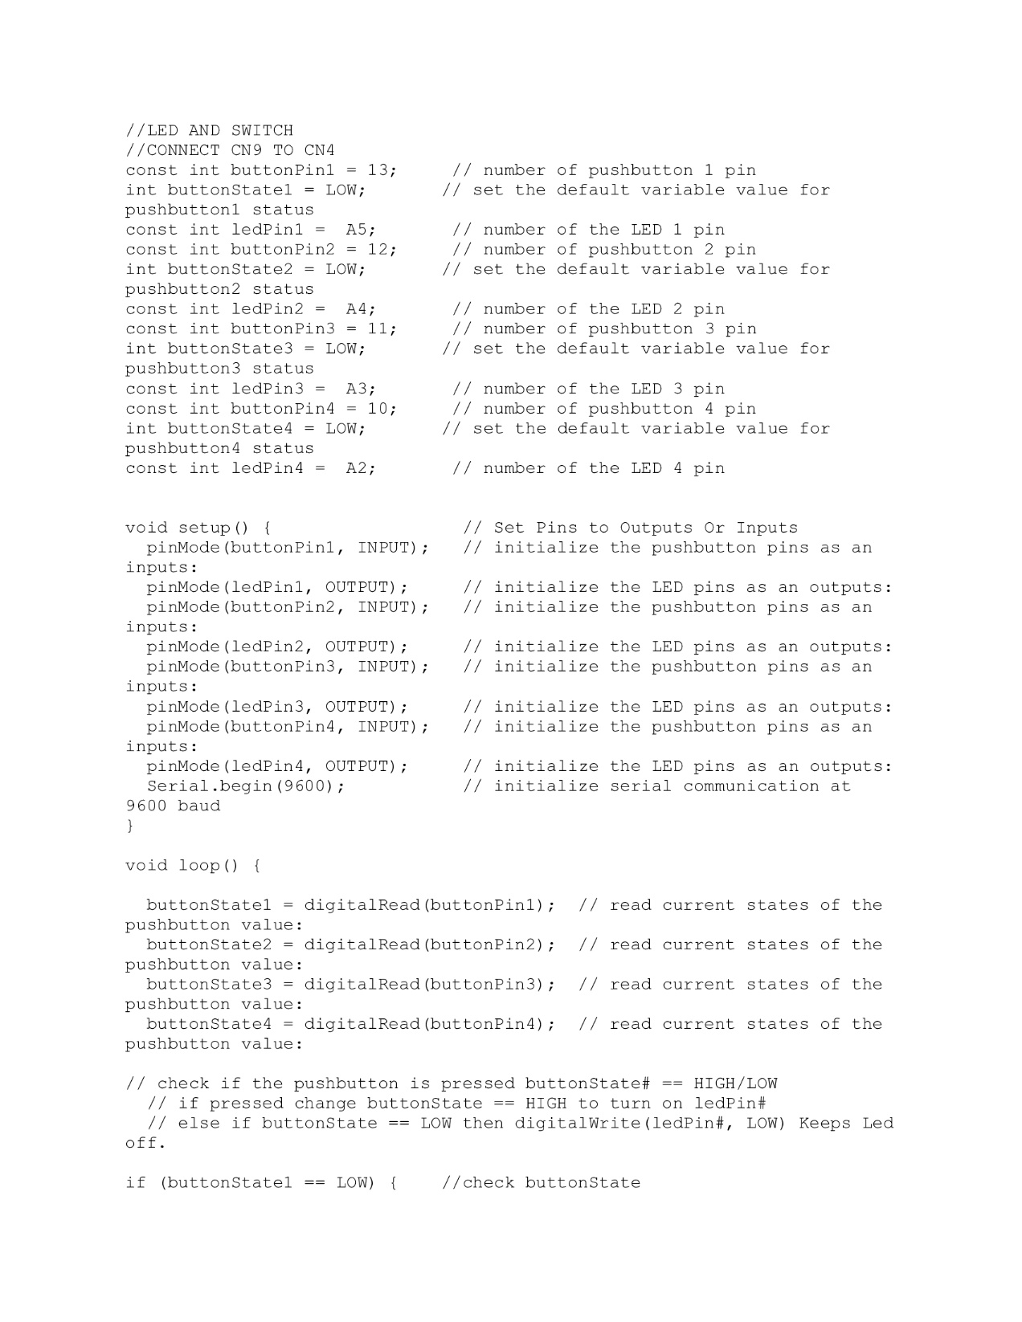
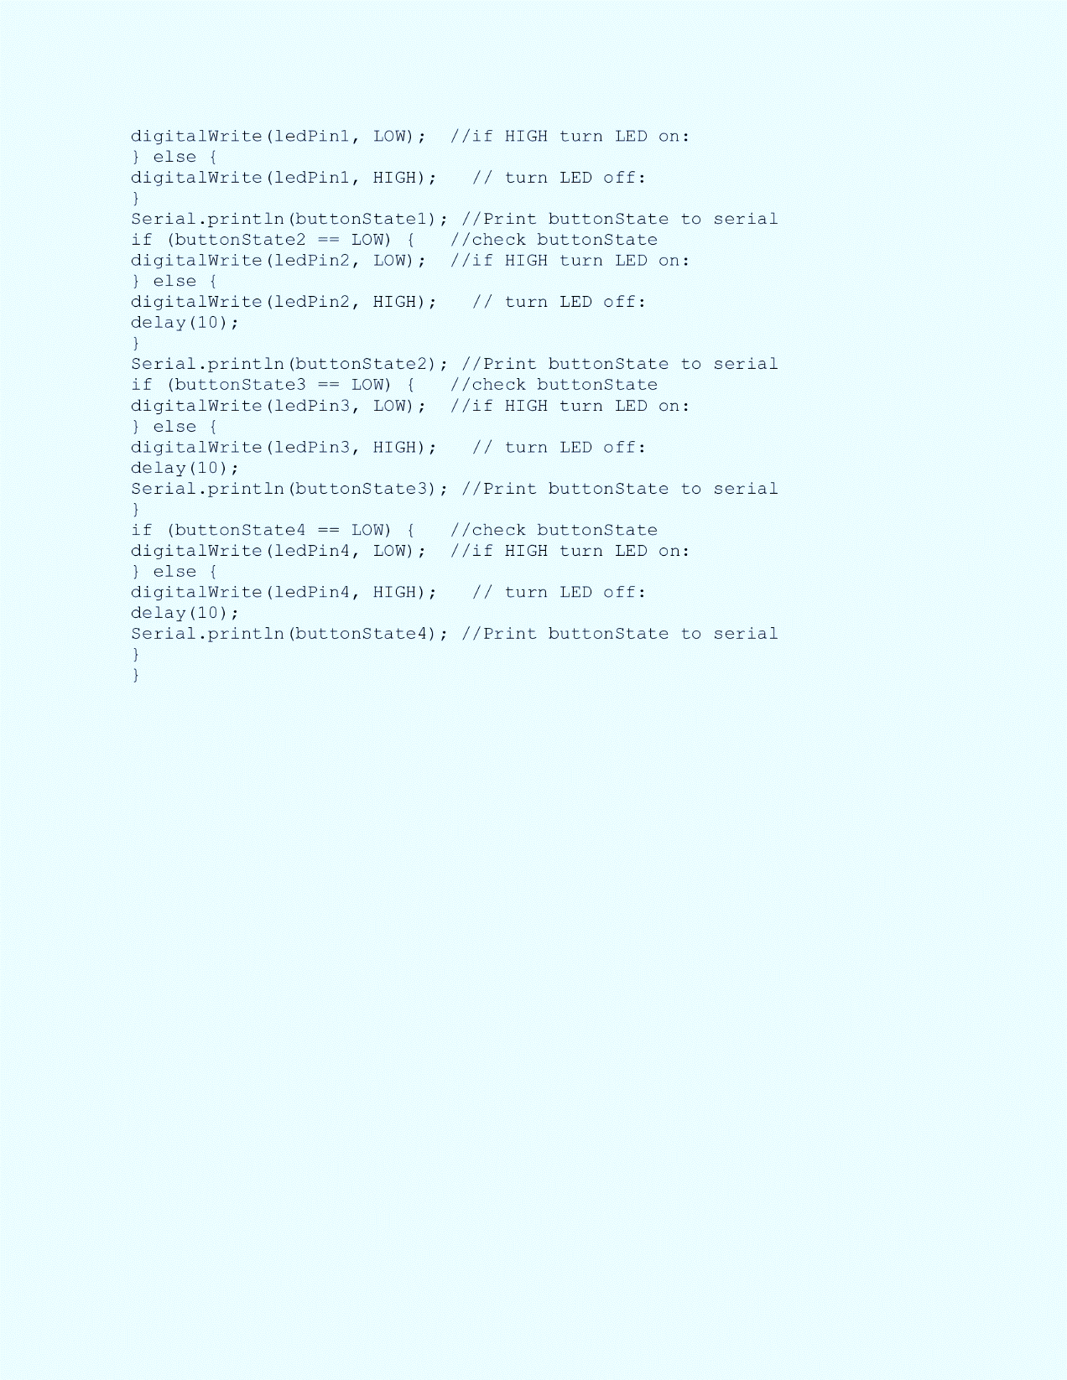
code

Slide 12
Connection details
Connect cn9 to cn4

Slide 13
Learning Outcomes of the Experiment
At the end of the session, students should be able to :
Interface pushbuttons and LEDs to Arduino uno r3.
Develop ‘C’ code to turn on led when push button is pressed.

Slide 14
Inquiry based learning
Develop an embedded ‘c’ program to generate a sequence on led’s upon pressing a push button

