Slide 1
EXPERIMENT 6: TITLE OF THE EXPERIMENT: DEVELOP AN EMBEDDED ‘C’ PROGRAM TO CONTROL THE RELAY THROUGH ARDUINO UNO R3.

Slide 2
Objectives of the Experiment:
To demonstrate the interfacing of Relay to Arduino UNO R3.
To develop an Embedded ‘C’ program to turn ON/OFF the Relay.

Slide 3
Relay
A relay basically isolate or change the state of an electric circuit from one state to another.
Relays use an electromagnet to mechanically operate a switch, but other operating principles are also used, such as solid-state relays.
Relay are used to control a circuit by a separate low-power signal.

Slide 4
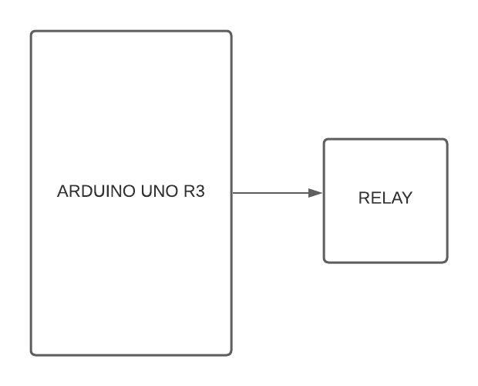
Interfacing block diagram

Slide 5
ALGORITHM
CONNECT RELAY TO ARDUINO PIN #23/ D9/ BOARD PIN 38.
MAKE RELAY PIN AS OUTPUT PIN.
MAKE RELAY PIN HIGH TO TURN ON THE RELAY USING DIGITAL WRITE.
INCLUDE DELAY.
MAKE RELAY PIN LOW TO TURN OFF THE RELAY USING DIGITAL WRITE.

Slide 6
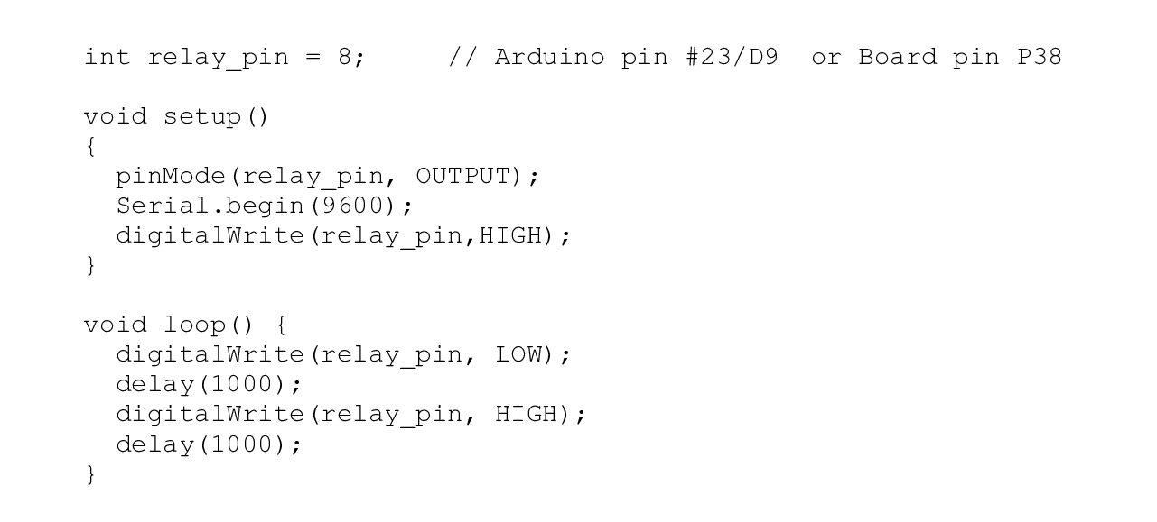
Code

Slide 7
Connection details
CONNECT RM17 - RM9

Slide 8
Learning Outcomes of the Experiment
At the end of the session, students should be able to :
Interface RELAY to Arduino UNO R3.
Develop ‘C’ code to turn on/off the relay.

