Slide 1
Experiment 7: Title of the experiment: Develop an Embedded ‘C’ program to interface DHT 11 sensor to Arduino UNO R3 and display the data acquired from sensors on serial monitor

Slide 2
Objectives of the Experiment:
To demonstrate the interfacing of DHT 11 sensor to Arduino UNO R3.
To develop an Embedded ‘C’ program to display the data (Temperature, Humidity) acquired from sensors on serial monitor.

Slide 3
Temperature and Humidity Sensor
The DHT11 is a digital temperature and humidity sensor.
It uses a humidity sensor and a thermistor to measure the surrounding air, and spits out a digital signal on the data pin.
It's fairly simple to use, but requires careful timing to grab data.
We can only get new data from it once every 2 seconds, so when using DHT 11 library, sensor readings can be up to 2 seconds old.

Slide 4
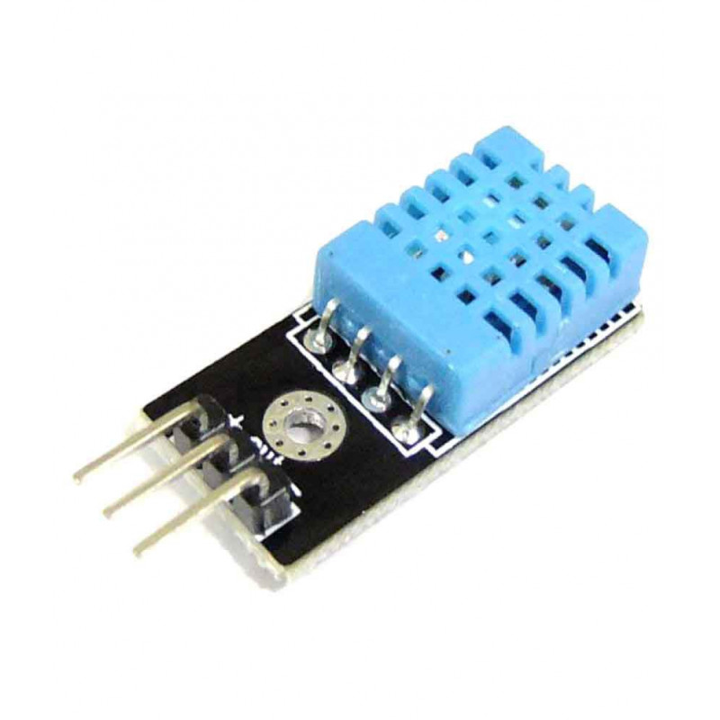
Temperature and Humidity Sensor (DHT11)

Slide 5
Temperature and Humidity Sensor
Specifications:
Operating Voltage: 3.5V to 5.5V.
Operating current: 0.3mA (measuring) 60uA (standby)
Output: Serial data.
Temperature Range: 0°C to 50°C.
Humidity Range: 20% to 90%
Resolution: Temperature and Humidity both are 16-bit.
Accuracy: ±1°C and ±1%

Slide 6
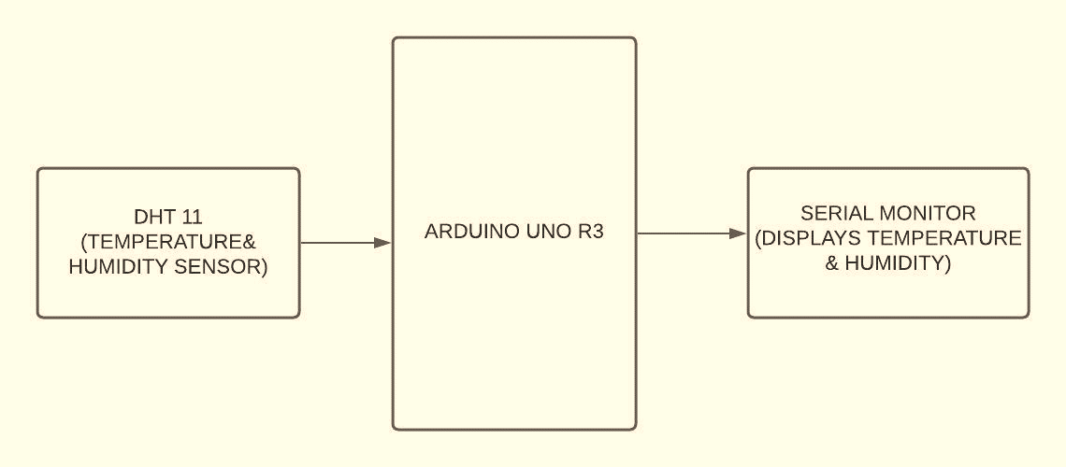
Interfacing block diagram

Slide 7
ALGORITHM
INCLUDE DHT LIBRARY
(* Sketch → Include Library→ add ZIP library)
DEFINE DHT 11 PIN 4
READ THE SENSOR READINGS
PRINT TEMPERATURE ON SERIAL MONITOR
PRINT HUMIDITY ON SERIAL MONITOR

Slide 8
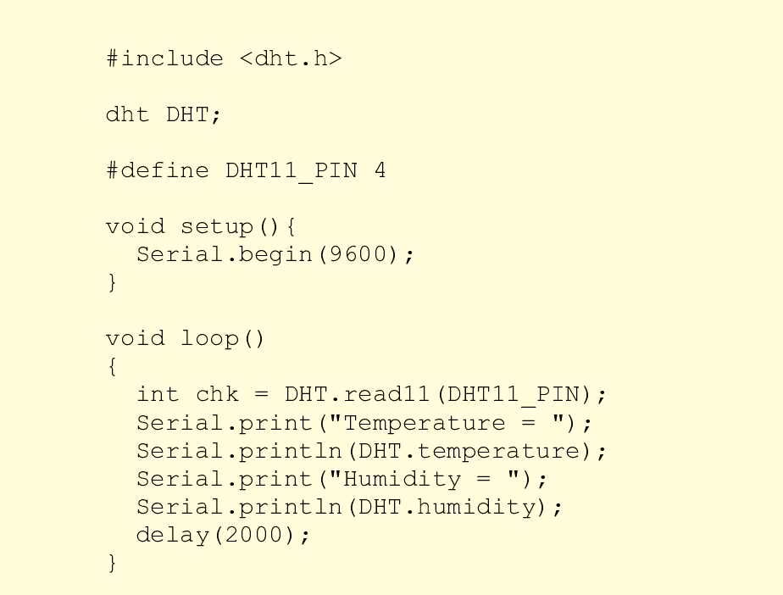
CODE

Slide 9
Connection details
CONNECT RM2 – RM19.

Slide 10
Learning Outcomes of the Experiment
At the end of the session, students should be able to :
Interface digital temperature and humidity sensor DHT 11 to Arduino UNO R3.
Develop ‘C’ code to read the data acquired from sensor (temperature & humidity) on serial monitor of Arduino UNO R3.

