Slide 1
Experiment 8: Title of the experiment: interface light dependent resistor (LDR)to Arduino uno R3 and develop an Embedded ‘C’ program to display the data acquired from sensor on serial monitor

Slide 2
Objectives of the Experiment:
To demonstrate the interfacing of LDR to Arduino uno R3.
To develop an Embedded ‘C’ program to display the data acquired from sensor on serial monitor.

Slide 3
LDR
Light dependent resistors, LDRs or photo resistors are often used in electronic circuit designs where it is necessary to detect the presence or the level of light.
A Light Sensor generates an output signal indicating the intensity of light by measuring the radiant energy that exists in a very narrow range of frequencies basically called “light”, and which ranges in frequency from “Infra-red” to “Visible” up to “Ultraviolet” light spectrum.
The light sensor converts this “light energy” whether visible or in the infrared parts of the spectrum into an electrical signal output.
Example: ldrs are used in street lights. During day time due to the sunlight falling on ldr, resistance is high and lights are off. During night, resistance of ldr decreases and lights are turned on.

Slide 4
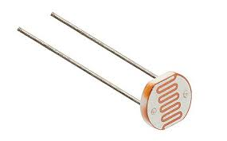
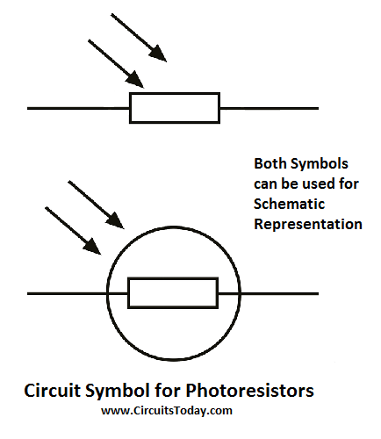
LDR SPECIFICATIONS
Using photosensitive resistance sensor sensitive type.
Working Voltage:3.3V-5V.
Output form: Digital Switch show (0 for Brightness and 1 for darkness).

Slide 5
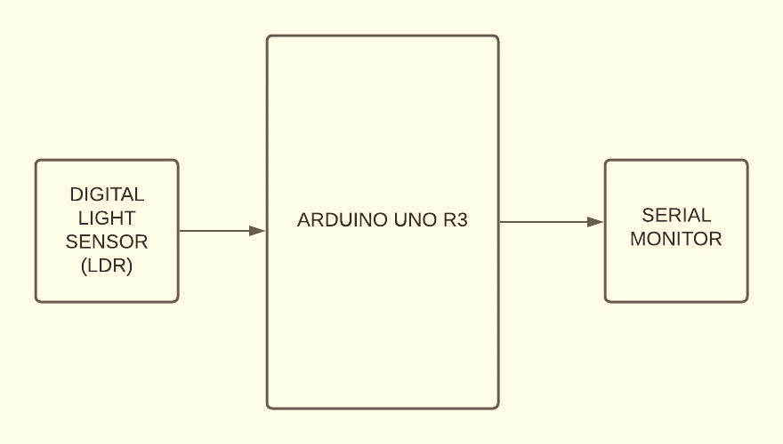
Interfacing block diagram

Slide 6
algorithm
CONNECT LIGHT SENSOR TO ARDUINO PIN 19 (D5)
CONFIGURE D5 AS INPUT TO READ THE VALUE FROM LIGHT SENSOR.
READ THE SENSOR OUTPUT.
IF SENSOR OUTPUT IS TRUE/LOGIC 1/HIGH
PRINT THE MESSAGE FOR DARKNESS ON SERIAL MONITOR (“LIGHT NOT DETECTED”)
ELSE
PRINT THE MESSAGE FOR BRIGHTNESS ON SERIAL MONITOR (“LIGHT DETECTED”)
INCLUDE DELAY.
REPEAT FOREVER.

Slide 7
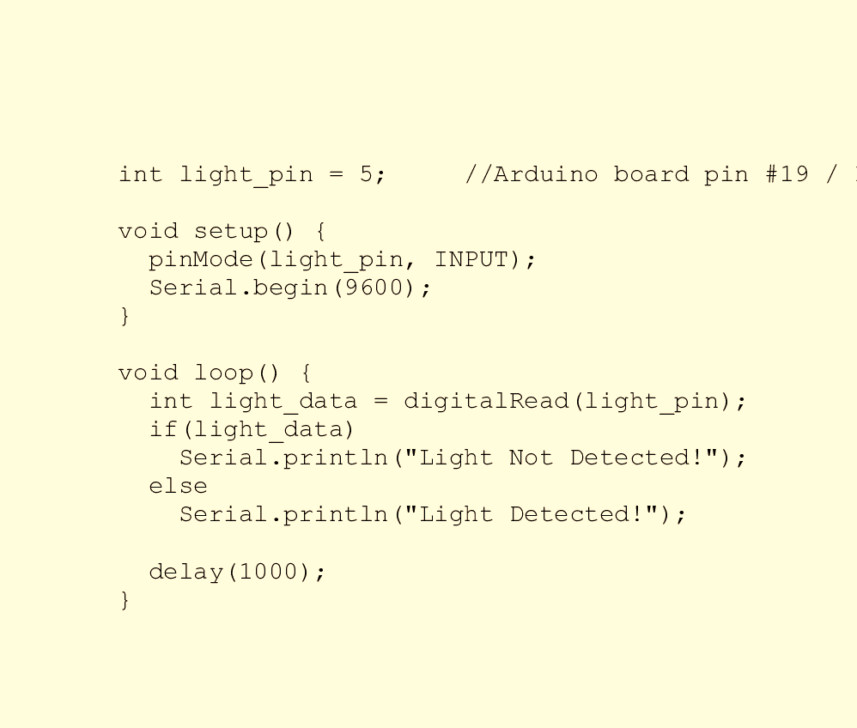
code

Slide 8
Connection details
Connect RM3 to RM20.

Slide 9
Learning Outcomes of the Experiment
At the end of the session, students should be able to :
Interface LDR to Arduino uno r3.
Develop ‘C’ code to DISPLAY THE SENSOR DATA ON SERIAL MONITOR OF Arduino uno r3.

