Slide 1
Term work 4:Using WIRESHARK observe the data transferred in client server communication using UDP and identify the UDP datagram.
Prepared by
Dr. Sharada M. Kori
Associate Professor, Department of Computer Science & Engineering, KLS GIT, Belagavi

Slide 2
INTRODUCTION TO WIRESHARK
Wireshark is a software tool used to monitor the network traffic through a network interface.
Most widely used network monitoring tool.
Users: System administrators, network engineers, network enthusiasts, network security professionals and black hat hackers.

Slide 3
WHY WIRESHARK IS SO POPULAR?
It has a great GUI as well as a conventional CLI(T Shark).
It offers network monitoring on almost all types of network standards (ETHERNET, WLAN, Bluetooth etc.,)
It is open-source with a large community of backers and developers.
All the necessary components for monitoring, analysing and documenting the network traffic are present.
It is free to use.

Slide 4
WIRESHARK HISTORY
Wireshark was started with the intention of developing a tool for closely analysing network packets.
It was started by Gerald Combez in 1997.
Its initial name was Ethereal. It was initially released in July 1998 as version 0.2.0.
Due to the support it got from the developer community, it grew rapidly and was released as version 1.0 in 2008, almost two years after it was renamed to Wireshark.

Slide 5


WIRESHARK INSTALLATION IN UBUNTU/ LINUX :
Open terminal in your system or press ALT + CTRL + T and run the below command:
Update the repository:
Install wire shark using the below command:
To run the wire shark use the below command:

Slide 6
BASIC FEATURES OF WIRESHARK
Packet Monitor:
This segment visually shows the packets flowing inside the network.
There are colour codes for each type of packet.
The packets are shown with the following information :
1. Source address
2. Destination address
3. Packet type
4. Hex dump of the packet
5. Contents of the packet in text
6. Source port(if applicable)
7. Destination port(if applicable)

Slide 7
WORKING WITH WIRESHARK
Import from a capture file: This feature lets you import packets dump from a capture file to analyse further. There are many formats supported by Wireshark, some of them are:
Pcapng
Export to a capture file: Wireshark lets you save the results as a capture file to continue working on them at later point of time. The supported formats are:
pcapng (*.pcapng)
Launch Wireshark, select an interface( select one that is currently communicating, which can be verified by the zigzag pattern in front of the name of the interface) and click on the fin icon to start capturing packets.
Save the result as a capture file and exit after you are done seeing the traffic.

Slide 8
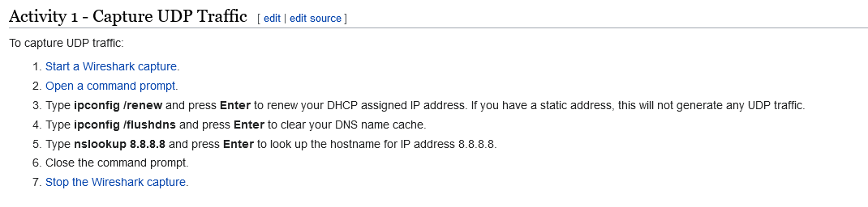
UDP Datagram Analysis using Wireshark

Slide 9
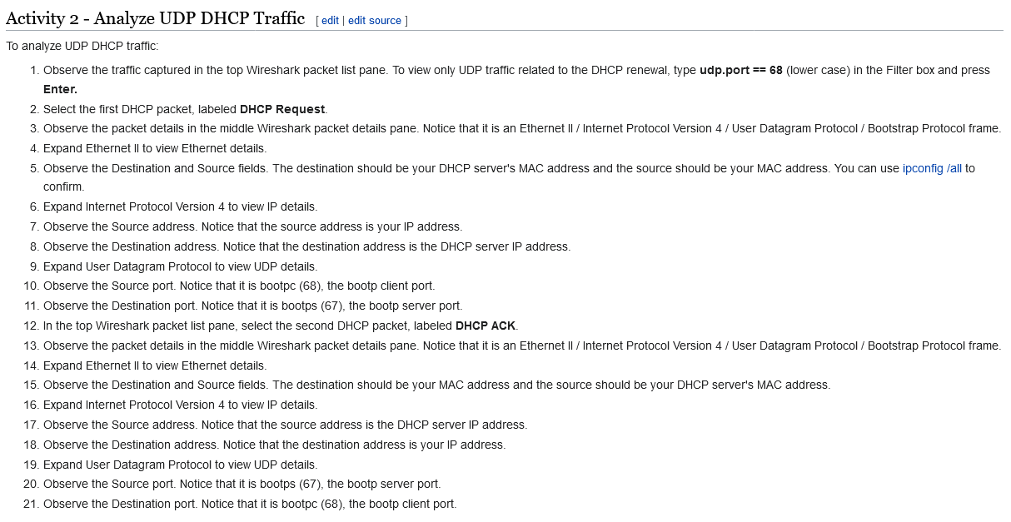

Slide 10
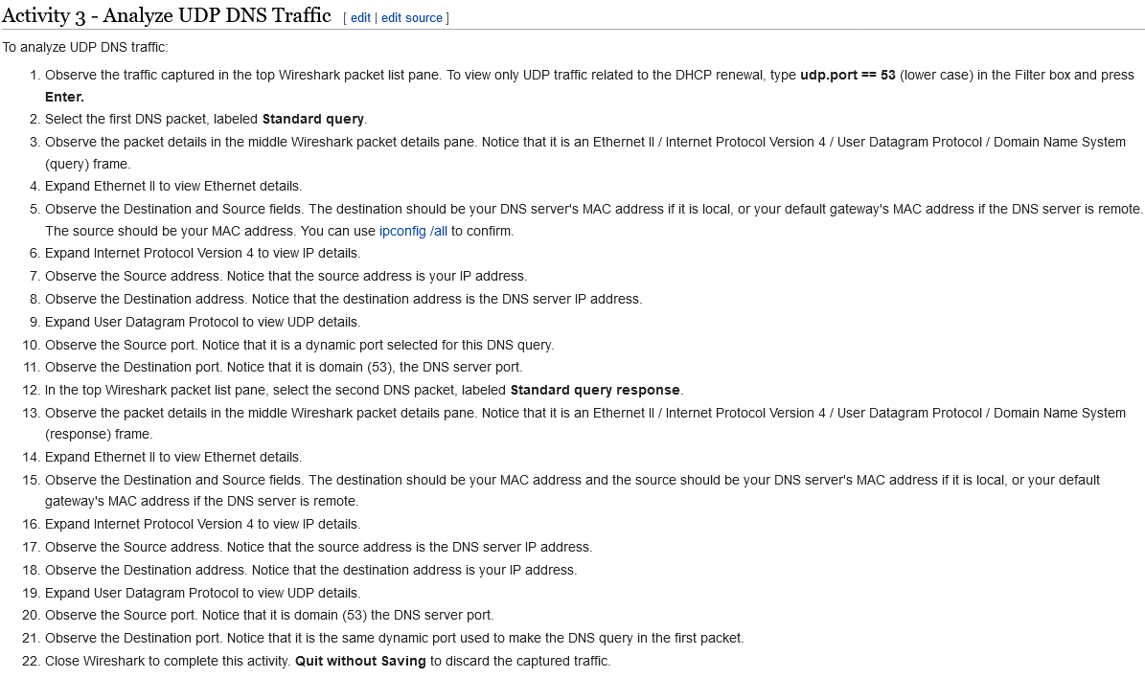

Slide 11
Learning outcomes
At the end of the session students will be able to:
Understand the significance of Wireshark tool.
Understand how to analyze the UDP Datagram using Wireshark.

Slide 12
References
https://www.wireshark.org/
W. Richard Stevens, Bill Fenner, Andrew M. Rodoff: “UNIX Network Programming”. Volume 1, Third Edition, Pearson 2004.
Barry Nance: “Network Programming in C”, PHI 2002 3.Bob Quinn, Dave Shute: “Windows Socket Network Programming”, Pearson 2003.
Richard Stevens: “UNIX Network Programming”. Volume 2, Second Edition.
James F Kurose and Keith W Ross, Computer Networking, A Top-Down Approach, Sixth edition, Pearson,2017

