Slide 1
Term work 5: Using WIRESHARK analyze three way handshaking connection establishment, data transfer and connection termination in client server communication using TCP
Prepared by
Dr. Sharada M. Kori
Associate Professor, Department of Computer Science & Engineering, KLS GIT, Belagavi

Slide 2
INTRODUCTION TO WIRESHARK
Wireshark is a software tool used to monitor the network traffic through a network interface.
Most widely used network monitoring tool.
Users: System administrators, network engineers, network enthusiasts, network security professionals and black hat hackers.

Slide 3
WHY WIRESHARK IS SO POPULAR?
It has a great GUI as well as a conventional CLI(T Shark).
It offers network monitoring on almost all types of network standards (ETHERNET, WLAN, Bluetooth etc.,)
It is open-source with a large community of backers and developers.
All the necessary components for monitoring, analysing and documenting the network traffic are present.
It is free to use.

Slide 4
WIRESHARK HISTORY
Wireshark was started with the intention of developing a tool for closely analysing network packets.
It was started by Gerald Combez in 1997.
Its initial name was Ethereal. It was initially released in July 1998 as version 0.2.0.
Due to the support it got from the developer community, it grew rapidly and was released as version 1.0 in 2008, almost two years after it was renamed to Wireshark.

Slide 5


WIRESHARK INSTALLATION IN UBUNTU/ LINUX :
Open terminal in your system or press ALT + CTRL + T and run the below command:
Update the repository:
Install wire shark using the below command:
To run the wire shark use the below command:

Slide 6
BASIC FEATURES OF WIRESHARK
Packet Monitor:
This segment visually shows the packets flowing inside the network.
There are colour codes for each type of packet.
The packets are shown with the following information :
1. Source address
2. Destination address
3. Packet type
4. Hex dump of the packet
5. Contents of the packet in text
6. Source port(if applicable)
7. Destination port(if applicable)

Slide 7
WORKING WITH WIRESHARK
Import from a capture file: This feature lets you import packets dump from a capture file to analyse further. There are many formats supported by Wireshark, some of them are:
Pcapng
Export to a capture file: Wireshark lets you save the results as a capture file to continue working on them at later point of time. The supported formats are:
pcapng (*.pcapng)
Launch Wireshark, select an interface( select one that is currently communicating, which can be verified by the zigzag pattern in front of the name of the interface) and click on the fin icon to start capturing packets.
Save the result as a capture file and exit after you are done seeing the traffic.

Slide 8
TCP ANALYSIS USING WIRESHARK
TCP or Transmission Control Protocol is a connection oriented, reliable, full –duplex, byte stream protocol.
It has algorithms that solve complex errors arising in packet communications, i.e. corrupted packets, invalid packets, duplicates, etc.
Since it is used with IP(Internet Protocol), many times it is also referred to as TCP/IP.
Other features of TCP: sequencing, packet retransmission, acknowledgement.
In order to start a communication, the TCP first establishes a connection using the three-way-handshake.

Slide 9
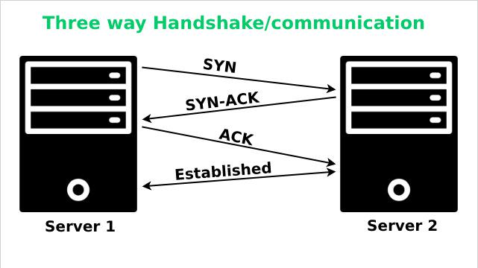
TCP Analysis using Wireshark

Slide 10
TCP ANALYSIS USING WIRESHARK
From the menu bar, select capture -> options -> interfaces.
In the interfaces, choose a particular interface, note down its IP, and click the start button of the selected adapter.
This starts capturing packets.
Run the TCP server and client programs to generate network traffic.

Slide 11
TCP Analysis using Wireshark
Observe the packets ACK, SYN, SYN-ACK is listed on their respective side.
Also observe the following details in the packet:
Source port: This is the port of your host network used for communication.
Destination port: This is the port of the destination server.
TCP segment length: It represents the data length in the selected packet.
Sequence number: It is a method used by Wireshark to give particular indexing to each packet for tracking packets with ease. This indexing starts from 0.
Next sequence number: It is the sum of the sequence number and the segment length of the current packet.
Acknowledgment number: It contains the byte length of data received.
Header length: It is the length of the TCP header and can vary from 20 to 60.

Slide 12
TCP Analysis using Wireshark
A major section of this TCP packet analysis is the flag section of a packet which gives further in-depth information about the packet.
The flag section has the following parameters which are enlisted with their respective significance.
Congestion window reduced(CWR): It signals a decrease in transmission rate.
ECN-Echo: It is set on receiving earlier congestion notifications.
Urgent: It is set when the packet is to be considered a priority.
Acknowledgment: It indicates whether the current packet contains an acknowledgment packet or not.
Push: The data should be saved and removed from the communication channel.
Reset: It indicates an error in the communication.
Syn: It denotes whether the packet is synchronization or SYN packet or not.
Fin: It indicates finalization i.e. end of the communication.

Slide 13
TCP Analysis using Wireshark
Further, in the subsections we have:
Window size value: This is the buffer size of the current host.
Checksum: It is used to verify that the received packet is OK or has an error.
Checksum status: The packet checksum is not verified by default, but one can enable it as per requirements.
The closing side or the local host sends the FIN or finalization packet.
The server sends an ACK signaling it has received the FIN packet and sends a FIN packet for confirmation on the closing side.
Lastly, the closing side receives the FIN packet and reciprocates by sending the ACK packet thus confirming the connection termination.

Slide 14
Learning outcomes
At the end of the session students will be able to:
Understand the significance of Wireshark tool.
Understand how to analyze the TCP packets using Wireshark.

Slide 15
References
https://www.wireshark.org/
W. Richard Stevens, Bill Fenner, Andrew M. Rodoff: “UNIX Network Programming”. Volume 1, Third Edition, Pearson 2004.
Barry Nance: “Network Programming in C”, PHI 2002 3.Bob Quinn, Dave Shute: “Windows Socket Network Programming”, Pearson 2003.
Richard Stevens: “UNIX Network Programming”. Volume 2, Second Edition.
James F Kurose and Keith W Ross, Computer Networking, A Top-Down Approach, Sixth edition, Pearson,2017

