Slide 1
Availability
For mission-critical systems like aeroplane operational and control system availability shall be 100%. It measures how much fault tolerant a system really is.

Slide 2
Availability
How Resistant a system is for failures.
Is your system completely go down or your system still going to be operational.
Notes:
6

Slide 3


Notes:
6

Slide 4
Availability
There are varying degree of availability that you might expect from different systems.
YouTube
Airplane System
Cloud Providers
Notes:
6

Slide 5
Availability
If a system is up and operational for half of an entire year, then system has 50% availability.
In practice, you could imagine that 50% availability would be really, really bad for most services.
Percentages can be pretty deceptive because even an availability of 90% isn't really great.
Outage of 36 days around out of the year.
Notes:
6

Slide 6
Nines
We measure availability not exactly in percentages but rather in what we call nines.
Nines are effectively percentages but they are specifically percentages with the number nine
If you have a system that has 99% availability. Then, in the industry, we say that your system has two nines of availability.
If it has 99.99%, then we say it has four nines of availability.
Notes:
6

Slide 7
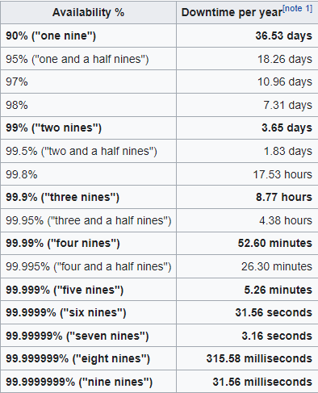
Notes:
<number>

