Slide 1
Consistent Hashing

Slide 2
Consistent Hashing
Consistent Hashing is a distributed hashing scheme that operates independently of the number of servers or objects
We assigning servers, object a position on an abstract circle, or hash ring.

Slide 3
Hash Ring

Slide 4
Hash Ring
The number of locations is no longer fixed, but the ring is considered to have an infinite number of points and the server nodes can be placed at random locations on this ring.
Of course, choosing this random number again can be done using a hash function.
Step of dividing it with the number of available locations is skipped as it is no longer a finite number.

Slide 5
Hash Ring
We will map the hash output range on the edge of a circle.
That means that the minimum possible hash value, zero, would correspond to an angle of zero,
The maximum possible value (some big integer we’ll call INT_MAX) or 360 degrees, and all other hash values would linearly fit somewhere in between.
The way that you place these servers here on the circle is by putting them through a hashing function.

Slide 6
Hash Ring
We will pass server names in a hashing function. You get a value and depending on the value, you position them on the circle.
If hashing function used is a good hashing function that has that uniformity about it, then the servers will be sort of evenly distributed.
Exact same thing with your clients. Our clients are going to go through a hashing function and then you position them on the circle

Slide 7
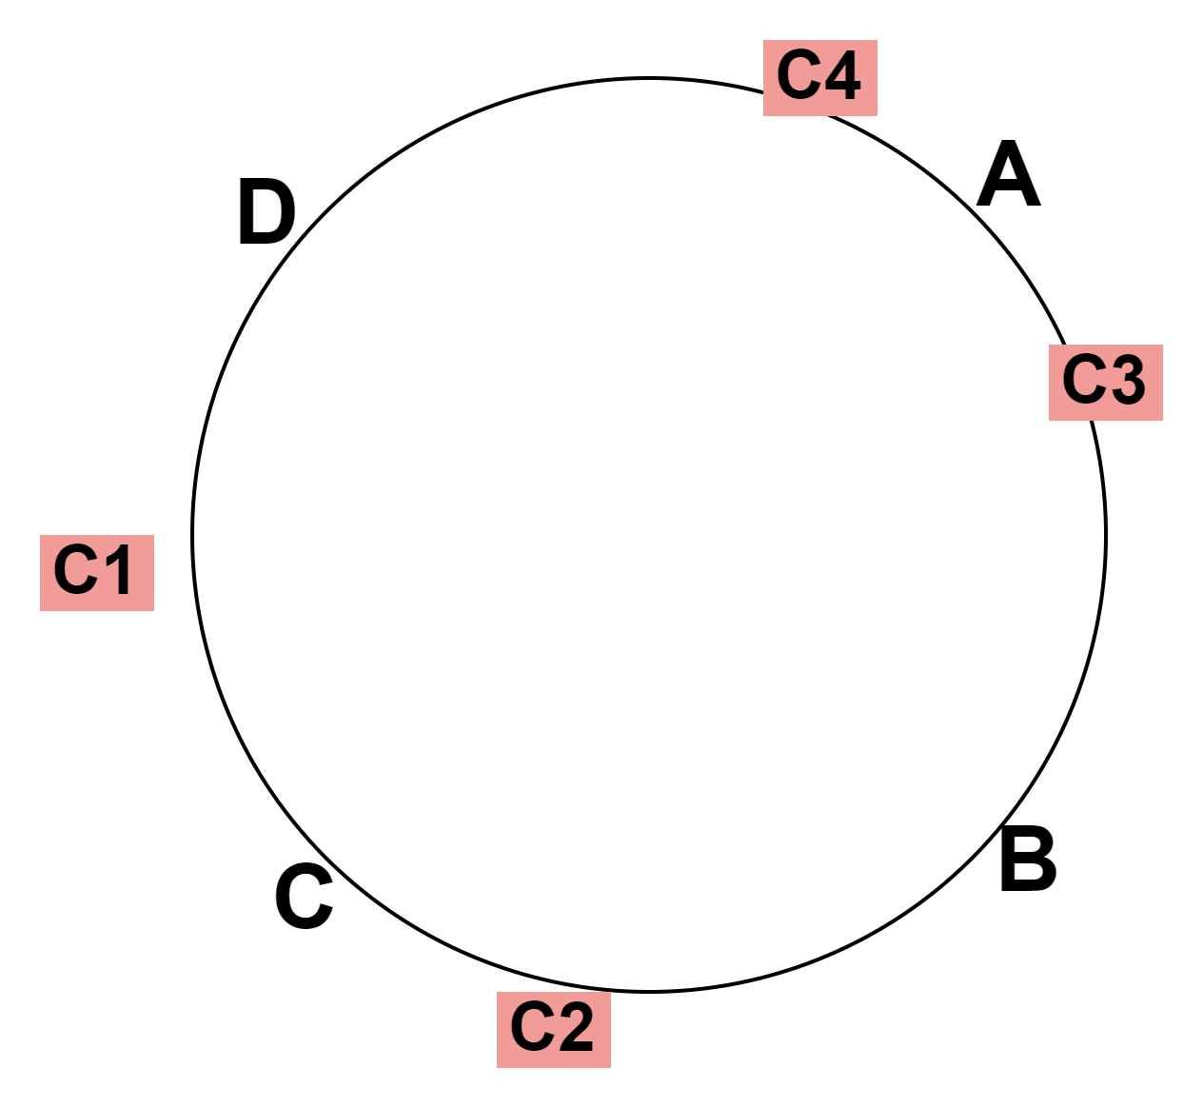
Servers and Clients plotted on Hash Ring

Slide 8
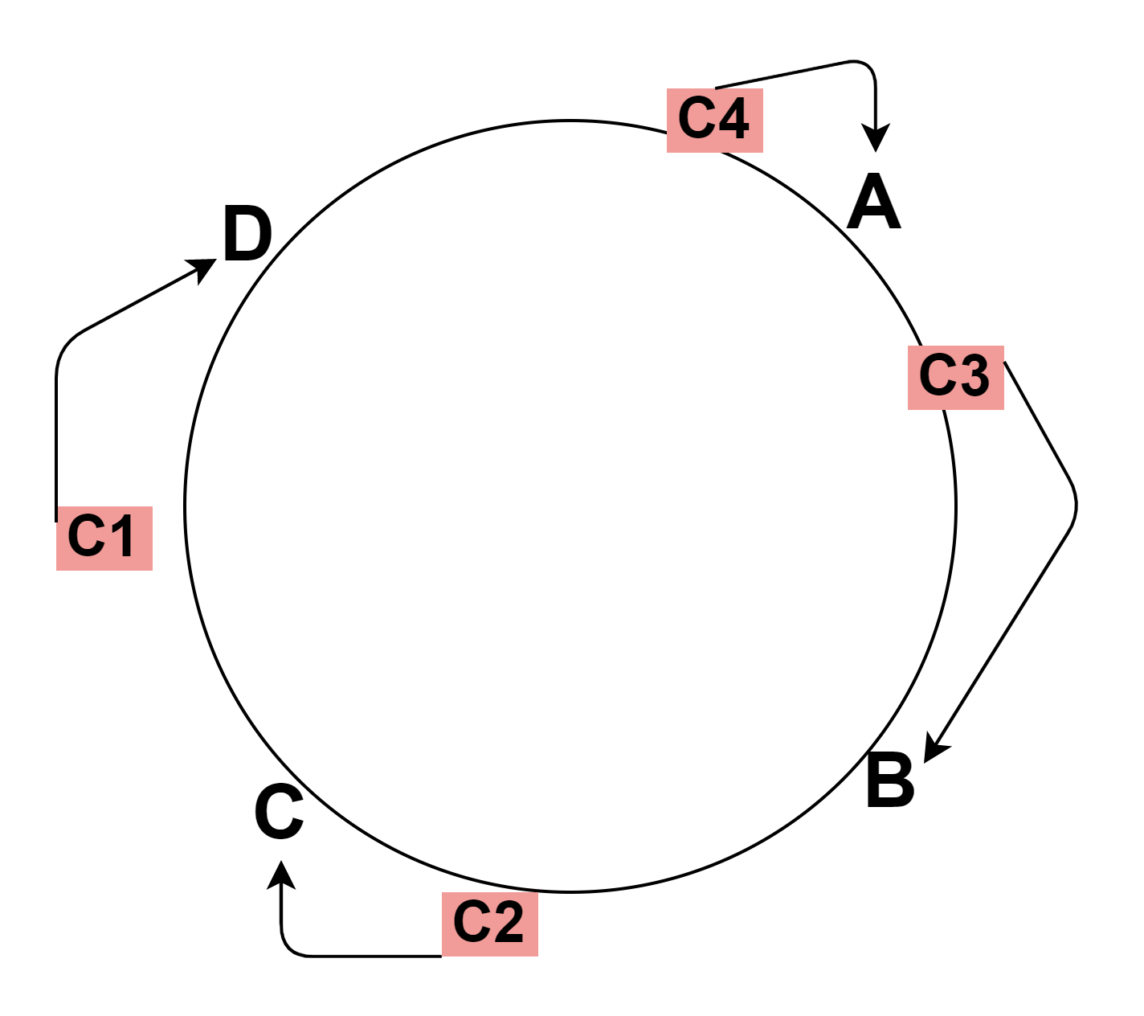
Routing of Requests

Slide 9
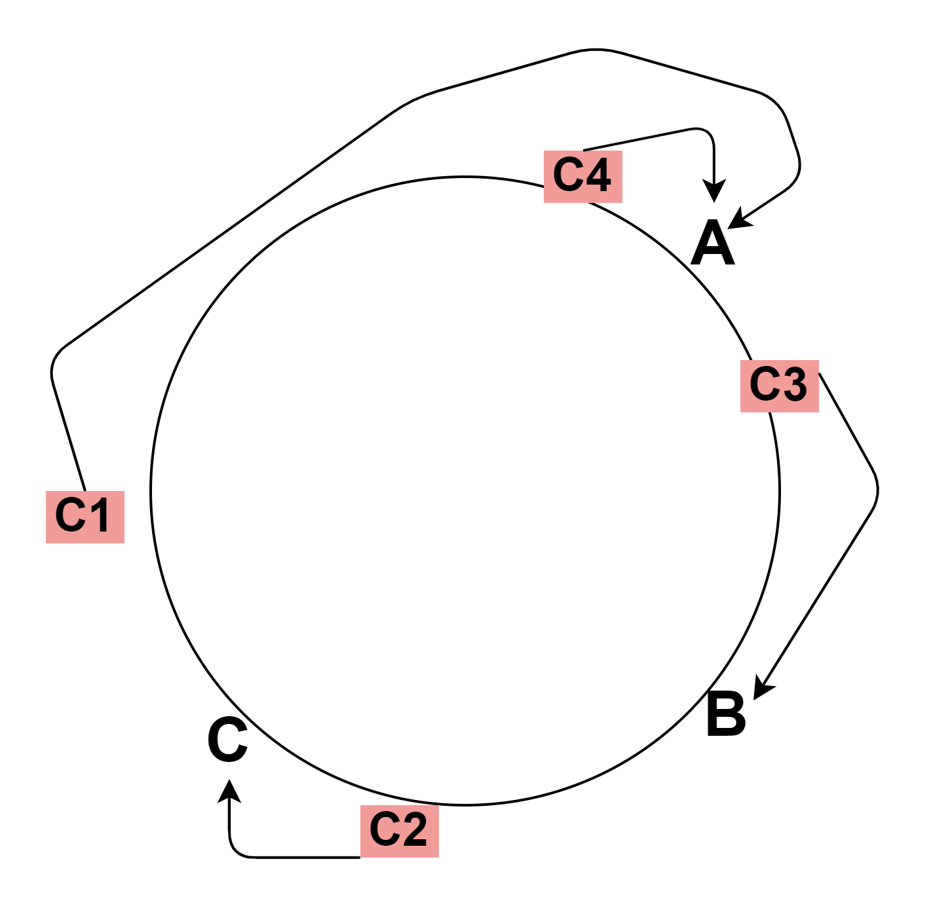
Routing when Server Dies

Slide 10
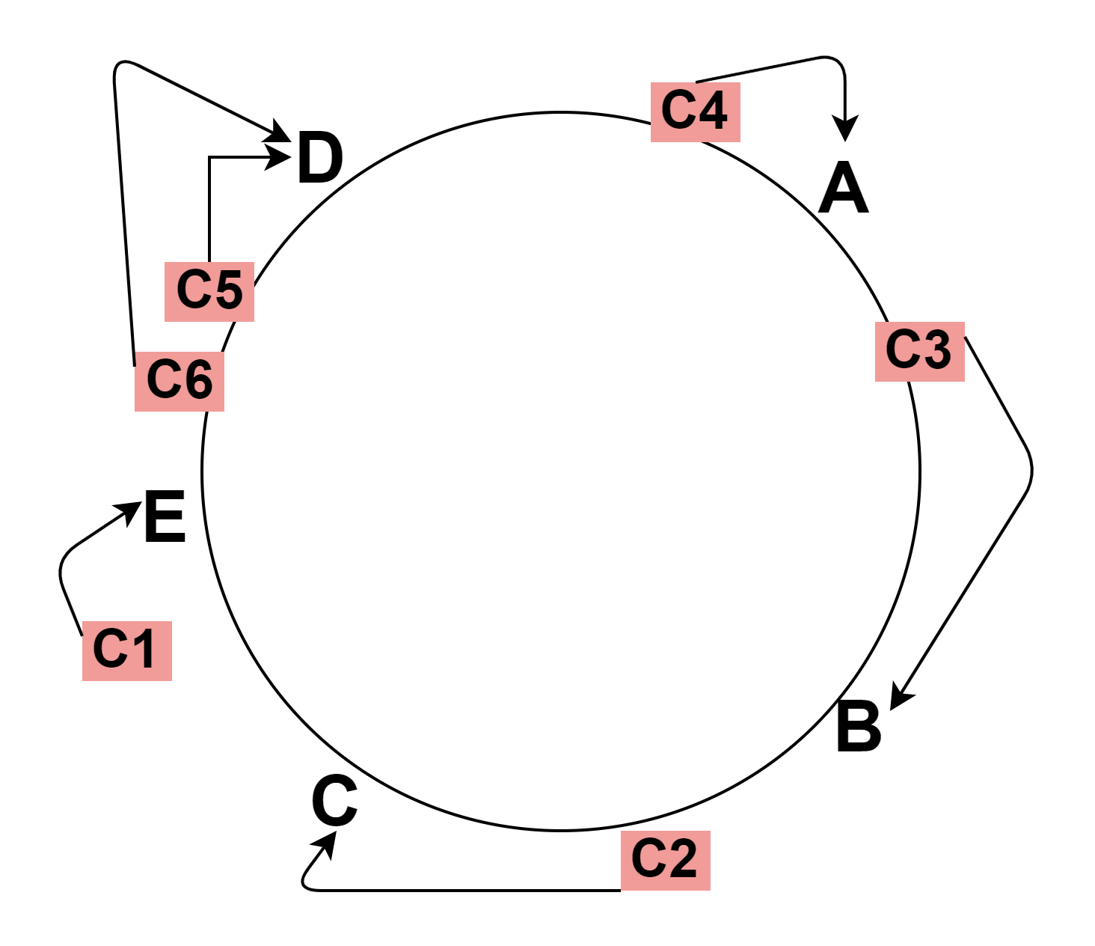
Routing when Server Added

Slide 11
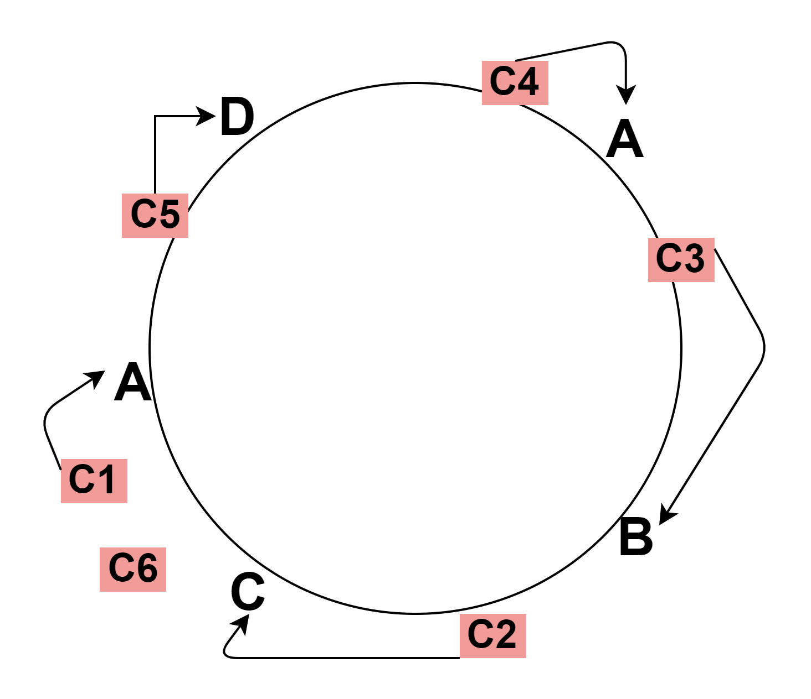
Routing when we have a Power Full Server

