Slide 1
Hashing

Slide 2
Hashing
Hashing is an action that you can perform to transform an arbitrary piece of data into a fixed size value, typically an integer value.
In the context of systems design interview, that arbitrary piece of data can be an IP address, it can be a username, it can be an HTTP request, anything that can be hashed or transformed into an integer value.

Slide 3
Hashing
Few hashing function and algorithm used in Industry
MD5 hashing
SHA-256 hashing algorithm,
Bcrypt hashing function

Slide 4
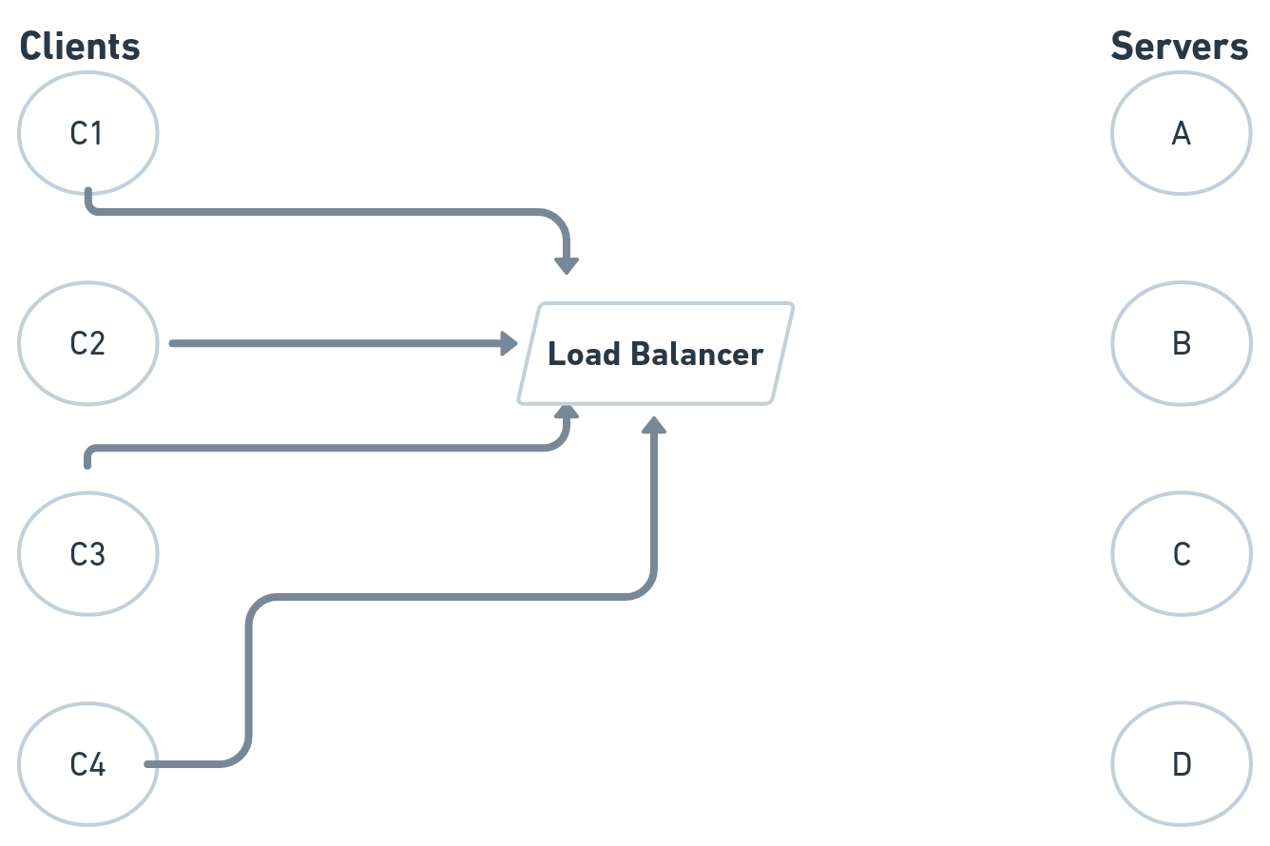
A Simple System with Load Balancer

Slide 5
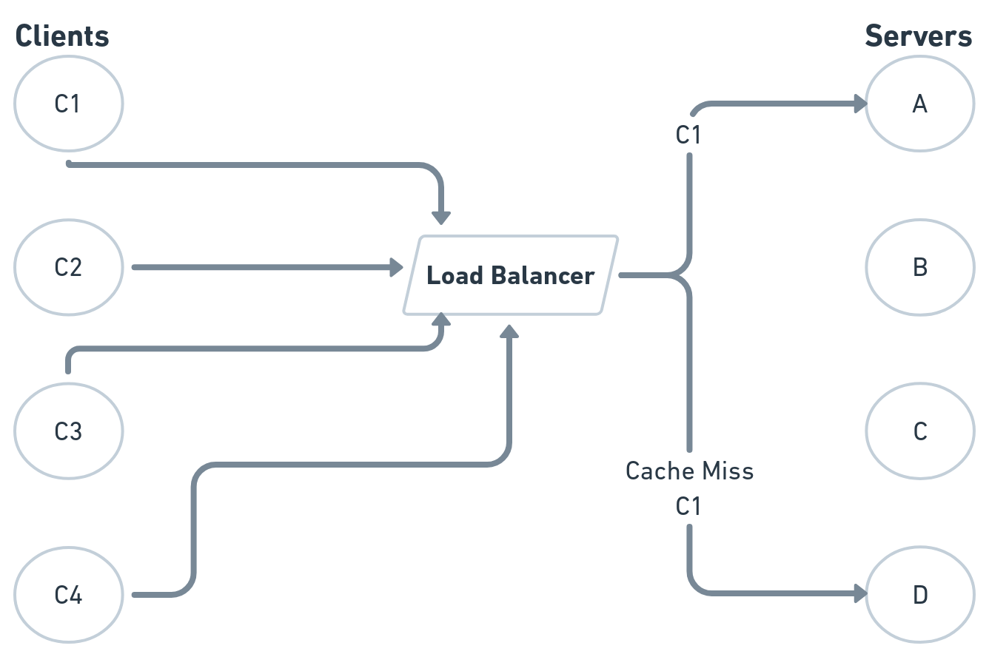

Slide 6
Simple Hashing Example or Why Consistent Hashing?
In Hashing we can hash the requests that come in to the load balancer.
And then based on the hash we can send the requests according to the position of the servers.
So let's walk through this example and for the sake of simplicity what we're going to do here is we're just going to hash the names of our clients.

Slide 7
Our goal is to get every client to have all of its requests rerouted to the same server.
We are going to hash the client's names themselves that is C1, C2, C3, C4.
Let's assume that we've got a hashing function that's been given to us and that when we pass C1, C2, C3, C4 through that hashing function.

Slide 8
We get the following results. 11 for C1, we get 12 for C2, we get 13 for C3 and we get 14 for C4.
remember that a hashing function transforms your arbitrary pieces of data into some fixed size value, typically an integer value.
Right Now we will use really the simplest hashing strategy in the context of systems design interviews,
We will mod these hashes here by the number of servers that we have.
11%4 = 3, 12%4 = 0, 13%4 = 1, 14%4= 2

Slide 9
Now it means that we have the numbers corresponding to our four servers that these four clients should be associated with.
C1 -> D. C2 -> A , C3 -> B , C4 -> C
11%4 = 3. 12%4 = 0. 13%4 = 1, 14%4= 2

Slide 10
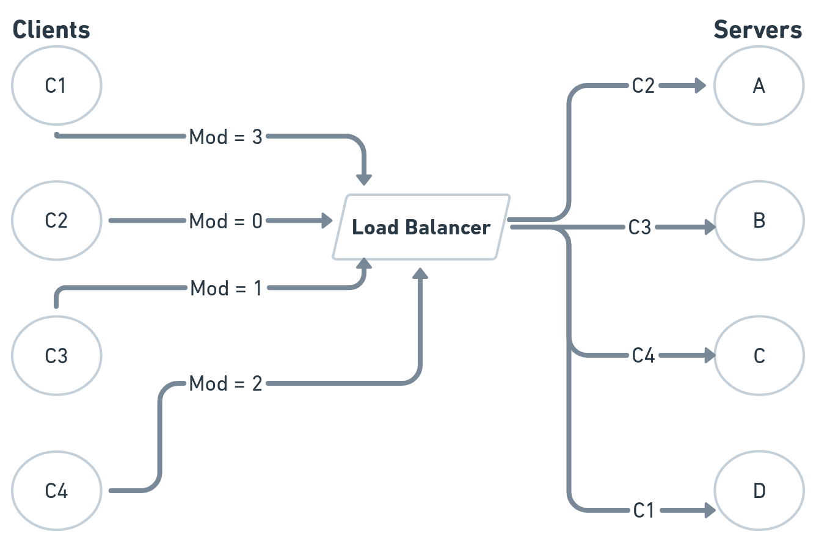

Slide 11
Problem with Simple Hashing
We could very easily have server A fail on us and completely die.
Similarly, our system could be experiencing a ton of traffic and we might need to add servers to our system.
So maybe our server A doesn't die, but maybe we need to add a new server to our system, server E to handle some new incoming traffic.

Slide 12
Problem with Simple Hashing
We can't continue to mod all of our hashes by four because we no longer have four servers. We have five servers.
If we keep modding our hashes for our clients by four, then all of our requests are always only going to go to servers A, B, C, and D. They're never going to go to E.
If we add a new server, we have to change some logic here. Namely, we have to mod our hashes by the new number of servers.

Slide 13
Problem with Simple Hashing
11%5 = 1 , 12%5 = 2, 13%5 =3, 14%5 =4
Previous values: 11%4 = 3. 12%4 = 0. 13%4 = 1, 14%4= 2
When we mod our hashes by five instead of four, we get completely different results for the servers that our clients are going to be rerouted to.

Slide 14
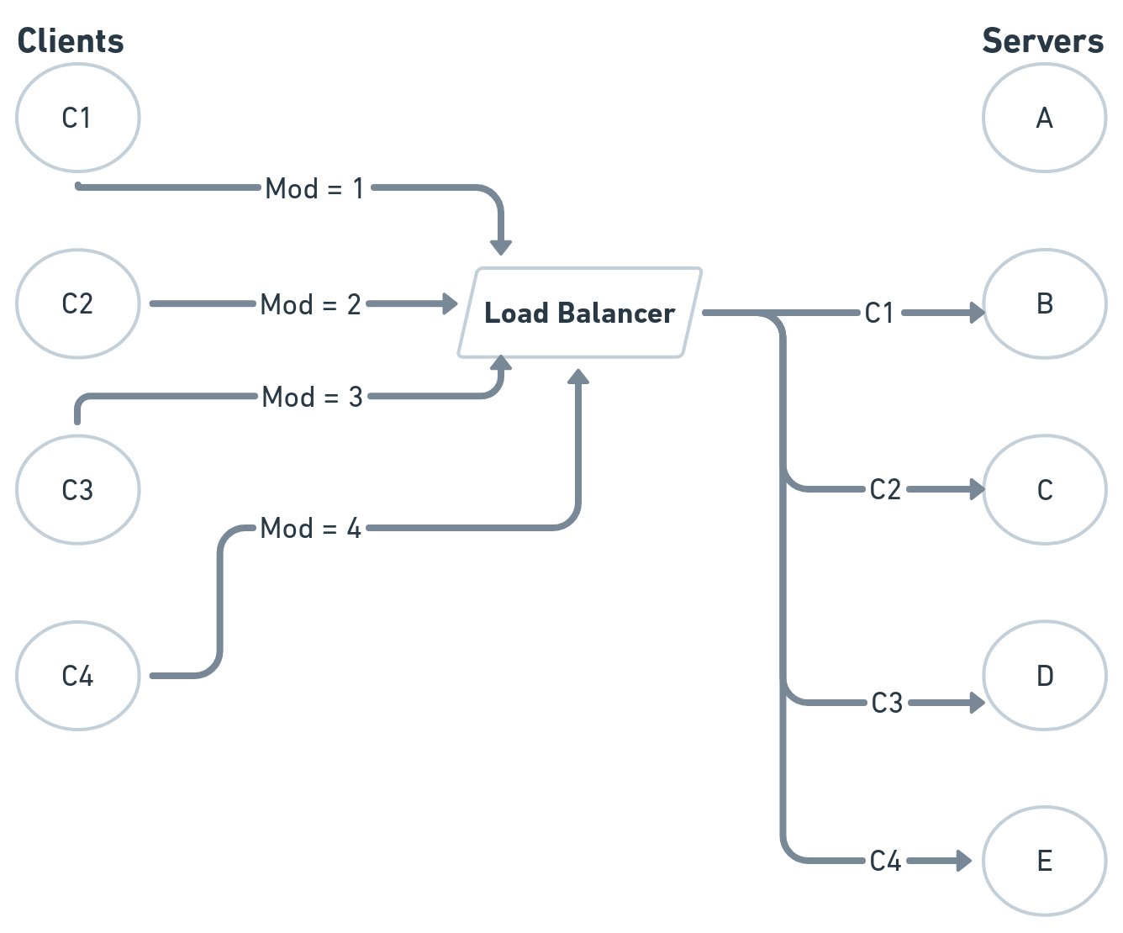

Slide 15
Problem with Simple Hashing
Our very simple hashing strategy of hashing our clients or requests IP addresses, and then modding the hashes by the number of servers to figure out what server to reroute stuff to just doesn't work.
All of your in-memory caches that you may have had in your system are no longer nearly as useful
Consistent Hashing to Rescue.

