Slide 1
Sharding

Slide 2
Sharding
Sharding is a database architecture where we separate table’s rows into multiple different tables, known as partitions.
Each partition has the same schema and columns, but also entirely different rows.
One part of the data would be stored in one database server, another part of the data would be stored in another database server, and so on.
Splitting up of main database into a bunch of little databases, which are called shards or data partitions.

Slide 3
Key Based Sharding
Key based sharding, also known as hash based sharding.
It involves using a value taken from newly written data - such as a customer’s ID number, a client application’s IP address, a ZIP code, etc
And plugging it into a hash function to determine which shard the data should go to

Slide 4
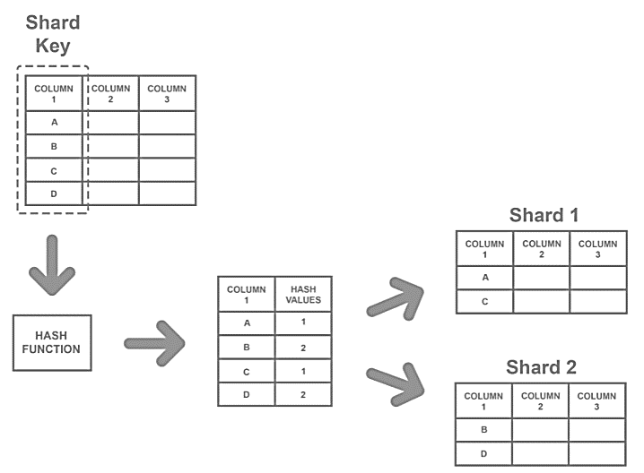

Slide 5
Key Based Sharding
To ensure that entries are placed in the correct shards and in a consistent manner, the values are passed through the hash function
The main appeal of this strategy is that it can be used to evenly distribute data so as to prevent hotspots.

Slide 6
Hotspots
The database hotspot problem arises when one shard accessed more as compared to all other shards
And hence, in this case, any benefits of sharding the database are cancelled out by the slowdowns and crashes.

Slide 7
Drawback of Key based Sharding
Its challenging to dynamically add or remove a database server.
Every time this happens, we need to re-shard the database which means we need to update the hash function and rebalance the data.
If your database server goes down, then consistent hashing will not help. We will probably need a replica of each shard.

Slide 8
Range Based Sharding
In range-based sharding, the shard is chosen on the basis of the range of a shard key.
Let’s say we have a recommender system that stores all the information about a user and recommends user movies based on their age.
Range-based sharding is easy to implement as we just need to check the range in which our current data falls and insert/read data from the shard corresponding to that shard.

Slide 9
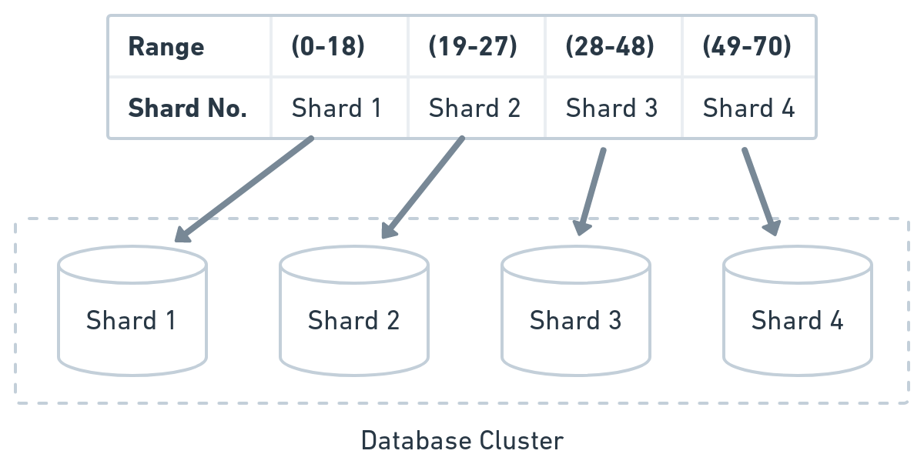

Slide 10
Drawback
The major drawback of this technique is that if our data is unevenly distributed, again it can lead to database hotspots.

Slide 11
Directory-Based Sharding
In directory-based sharding have a lookup table.
It stores the shard key to keep track of which shard store what entry.
To read or write data, first we need to consult the lookup table to find the shard number for the corresponding data using the shard-key and then visits a particular shard to perform the further operation.

Slide 12
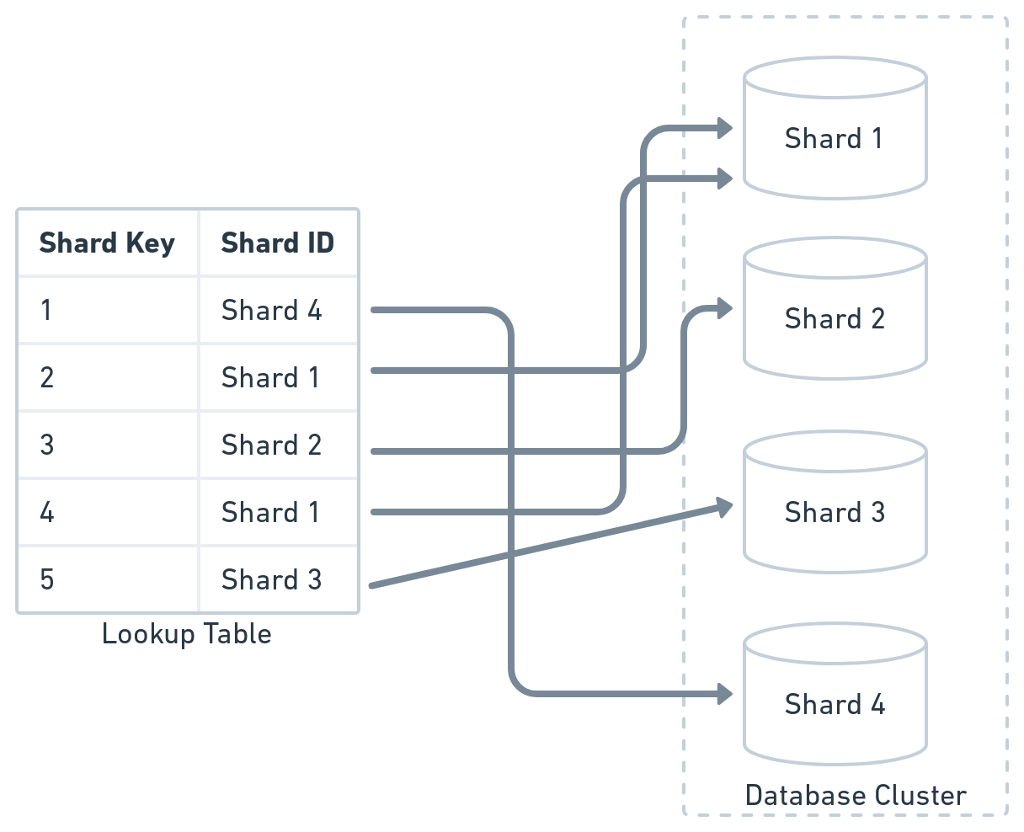

Slide 13
Drawback
The main issue with directory-based sharding is we need to consult a lookup table before every read and write query hence it can impact application performance.
Also, the lookup table is prone to a single point of failure.

Slide 14
Geo-Based sharding
In Geo-based sharding, the data is processed by a shard corresponding to the user region or location.
The obvious problem we will face using this strategy is if we have the majority of users from one pin code, city, or country, then we will have hotspots.

Slide 15
Where to put Sharding logic?
At server level
The end user makes a request for data to the server, and then the server has some sort of logic in here. And then finally, your server goes to that shard

Slide 16
Where to put Sharding logic?
At Reverse Proxy
Your server would make a request to read data from or to write data to the database, but this request would actually go to the reverse proxy.
Then reverse proxy have the job of actually figuring out what shard it should go to.

Slide 17
Should I Shard?
Shard when a data store is likely need to scale beyond the resources available to a single storage node.
To improve performance by reducing load.
The primary focus of sharding is to improve the performance and scalability of a system, but as a by-product it can also improve availability.

Slide 18
Should I Shard?
The data is divided into separate partitions. A failure in one partition doesn't necessarily prevent an application from accessing data held in other partitions
The volume of writes or reads to the database surpasses what a single node or its read replicas can handle, resulting in slowed response times or timeouts.
There is no one technique of sharding that will fit for all systems.

