Slide 1

Blood Supply Chain Management System Using Blockchain
Group Members: Umair Maratab (P18-0045) Moiz Ahmed (P18-0107) Muhammad Aamir (P18-0121) Supervisor: Dr. M. Taimoor Khan

Slide 2
Introduction
Blood is essential for human life
System should be trustworthy
Mismanagement leads to blood wastage
Blockchain brings blood Banks, Donors,Blood collection, Testing centers, Hospital and Patient at one platform

Slide 3
Literature Review

Slide 4
Reference No | Paper Name | Proposed Methodology | Results | Limitations
1 | Development of a Blood Bank Management System | Website developed using HTML,CSS, Javascript, MySql | Website shows donor, doctor and other details. | No security No Integrity No Traceability Centre point of failure
2 | Online Blood Bank Management System Using Android Application | Android Application to manage blood, admin manages everything. | Android Application registers users and show them the pages according to their designed policies. | Platform dependent No Integrity No Traceability Centre point of failure
3 | Implementation of a Blood Cold Chain System Using Blockchain Technology | Blood management using Hyperledger | Hyperledger based system which manages blood but it was not applied on an actual hospital. | Private No Traceability at donor side No Additional security checks No Expiry checking

Slide 5
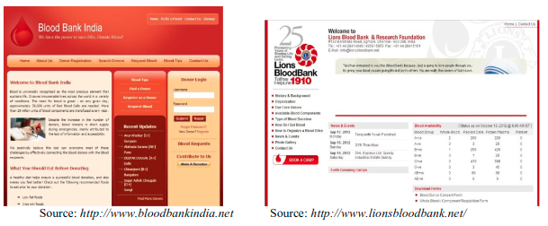
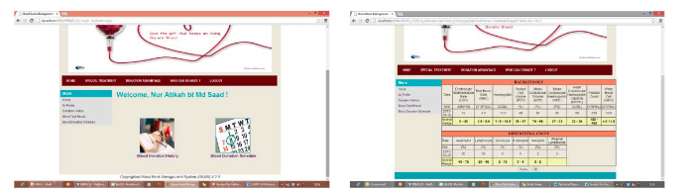
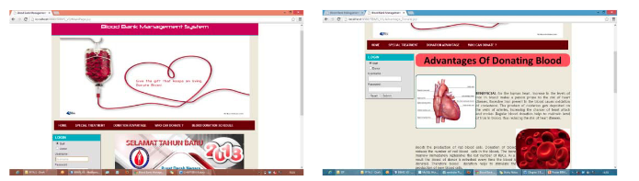

Slide 6
Reference No | Paper Name | Proposed Methodology | Results | Limitations
4 | A Novel Blockchain-Based Product Ownership Management System (POMS) for Anti-Counterfeits in the Post Supply Chain | blockchain-based trade supply management system that traces the origin and ownership of the product | Blockchain website | Public Ethereum
5 | Blockchain-Based Management of Blood Donation | Adding donors details and their Blood details to the Blockchain | Blockchain website | No Multiple Blood Banks Attached, Blood Could be collected by only Admin.
6 | Implementation of Blockchain-Based Blood Donation Framework | Blood management using Hyperledger | Blockchain website | Does not keep track of the identity of the donor and does not examine the components of the blood unit.

Slide 7
Our Solution
Ethereum
Smart Contract
Ganache
Truffle
Web3.js
Remix

Slide 8
Functionalities
Secure
Integrity
Expiry check
Traceability
Admin Privileges
Supply demand graph
Emergency service
Donor Informing (Blood usage)
Additional Security checks

Slide 9
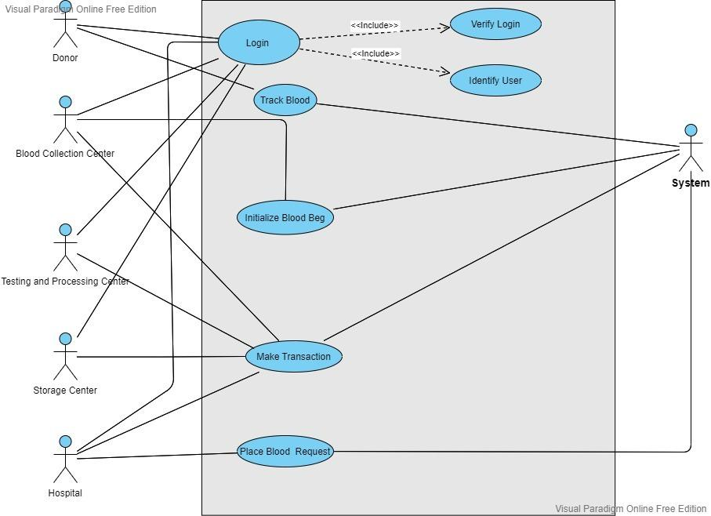
Use Case Diagram

Slide 10
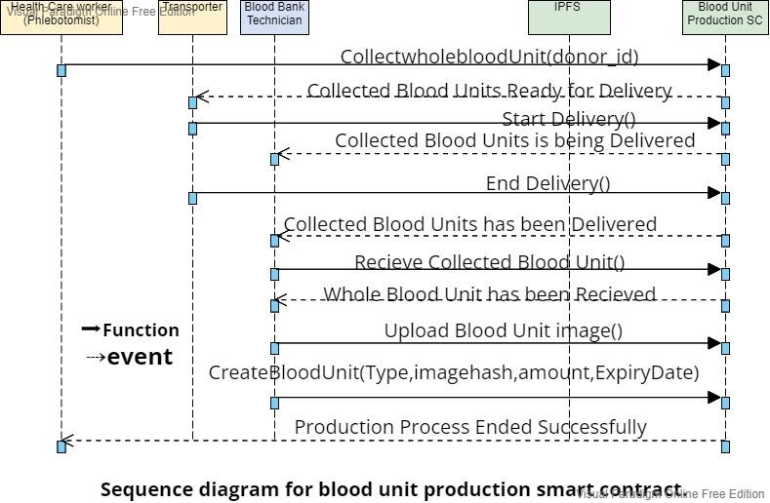

Slide 11
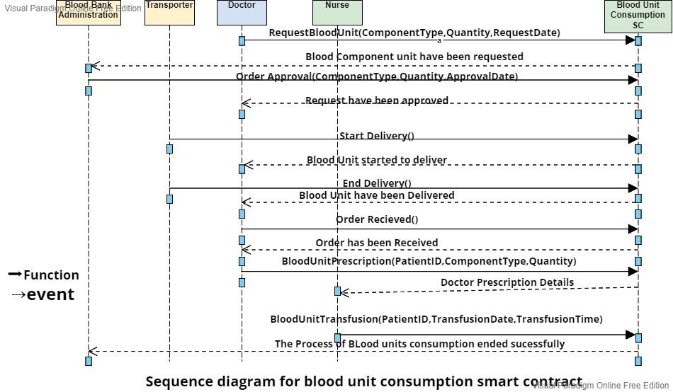

Slide 12
References
https://doi.org/10.1016/j.sbspro.2015.06.215. (https://www.sciencedirect.com/science/article/pii/S1877042815036940)
Mange, Manali and Shaikh Mohammad, Bilal N, Online Blood Bank Management System Using Android Application (April 8, 2020). Proceedings of the 3rd International Conference on Advances in Science & Technology (ICAST) 2020, Available at SSRN: https://ssrn.com/abstract=3568530 or http://dx.doi.org/10.2139/ssrn.3568530
Kim, S.; Kim, J.; Kim, D. Implementation of a Blood Cold Chain System Using Blockchain Technology. Appl. Sci. 2020, 10, 3330. https://doi.org/10.3390/app10093330
K. Toyoda, P. T. Mathiopoulos, I. Sasase and T. Ohtsuki, "A Novel Blockchain-Based Product Ownership Management System (POMS) for Anti-Counterfeits in the Post Supply Chain," in IEEE Access, vol. 5, pp. 17465-17477, 2017
D. Hawashin et al., "Blockchain-Based Management of Blood Donation," in IEEE Access, vol. 9, pp. 163016-163032, 2021, doi: 10.1109/ACCESS.2021.3133953.
S. Lakshminarayanan, P. N. Kumar, and N. M. Dhanya, Implementation of Blockchain-Based Blood Donation Framework (IFIP Advances in Information and Communication Technology), vol. 578. Cham, Switzerland: Springer, 2020, pp. 276–290, doi: 10.1007/978-3-030-63467-4_22.

