Slide 1

TOPIC : Parts Of Speech Tagging of Hindi Language. DOMAIN: Natural Language Processing
BY-AAMIR MIYAJIWALA
COLLEGE-PICT

Slide 2
INDEX
Problem Definition
Introduction
Motivation
Objective
Methodologies.
Software and Hardware Requirement
Implementation
Results and Evaluation.
Future Scope.

Slide 3
PROBLEM DEFINITION
To develop models for POS tagging of Hindi Language.

Slide 4
INTRODUCTION
In corpus linguistics, part-of-speech (POS-TAGGING), also called grammatical tagging is the process of marking up a word(token) in a text (corpus) as corresponding to a particular part of speech, based on both its definition and its context. A simplified form of this is taught to school-age children, in the identification of words as nouns, verbs, adjectives and adverbs etc.
POS tagging is a building block for a wide-range of NLP tasks. It is used for NER (Named Entity Recognition), sentiment analysis of reviews of a product and solving the problem of word sense disambiguation. Word sense disambiguation is the problem of determining which “sense” (meaning) of a word is activated by the use of the word in a particular context, a process which appears to be largely unconscious in people.

Slide 5
MOTIVATION
POS Tagging for English has been researched a lot in the past and almost a solved problem. It is used in open source nlp libraries like spaCy and nltk as an inbuilt function with an accuracy of around 97%.
However for Indian Languages like Hindi , Tamil , Malayalam which are widely used languages , POS taggers built are not that effective due to lack of datasets to train on and their different semantic structures.
A lot of textual data is available in these languages which needs to be pre processed and hence an effective pos tagger needs to be built.

Slide 6
Objective
To study different methodologies that are adopted for POS tagging.
Develop different models and compare their results
See which methodology works best.

Slide 7
Methodologies.
To study different methodologies that are adopted for POS tagging.
Rule Based Pos tagging: In this methodology we specify a set of rules which determine the tag associated with a word. For example:
If word is adjective then there is high probability that next word will be a noun.
If word is relative pronoun then there is high probability that next word will be noun.
If current word is verb then there is probability that previous word will be noun.
Statistics based POS tagger: This makes use of probability of transitions from one tag to another tag and also the probability of a word being tagged with a particular tag is calculated.
Most popular models used are HMM(Hidden Markov Model)
Conditional Random Fields model which slightly performs better than HMM as it uses linguistic features.
Neural Network based : Using supervised learning we develop neural networks which incorporate the use of word embeddings to convert words into vectors of particular dimensions to feed textual data into the model.

Slide 8
SOFTWARE AND HARDWARE REQUIREMENTS
Software Requirement:-
I. Anaconda Navigator 3.0.1
II.scikit-learn 0.20.3
III.Numpy 1.15.4
IV.Pandas 0.24.2
V.nltk
VI.tensorflow.
VII.streamlit
------------------------------------
Hardware Requirements:-
I. Core i5 machine

Slide 9
IMPLEMENTATION
Following models were implemented for performing Hindi POS tagging.
1.Hidden Markov Model- Here the transition probabilities from one tag to another tag is calculated and emission probability of each word having a particular tag is calculated. These are stored in a matrix form and using these matrices words are tagged with particular pos tags.
2.Conditional Random Fields Model-Here features are calculated for each word like:
The word itself
Word proceeding it and word preceding it
Whether the word is a number
Whether it is the first word of a sentence or whether it is the last word.
Suffix and prefix of each word.
3.LSTM Model. Here pos tagging is performed for each word individually.

Slide 10
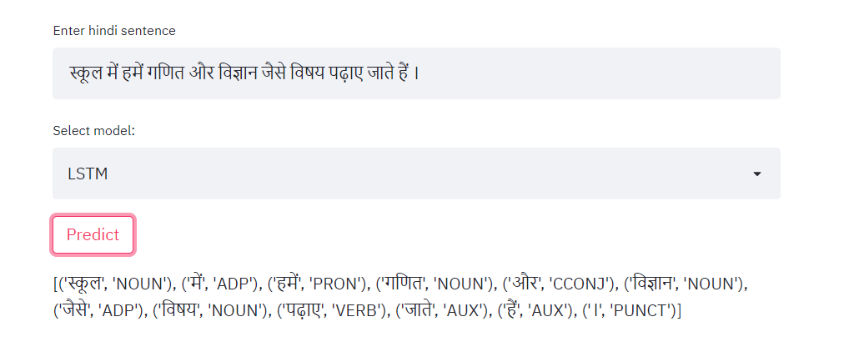
IMPLEMENTATION

Slide 11
Results and evaluation
Model | Train Accuracy | Test Accuracy | Validation Accuracy
HMM Model | 0.96 | 0.924 | 0.928
CRF Model | 0.983 | 0.958 | 0.95
LSTM Model | 0.90 | 0.887 | 0.886
We can see clearly that HMM and CRF models perform very well whereas LSTM performs moderately well .This corroborates the statement made before about the performance of models on Hindi POS tagging.

Slide 12
FUTURE SCOPE
Further experimentation can be done by using Government and Binding Theory and use of Fuzzy logic to build Hindi POS tagger.
Also developing a BiLSTM model could also help.

