Slide 1
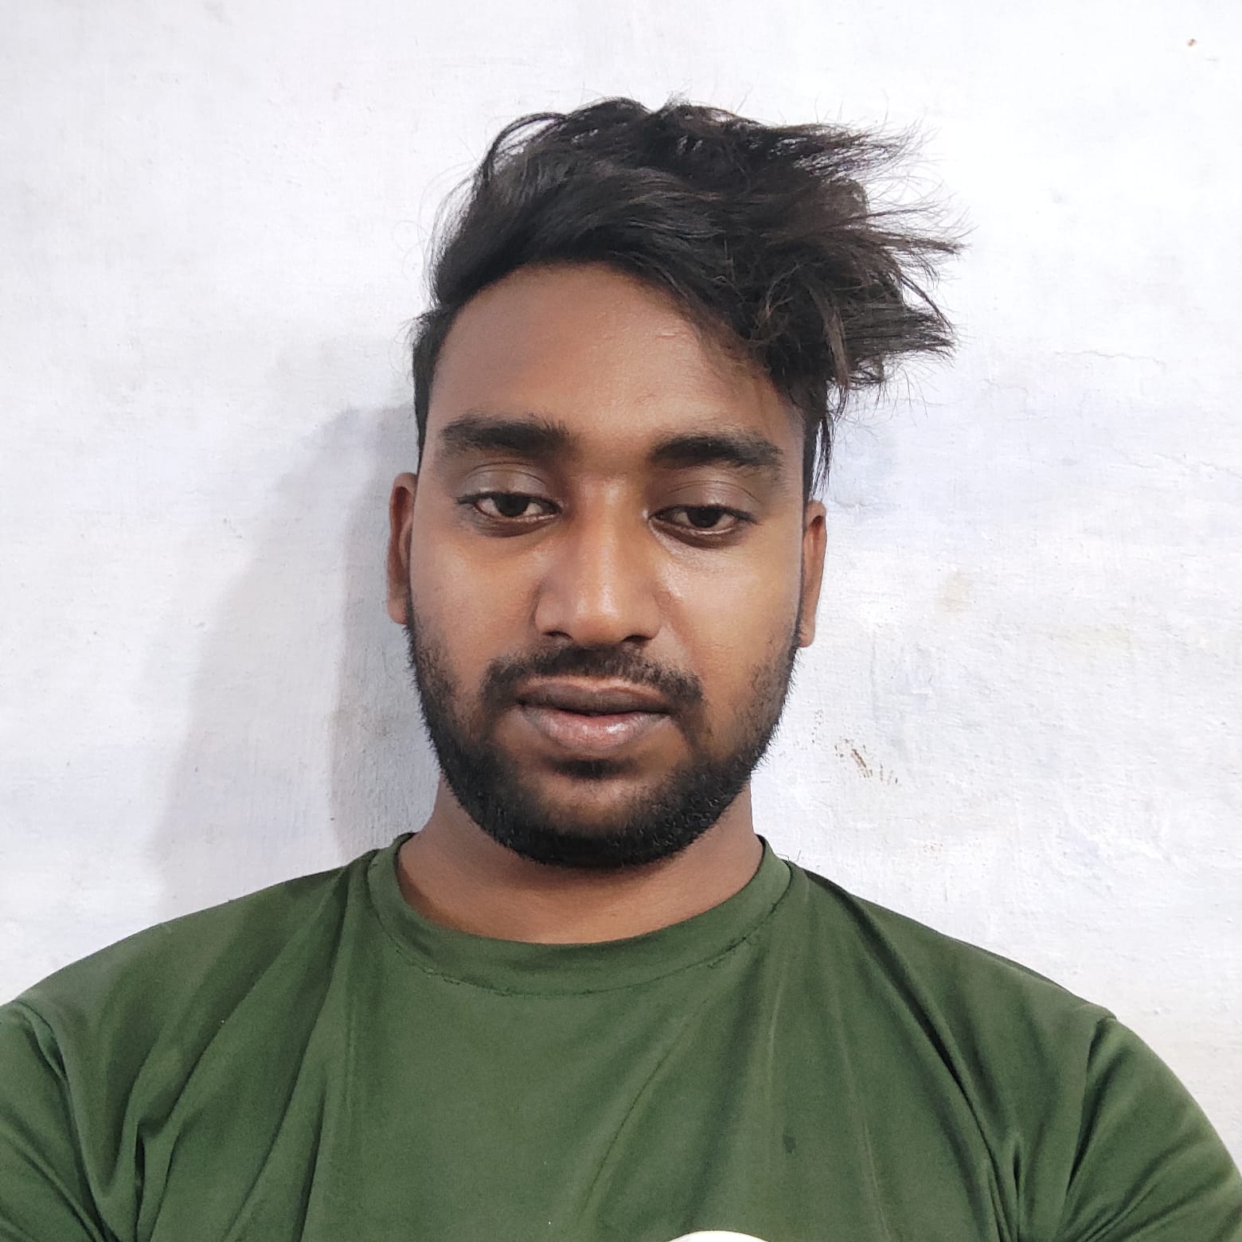


Aamir Suhail
B. Tech
YEAR:2017-2021
Analyst/Software Engineer
Skills
Mumbai
JAVA | Basics of java, Core Java,, Oops concepts
UI Framework-React | Fundamentals components ,Java Script, Working with states & props in React , Event Handling in React , Routing ,Life Cycle Method, Working with HTTP in React.
React | Components, Services, Modules, Routing, Forms & Validation, Testing using Jasmin & Karma
Database | MongoDB,
UI Tech | HTML 5 & CSS 3,JavaScript, Optimized UI Designed
Tools | Spring Tool ,Visual Studio 2019, Visual Studio code, Swagger, Postman, SSMS.
Add On skills | Communications, Team management. Peer learning
aamir.suhail@capgemini.com
+91 9760200606
A4
Proficient in JAVA and OOPs concepts.
Hands on experience in creating Web Application with Spring Boot and React.
Practical Understanding of Mongo Database
Hands on experience in developing web pages using HTML5, CSS3, Object Oriented Programming, JSON, XML. Good understanding of Document Object Model (DOM) and DOM Functions.
Practical understanding of rendering SPRINGMVC, REST API.
Proficient React developer with working knowledge on React.
Implemented Web API and React in case study and up skilling this knowledge continuously.
Flight Booking System
Working on end-to-end case study Online Flight Booking System along with authentication, Swagger and React used for user interface.
Java Full Stack Developer in Degreed Platform
Completed this course with optimal Knowledge of MVC ,Web API , RESTful services , Components.

