Slide 1
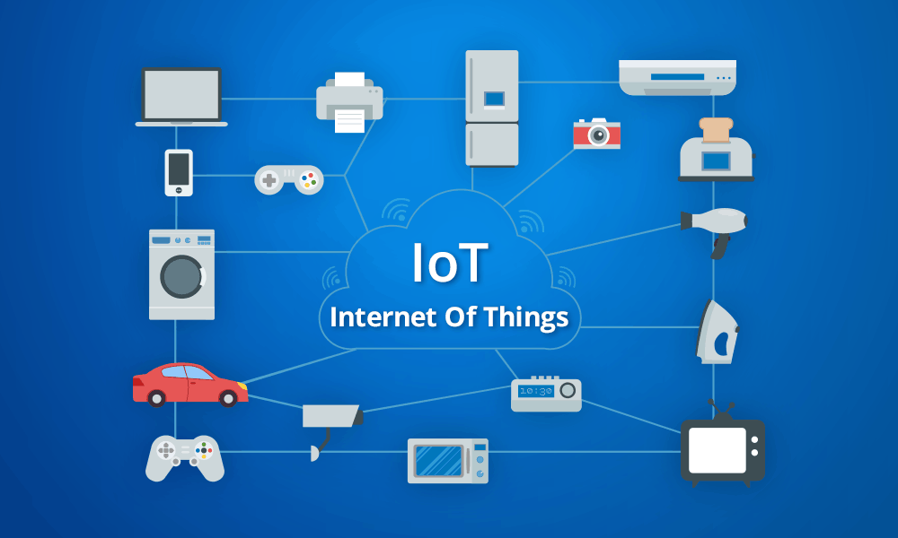
ROBOTIC HAND IOT(Internet of things)Mini Project

Slide 2
Introduction to IOT
IoT refers to an Internet Of Things (IoT). Connecting any device (including everything from cell phones,vehicles, home appliances and other wearable embedded with sensors and actuators) with Internet so that these objects can exchange data with each other on a network
Internet of things is advanced automation and analytics system which exploits networking ,sensing ,bigdata and artificial intelligence technology to deliver complete systems for a product or service .these system allows greater transparency ,control ,and performance when applied to any industry or system.
IoT systems have applications across industries through their unique
flexibility and ability to be suitable in any environment. They enhance data collection, automation, operations, and much more through smart devices and powerful enabling technology.

Slide 3
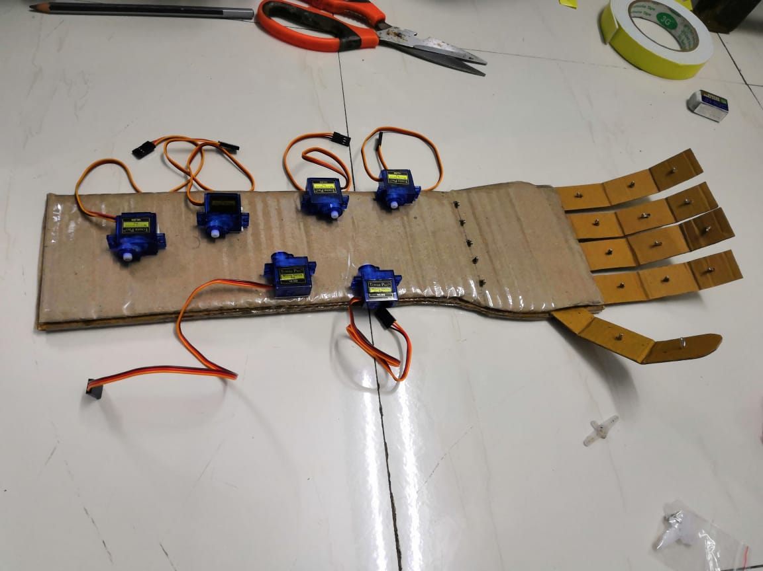
ROBOTIC HAND

Slide 4
LITERATURE SURVEY

Slide 5
Problem Statement
Presently as we all know Workers that works in industries have many risk of getting injured while doing welding,material handling,material removing, palleting, etc. So here we develop a tool which will work same as human hand being more efficient and convinient. Our Project consist of servo motors ,arduino uno and a bread board for connection. Servo motors is used for rotation and movment of the arm.

Slide 6
Objectives
Developing a tool which can serve as a human hand being more efficient and convinient
These robot arms help humans out three-fold: they take over tedious work from human workers, they save manufacturers money, and they improve production, which gets products to consumers faster.
These robot arms can also increase production, which saves manufacturers money and pushes out products to consumers. They have reduced cycle times and increased repeatability that can’t be matched by manual applications.

Slide 7
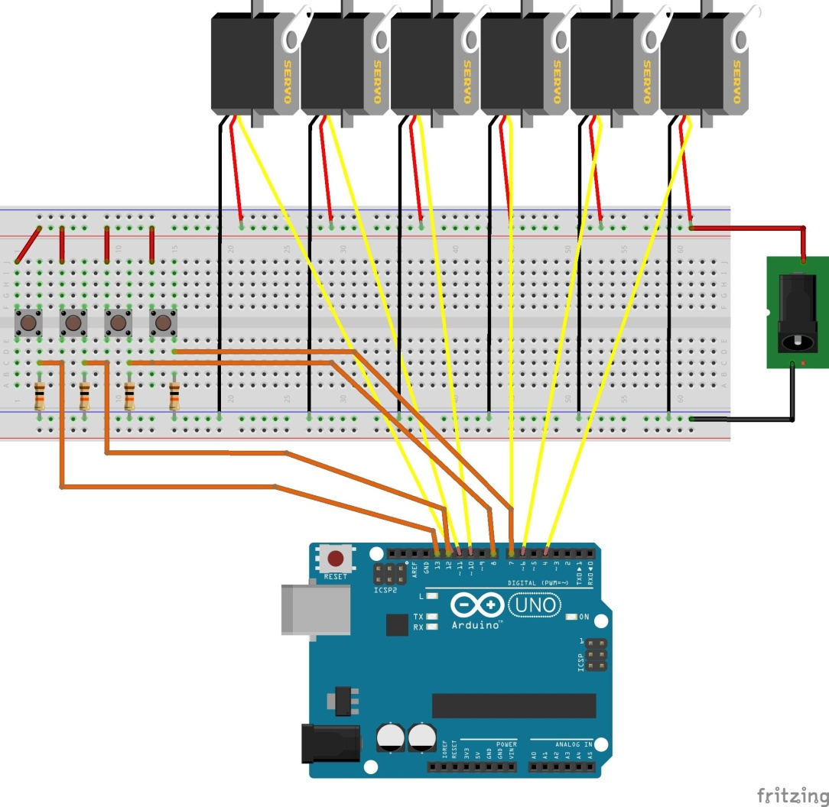
Circuit Diagram

Slide 8
Requirements
Hardware required
Arduino uno
Servo motors
Bread board
Batteries
DC jack
Software required
Arduino Ide

Slide 9
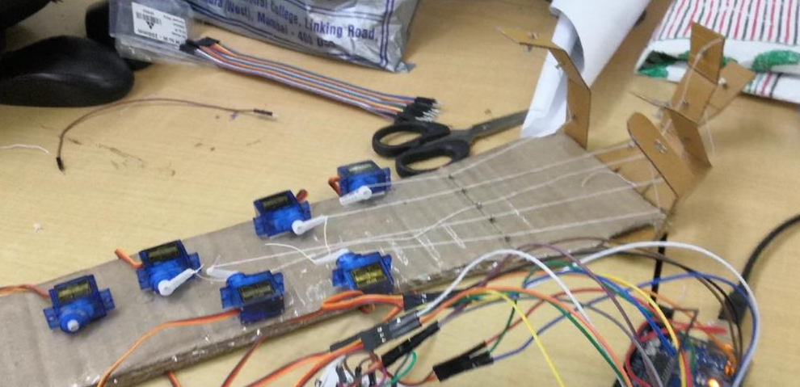
Working Model

Slide 10
Advantages
Can be use in industrial as well as medical fields
Effiecient and accurate.
Works in environemnt that are in hospitable to humans.
More production.

Slide 11
Future scope

Slide 12
Conclusion
This wooden Handcam can teach you servo control mechatronics arduino programming
It can be further improved to have more decision taking capabilities by employing varied types of sensors and thus could be used for different applications. It aims to solve the problems faced by the blind people in their daily life. The system also takes measures to ensure their safety.

Slide 13
Reference
Youtube link:
https://www.youtube.com/watch?v=t52edTD9RA0
[1] Jacobsen, S.C., Wood, J.E., Knutti D. and Biggers K.B., Dextrous hand: Work in progress, Int J
Robot Res., 321–350, 1984.
[2] Bekey, G.A., Liu H., Tomovic, R., et al. Knowledge-based control of grasping in robot hands
using heuristics from human motor skills, IEEE Trans Robot Autom. 9,709–722, 1993.

