Slide 1
IOT PROJECT ON
FIREFIGHTER TRUCK USING BLUETOOTH MODULE
GROUP MEMBERS-
FARMAN ANSARI - 6117005
AMIR CHAPPALWALA - 6117009
SIDRAH KHATRI - 6117023

Slide 2
PROBLEM STATEMENT :
Now a days, fire accidents are very common and sometimes it becomes very difficult for a fireman to save someone’s life.
It is not possible to appoint a person to continuously observe for accidental fire BUT A FIRE FIGHTER BASED MACHINE can do that. Therefore in such cases fire fighting TRUCK comes in picture .
THIS FIRE FIGHTER TRUCK can be used to extinguish fire remotely. TheY are mostly useful in industries AND VARIOUS OTHER SITES where probability of accidental fire is more.

Slide 3
CONCEPT :
-> The proposed vehicle is able to extinguisH THE FIRE CAUSED BY ACCIDENTS. It contains gear motors and motor driver to control the movement of robot. Relay circuit is used to control the pump and then it will communicate with Arduino UNO through Bluetooth.
-> The proposed VEHICLE is capable of SPRINKLING WATER. THIS IS towards the required Direction. At the time of moving towards the source of fire Communication between the mobile phone and robot will take place through Bluetooth.
-> When mobile gets connected to Bluetooth firstly it will implement Bluetooth communication between smartphones and microcontroller. THIS VEHICLE can be used easily in everyday life such as in homes, market, companies etc. The development of apps for Android in is easy and free of cost.

Slide 4
OBJECTIVES :
1. By inventing such a device, humans as well as property can be saved at higher rate with minimum damage caused by the fire. 2. As instrumentation engineers, our task was to design and build a prototype system that could extinguish a fire and also aims at minimizing the air pollution.
3. The possibilities of fire are at any remote area or in an industry such as in garments go down, cotton mills, and fuel storage tanks, electric leakages may result in terrible fire & CAUSE harm TO PRODUCTIONS AND PEOPLE. 4. ALSO IT REDUCES HUMAN EFFORT COMPARATIVELY.
5. ANOTHER ASPECT IS THAT IT IS NOT SENSITIVE TO WEATHER CONDITIONS.
6. THIS MODEL IS ECONOMICAL AND VERY RELIABLE.

Slide 5
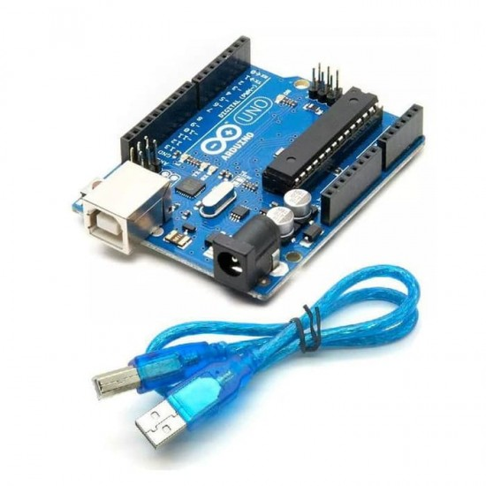
HARDWARE REQUIREMENTS :
Arduino uno:
The Arduino Uno R3 Compatible board is a micro controller board which is based on the ATmega328. Arduino Uno have 14 digital input or output pins, 6 analog inputs, a 16 MHz ceramic resonator, a USB connection, a power jack, an ICSP header and a reset button. It have everything needed to support the microcontroller, you need to simply connect it to a computer with a USB cable or power it with a AC-to-DC adapter or battery to get started.
Easy application programming using open source IDE. Easy to learn Microcontroller using Arduino boards.

Slide 6
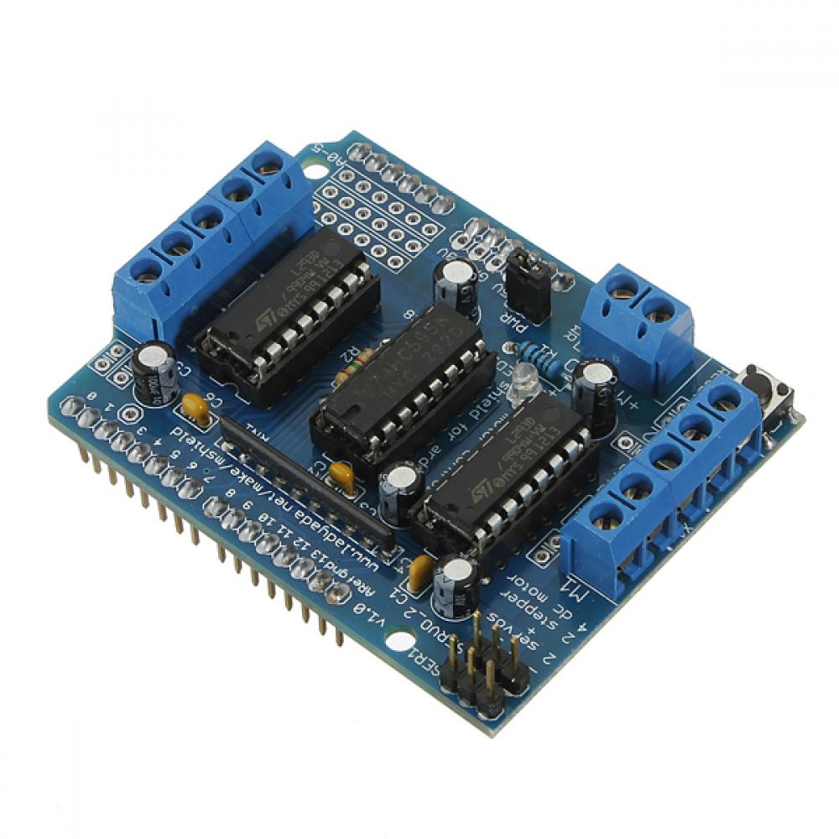
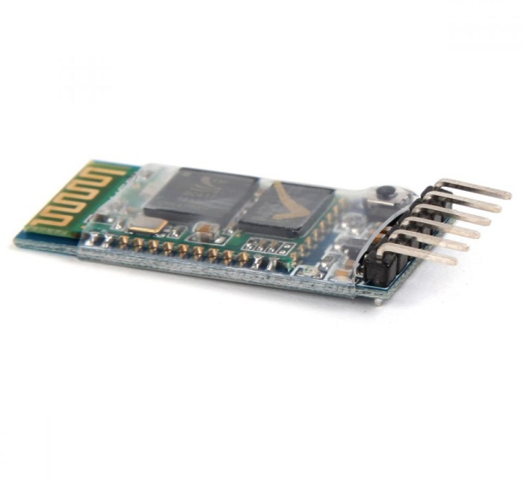
L293D MOTOR
(MOTOR SHEILD):
L293D use 16 pin DIP package, its internal integration is bipolar H - bridge circuit. This kind of bipolar pulse width method has many advantages, such as the current continuous, or micro current vibration when motor stops, which as a lubrication effect. It can eliminate the dead zone of static friction when positive and negative.
HC-05 Bluetooth:
HC-05 Bluetooth Module with Breakout Board. HC-05 module Bluetooth SPP(Serial Port Protocol) module, designed for wireless serial connection setup. It has EDR (Enhanced Data Rate) of 3Mbps Modulation with complete 2.4GHz radio transceiver and baseband.

Slide 7
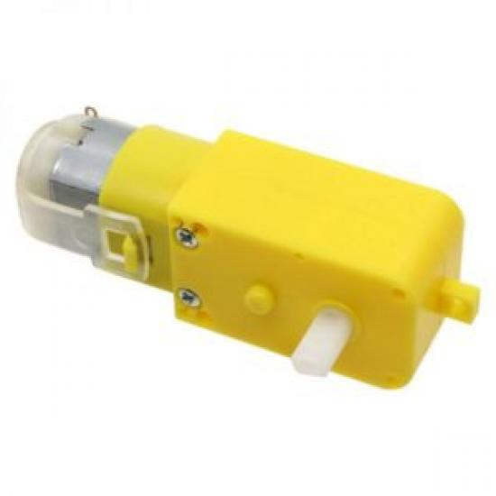
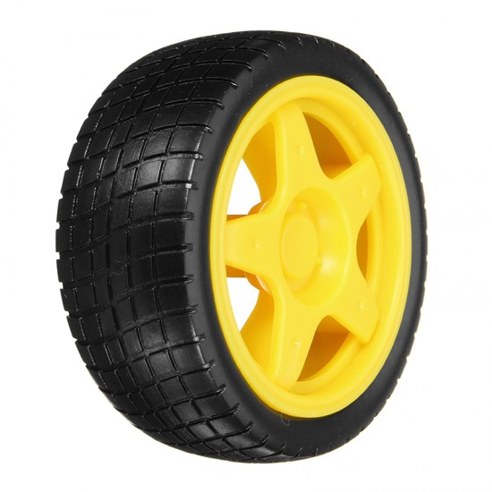
DC 3-6v BO Gear Motor For Arduino Smart Car
Smart Robot Car Tyres Wheels For Arduino BO Gear Motor Chassis

Slide 8

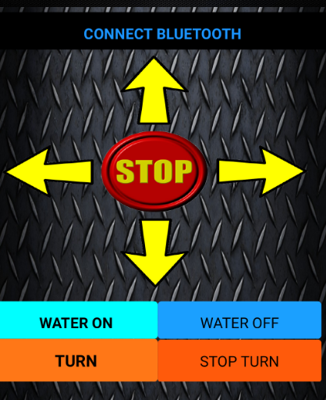

SOFTWARE REQUIREMENTS :
The open-source Arduino Software (IDE) makes it easy to write code and upload it to the board. It runs on Windows, Mac OS X, and Linux. It is written in Java and based on processing and can be used with any Arduino board.
About the application to be used-

Slide 9
CONCLUSION :
In many places such as schools, colleges, industries, production sites and feul storage sites our proposed project will be helpful.
This model aims to develop an Arduino controlled fire fighter truck that can be used to extinguish fires through remote handling.
By this we can avoid fire accidents and also prevent manual intervention of fire extinguishers and minimize the hazards caused.

Slide 10
REFERENCES :
Selection and Dimensioning of High-Voltage Insulators Intended for Use in Polluted Conditions – Part 1: Definitions, Information and General Principles, IEC/TS 60815-1, 2008. IEEE Standard for High-Voltage Testing Techniques, IEEE Std 2013. S. Zhao, X. Jiang, Z. Zhang, J. Hu and L. Shu,” Flashover Voltage Prediction of Composite Insulators Based on the Characteristics of LeaNage Current,” IEEE Trans. Power Delivery, Vol. 28, No. 3, pp. 1699-1708, 2013.S. VenNataraman and R. S. Gorur,” Prediction of Flashover Voltage of Non-ceramic Insulators under Contaminated Conditions,” Power, Dielectric and Energy.
www.howtomechatronics.com
www. youtube.com
www.slideshares.com.

