Slide 1
Company Name : MindScript Problem Statement : Billing & Certificate System Leader Name : Mohammed Tauseef Ansari College Name : M.H. Saboo Siddik College of Engineering
IDEA/SOLUTION :-
Education system forms the backbone of every nation. And hence it is important to provide a strong educational digital platform to the upcoming generation. Some of the problem faced by manual Management system are managing students record ,courses , payment issue, placement etc. The maintenance of records may take several amount of time and effort.
Our Solution is to develop a Web App which allow Admin, Staff members and Students to interact with application through an online environment
WORKING :-
The web based software is able to enroll students for their different courses and to maintain the database of students as well as staff.
Admin Role:
Admin can view all the students details which is enrolled by the Staff. admin can view the payment details such as balanced ,installments which are done by the students .the new courses added and viewed by the admin . Administrator is responsible for managing Staff records such as Adding/ Updating/ Deleting in the system. Admin has all the records of the placements done .
Staff Role:
Staff can manage students records i.e. Add ,update or delete a student records and enroll students for the course . Staff can confirm the enrollment of the courses and also see the balanced payment of the student and if the installment is pending staff can messaged to student .After course completion , certificates will be provided by the Staff to the students .the staff will place their students into good companies on the basis of certificates.
Student Role:
Student can view their profile and download the certificate if the course is completed else student has to reappear for the course.
Our Responsive System has some extra features:
Our system can send birthday wish to the student via email
Send payment receipt and certificate details to students via email
Certificates will be automatically generated when the course is completed

Slide 2
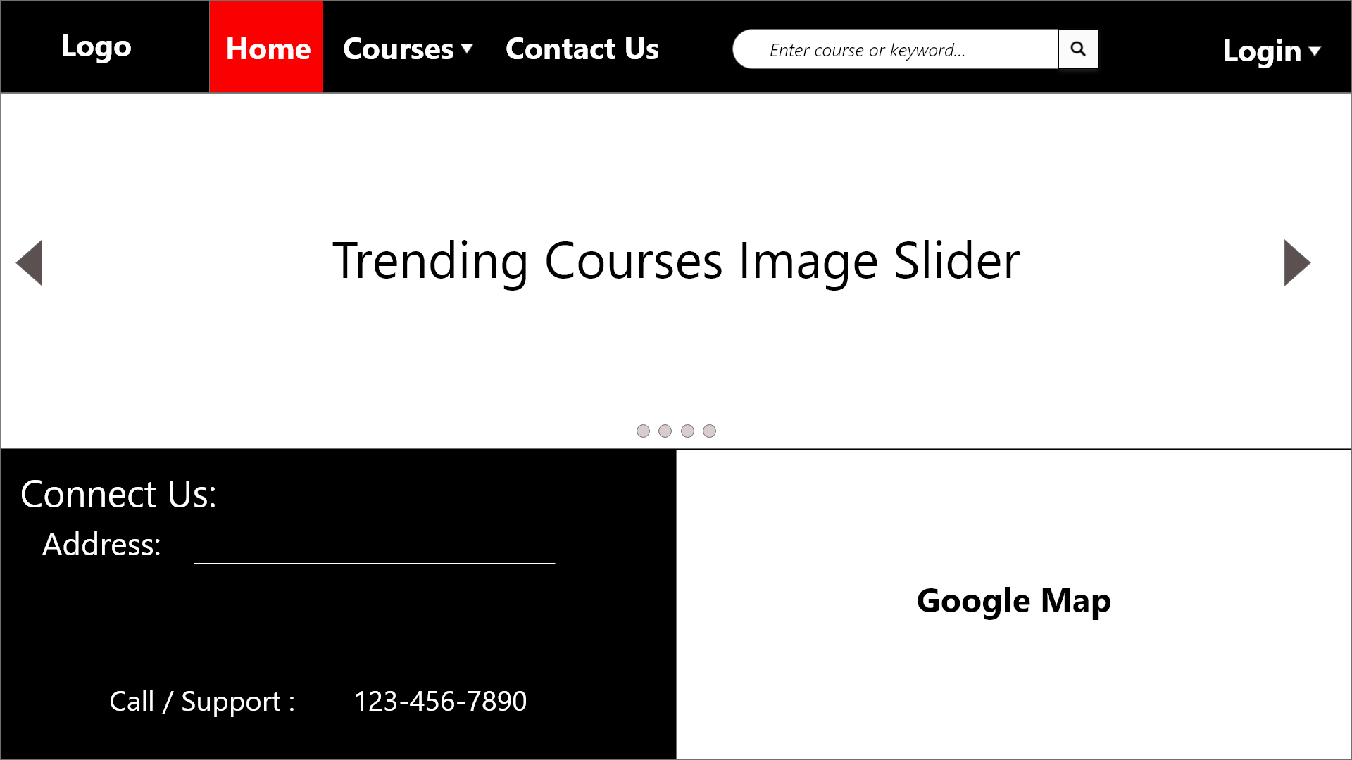
PROTOTYPE
1
Home Page
Website homepage display on start
2
Login
Go to Login Form

Slide 3
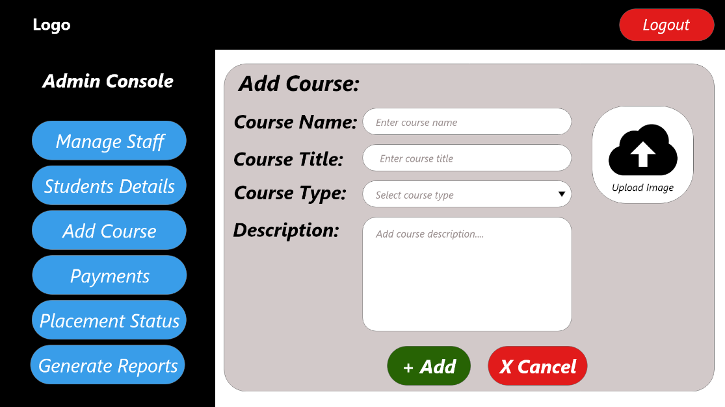
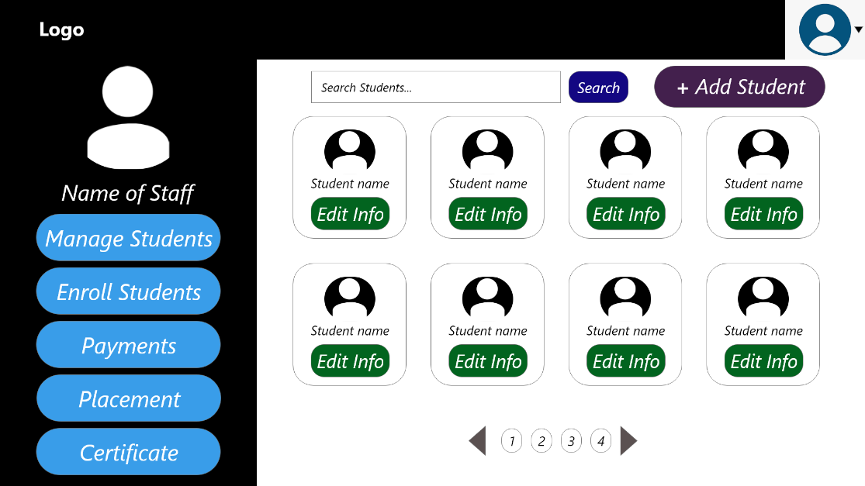
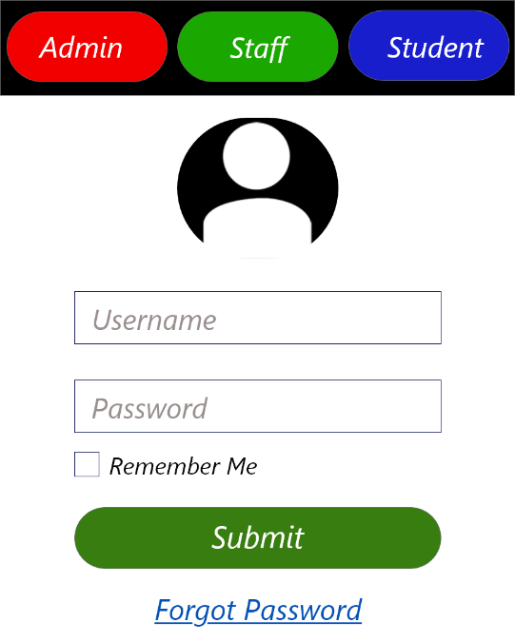
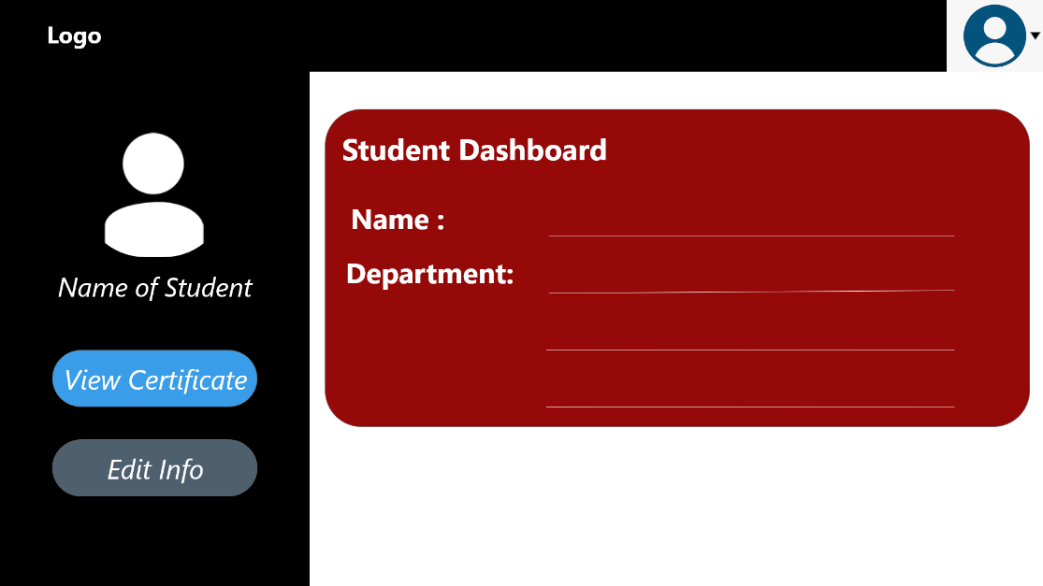
Staff Login
Go to Staff Console to manage students and generate certificates
4
Admin Login
Go to Admin Console to manage staff and payment options
5
Student Login
Go to Student page and view or download certificates
3

Slide 4
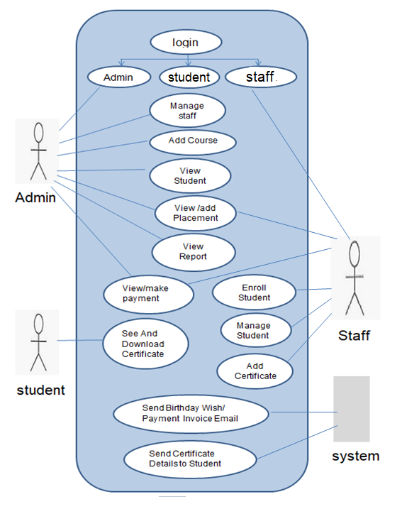
Use Case

Slide 5
Technology Stack
Platform : Web App (Website)
Category : Software
Technology : PHP, MySQL, HTML5, jQuery & AJAX
Designing : CSS3 & Adobe XD
Responsive : Bootstrap 4
Scripting : JavaScript(JS)

