Slide 1
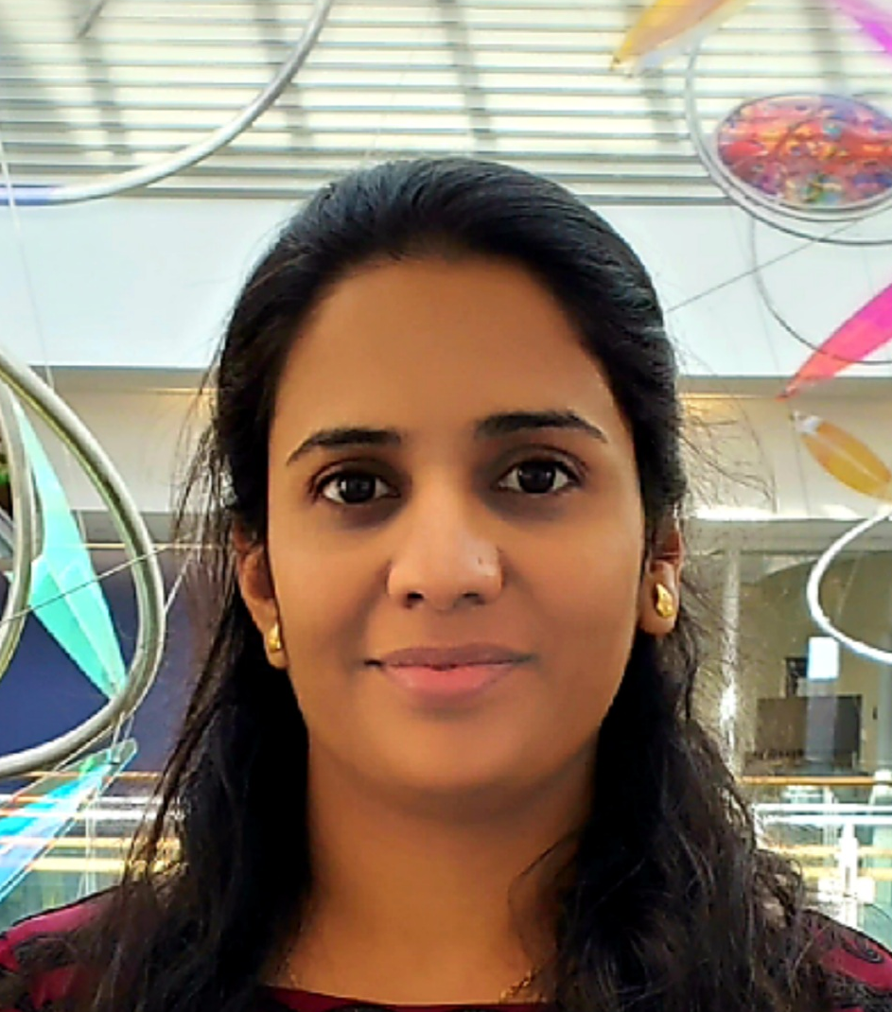
Shaila Kadam (Chair)
My research focuses on soybean seed composition traits mainly protein content.
For
Harpreet Kaur
Hua Yang
Sanzida Rahman
Amelia Griffith
Dongho Lee

