Slide 1
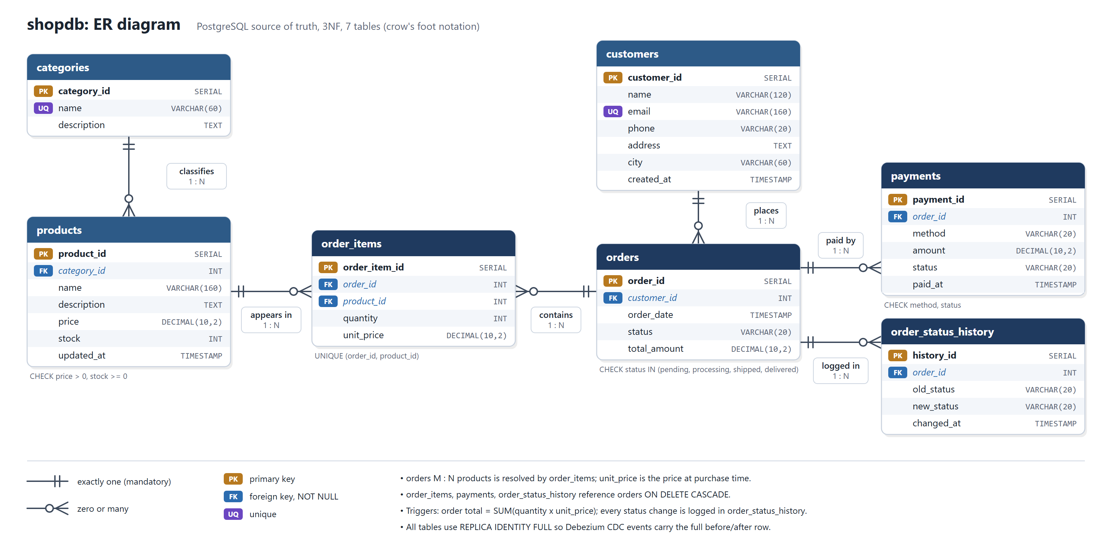
ER Diagram
Notes:
Replaces the Review 1 ER slide. Seven tables in 3NF. The old slide said products 1:N orders; with order_items, orders and products are many-to-many, resolved by order_items, which also stores the price at purchase time. Crow's foot: two bars = exactly one, circle + crow's foot = zero or many. All foreign keys are NOT NULL; order_items, payments and order_status_history cascade on delete.

Slide 2
Relational Schema
Table | Primary key | Foreign keys | Key attributes and constraints
categories | category_id | – | name UNIQUE, description
customers | customer_id | – | name, email UNIQUE + CHECK, phone, address, city, created_at
products | product_id | category_id → categories | price DECIMAL(10,2) CHECK > 0, stock CHECK ≥ 0, updated_at
orders | order_id | customer_id → customers | order_date, status CHECK IN (4 values), total_amount CHECK ≥ 0
order_items | order_item_id | order_id → orders (CASCADE), product_id → products | quantity CHECK > 0, unit_price, UNIQUE (order_id, product_id)
payments | payment_id | order_id → orders (CASCADE) | method CHECK, amount, status CHECK, paid_at
order_status_history | history_id | order_id → orders (CASCADE) | old_status, new_status, changed_at (written by trigger)
Triggers: order total = Σ quantity × unit_price · every status change logged · products.updated_at. CDC: wal_level = logical, REPLICA IDENTITY FULL on all 7 tables.
Notes:
Replaces the Review 1 relational schema slide, which had its columns shifted. Every money column is DECIMAL(10,2), status values are enforced by CHECK, and three triggers keep derived data correct inside the same transaction.

Slide 3
Architecture
WRITE PATH
CHANGE DATA CAPTURE
READ PATH
Write API
Order System · Flask
PostgreSQL
7 tables · source of truth
Debezium
reads the WAL
Kafka ×3
RF 3 · min ISR 2
Consumer
builds read views
Redis
read model
Kafka cluster: 3 brokers, every event on 3 replicas
Read API
customers
✓
Single write path
The app writes only to PostgreSQL, in one ACID transaction. It never writes the cache.
✓
Durable, ordered log
Debezium turns each committed row change into a Kafka event, keyed by primary key.
✓
Fast, eventually consistent reads
Redis holds pre-joined documents: one GET per order. Converges to PostgreSQL in ~120 ms.
Notes:
End to end: Write API -> PostgreSQL (one transaction) -> WAL -> Debezium -> Kafka (3 brokers) -> consumer -> Redis -> Read API. Prometheus scrapes the consumer and Grafana charts it. All of it runs with one command: docker compose up -d --build.

Slide 4
Results: Read Performance
7.9×
faster reads from Redis
0.16 ms vs 1.24 ms
4.8×
faster while writes run
Postgres reads slow 1.8× under write load
~120 ms
commit → visible in Redis
median, end to end
0
differences PostgreSQL vs Redis
consistency check, all orders
Notes:
Measured with benchmark/benchmark.py: 4,000 reads per path, 4 reader processes, full order document. Postgres runs a 6-table JOIN on the OLTP database; Redis is one GET of the document the consumer pre-built. Key point: with concurrent writes, Postgres reads nearly double (1.24 -> 2.20 ms). That is the heavy-read bottleneck from the problem statement, and Redis takes that read load off the database entirely.

Slide 5
Fault Tolerance: Losing a Kafka Broker
1
2
3
4
All 3 brokers up
10 orders placed, 10/10 in Redis
Stop broker 2
105 partitions under-replicated, 2 copies left
Keep writing
20 orders placed, 20/20 reached Redis
Restart broker 2
fully re-replicated in 15 s
30 / 30
orders survived a broker failure. Zero events lost.
✓
Replication factor 3
every topic is copied to all three brokers
✓
min.insync.replicas = 2, acks = all
a write counts only once 2 brokers have it
✓
At-least-once + idempotent
offsets commit after Redis; replays are harmless
Notes:
tests/test_failover.py does this live: it stops a broker with docker stop, keeps placing orders through the Write API, checks every one arrives in Redis, then restarts the broker and waits for full replication. Recovery takes 1 to 16 s depending on whether the stopped broker coordinated the consumer group; nothing is lost either way.

Slide 6
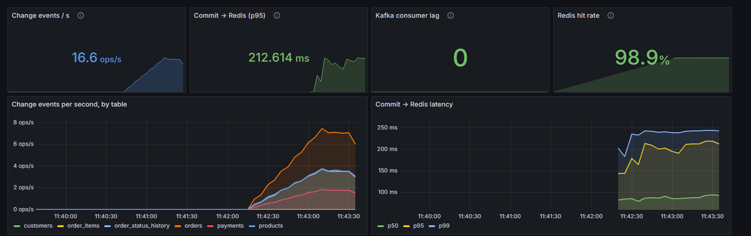
Monitoring: Prometheus + Grafana
✓
Kafka consumer lag
events in Kafka not yet in Redis; spikes drain back to 0
✓
Redis hit rate
98.9% of key lookups found a key
✓
Commit → Redis latency
p50 ≈ 90 ms, p95 ≈ 210 ms under simulated load
Notes:
The consumer exports Prometheus metrics on port 8000; Prometheus scrapes every 5 s; the Grafana dashboard is provisioned automatically at http://localhost:3000. These are exactly the metrics promised in the Review 1 future-work slide: Kafka lag, Redis hit rate and consumer latency.

Slide 7
Security and Kubernetes
Least-privilege database roles
Kubernetes, verified on a real cluster (k3s)
Role | Can | Cannot
app_writer | SELECT, INSERT, UPDATE, DELETE | DROP or ALTER tables
debezium | SELECT + REPLICATION | change any data
cdcuser | owns the schema (setup only) | –
✓
12 pods running
Postgres StatefulSet + PVC, Kafka, Connect, Redis, apps
✓
15 / 15 tests passed
the same end-to-end suite, run against the cluster
✓
NetworkPolicies enforced
read-api → Postgres blocked, frontend → Redis blocked
Tested: app_writer gets "must be owner of table" on DROP; debezium gets "permission denied" on UPDATE.
Passwords live in a Kubernetes Secret, not in pod specs.
Autoscaling works
HPA scaled the consumer 2 → 3 replicas under load
✓
Notes:
k8s/k3s-local.ps1 creates a real Kubernetes cluster inside Docker, loads the images, applies all the manifests and waits for the pods. Network policies were probed from inside the pods: allowed paths connect, blocked paths are refused.

Slide 8
Review 2: Work Completed
✓
Benchmarking
✓
Monitoring
✓
Security
Postgres JOIN vs Redis: 7.9× faster, 4.8× under write load
Prometheus + Grafana: Kafka lag, Redis hit rate, latency
least-privilege DB roles, Secrets, enforced NetworkPolicies
✓
Scaling
✓
Fault tolerance
✓
Testing
consumer group + HPA: 2 → 3 replicas, Kafka rebalances
3 Kafka brokers, RF 3: 30/30 orders survive a broker loss
15 end-to-end tests + failover test, on Docker and Kubernetes
Single source of truth + CDC + Redis read model = scalable, consistent and fault-tolerant
Notes:
Replaces the Review 1 'Future Work' slide: every Review 2 goal on it is now done and measured. Remaining limits: single-node Postgres and Redis, and the demo runs on one machine.

