Slide 1
Real-Time CDC Pipeline for an E-Commerce Database
PostgreSQL · Debezium · Kafka · Redis | 22AIE303 Database Management Systems
Team : AB05
Aamith Kishore T J – CB.SC.U4AIE24001 Naveen U – CB.SC.U4AIE24035
Ragav S – CB.SC.U4AIE24041 Padmesh Sivalingam – CB.SC.U4AIE24044

Slide 2
Problem Statement & Objectives
What problem the system solves, the existing difficulties, and why the system is needed
Problem and existing difficulties
Objectives
Heavy reads on the OLTP database. An online shop serves far more reads (order tracking, history, product pages) than writes, and showing one order needs a 6-table JOIN.
Reads and writes compete. With concurrent writers, PostgreSQL read latency almost doubles (1.24 → 2.20 ms per order).
Dual-write problem. The usual fix writes to the database and a cache separately. A crash between the two writes leaves the cache permanently wrong, and nothing repairs it.
Why the system is needed: the application must write to exactly one database, reads must not load it, and the fast copy must always converge to the truth.
Model the shop with an ER diagram and map it to a relational schema (CO2)
Normalize to 3NF / BCNF with functional-dependency proof (CO3)
Implement constraints, triggers and advanced SQL queries (CO1)
Guarantee ACID transactions and concurrency control for orders (CO4)
Use the right high-level databases: Redis read model fed through Kafka by Change Data Capture (CO5)
Build a Flask + HTML/JS web application that demonstrates every operation

Slide 3
Use Case Diagram
ShopDB order system: actors, use cases and «include» relationships
ShopDB Order System
Browse Products
Record Status History
«include»
Update Order Status
Delete Order & Restock
Place Order
«include»
Make Payment
«include»
Manage Products & Stock
Customer
Track Order
Update Stock
Manage Customers
Shop Admin
View Order History
View Sales Reports
Monitor Pipeline
Sync Read Model (Redis)
CDC Pipeline
(Debezium + Consumer)

Slide 4
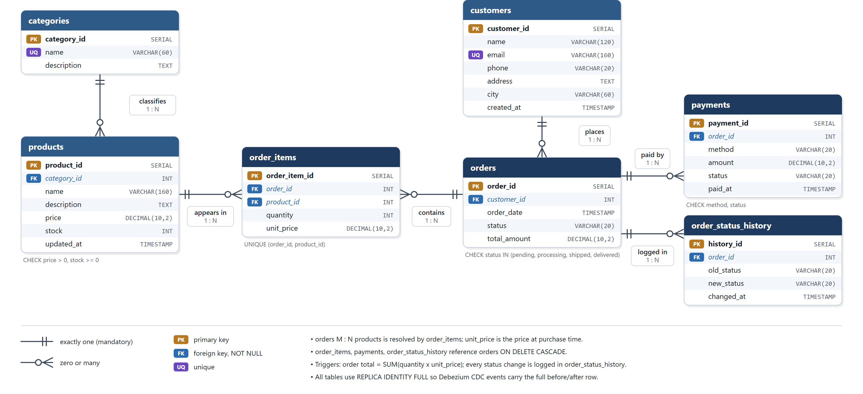
Database Design: ER Diagram
7 entities with attributes, keys and relationship cardinalities (crow's-foot notation)

Slide 5
Database Design: Relational Schema
Primary keys (bold), foreign keys and constraints of the 7 relations in shopdb
Relation | Attributes (PK in bold) | Foreign keys | Constraints
categories | category_id, name, description | - | name UNIQUE, NOT NULL
customers | customer_id, name, email, phone, address, city, created_at | - | email UNIQUE + CHECK (valid format)
products | product_id, category_id, name, description, price, stock, updated_at | category_id → categories | CHECK price > 0, stock ≥ 0
orders | order_id, customer_id, order_date, status, total_amount | customer_id → customers | CHECK status IN (pending, processing, shipped, delivered); total ≥ 0
order_items | order_item_id, order_id, product_id, quantity, unit_price | order_id → orders ON DELETE CASCADE; product_id → products | CHECK quantity > 0; UNIQUE (order_id, product_id)
payments | payment_id, order_id, method, amount, status, paid_at | order_id → orders ON DELETE CASCADE | CHECK method IN (card, upi, netbanking, cod); amount ≥ 0
order_status_history | history_id, order_id, old_status, new_status, changed_at | order_id → orders ON DELETE CASCADE | Written only by a trigger
Relationships: customers 1 : N orders · orders 1 : N order_items N : 1 products (orders M : N products) · categories 1 : N products · orders 1 : N payments · orders 1 : N order_status_history
Every FK column is NOT NULL; money uses DECIMAL(10,2); B-tree indexes on every FK and on orders.status.

Slide 6
Normalization: Functional Dependencies
Every determinant is a candidate key, so every relation is in BCNF (and therefore 3NF)
Relation | Functional dependencies | Candidate keys | NF
categories | category_id → name, description; name → category_id, description | {category_id}, {name} | BCNF
customers | customer_id → name, email, phone, address, city, created_at; email → customer_id, … | {customer_id}, {email} | BCNF
products | product_id → category_id, name, description, price, stock, updated_at | {product_id} | BCNF
orders | order_id → customer_id, order_date, status, total_amount | {order_id} | BCNF
order_items | order_item_id → order_id, product_id, quantity, unit_price; (order_id, product_id) → order_item_id, quantity, unit_price | {order_item_id}, {order_id, product_id} | BCNF
payments | payment_id → order_id, method, amount, status, paid_at | {payment_id} | BCNF
order_status_history | history_id → order_id, old_status, new_status, changed_at | {history_id} | BCNF
1NF: all values atomic; the repeating group of items is its own relation (order_items).
2NF: no partial dependency; quantity and unit_price need the whole key (order_id, product_id).
3NF / BCNF: no transitive dependency; customer and category details live only in their own tables.
unit_price is the price at purchase time, not a copy of products.price; total_amount is kept correct by a trigger in the same transaction.

Slide 7
Normalization: 1NF → 2NF → 3NF / BCNF
Decomposition from 1NF to BCNF, removing the dependencies that cause anomalies
1NF
2NF
3NF / BCNF
OrderLine(order_id, product_id, date, customer_id, customer_name, email, city, product_name, category, qty, unit_price, pay_method, status)
Orders(order_id, date, customer_id, customer_name, …, status) Products(product_id, name, category, …) OrderItems(order_id, product_id, qty, unit_price)
customers · categories · products · orders · order_items · payments · order_status_history
One row per item. Key = (order_id, product_id)
Removed partial dependencies: order_id → order data, product_id → product data
Removed transitive dependencies: order_id → customer_id → name, email, city; product_id → category_id → category
Anomalies removed. Update: a customer's email changes in one row only. Insert: a new product can exist before anyone orders it. Delete: deleting the last order of a product does not lose the product.

Slide 8
Advanced SQL: Joins and Aggregation
Queries run on the live database (1,200 orders); outputs below each query
Q1. Multi-table JOIN: lines of order #1 (5 tables)
Q2. GROUP BY + aggregates: revenue by category
SELECT o.order_id, c.name AS customer, p.name AS product,
cat.name AS category, oi.quantity, oi.unit_price,
oi.quantity * oi.unit_price AS line_total
FROM orders o
JOIN customers c ON c.customer_id = o.customer_id
JOIN order_items oi ON oi.order_id = o.order_id
JOIN products p ON p.product_id = oi.product_id
JOIN categories cat ON cat.category_id = p.category_id
WHERE o.order_id = 1;
SELECT cat.name AS category,
COUNT(DISTINCT oi.order_id) AS orders,
SUM(oi.quantity) AS units,
SUM(oi.quantity * oi.unit_price) AS revenue
FROM order_items oi
JOIN products p ON p.product_id = oi.product_id
JOIN categories cat ON cat.category_id = p.category_id
GROUP BY cat.name
ORDER BY revenue DESC;
customer | product | category | qty | unit_price | line_total
Lakshmi Rao | Wireless Earbuds | Electronics | 1 | 2499.00 | 2499.00
Lakshmi Rao | Water Bottle | Home | 2 | 599.00 | 1198.00
category | orders | units | revenue (₹)
Computers | 553 | 1,284 | 60,58,716
Electronics | 363 | 754 | 21,79,346
Home | 421 | 891 | 17,55,309
Fashion | 312 | 655 | 15,45,645
Sports | 278 | 552 | 14,04,948
Books | 423 | 927 | 10,00,256
The application's order view extends this into a 6-table query with json_agg sub-queries (items, payment, status history) in a single statement.

Slide 9
Choosing the Right Database for Each Job
Change Data Capture keeps a relational source of truth and a fast key-value read model in sync
Write API
PostgreSQL
Debezium (WAL)
Kafka ×3
Consumer
Redis
Read API
Write path → only PostgreSQL. Every committed change flows through the log into Redis. Read path → only Redis.
Database | Type | Used for | Why this database
PostgreSQL 15 | Relational (OLTP) | Source of truth: 7 normalized tables | ACID transactions, constraints, triggers, row locks, WAL for logical decoding
Apache Kafka | Distributed commit log | Stream of change events (one topic per table) | Durable and ordered per row; 3 brokers, replication factor 3, survives a broker failure
Redis 7 | In-memory key-value store | Read model: pre-joined order / customer / product documents | One GET per order: 0.21 ms vs 2.29 ms for the 6-table JOIN (11.1× faster)
Prometheus | Time-series database | Pipeline metrics every 5 s, shown in Grafana | Latency, events/s and lag over time
Eventual consistency: Redis is typically 150–250 ms behind PostgreSQL and always converges; the consumer is idempotent and commits Kafka offsets only after Redis is updated.

Slide 10
Work Completed & Output
What has been completed for the final review
Completed
15 / 15
end-to-end tests passed
ER model, relational schema and 3NF/BCNF design of 7 tables with seed data (200 customers, 1,200+ orders)
DDL with PK, FK, CHECK, UNIQUE, ON DELETE CASCADE, indexes, 3 triggers and least-privilege roles
Write API (Flask) with ACID transactions, row locking and parameterized queries
Change Data Capture: Debezium → 3-broker Kafka → consumer → Redis read model
Read API (Redis only) and web app: Shop, Orders, How it works
Advanced SQL queries, benchmark, consistency check and dual-write failure demo
15 automated end-to-end tests; Grafana monitoring; deployed with Docker on Microsoft Azure
11.1×
faster reads from Redis than the 6-table JOIN
≈ 245 ms
commit → Redis (p95)
30 / 30
orders survived a Kafka broker failure

Slide 11
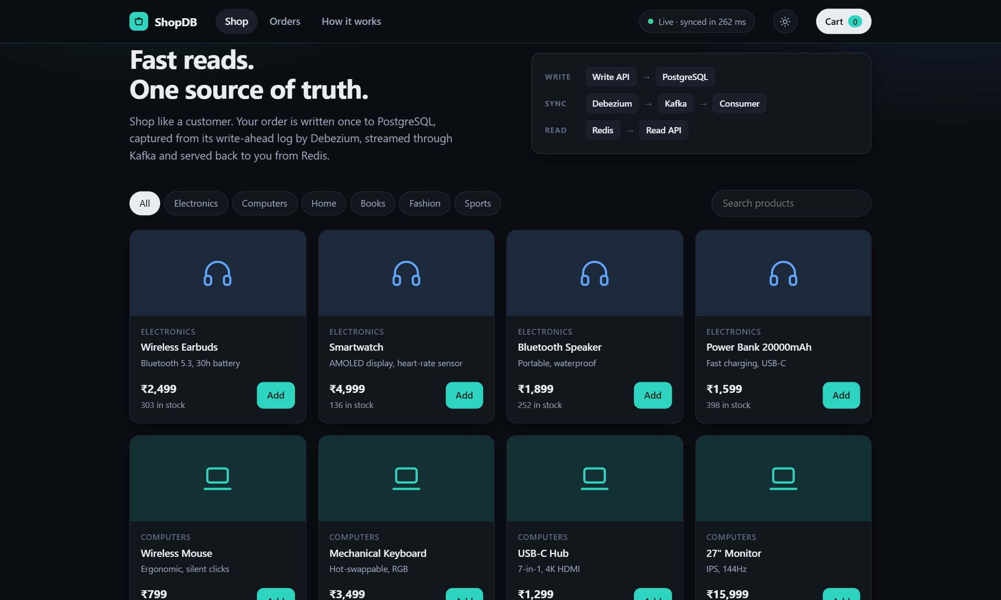
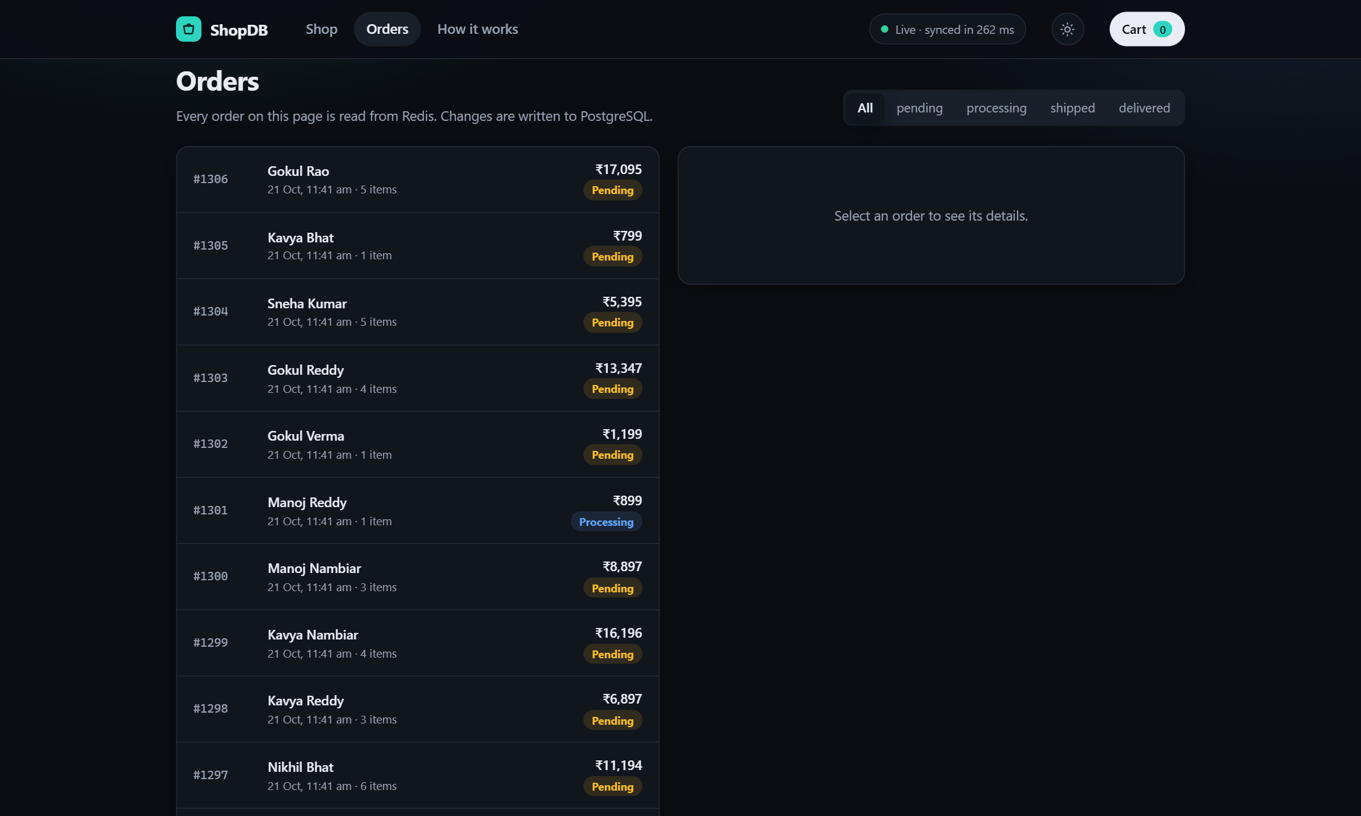
Output: Web Application
Every read below comes from Redis; every change was written to PostgreSQL only
Orders: list from a Redis sorted set; one GET returns a full order
Write path: Write API → PostgreSQL only
Read path: Read API → Redis only
Live: the header shows the commit → Redis delay (≈ 262 ms)
Shop: catalogue and stock read from Redis; orders written to PostgreSQL

Slide 12
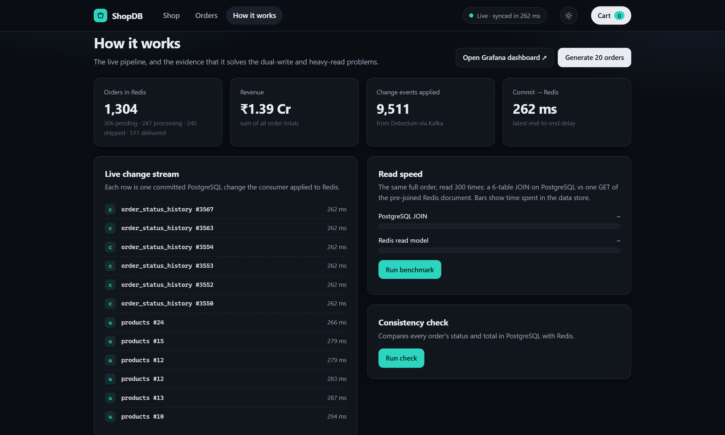
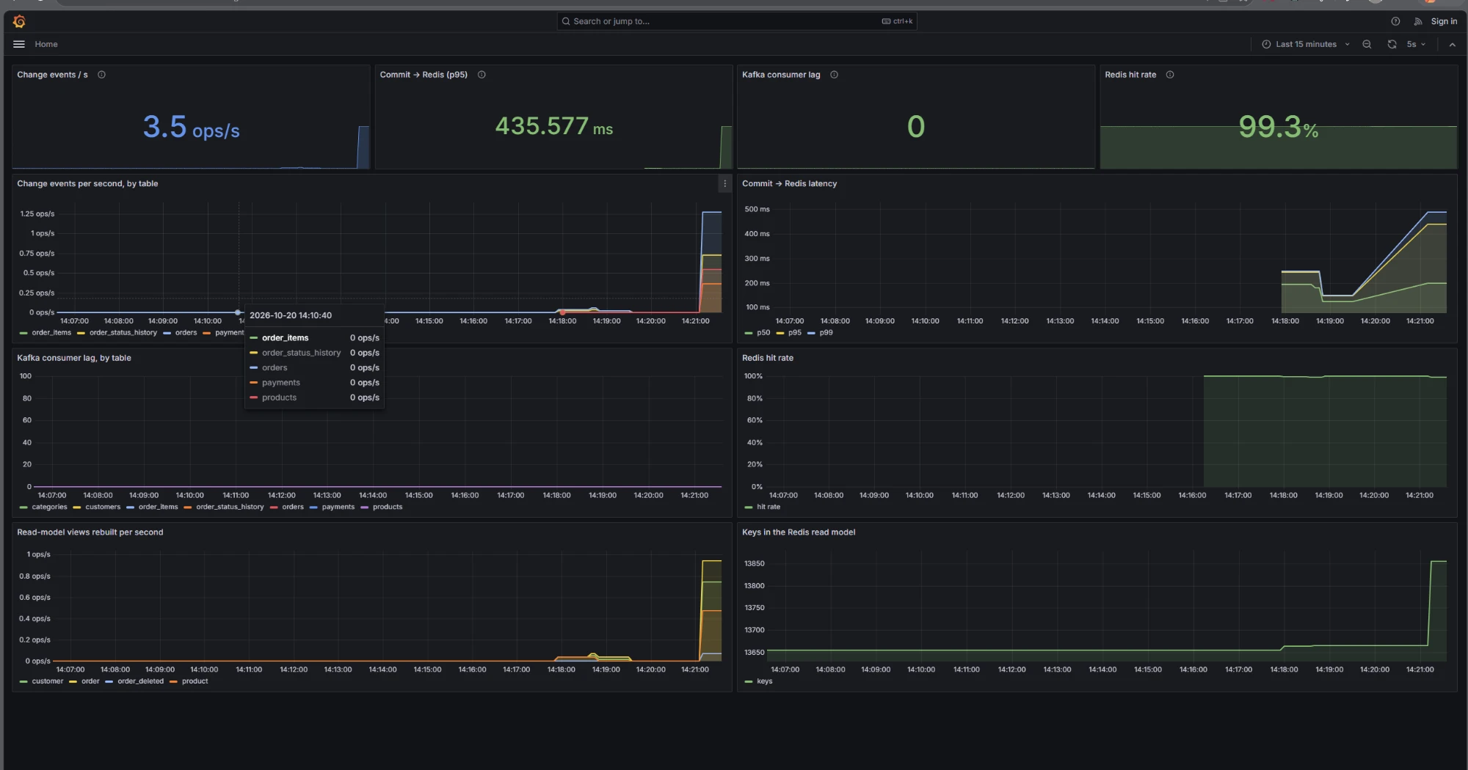
Output: Live Pipeline and Monitoring
Change stream, KPIs and the Grafana dashboard during a 20-order burst
Grafana: change events/s, commit → Redis latency, Kafka lag, Redis hit rate
How it works: live change stream, KPIs, benchmark and consistency check
1,304
9,511
262 ms
0
99.3 %
orders in Redis
change events applied
commit → Redis
Kafka consumer lag
Redis hit rate

Slide 13
Conclusion and Possible Future Enhancements
Conclusion
Future enhancements
A normalized (BCNF) PostgreSQL schema with constraints, triggers and ACID transactions is the single source of truth.
Change Data Capture removes the dual-write problem: the application writes once, and Redis is derived from the log.
Reads are 11.1× faster and never load the transactional database; all 15 tests pass.
Table partitioning and materialized views for reporting
User authentication with row-level security
Managed cloud databases (Azure Database for PostgreSQL, Azure Cache for Redis)
Use the change stream for ML features: demand forecasting and recommendations
Course outcomes covered
CO1: SQL & PL/pgSQL
CO2: ER model
CO3: Normalization
CO4: Transactions
CO5: Right database
GitHub: github.com/aamithkishoretj/CDC-pipeline-CC-DBMS-

Slide 14
THANK YOU

