Slide 1
IEEE BigData 2024
CryptoPulse: Short-Term Cryptocurrency Forecasting with Dual-Prediction and Cross-Correlated Market Indicators
Amit Kumar, Taoran Ji
Presented by: Amit Kumar
Notes:
Good morning everyone! My name is Amit Kumar, and I am a Master’s student at Texas A&M CC. Today, I am going to present our work “CryptoPulse: Short-Term Cryptocurrency Forecasting with Dual-Prediction and Cross-Correlated Market Indicators.” which is supervised by my professor Dr. Taoran Ji.

Slide 2
Introduction
Gaps in existing cryptocurrency forecasting systems:
Over-reliance on historical data without considering real-time market sentiment and technical indicators .
Limited Scope to Major Cryptocurrencies like Bitcoin and Ethereum.
Challenges in Scaling Sentiment Analysis.
Notes:
Cryptocurrencies fluctuate in markets with high price volatility, which becomes a great challenge for investors. To aid investors in making informed decisions, systems predicting cryptocurrency market movements have been developed.
Many studies have employed traditional machine learning and deep learning methods like SVM, Random Forest, and LSTM, primarily focusing on historical price data. These methods often fail to incorporate additional market indicators like technical factors and sentiment analysis, which play a significant role in influencing short-term price movements.
Existing models often focus on the top cryptocurrencies (e.g., Bitcoin and Ethereum) by market capitalization. This approach overlooks other cryptocurrencies with different behaviors and lower liquidity, which are equally affected by market dynamics. Integrating market sentiment into predictions is rare due to the reliance on manually labeled sentiment data, a process that is time-intensive and challenging to scale for real-time predictions across multiple cryptocurrencies. Most studies who sentiment analysis have focused narrowly on specific cryptocurrencies or trading strategies.

Slide 3
Introduction
To overcome the mentioned challenges, this paper introduces “CryptoPulse,” a novel framework designed for forecasting next-day closing prices by leveraging three primary factors:
Complex dynamics of price changes embedded in the historical data and technical indicators of the target cryptocurrency.
Broad market sentiment as reflected in real-time News.
Macro investing environment indicated by the fluctuations of major cryptocurrencies.
Notes:
In particular, the key contributions and highlights of this paper are
Formulated a novel framework for next-day cryptocurrency forecasting, leveraging short-term observations of key market indicators including market sentiment, macro investing environment, technical indicators, and inherent pricing dynamics.
Designed a novel prompting strategy using few-shot learning and consistency-based calibration for effective LLM-based market sentiment analysis of cryptocurrency news.
Developed a dual-prediction mechanism that separately forecasts prices based on macro conditions and cryptocurrency dynamics, then fuses them using a market sentiment-driven strategy for enhanced accuracy.
Conducted extensive evaluations on a newly curated, large-scale real-world dataset to demonstrate our model’s effectiveness in next-day price prediction against ten comparison methods.

Slide 4

Problem Formulation
Predict the next day’s closing price:
where:
- C: Historical price data along.
- D: Sentiment from news articles.
- g: Our model that integrates market sentiment, price dynamics, technical indicators and macroeconomic trends.

Slide 5
Dataset
Dataset Component | Details
Price History | - Source: Yahoo Finance - Covers 75 cryptocurrencies with market cap > $8B. - Time period: January 1, 2021 – April 1, 2024. - Data includes: Open, High, Low, Close, and Volume.
Macro Market Environment | - Derived from price data of top cryptocurrencies (e.g., Bitcoin, Ethereum, Tether). - Captures the collective behavior and trends of the broader cryptocurrency market.
Technical Indicators | - Derived from price data. - Includes 7 indicators: 1. Stochastic Oscillator (%K) 2. Momentum (MOM) 3. Williams %R (WILLR) 4. Moving Average (MA) 5. Exponential Moving Average (EMA) 6. Relative Strength Index (RSI) 7. Moving Average Convergence Divergence (MACD).
Crypto Market News | - Source: Cointelegraph. - Contains 25,210 news articles. - Time period: January 1, 2021 – April 1, 2024. - Data includes: Publication date, title, and content.
Notes:
Overall Benefit:
By incorporating these indicators, the model gains a deeper understanding of market trends, momentum, and conditions, improving its ability to predict price movements accurately. These indicators enhance the robustness of the predictions, particularly in volatile cryptocurrency markets.
Momentum Analysis:
Indicators like Momentum (MOM) and Relative Strength Index (RSI) help measure the rate of price change and identify overbought/oversold conditions.
This improves the model's ability to detect price reversals or sustained trends.
Trend Identification:
Moving Average (MA) and Exponential Moving Average (EMA) smooth price fluctuations to identify short-term and long-term trends.
They help the model understand the direction of price movements.
Market Conditions:
Stochastic Oscillator (%K) and Williams %R (WILLR) identify overbought or oversold conditions in the market, signaling potential trend reversals.
This is crucial for capturing key turning points in cryptocurrency prices.
Trend Strength and Changes:
MACD (Moving Average Convergence Divergence) highlights changes in trend strength and direction by combining short-term and long-term moving averages.
This improves the model’s understanding of trend momentum shifts.

Slide 6
LLM Based Sentiment Analysis
Goal:
Classify cryptocurrency news into Positive, Negative, or Neutral sentiment.
Model Used:
LLM based approach where we Leveraged GPT-3.5 Turbo.
Combined Techniques:
Few-Shot Learning: Provided 3 labeled examples (Positive, Negative, Neutral).
Think-Tank Discussion: Simulated a group of traders collaboratively determining sentiment.
Prompt Design:
“[m] different cryptocurrency traders are reading this news. Each trader will assign a sentiment label from [“negative”, “positive”, “neutral”]. Then, each trader will share their label with the group. The majority label will be accepted. Return the majority label without any other text. The news is [news content] Label: [True sentiment label]”
Notes:
Let me start by briefly introducing the challenge we faced. While performing sentiment analysis on cryptocurrency news, we aimed to classify it as Positive, Negative, or Neutral. Many recent studies have shown that few-shot learning—providing a few labeled examples in the prompt—improves the accuracy of large language models (LLMs) like GPT-3.5-Turbo.
However, few-shot learning alone proved to be insufficient in our case due to two main challenges:
Instability of LLM outputs – The same prompt could sometimes yield different results.
Vulnerability to noisy contexts – For example, irrelevant sentences like ‘the movie is good’ can lead to misclassifications."
Our Approach (Key Innovation):
"To address these challenges, we proposed combining few-shot learning with a ‘think-tank discussion’-like prompt pattern.
The idea is to simulate a group of cryptocurrency traders collaborating to determine the sentiment of a given news article. This approach aligns with consistency-based calibration, where agreement between multiple ‘voters’ increases confidence in the output."

Slide 7
Model Overview and Training
Training Setup:
Learning Rate: 0.0005
Evaluation Metrics:
MAE (Mean Absolute Error)
MSE (Mean Squared Error)
CORR (Correlation).
Batch Size: 32
Training Epochs: 100
Activation Function: GELU
Dropout Rate: 0.05
Observation Length: 7
Data Split: Train: 70%, Validation: 15%, Test: 15%
Notes:
A normalized cross-correlation close to 1 indicates a strong positive relationship between the predicted and true values, signifying accurate model predictions. Values near -1 suggest a strong negative relationship, while values around 0 imply no linear relationship.

Slide 8
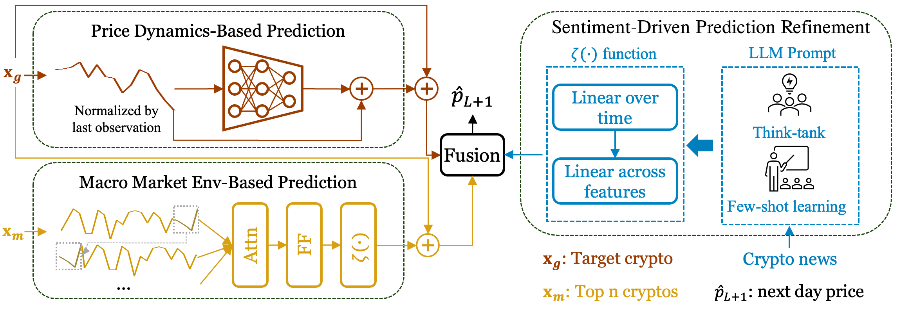
Overview of CryptoPulse architecture for next-day closing price
prediction
Notes:
The CryptoPulse model is a novel hybrid deep learning framework designed for next-day cryptocurrency price prediction. It combines the strengths of attention-based mechanisms, feedforward networks, and real-time sentiment integration to deliver highly accurate and robust forecasts. At its core, the model introduces a dual-prediction mechanism that separately analyzes macro market trends and target cryptocurrency price dynamics, and then intelligently fuses these predictions using a sentiment-guided gating mechanism.
********************************2nd Slide*******************************************
How the Model Works:
Input Processing and Embedding: The model takes three main inputs:
Target Cryptocurrency Data (Xg): A 7-day sliding window of historical price sequences and technical indicators for the target cryptocurrency.
Macro Market Data (Xm): The collective behavior of major cryptocurrencies (macro trends) influencing the overall market.
News Sentiment Data (S): Real-time sentiment derived from cryptocurrency-related news articles, embedded using an LLM-based analysis pipeline. Each input is passed through InputEmbedding layers, which project the raw inputs into high-dimensional feature spaces to capture rich information.
Sentiment as a Scaling Factor: Sentiment data plays a critical role in rescaling predictions. The sentiment embedding S_ is projected through a linear transformation followed by Tanh activation to generate a sentiment trend signal (sent_trend). This signal adjusts the magnitude of predictions coming from both branches of the model, ensuring the predictions are aligned with current market sentiment.
Dual-Prediction Mechanism:
Macro Market Prediction (pred1): The macro market input Xm is processed using an Auto-Correlation Multi-Head Attention (AutoCorrelationMH) mechanism. This mechanism captures cross-correlations between the macro market and the target cryptocurrency to understand how broader market trends influence individual cryptocurrency prices. The output is refined through a feedforward network and combined with the sentiment trend to produce the macro-driven prediction:pred1=last observed price+δ1×sent_trend
Price Dynamics Prediction (pred2): The model also focuses on the target cryptocurrency’s historical price dynamics. A linear projection of the price data generates a price change signal (δ2), which is again scaled by the sentiment trend to produce the price-driven prediction: pred2=last observed price+δ2×sent_trend
**********************3rd Slide*****************************************
Fusion of Predictions: To combine the two predictions (pred1 and pred2), the model uses a gating mechanism.
The gating network processes the environment embedding (combining target and sentiment data) and outputs a dynamic weight γ(gamma) using a sigmoid activation.
The final prediction is a weighted combination of the macro and price-based predictions: Final Prediction=γ×pred1+(1−γ)×pred2\text{Final Prediction} = \gamma \times \text{pred1} + (1 - \gamma) \times \text{pred2}Final Prediction=γ×pred1+(1−γ)×pred2 Here:
If γ is close to 1 → The model gives more importance to macro trends.
If γ is close to 0 → The model prioritizes price dynamics. This dynamic fusion allows the model to adapt to varying market conditions.
Output and Training: The final fused prediction is evaluated against the true price using Mean Squared Error (MSE) as the loss function. During training, the model adjusts its parameters to minimize this error. Additionally, the model is validated on large-scale real-world data using metrics such as Mean Absolute Error (MAE), MSE, and correlation.
Summary
Total Layers:
Linear Layers: 9
Convolutional Layers: 2
Activation Functions: GELU, Tanh, Softplus, Sigmoid
Dropout Layers: 2
Neurons per Layer:
Input Embeddings: 512 neurons each
Feedforward Network:
First Conv1D Layer: 2048 neurons
Second Conv1D Layer: 512 neurons

Slide 9
Model Overview and Training
1. Input Processing and Embedding
Three Inputs:
Target Crypto Data Xg: Historical price & technical indicators.
Macro Market Data Xm: Broader crypto market trends.
News Sentiment Data S: Extracted using LLM-based analysis.
Embedding: All inputs are projected into high-dimensional spaces for feature extraction.
2.Sentiment as a Scaling Factor:
The sentiment embedding S is transformed using a linear layer and Tanh activation to produce the sentiment trend signal (sent_trend), which scales predictions to align with market sentiment.
2. Dual-Prediction Mechanism
Macro Market Prediction: Captures macro trends using Auto-Correlation Attention.
Price Dynamics Prediction: Focuses on target cryptocurrency price patterns.
Notes:
How the Model Works:
Input Processing and Embedding: The model takes three main inputs:
Target Cryptocurrency Data (Xg): A 7-day sliding window of historical price sequences and technical indicators for the target cryptocurrency.
Macro Market Data (Xm): The collective behavior of major cryptocurrencies (macro trends) influencing the overall market.
News Sentiment Data (S): Real-time sentiment derived from cryptocurrency-related news articles, embedded using an LLM-based analysis pipeline. Each input is passed through InputEmbedding layers, which project the raw inputs into high-dimensional feature spaces to capture rich information.
Sentiment as a Scaling Factor: Sentiment data plays a critical role in rescaling predictions. The sentiment embedding S_ is projected through a linear transformation followed by Tanh activation to generate a sentiment trend signal (sent_trend). This signal adjusts the magnitude of predictions coming from both branches of the model, ensuring the predictions are aligned with current market sentiment.
Dual-Prediction Mechanism:
Macro Market Prediction (pred1): The macro market input Xm is processed using an Auto-Correlation Multi-Head Attention (AutoCorrelationMH) mechanism. This mechanism captures cross-correlations between the macro market and the target cryptocurrency to understand how broader market trends influence individual cryptocurrency prices. The output is refined through a feedforward network and combined with the sentiment trend to produce the macro-driven prediction:pred1=last observed price+δ1×sent_trend
Price Dynamics Prediction (pred2): The model also focuses on the target cryptocurrency’s historical price dynamics. A linear projection of the price data generates a price change signal (δ2), which is again scaled by the sentiment trend to produce the price-driven prediction: pred2=last observed price+δ2×sent_trend

Slide 10
Model Overview and Training
3. Fusion and Training
The model combines predictions from macro market trends (pred1) and price dynamics (pred2) using a sentiment-guided gating mechanism.
A sigmoid activation generates a dynamic weight γ based on the environment embedding:
γ = σ(Wg​⋅ E)
where Wg is the learned weight matrix and E is the combined target, macro, and sentiment features.
The final prediction is a weighted combination of the two predictions:
Final Prediction = γ⋅pred1+(1−γ)⋅pred2
If γ→1: Macro market trends dominate.
If γ→0: Price dynamics dominate.
This fusion ensures the model adapts to varying market conditions, guided dynamically by sentiment signals.
Notes:
Fusion of Predictions: To combine the two predictions (pred1 and pred2), the model uses a gating mechanism.
The gating network processes the environment embedding (combining target and sentiment data) and outputs a dynamic weight γ(gamma) using a sigmoid activation.
The final prediction is a weighted combination of the macro and price-based predictions: Final Prediction=γ×pred1+(1−γ)×pred2\text{Final Prediction} = \gamma \times \text{pred1} + (1 - \gamma) \times \text{pred2}Final Prediction=γ×pred1+(1−γ)×pred2 Here:
If γ is close to 1 → The model gives more importance to macro trends.
If γ is close to 0 → The model prioritizes price dynamics. This dynamic fusion allows the model to adapt to varying market conditions.
Output and Training: The final fused prediction is evaluated against the true price using Mean Squared Error (MSE) as the loss function. During training, the model adjusts its parameters to minimize this error. Additionally, the model is validated on large-scale real-world data using metrics such as Mean Absolute Error (MAE), MSE, and correlation.

Slide 11
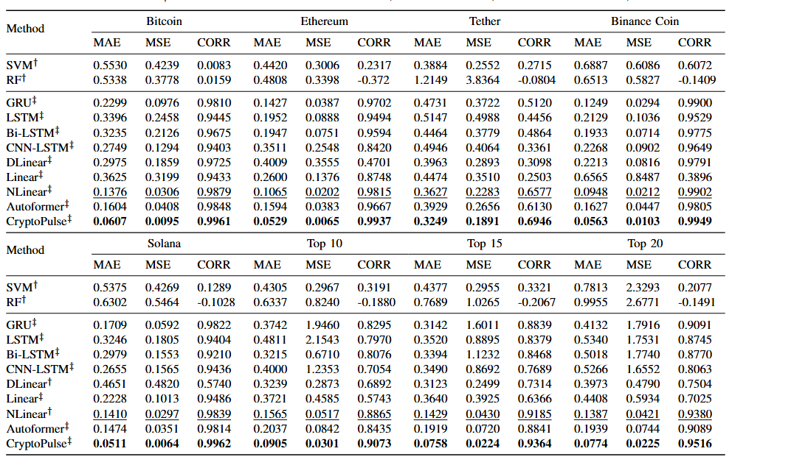
Results and Discussion
As we incorporated the full dataset , the performance of our model outperforms its competitors.
Notes:
Ten other state-of-the-art (SOTA) baseline methods are used for comparison in our experiments. The selected models include four general time series fore-
casting methods: DLinear [29], NLinear [29], Linear [29], and Autoformer [28]; three RNN-based methods adapted for cryptocurrency forecasting: LSTM [10], [15], GRU [10], and Bi-LSTM [10]; one hybrid RNN method, CNN-LSTM [12]; and two traditional machine learning approaches, both adapted
for cryptocurrency forecasting: SVM [8] and RF [8].
we evaluate the performance of our proposed model, CryptoPulse, by comparing it with ten SOTA
Models. We report the performance in Table I for the top five cryptocur-
rencies by market value, along with the average performance
for the top 10, 15, and 20 cryptocurrencies.
our model consistently and signifi-
cantly outperforms the comparison methods across all cases.
Specifically, for the top 5 individual cryptocurrencies, our
model improves MAE by 10.4% to 63.8% and MSE by
17.2% to 69.0% as compared to the best comparison method.
When extending the evaluation from the top 5 to the top 10,
15, and 20 cryptocurrencies, the performance boost becomes
even more consistent, with improvements in MAE ranging
from 42.2% to 46.9%, and in MSE from 41.8% to 47.9%.
This observation underscores the effectiveness of our model’s
design, showing that incorporating macroeconomic environ-
ment approximation, technical indicators and market sentiment
analysis can indeed improve performance in cryptocurrency
price forecasting

Slide 12
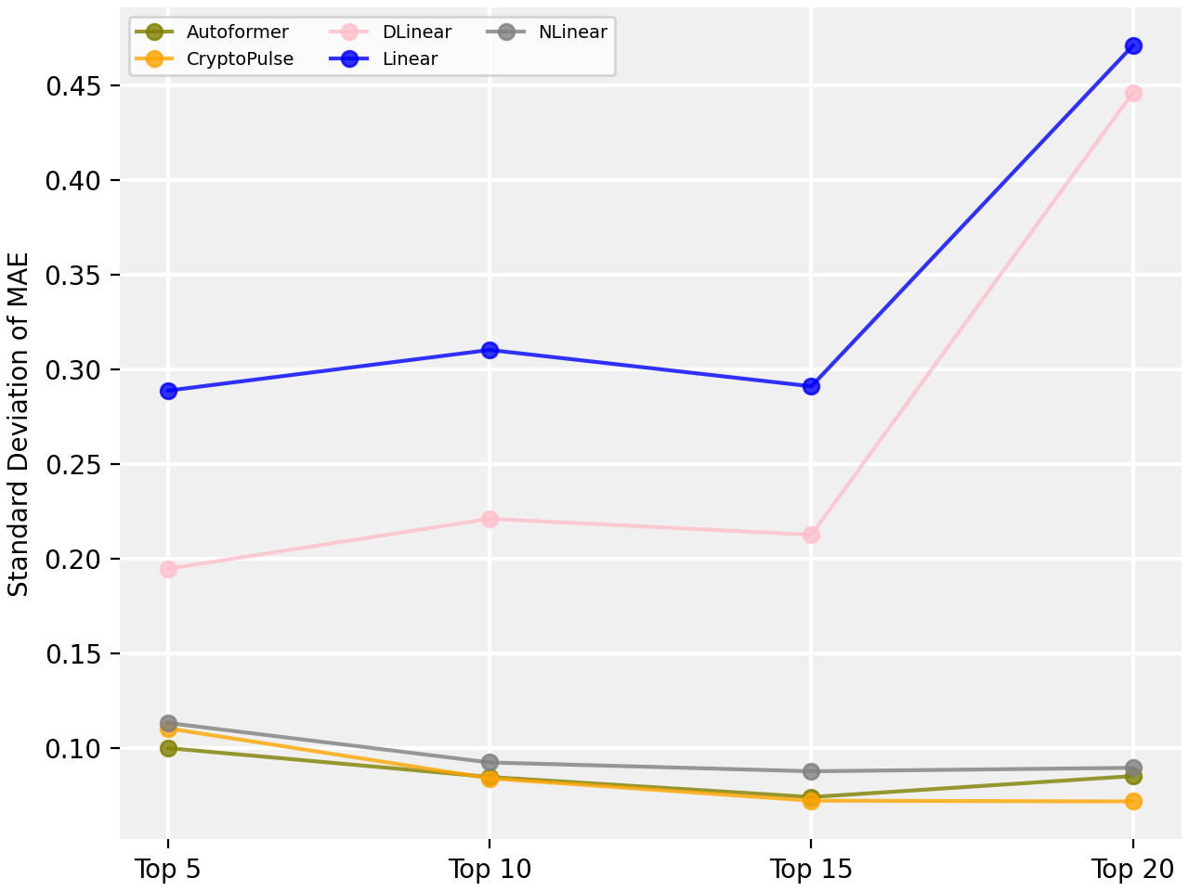
Results and Discussion
Our model demonstrated the lowest standard deviation during training for the top 10, 15, and 20 cryptocurrencies, with comparable performance to the best models for the top 5. It also proved highly robust in handling volatile, smaller-market-cap cryptocurrencies, outperforming Linear and DLinear models in these challenging scenarios.

Slide 13
Summary
Novel Framework: Designed for next-day cryptocurrency forecasting by integrating market sentiment, macro trends, technical indicators, and pricing dynamics.
Advanced Prompting Strategy: Utilized few-shot learning and calibration for effective LLM-based sentiment analysis.
Dual-Prediction Mechanism: Combined macroeconomic and cryptocurrency-specific predictions with sentiment-driven fusion for higher accuracy.
Validated Results: Outperformed 10 comparison methods demonstrating effectiveness using a large-scale real-world dataset.

Slide 14
Acknowledgment
This work is supported by the National Science Foundation (NSF) via grants CNS-2431176 and ITE-2431845.
Notes:
Thanks to National Science Foundation for funding this project

Slide 15
Thank you
The code and slides are available at https://github.com/Sequential-Analytics-Lab/SAL-CryptoPulse.git
Welcome any related questions and suggestions.
https://www.linkedin.com/in/aamit-datascientist/

