Slide 1



$ curl -s -o /dev/null -v http://www.google.com
* Trying 2a00:1450:4001:801::2004...
* TCP_NODELAY set
* Connected to www.google.com (2a00:1450:4001:801::2004) port 80 (#0)
> GET / HTTP/1.1
> Host: www.google.com
> User-Agent: curl/7.64.1
> Accept: */*
>
…

Slide 2
Our application is deployed to an application or web server
Other applications running on the same application or web server
Deployment Unit
Application/Web Server
One Java process
Java
Operating System

Slide 3
Application
Deployment Unit
Application/Web Server
Java
Operating System

Slide 4
The container became the deployment unit

Slide 5
REST Controller
Repository
Service
Repository
REST Controller

Slide 6
spring-boot-autoconfigure
Autoconfigure
Dependency
spring-boot-starter
Starter

Slide 7
Without Spring Boot
With Spring Boot
Dependency
Configuration
Dependency
(starter)
Configuration
+
Use the dependency
Configure the dependency
Use the starter that comes with the configuration

Slide 8
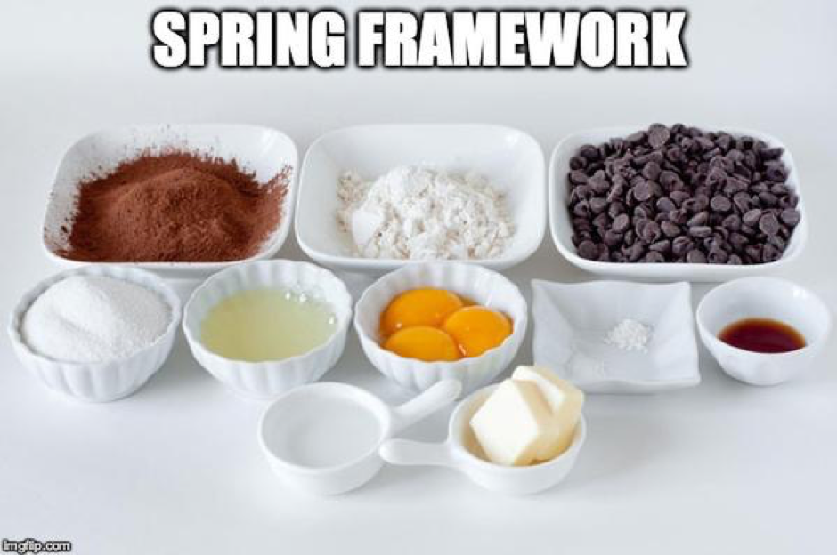


Slide 9
Docker Command
Builds on the previous layer
Layer
FROM adoptopenjdk/openjdk14:jre-14.0.1_7-alpine
WORKDIR /opt/app
+
=
Intermediate images
ADD ./build/libs/*.jar ./application.jar
+
=
CMD ["java", "-jar", "application.jar"]
+
=
Final image

Slide 10
The existing intermediate images are reused
The application.jar file contains our code together with the dependencies
Version 1
Version 2
Version 3
Version 4

Slide 11
The existing intermediate images are reused
The application dependencies
The layer contains our code together without the dependencies
The application code
Version 1
Version 2
Version 3
Version 4

Slide 12

Consumer
Controller
Service
GET /offices
Call Service
Read File
Return Offices
Return Offices (JSON)

Slide 13
Spring Data
Spring Data JDBC
Spring Data Pivotal GemFire
Spring Data Elasticsearch
Spring Data JPA
Spring Data Neo4J
Spring Data MongoDB
Spring Data Redis
Spring Data R2DBC
Spring Data REST
Spring Data Apache Cassandra
Spring Data Apache Geode
Spring Data Apache Solr
Spring Data Couchbase
Spring Data Envers

Slide 14
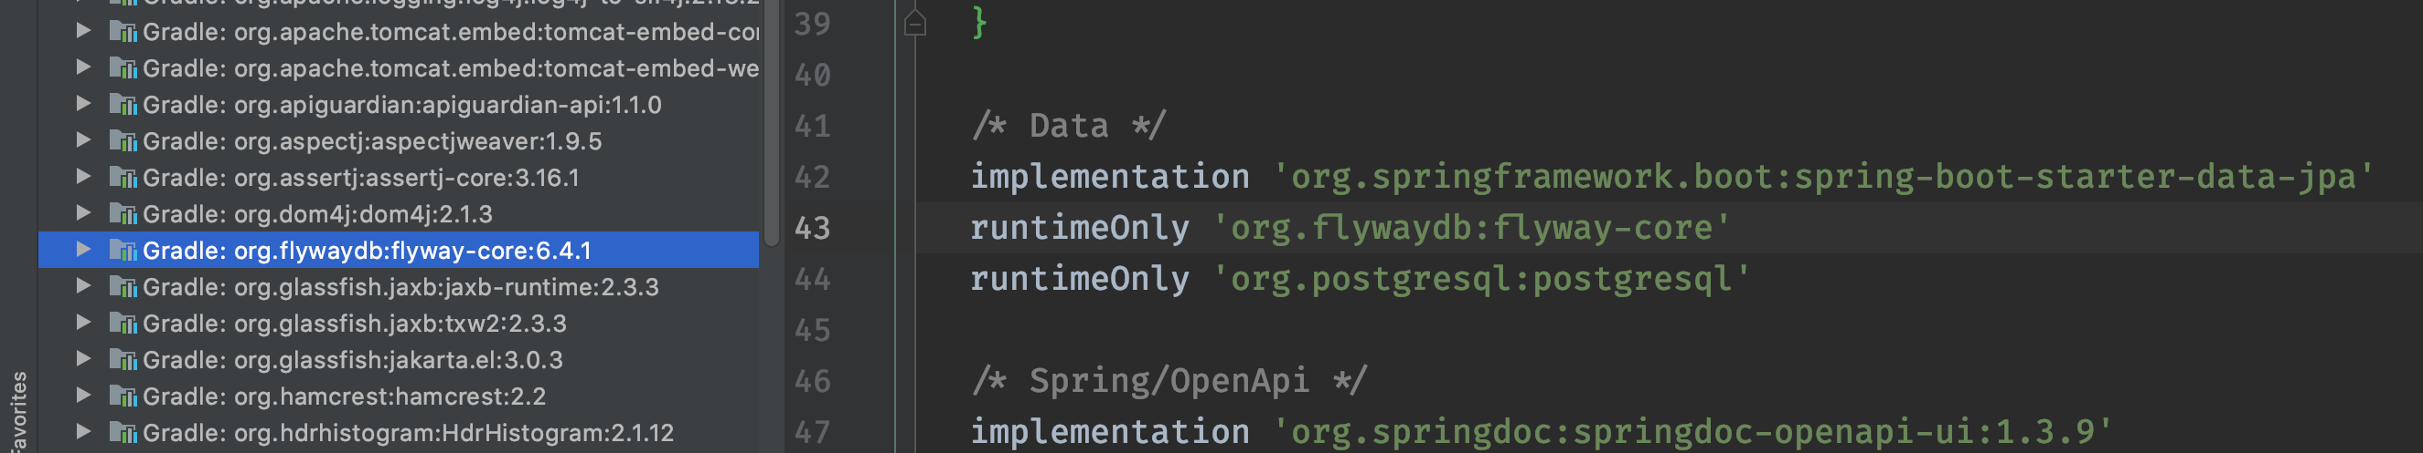
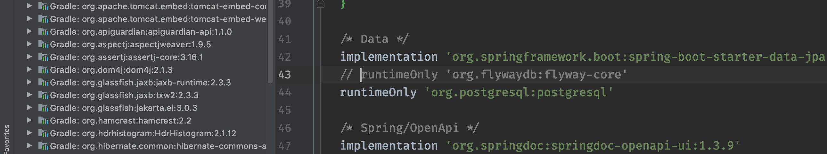
Flyway is only added when the dependency is present

Slide 15
CSV
Contact Us Service
JPA

