Slide 1
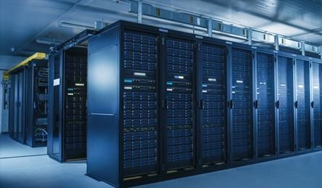
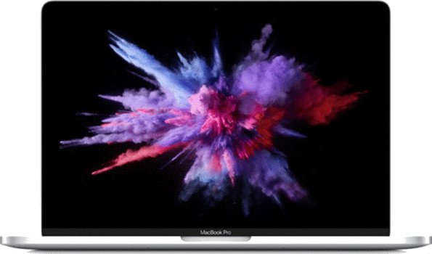

$ curl -s -o /dev/null -v http://www.google.com
* Trying 2a00:1450:4001:801::2004...
* TCP_NODELAY set
* Connected to www.google.com (2a00:1450:4001:801::2004) port 80 (#0)
> GET / HTTP/1.1
> Host: www.google.com
> User-Agent: curl/7.64.1
> Accept: */*
>
…

Slide 2
Our application is deployed to an application or web server
Other applications running on the same application or web server
Deployment Unit
Application/Web Server
One Java process
Java
Operating System

Slide 3
Application
Deployment Unit
Application/Web Server
Java
Operating System

Slide 4
The container became the deployment unit

Slide 5
REST Controller
Repository
Service
Repository
REST Controller

Slide 6
spring-boot-autoconfigure
Autoconfigure
Dependency
spring-boot-starter
Starter

Slide 7
Without Spring Boot
With Spring Boot
Dependency
Configuration
Dependency
(starter)
Configuration
+
Use the dependency
Configure the dependency
Use the starter that comes with the configuration

Slide 8
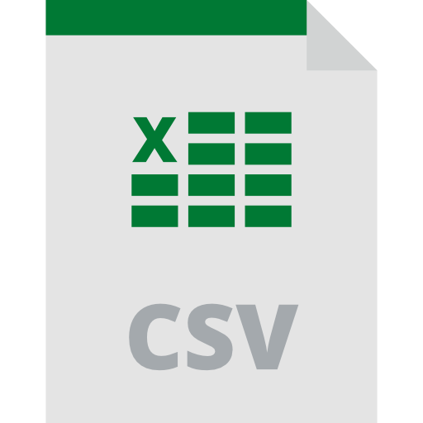
Consumer
Controller
Service
GET /offices
Call Service
Read File
Return Offices
Return Offices (JSON)

Slide 9
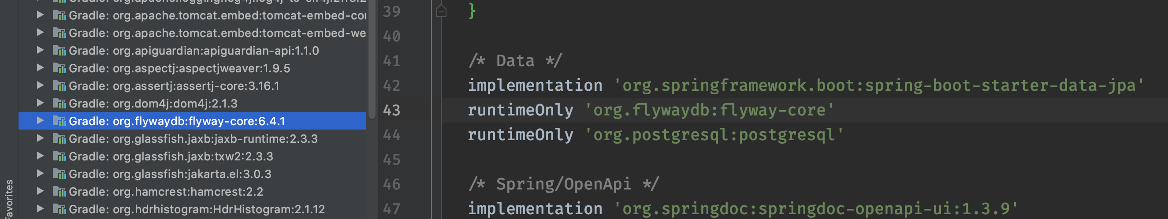
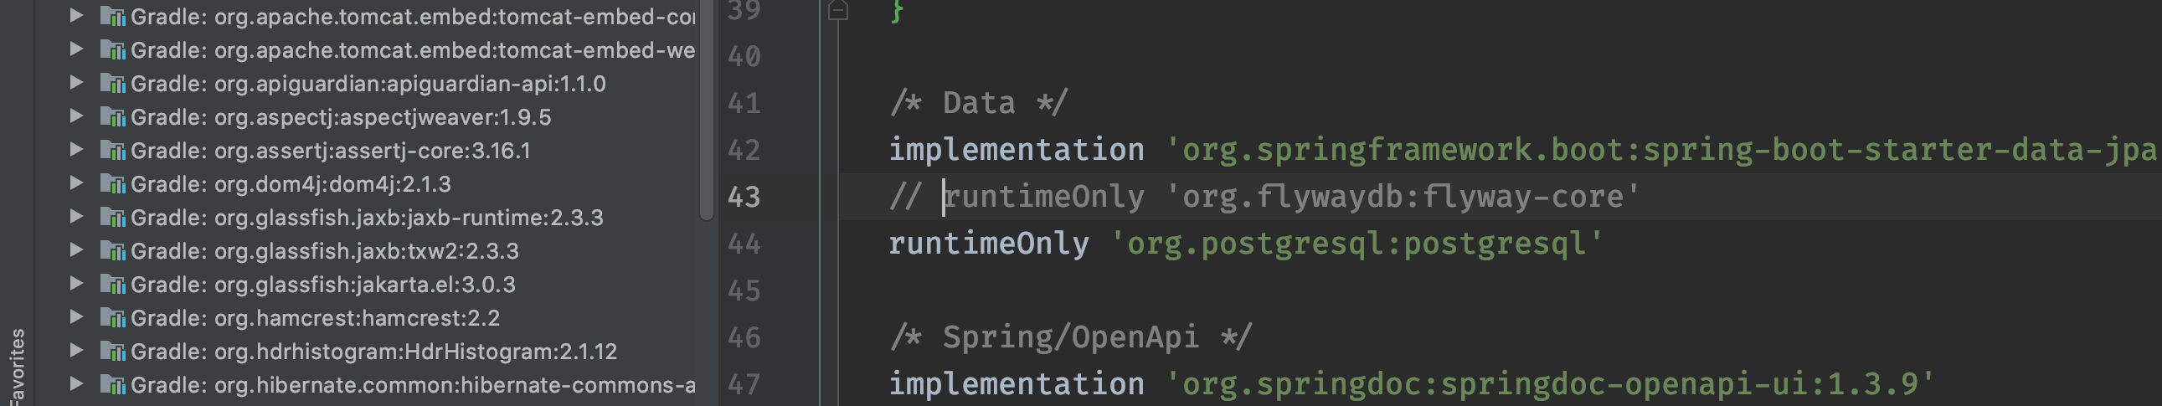
Flyway is only added when the dependency is present

Slide 10
CSV
Contact Us Service
JPA

