Slide 1


Smart Doorbell Camera
Performed by: Guy Abramovich, Asaf Amnony
Instructor: Oren Kalinsky
16.09.2019

Slide 2
Project Description
Automatically opens door for authorized people using face recognition.
Notifies owner when unauthorized people try to access house.
Allows owner to alter his/her authorized people database.
Owner can authorize people in real time.
Stream video of door area to its owner.

Slide 3
Project Goals
Build login platform for owners using AWS Cognito and IAM.
Create database for authorized people using AWS Rekognition.
Create log of last successful and failed entrances, along with images.
Implement video streaming from Raspberry Pi to Android using Jitsi.
Implement motion detection on Raspberry Pi.
Use AWS Rekognition to recognize familiar faces.
Implement communication using MQTT protocol and Google FCM.
Create interactive Android application for owners.

Slide 4


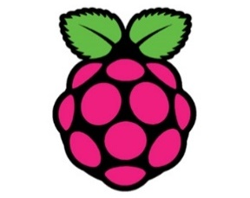


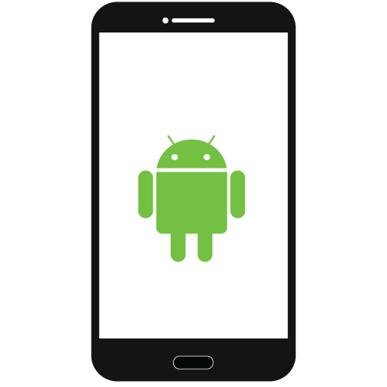
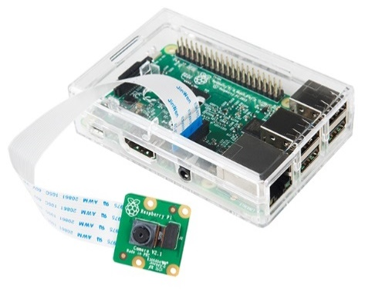





Authentication
Login
Amazon Cognito
Video Streaming
Video Streaming
Raspberry Pi + Camera Module
UV4L
MQTT
MQTT
Amazon IoT
Google FCM
NoSQL
Face Recognition

Slide 5
EC2 Design
The EC2 instance runs UV4L and Jitsi on Ubuntu 18.04 to provide the video streaming capabilities.
UV4L and Jitsi were installed by following the official UV4L guide.
The EC2 instance is hosted on the AWS domain but is forwarded from the URL: smartdoorbell.ga (provided by freenom.com) which we certified using AWS ACM.

Slide 6
OpenCV and Rekognition
OpenCV runs on the Raspberry Pi and is used to minimize web traffic to AWS Rekognition
Only images that contain faces are sent to the cloud
Capture image from camera
Use OpenCV to check for face in image
Send last image to AWS Rekognition
Open door
Face exists in 10 consecutive frames
Face is recognized

Slide 7
Raspberry Pi – Software
The Raspberry Pi runs a Python script which consists of:
A finite state machine (FSM) running indefinitely on a thread
A listener running indefinitely on a thread for detecting incoming MQTT messages
A listener running indefinitely on a thread for detecting presses on the ring button

Slide 8
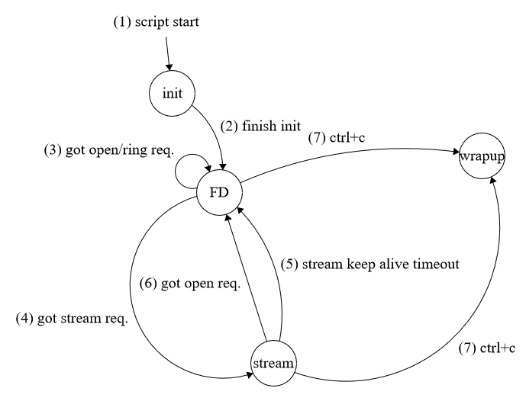
Raspberry Pi – Software (2)

Slide 9
import firebase_admin
class Messaging:
@staticmethod
def init_fcm():
fcm_credentials = firebase_admin.credentials.Certificate(FCM_CONFIG_PATH)
fcm_app = firebase_admin.initialize_app(fcm_credentials)
@staticmethod
def publish_message(image_name: str) -> None:
message = firebase_admin.messaging.Message(
data={
'image_name': image_name,
'camera_name': CAMERA_NAME,
},
topic=USER_NAME,
)
response = firebase_admin.messaging.send(message)
log('Successfully sent message: ', response, level=1)
@staticmethod
def get_mqtt_client() -> AWSIoTPythonSDK.MQTTLib.AWSIoTMQTTClient:
mqtt_client = AWSIoTPythonSDK.MQTTLib.AWSIoTMQTTClient(USER_NAME + '/' + CAMERA_NAME)
mqtt_client.disableMetricsCollection()
mqtt_client.configureEndpoint(MQTT_ENDPOINT, 8883)
mqtt_client.configureCredentials(MQTT_ROOT_CERTIFICATE_PATH, MQTT_PRIVATE_KEY_PATH, MQTT_CERTIFICATE_PATH)
mqtt_client.configureOfflinePublishQueueing(-1) # Infinite offline Publish queueing
mqtt_client.configureDrainingFrequency(2) # Draining: 2 Hz
mqtt_client.configureConnectDisconnectTimeout(10) # 10 sec
mqtt_client.configureMQTTOperationTimeout(5) # 5 sec
return mqtt_client

Slide 10
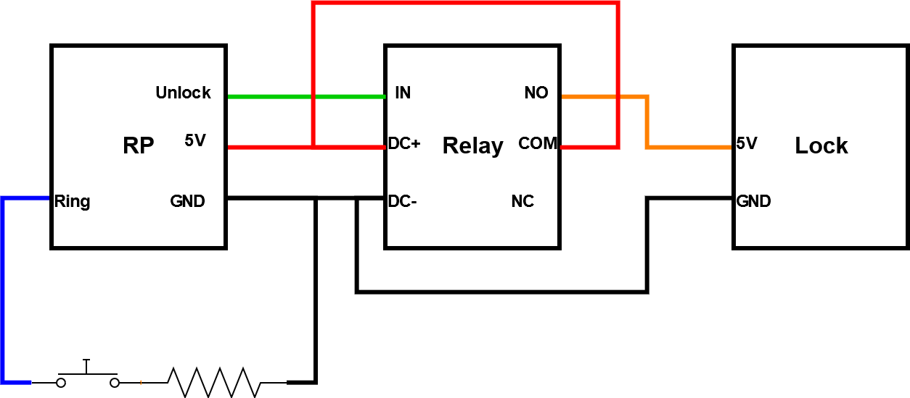
Raspberry Pi – Hardware
The Raspberry Pi circuit consists of a pushbutton which act as a ringer, and a lock
The relay is used to drive the lock due to lack of current from the Raspberry Pi user pins (i.e. the “Unlock” pin in the diagram).

Slide 11
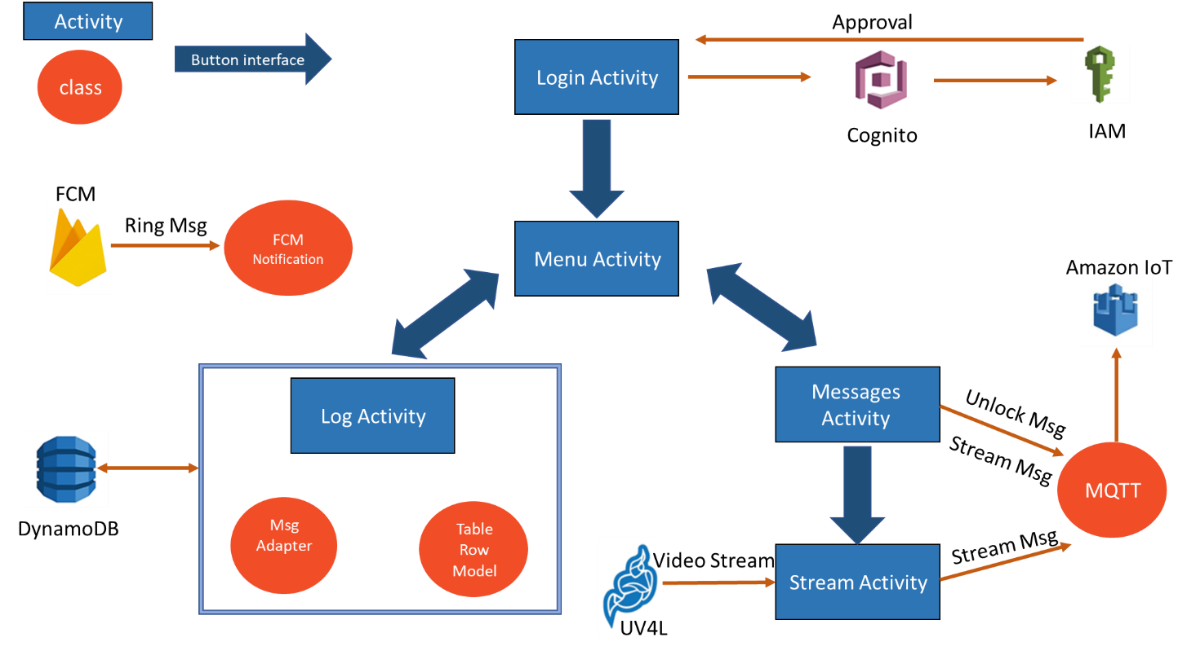
Android App – Overview

Slide 12
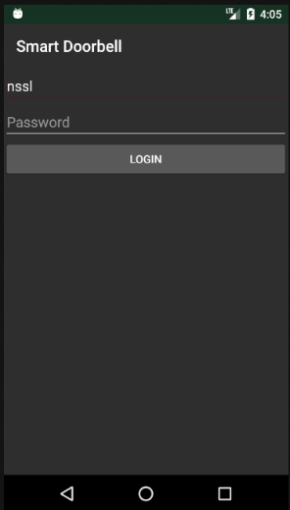
Android App – LoginActivity
Allows the user to login with the home's username as password
Registration of a user to the system is done manually.
If the username and password are approved by IAM+Cognito, the app switches to MenuActivity.
Otherwise, an error message is displayed.

Slide 13
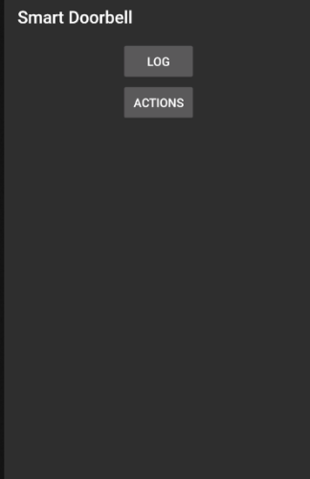
Android App – MenuActivity
Acts as the gate to all other screens of the application.

Slide 14
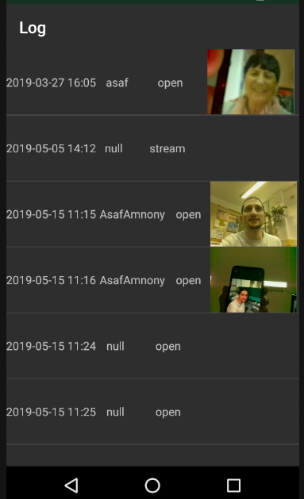
Android App – LogActivity
Displays log entries in a ListView
Log entries are fetched from DynamoDB
Images are not stored directly on DynamoDB
Images are stored in S3 and DynamoDB contains their locations
Some actions don't have snapshots or person names, so default values are displayed ("null" for the person name, empty image for the snapshot).

Slide 15
@DynamoDBTable(tableName = "SmartDoorbellLogTable")
public class TableRowModel {
private String personName;
private Double timeStamp;
private String actionType;
private String snapshotId;
private String userCamera;
private String snapshotTempUrl;
@DynamoDBAttribute(attributeName = "User/Camera")
@DynamoDBHashKey(attributeName = "User/Camera")
public String getUserCamera() {
return userCamera;
}
public void setUserCamera(String userCamera) {
this.userCamera = userCamera;
}
@DynamoDBAttribute(attributeName = "PersonName")
public String getPersonName() {
return personName;
}
public void setPersonName(String personName) {
this.personName = personName;
}

Slide 16
public class MsgAdapter extends BaseAdapter {
...
@Override
public View getView(int position, View convertView, ViewGroup parent) {
Holder holder;
if (convertView == null) {
convertView = mInflater.inflate(R.layout.log_item, parent, false);
holder = new Holder();
holder.personName = convertView.findViewById(R.id.txtPerson);
holder.actionType = convertView.findViewById(R.id.txtActionType);
holder.timestamp = convertView.findViewById(R.id.txtTime);
holder.snapshot = convertView.findViewById(R.id.imgSnapshot);
convertView.setTag(holder);
} else {
holder = (Holder) convertView.getTag();
}
TableRowModel item = getItem(position);
holder.personName.setText(item.getPersonName());
holder.actionType.setText(item.getActionType());
Date dt = new Date((long)(item.getTimeStamp()*1000));
holder.timestamp.setText(FORMAT.format(dt));
if (item.getSnapshotTempUrl() != null) {
Picasso.get().load(item.getSnapshotTempUrl()).into(holder.snapshot);
}
return convertView;
}

Slide 17
Android App – Messages Structure
FCM messages contain Maps with the following data:
MQTT messages have the following format:
Key | Value
camera_name | The name/ID of the camera/RP that sent the message
image_name | The name of the image snapshot in the S3 bucket, at the time when the doorbell was rung
Action | Message Format
Stream | stream
Unlock | open
Unlock & Add | open <added_person_name> <snapshot_id>

Slide 18
public class Mqtt {
...
public void sendMessage(String topic, String command, String... args) {
if (args.length > 0 && command.equals(ACTION_UNLOCK_DOOR)) {
command += " " + args[0] + " " + args[1];
}
String sendCommand = command;
try {
mqttManager.connect(clientKeyStore, (status, throwable) -> {
if (status == AWSIotMqttClientStatusCallback.AWSIotMqttClientStatus.Connected) {
mqttManager.publishString(sendCommand, topic, AWSIotMqttQos.QOS0, (status1, userData)
-> {
switch (status1) {
case Success:
break;
case Fail:
Log.e(TAG, "Publish error.");
break;
}
}, null);
}
});
} catch (final Exception e) {
Log.e(TAG, "Connection error.", e);
}
}

Slide 19
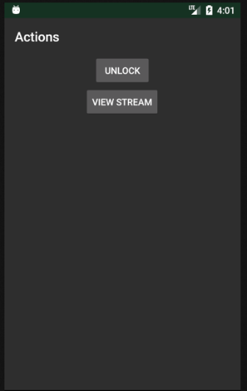
Android App – MessagesActivity
Allows the user to perform two main actions:
Unlock the door
View stream
Actions are sent as MQTT messages

Slide 20
public class MessagesActivity extends AppCompatActivity {
...
private View.OnClickListener onUnlockClicked = v ->
mqtt.sendMessage(AppHelper.getCurrUser() + "/" + cameraName, Mqtt.ACTION_UNLOCK_DOOR);
private View.OnClickListener onStreamClicked = v -> {
Intent streamIntent = new Intent(MessagesActivity.this, StreamActivity.class);
streamIntent.putExtra(StreamActivity.CAMERA_NAME, cameraName);
startActivity(streamIntent);
};
private void showAddPersonDialog() {
final EditText taskEditText = new EditText(this);
AlertDialog dialog = new AlertDialog.Builder(this)
.setTitle("Add a new person to the database")
.setMessage("Please insert person's name without spaces")
.setView(taskEditText)
.setPositiveButton("Add", (dialog1, which) -> {
String name = String.valueOf(taskEditText.getText());
mqtt.sendMessage(AppHelper.getCurrUser() + "/" + cameraName,
Mqtt.ACTION_UNLOCK_DOOR,
name,
snapshotId);
})
.setNegativeButton("Cancel", null)
.create();
dialog.show();
}

Slide 21
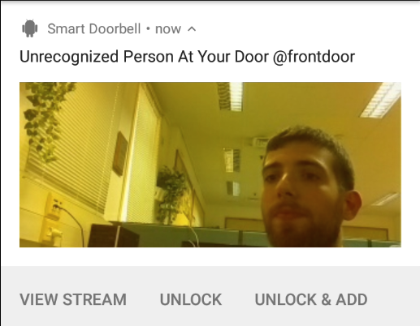
Android App – FcmNotification
Displays “Ring” messages as Android notifications.
“Ring” messages are received from the Raspberry Pi via FCM service
Each notification contains:
A snapshot the camera took when the doorbell was rung
Button to view stream
Button to unlock the door
Button to unlock the door and add the current snapshot to the recognized faces database
1
2
3
4

Slide 22
public class FcmNotification{
public static void post(Map<String, String> data, Context context) {
int notificationId = ("SmartDoorbell:" + AppHelper.getCurrUser() + "/" + data.get("camera_name")).hashCode();
NotificationCompat.Builder builder = buildNotification(data, context, createChannel(context), notificationId);
NotificationManagerCompat notificationManager = NotificationManagerCompat.from(context);
notificationManager.cancel(notificationId);
notificationManager.notify(notificationId, builder.build());
}
private static NotificationCompat.Builder buildNotification(Map<String, String> data, Context context, String channel, int notificationId) {
String snapshotId = data.get("image_name");
String cameraName = data.get("camera_name");
NotificationCompat.Builder builder = new NotificationCompat.Builder(context, channel)
.setAutoCancel(true)
.setSmallIcon(R.drawable.ic_launcher)
.setContentTitle("Unrecognized Person At Your Door @" + cameraName)
.setDefaults(Notification.DEFAULT_ALL);
CognitoCachingCredentialsProvider credentialsProvider = new CognitoCachingCredentialsProvider(
context.getApplicationContext(),
AppHelper.IDENTITIES_POOL_ID,
AppHelper.IOT_REGION
);
AmazonS3Client s3Client = new AmazonS3Client(credentialsProvider);
s3Client.setRegion(Region.getRegion(AppHelper.COGNITO_REGION));
S3Object s3Object = s3Client.getObject(AppHelper.S3_BUCKET_NAME, snapshotId);
Bitmap bmp = BitmapFactory.decodeStream(s3Object.getObjectContent());
new NotificationCompat.BigPictureStyle().bigPicture(bmp).setBuilder(builder);

Slide 23
Intent unlockIntent = new Intent(context, MessagesActivity1.class);
unlockIntent.putExtra(MessagesActivity.CAMERA_NAME, cameraName);
unlockIntent.putExtra(MessagesActivity.SNAPSHOT_ID, snapshotId);
unlockIntent.putExtra(MessagesActivity.ADD, "0");
unlockIntent.putExtra(MessagesActivity.NOTIFICATION_ID, notificationId);
builder.addAction(
android.R.drawable.ic_lock_lock,
context.getString(R.string.unlock),
PendingIntent.getActivity(context, 0, unlockIntent,
PendingIntent.FLAG_UPDATE_CURRENT)
);
Intent unlockAndAddIntent = new Intent(context, MessagesActivity.class);
unlockAndAddIntent.putExtra(MessagesActivity.CAMERA_NAME, cameraName);
unlockAndAddIntent.putExtra(MessagesActivity.SNAPSHOT_ID, snapshotId);
unlockAndAddIntent.putExtra(MessagesActivity.ADD, "1");
unlockAndAddIntent.putExtra(MessagesActivity.NOTIFICATION_ID, notificationId);
builder.addAction(
android.R.drawable.ic_menu_add,
context.getString(R.string.unlock_and_add),
PendingIntent.getActivity(context, 0, unlockAndAddIntent,
PendingIntent.FLAG_UPDATE_CURRENT)
);
return builder;
}
}

Slide 24
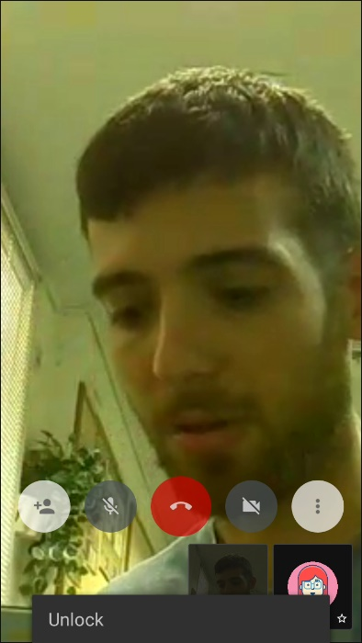
Android App – StreamActivity
Extends JitsiMeetActivity that is supplied directly from Jitsi. Two extensions were added:
Unlock the door directly from this activity
A messages mechanism that sends keepalive messages to the Raspberry Pi: While the activity is alive, it sends MQTT "stream" messages, so that the Raspberry Pi keeps streaming video.

Slide 25
Issues
Physical lock couldn’t be toggled directly from PI outputs because of lack of current
Solution: used relay
Camera module not detected
Solution: Installed TC358743 driver and replaced faulty flat cable
OpenCV installation failed countless times, including freezing and ruining the SD-card
Solution: used 1 job instead of 4 jobs: make -j1 (instead of -j4)
Jitsi released a new version (with backward incompatible API) and Android compiled the new version
Solution: Used explicit gradle library versions for all libraries in Android app

Slide 26
What Did We Learn
Pros and cons of using cloud services
Using 3rd party libraries – FCM, AWS, Jitsi
Pros and cons of Raspberry Pi
Programming in Java and Python
Pros of using Git
Correct teamwork and project management

Slide 27
Current System State
In its current state the system supports a single user and a single camera
New users need to be registered in AWS manually by the system administrator
The Android app supports a specific camera in streaming
The Raspberry Pi is designed as a single camera for a specific user and can be configured easily as a different camera for a different user
We designed all AWS infrastructure, so it supports multi-users and multi-cameras without further adjustments

Slide 28
Future Development
Create an automatic registration process
Add support for multi-cameras in Android app
Secure MQTT communication

Slide 29
Demo
System Demonstration Video

