Slide 1
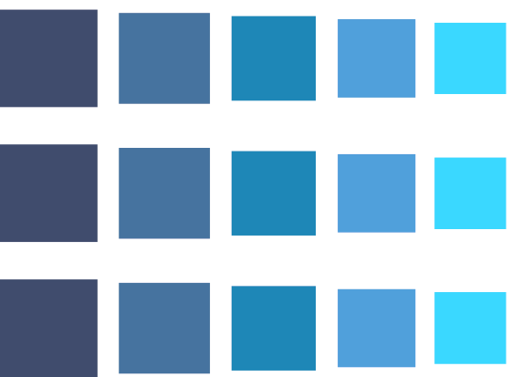


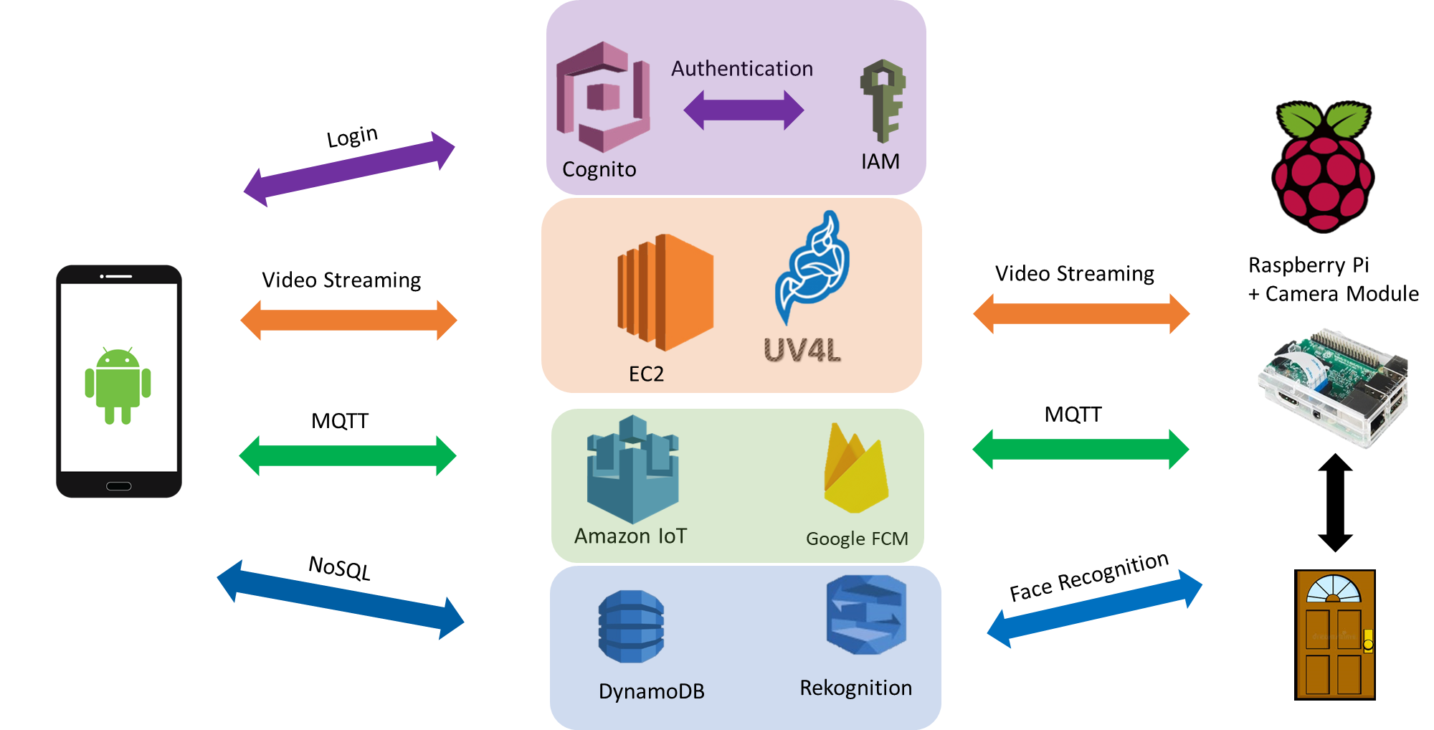
NSSL
Smart Doorbell Camera
Asaf Amnony and Guy Abramovich Supervised by Oren Kalinsky
Abstract
The concept of home automation has been around for around 100 years, from the early beginnings of electrical appliances such as basic washing machines, dishwashers, etc. to Artificial Intelligence and Internet of Things which let appliances communicate with themselves.
Homes are becoming smarter and smarter!
One aspect of smart homes is security, mainly door security – granting access only to authorized personal and continuously logging every action which homeowners can view at any time.
This project integrates software and hardware to develop a mobile application for Android devices, which provides users the ability to monitor and control a smart door which opens itself for recognized personal.
System Properties
• The system shall open the door when a recognized person arrives at the door
• The system shall notify the owner with an Android app notification and a snapshot when an unrecognized person rings the doorbell
• The owner shall be able to open the door
• The owner shall be able to view a livestream of the door
• The owner shall be able to view a log of all activities of the system
Project Sponsors:

