Slide 1


Smart Doorbell Camera
Performed by: Guy Abramovich, Asaf Amnony
Instructor: Oren Kalinsky
12.12.2018

Slide 2
Project Description
Automatically opens door for authorized people using face recognition.
Notifies owner when unauthorized people try to access house.
Allows owner to alter his/her authorized people database.
Owner can authorize people in real time.
Stream video of door area to its owner.

Slide 3


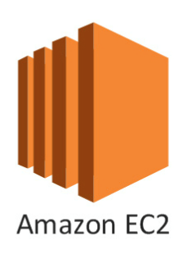

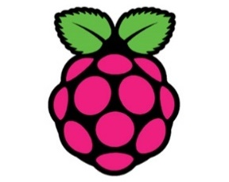
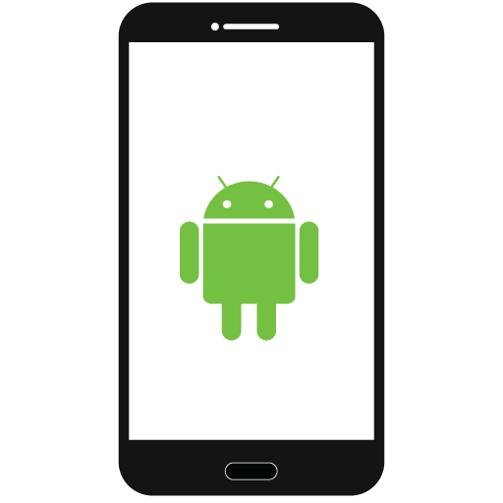
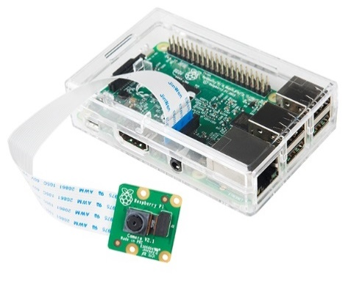

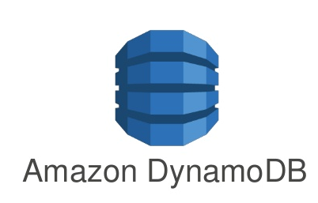

Authentication
Login
Amazon Cognito
Video Streaming
Video Streaming
UV4L
Raspberry Pi + Camera Module
MQTT
MQTT
Amazon IoT
NoSQL
Face Recognition

Slide 4
Project Goals
Build login platform for owners using AWS Cognito and IAM.
Create database for authorized people using AWS DynamoDB.
Create log of last successful and failed entrances, along with images.
Implement video streaming from Raspberry Pi to Android using Jitsi.
Implement motion detection on Raspberry Pi.
Use AWS Rekognition to recognize familiar faces.
Implement PubSub communication using MQTT protocol.
Create interactive Android application for owners.

Slide 5
What We’ve Done so Far

Slide 6
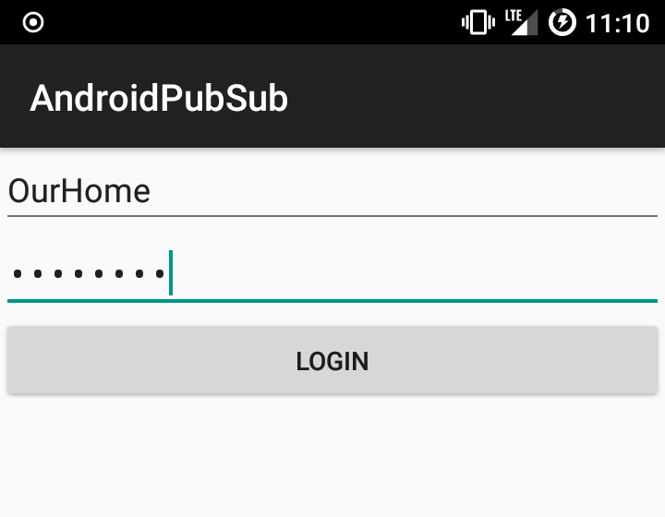
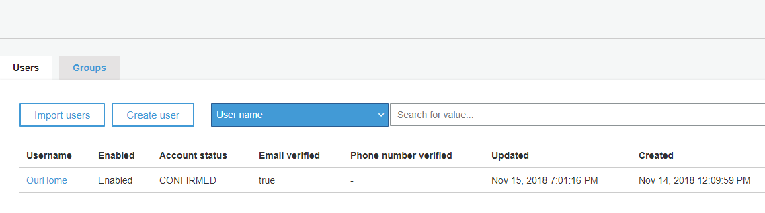
Login (Cognito + IAM)
One user per house.
User management is manual in Cognito (for now).

Slide 7
Video Streaming – Why Jitsi?
Introduced to 2 main options: Jitsi and Janus.
Found that Jitsi has:
Good documented SDK.
An official Android application that works.
Native Android View.
Janus has none of these.
There is a reference Janus based project.
Chose Jitsi!

Slide 8
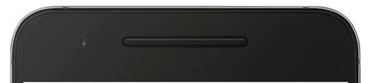
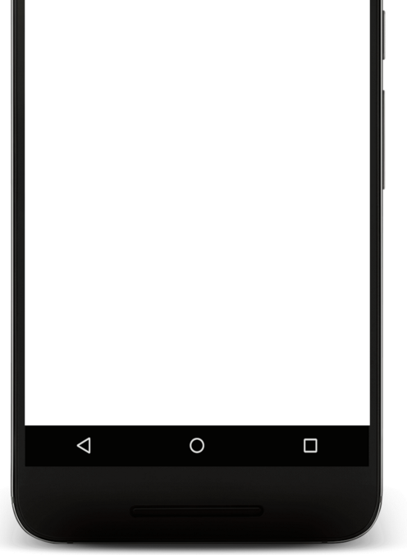
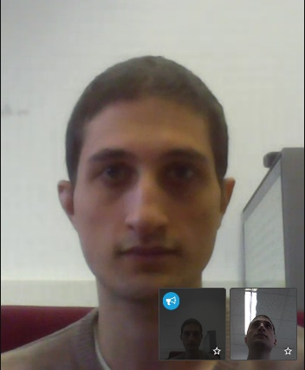
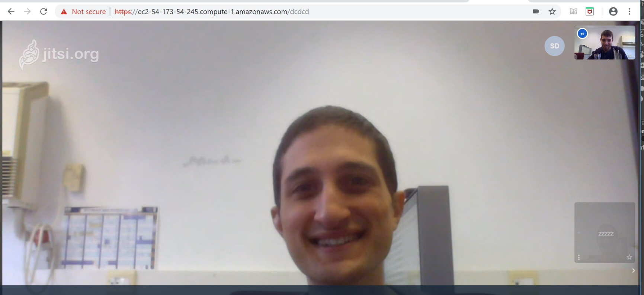
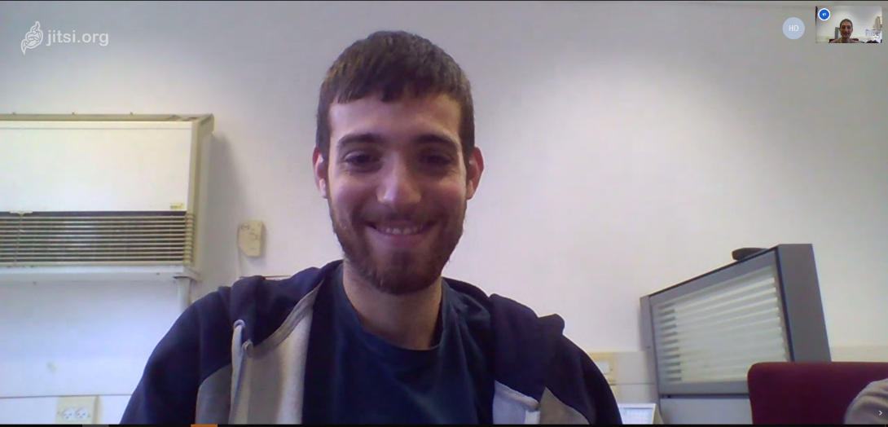
Video Streaming
Setup Jitsi + UV4L on EC2.
Ran streaming test between two computers.
Added Jitsi SDK to our Android app.
Started testing between Android and computer.
So far on official Jitsi server (due to EC2 certification issues).
Our EC2 Server Address

Slide 9
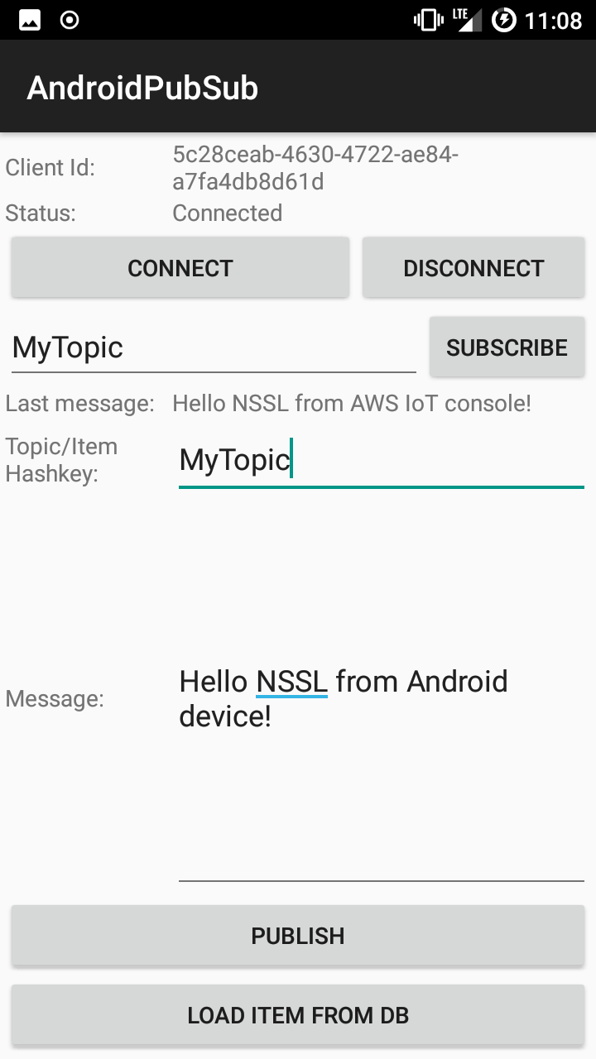
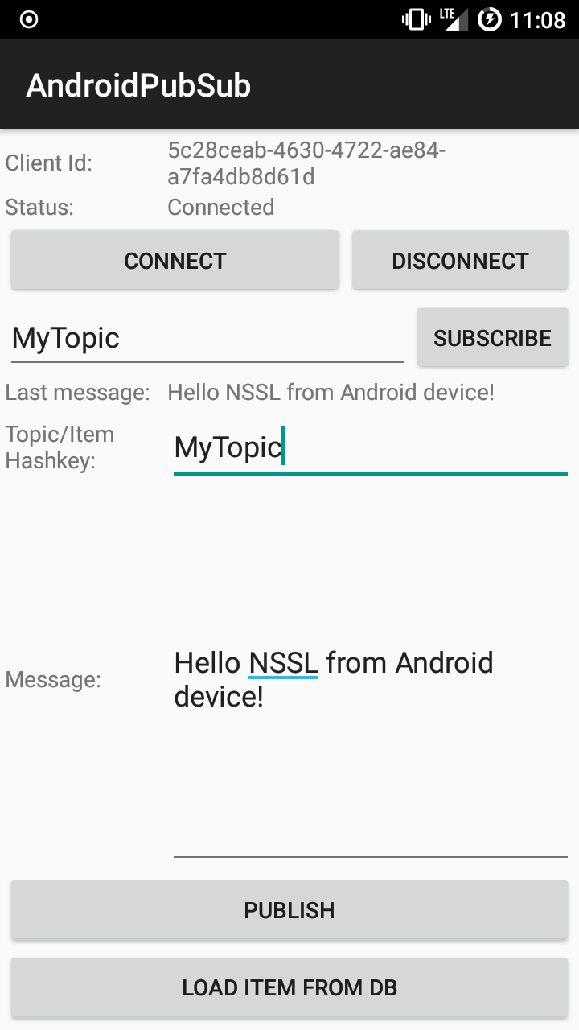
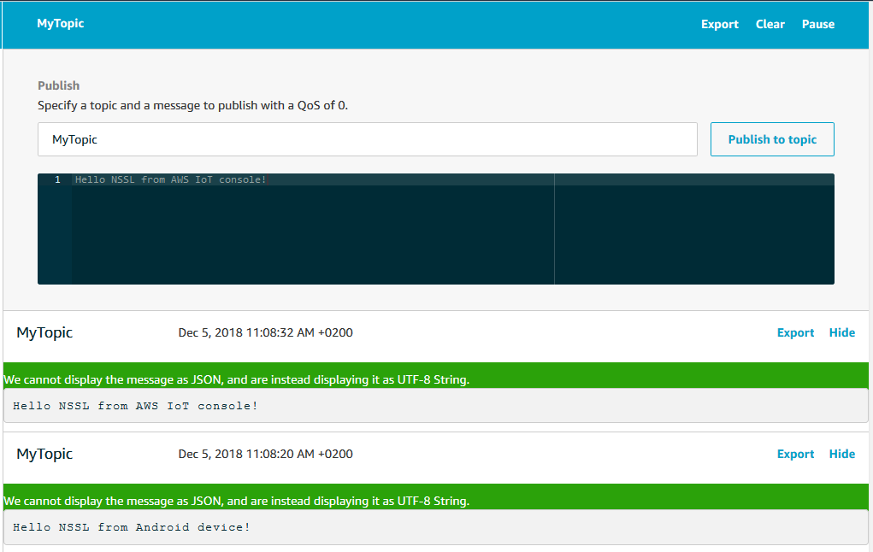
PubSub (MQTT)
Implementing messaging service between Android and AWS
AWS Publish
Everyone Subs
Android Publish
Everyone Subs

Slide 10
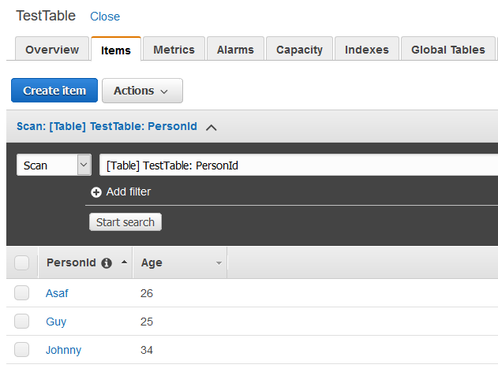
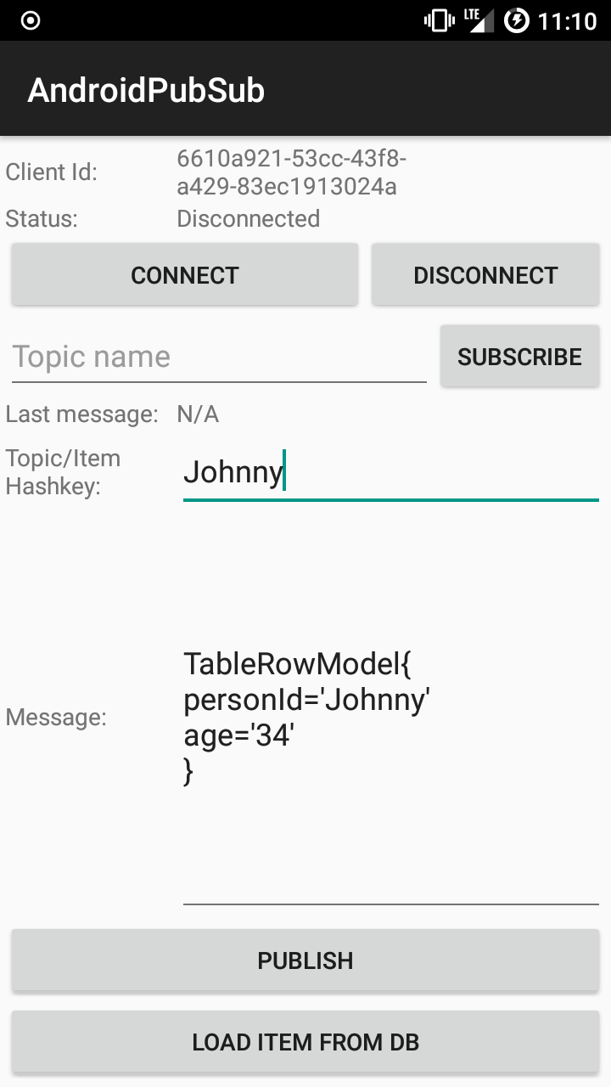
DynamoDB

Slide 11
Issues
UV4L+Jitsi setup on EC2 – solved by using Ubuntu 18.04.
Jitsi requires secured connection with certificate – solved by:
External domain – www.smartdoorbell.ga.
Connecting domain to our ELB DNS.
Connecting ELB to our EC2 instance.
Getting certificate from AWS ACM for the external domain.
Raspberry Pi
Faulty SD card – bought a new one.
Possibly faulty device – need to verify.
Android authenticated PubSub connection – doesn’t seem to work.

Slide 12
What’s Next?
Raspberry Pi
PubSub – 1 week
Video streaming – < 1 week
Motion detection – 1 week
Door open/close switch indication – < 1 week
AWS
Face recognition – 1 week
Database – 1-2 week
Android
Notifications – 2 weeks
GUI – 1 week
Integration – 2-3 weeks

