Slide 1
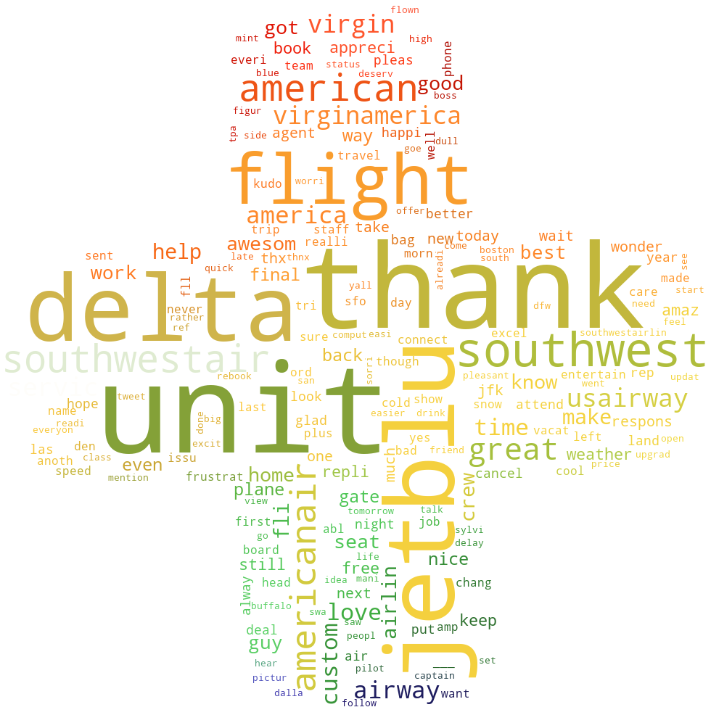
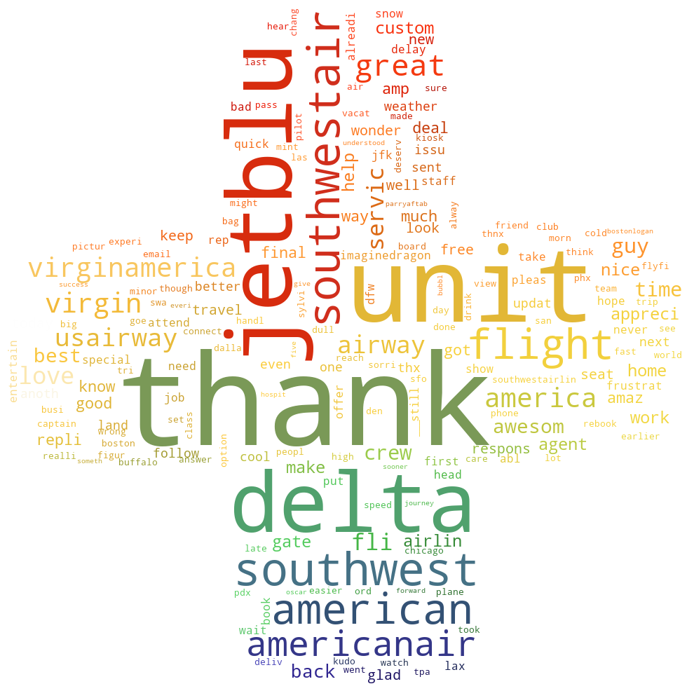
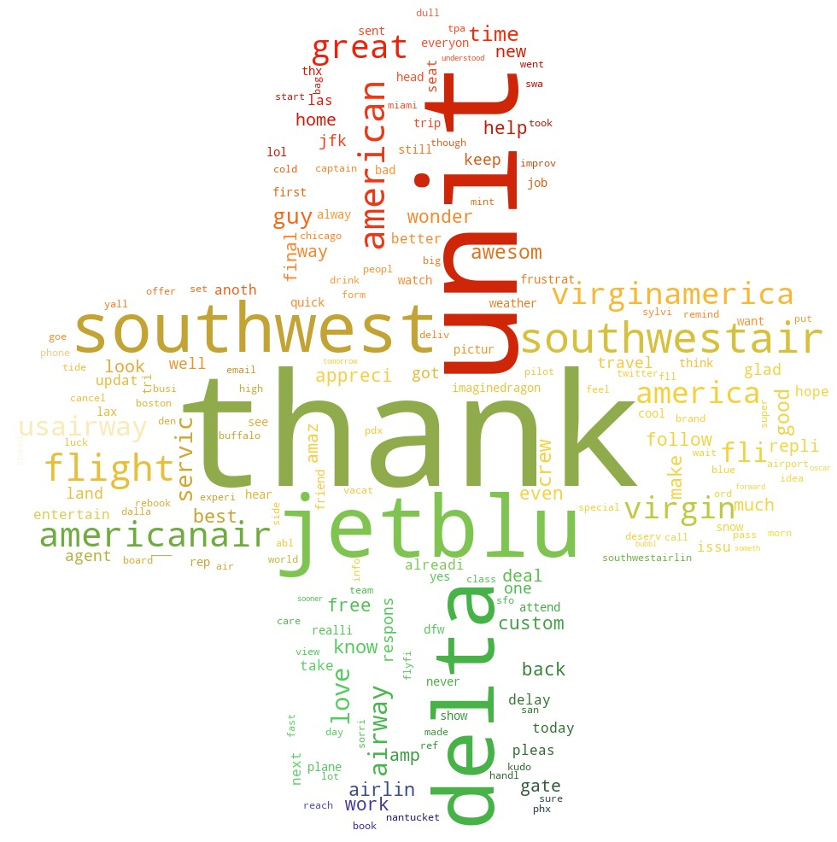
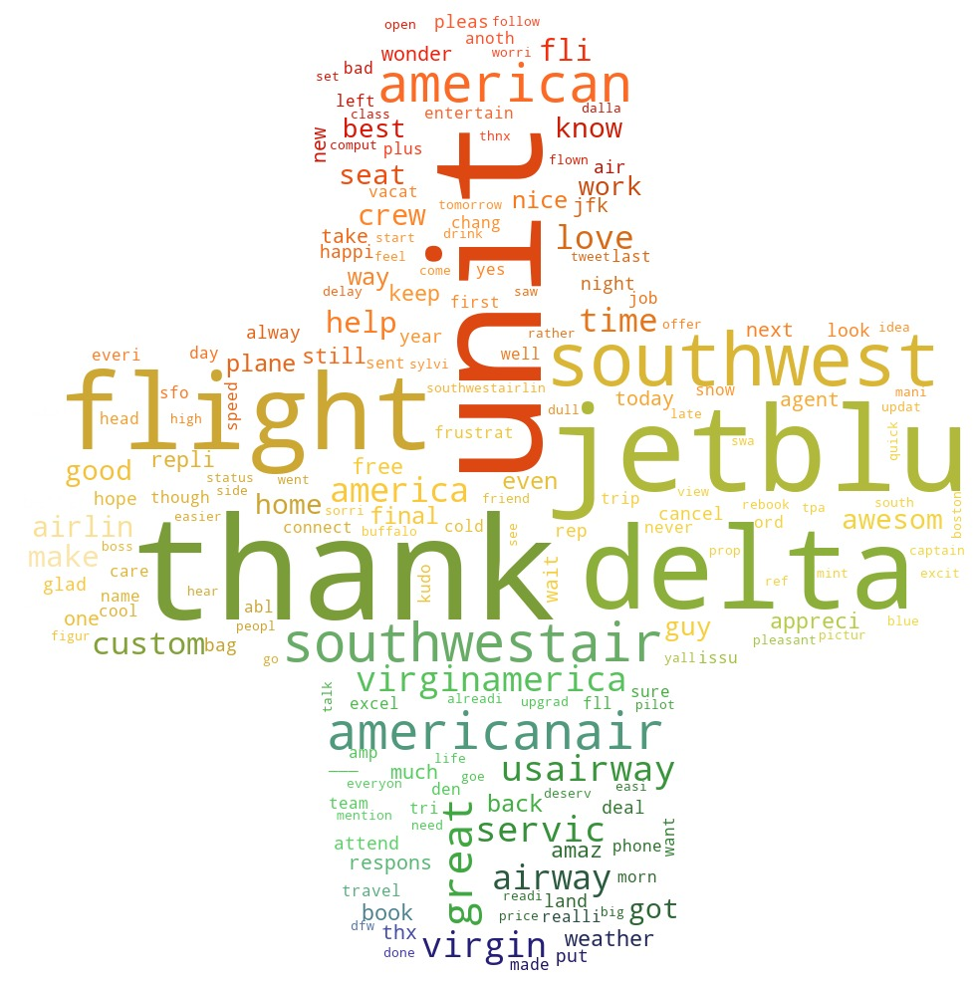
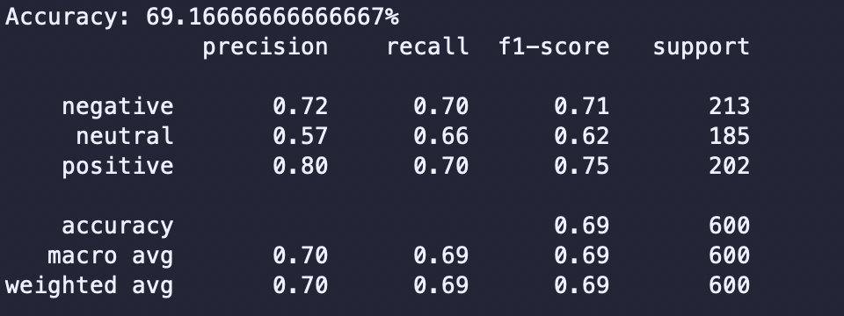
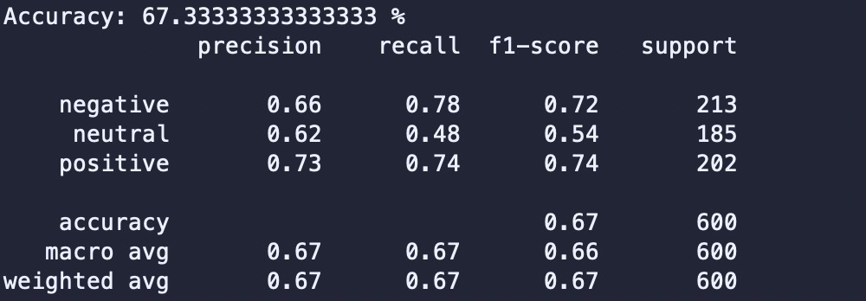
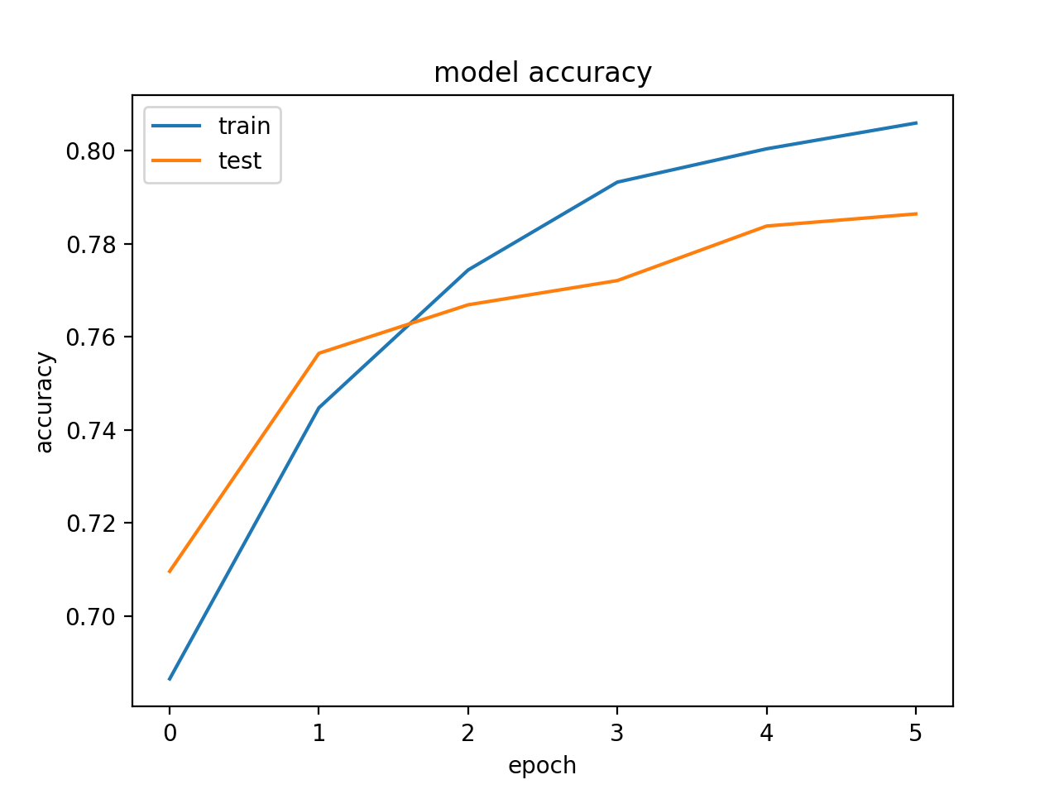
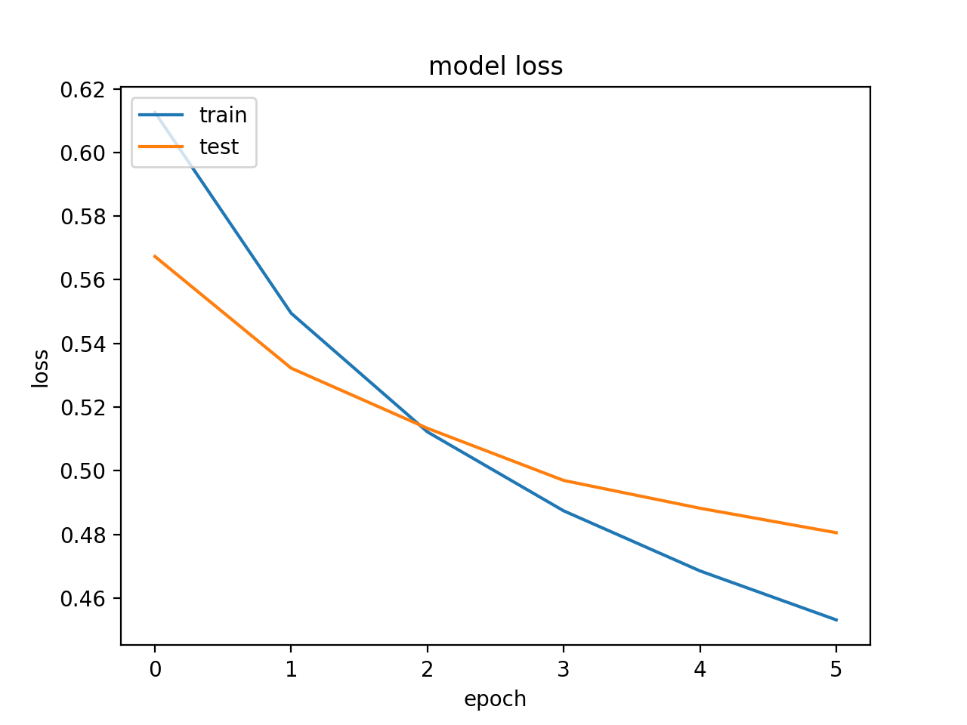
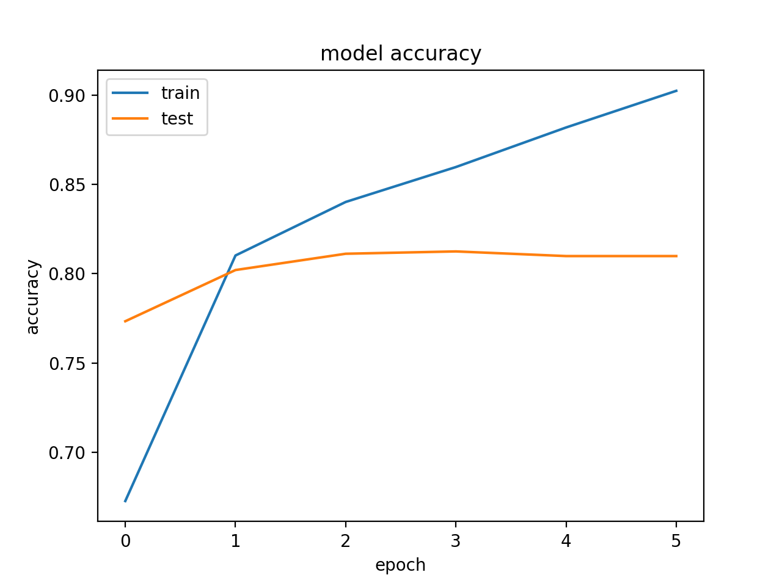
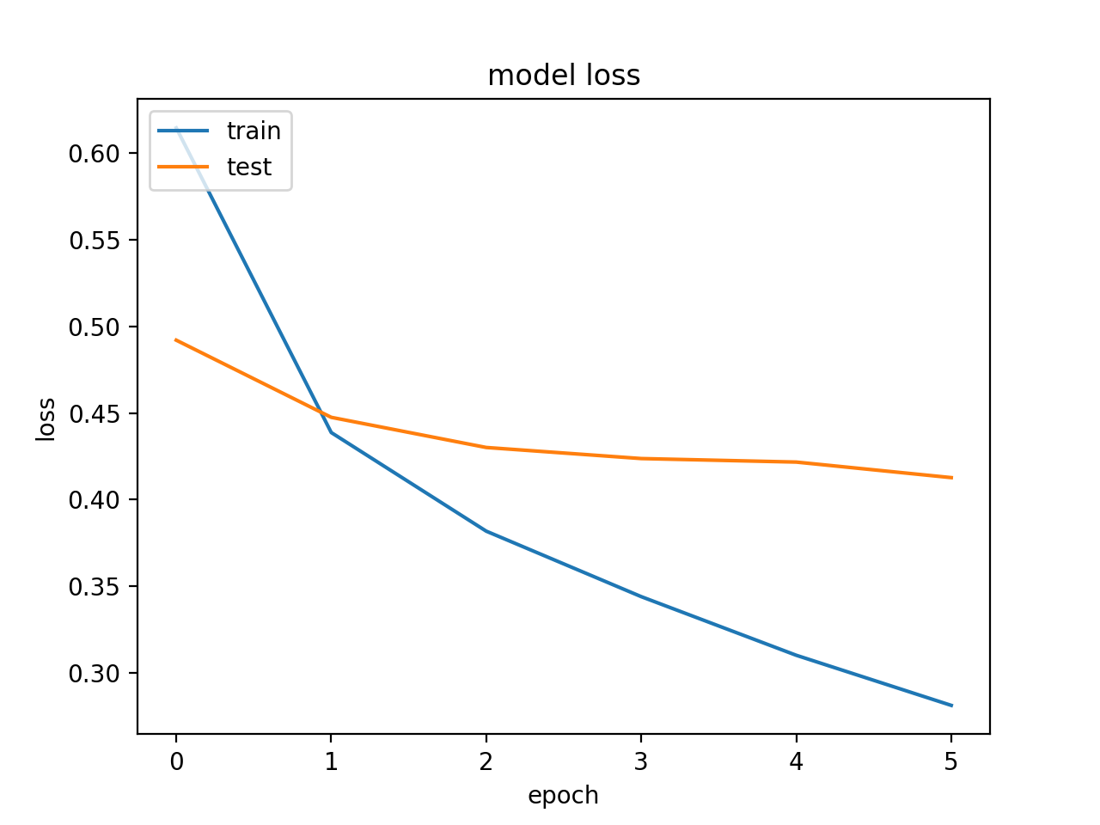
PERFORMANCE COMPARISON BETWEEN SUPPORT VECTOR MACHINE, NAÏVE BAYES CLASSIFIER, SEQUENTIAL MODEL, AND CONVOLUTIONAL NEURAL NETWORK FOR TEXT DATASET SENTIMENT ANALYSIS
Aamod Khatiwada, Nitisha Patange, Humberto Pinon
Abstract
This project compares the classification performances among the Naïve Bayes Classifier, Support Vector Machine (SVM), Sequential Model, and Convolutional Neural Network (CNN). The airline review twitter dataset from Kaggle was used, which consists of Positive, Negative, and Neutral as the classification labels. The models were trained using the same dataset and the four different algorithms. The best classification accuracy obtained from all four models were used for the final comparison. The visualization tools like graphs and word clouds are used to support the results. The project concludes that the deep learning models are more accurate on the classification task for the selected dataset.
Dataset Introduction
Dataset: Twitter US Airline Sentiment
Dataset was obtained from Kaggle.
The tweets were collected according to 3 classes: positive, negative and neutral.
Total number of Tweets: 3000
2400 for training (80%).
600 for testing (20%).
Positive: 1000
Negative: 1000
Neutral: 1000
Actual
Predicted
Sequential Model
1 embedding layer and 1 dense layer
Activation Function: Sigmoid
Number of epochs (number of times the model will cycle through the data): 6
SVM Word Cloud
Convolutional Neural Network
1D convolutional layer and 1 pooling layer
Activation Function: Sigmoid
Number of epochs (number of times the model will cycle through the data): 6
128 kernels (kernel size = 5)
Naïve Bayes
Word Cloud
SVM classifier for Gamma=0.7, C=1.5
Naïve Bayes Classifier
Primary Objective
To compare the text sentiment classification accuracy of SVM, Naïve Bayes, sequential, and CNN for an Airline review twitter dataset.
Conclusion
Naïve Bayes and SVM: Almost equal accuracy.
Sequential model and CNN: Almost equal accuracy.
Higher classification Accuracy seen on deep learning models with CNN leading among the two.
Most inaccurate classification in general: Neutral Sentiment Texts
Sequential (1 embedding layer and 1 dense layer)
CNN (1D convolutional layer and 1 pooling layer)

