Slide 1
Mushroom Classification
By: Ijeoma Akamnonu and Raizel Bernstein

Slide 2
Business Problem
Restaurants rely on only edible mushrooms
Poisonous mushrooms are a liability that could cost the business millions if not carefully weeded out
Customers could face adverse side effects
Possibility of getting sued
A single slip up could lead to an ill customer or even a death.
This situation must be avoided

Slide 3
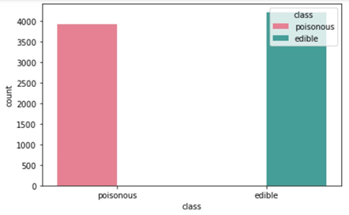
Data
data from Kaggle.com
23 columns and 8124 rows
No class imbalences
light cleaning (no missing values)
Labeled for easier observations
Label encoded for modelling

Slide 4
Methods
We used 3 models in total to create our predictions.
Random Forest
categorical
Decision Tree
categorical
Logistic Regression
Logged odds coefficients
Features based on data and domain knowledge

Slide 5
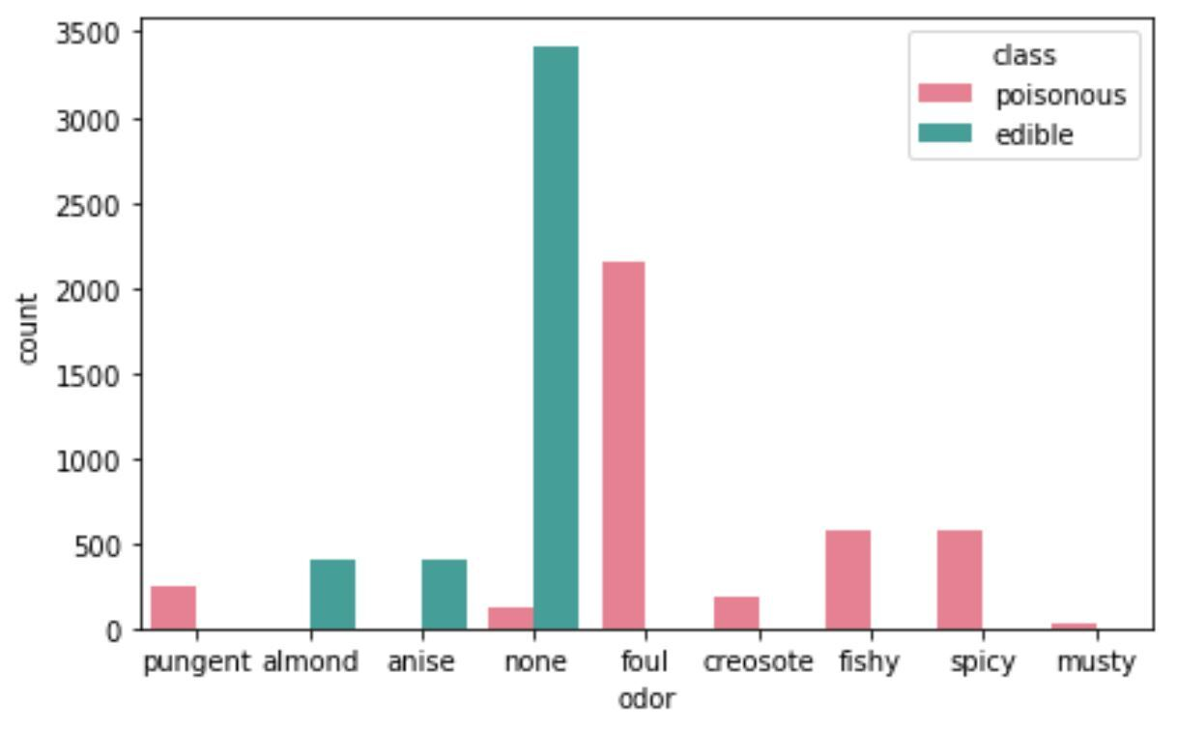
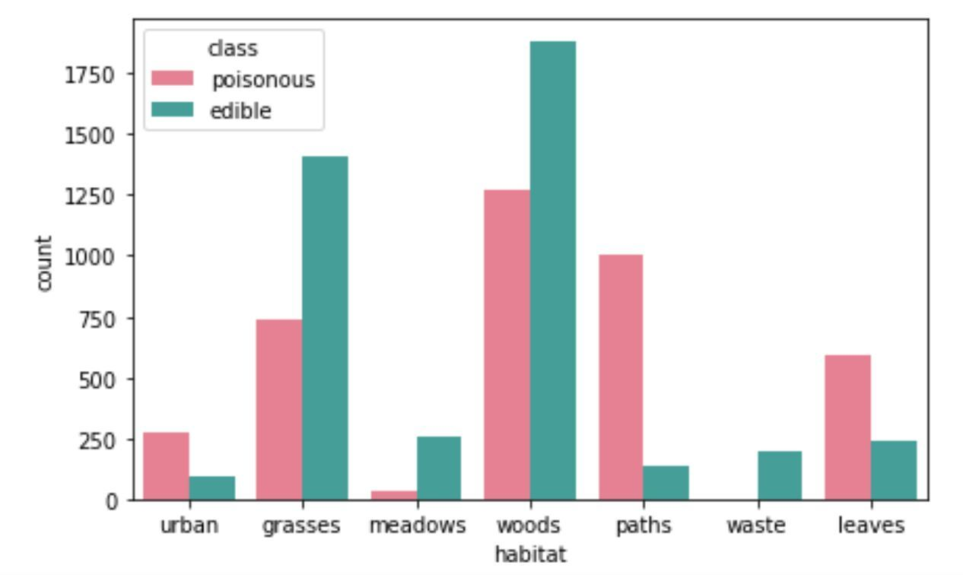
Based on EDA
odor: Interestingly, things that we would typically consider "good" smells are for mainly for edible mushrooms. All other less pleasant smelling mushrooms are indications of a poisonous species.
Habitat: From the habitat graph one can see that waste has edible mushrooms. Wood and grass areas are more likely to have edible mushrooms, but a lot of mushrooms found in the woody and grassy areas are poisonous. Paths are likely to have poisonous mushrooms.

Slide 6
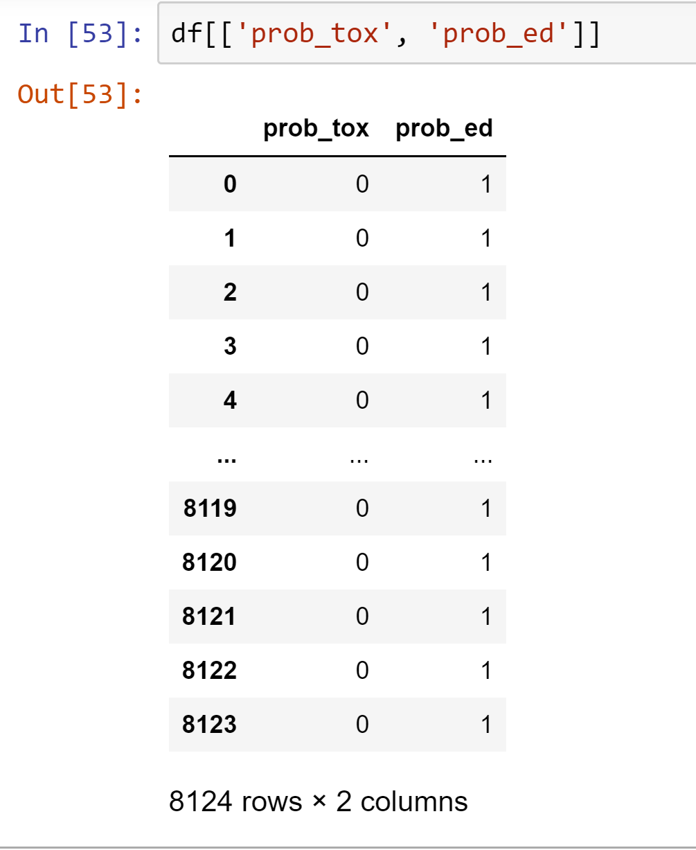
Based on Domain
Information from several websites helped compile 2 features based on common toxic and edible characteristics of mushrooms.
Prob_tox: toxic mushrooms usually have red caps, white spores, etc.
Prob_ed: non-toxic mushrooms usually have tan and brown gill colors, etc

Slide 7
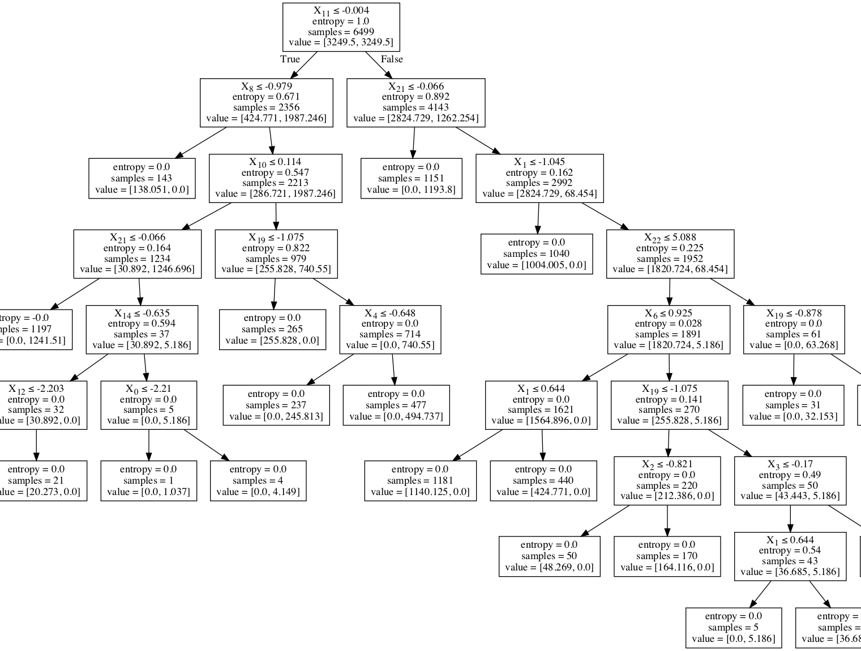
Results
Giving us an accuracy score of 100%, Decision Tree was the best model.
Our 4 best features were odor, stalk-above-ring, bruises, and habitat.

Slide 8
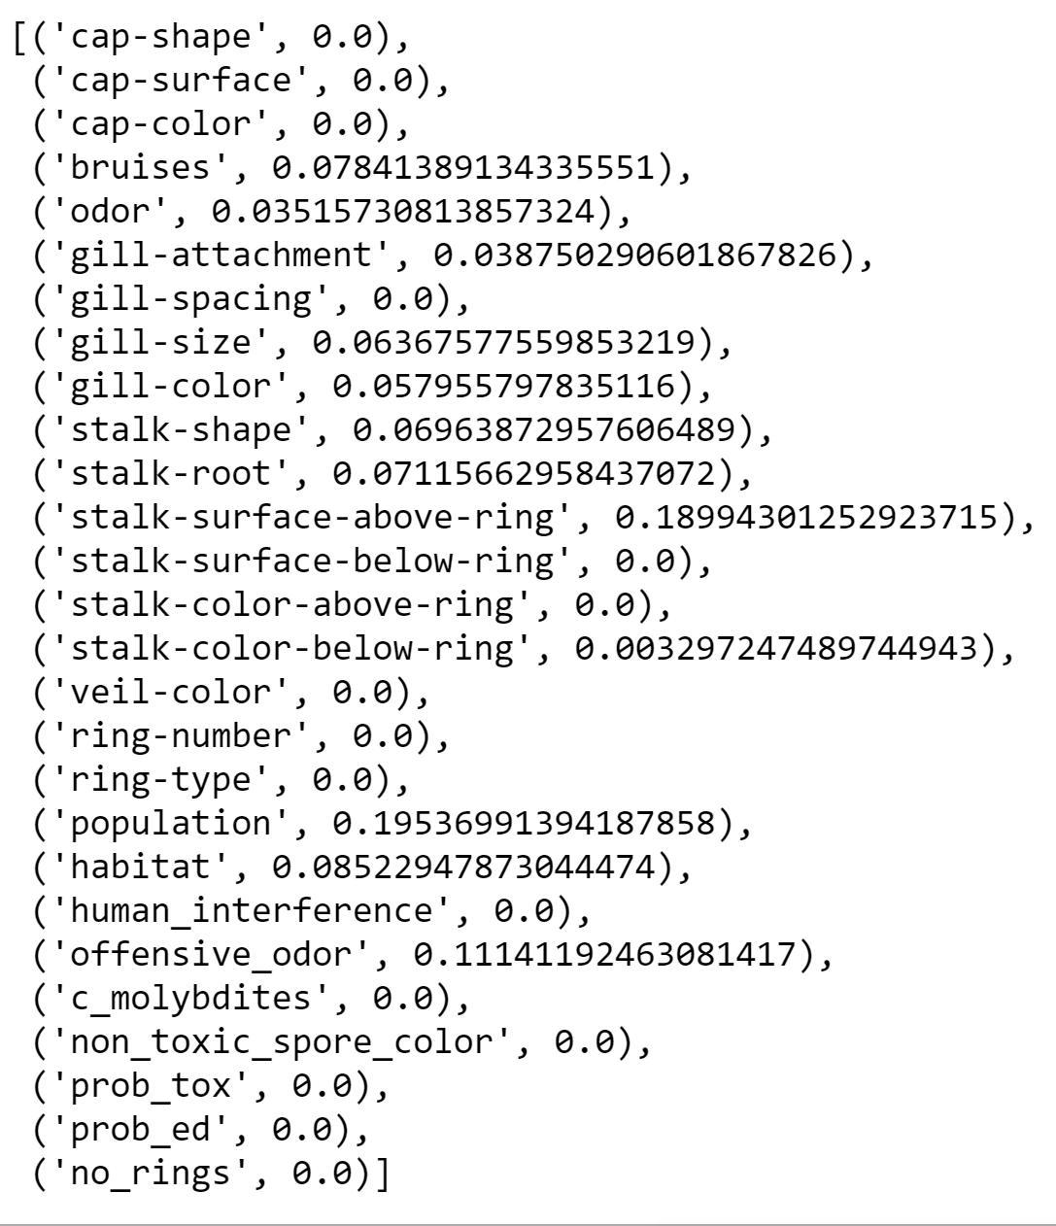
Conclusions and Insights
Spore print color plays a major role in the predictability of the model before fine tuning.
Decision tree was considered the best model because unlike random forest, it did not include our most predictive features.

Slide 9
Next Steps
Get more data to ensure all bases have been covered. We cannot risk ingesting a single toxic mushroom.

