Slide 1

Cuisine Classification
By: Ijeoma Akamnonu

Slide 2
Summary
During this NLP Project, a model was trained to classify 20 cuisine types.
Best baseline model was using Logistic Regression
Prioritized accuracy at 62%

Slide 3
Outline
Business Problem
Data and Methods
Results
Conclusions
Next Steps

Slide 4

Business Problem
Build a model that can correctly classify a cuisine based on key words in a given recipe.

Slide 5
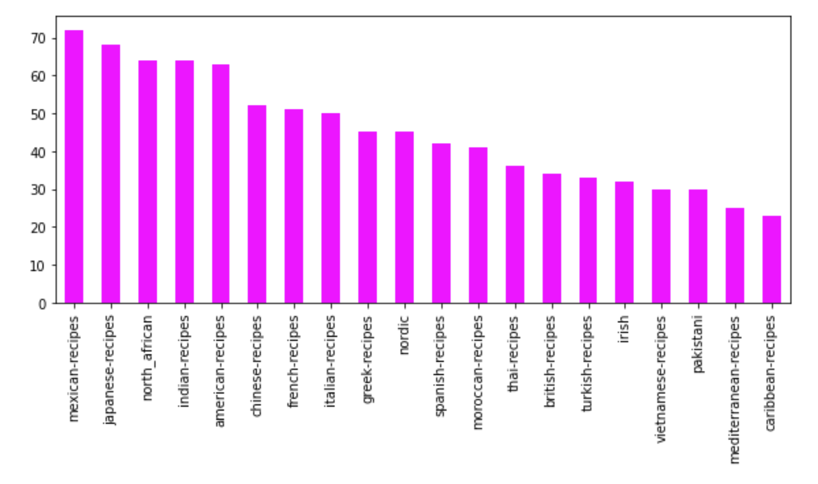
Data
Web scraped from GoodFood.com, a bbc affiliated website
Concatenated 4 more cuisines from preexisting data
900 recipes in total
20 Cuisines

Slide 6
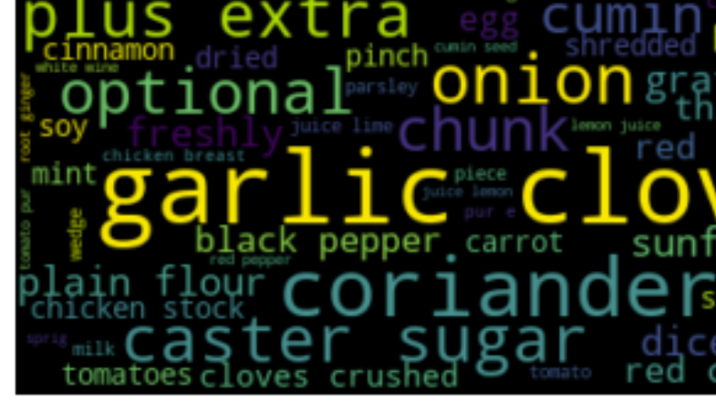
Methods
Cleaning done using:
Regular Expression
Tokenization
Custom stop-word removal
WordClouds
Models
Naive Bayes
SVM
Logistic Regression

Slide 7
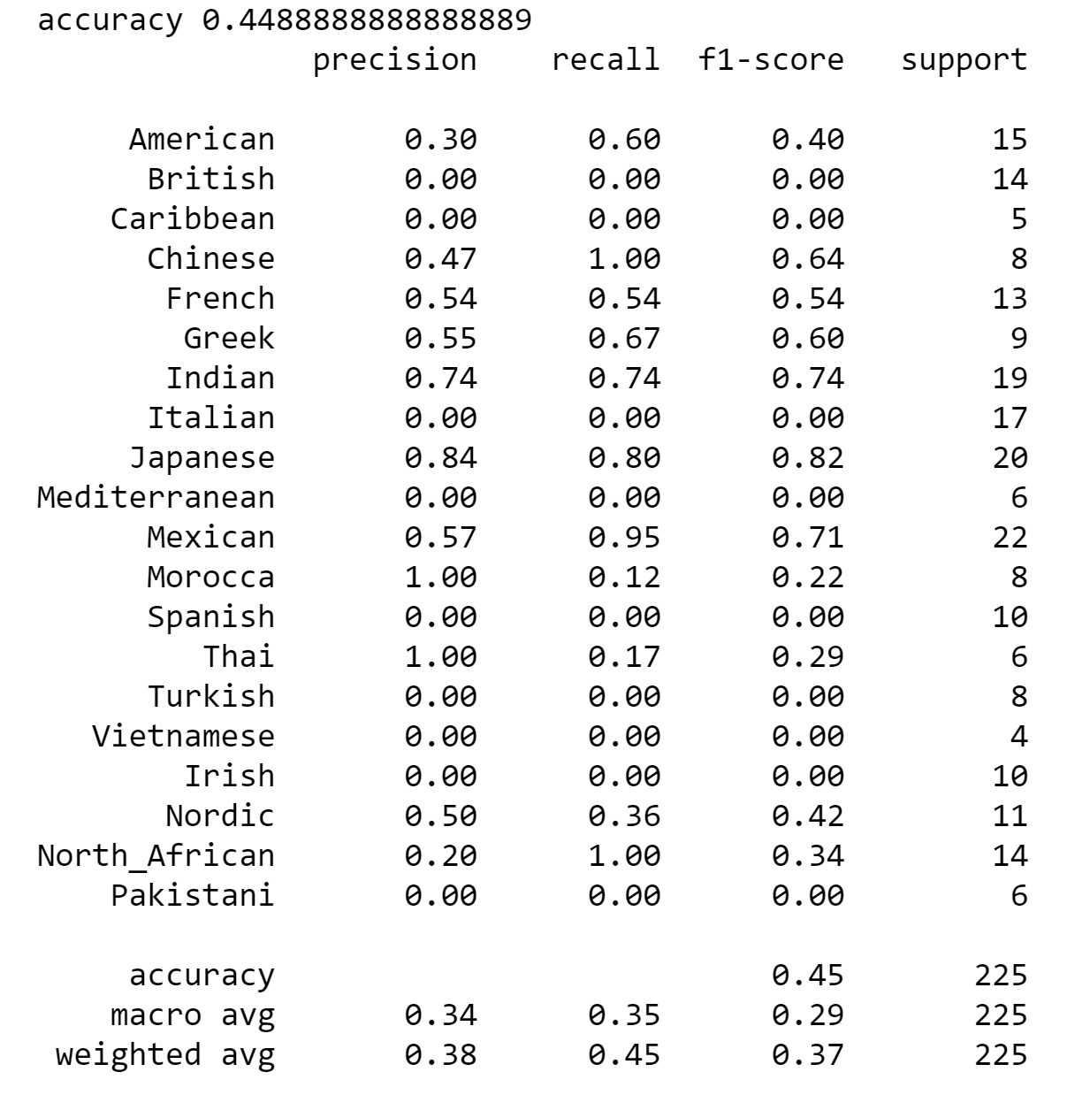
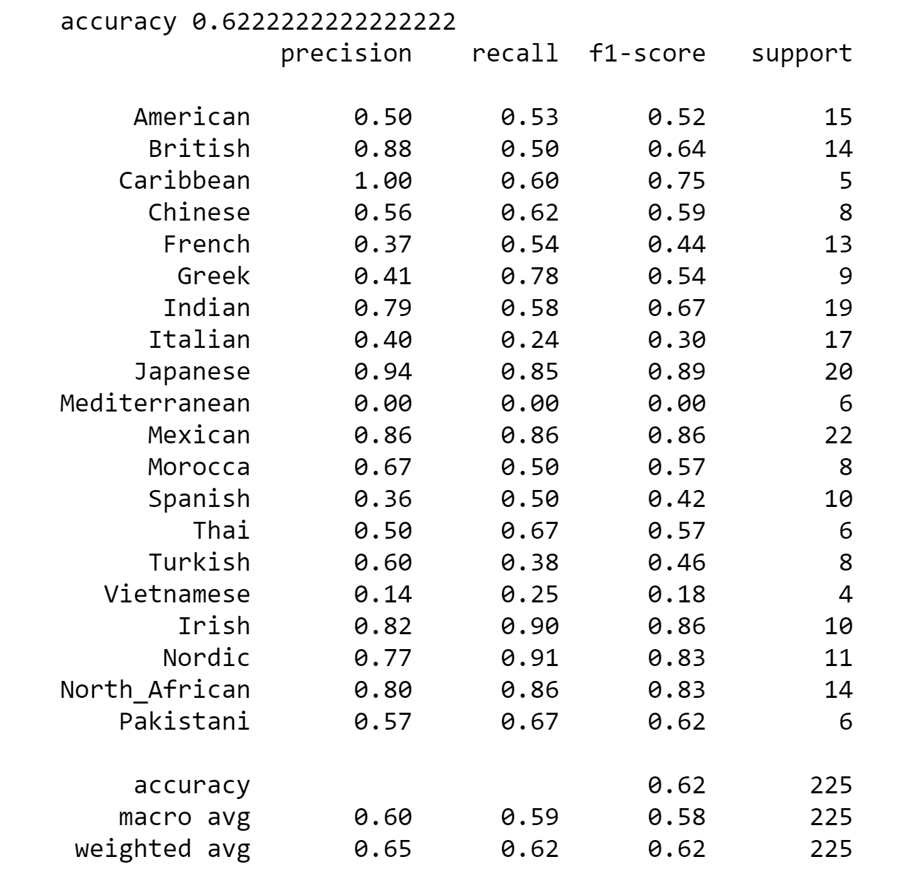
Results
Naïve Bayes
Logistic Regression

Slide 8
Conclusion
Further cleaning can help the model
Model struggled at classifying Vietnamese cuisines
Generate more insights to see why

Slide 9
Next Steps
More data analysis and insights
Feature engineering
Common words
Patterns
Use best model to generate a recommendation system that can provide a cuisine given on-hand ingredients
Implement Neural Network

