Slide 1

Cuisine Classification
By: Ijeoma N. Akamnonu

Slide 2
Summary
Natural Language Processing
model trained to classify 20 cuisine types.
Best baseline model was using Logistic Regression
Prioritized baseline accuracy at 62%

Slide 3
Term Clarification
A Cuisine is a style of cooking associated to a specific region of the world
A Recipe is the instructions on how to create a specific cuisine
Ingredients are the building blocks for the recipe

Slide 4
Why Should You Be Interested?
Everybody eats!
Amateur chefs can cook too
Restaurant Inclusivity
Enhancing the menu
Gain popularity among multiple cuisine cultures
Recipe generation

Slide 5
Outline
Business Problem & Understanding
Data Collection & Methods
Results
Conclusions
Next Steps

Slide 6

Business Problem & Understanding
Build a model that can accurately classify a cuisine based on key words in a given recipe.
WHY?
Gain insights and make patterns between different cuisines through classification
Use those insights and patterns to generate novel, possibly delicious recipes

Slide 7


Data Collection
Web scraped 700 recipes from GoodFood.com, a bbc affiliated website
Concatenated 200 more recipes using 4 more cuisines from pre-existing data scraped from bbc.co.uk/food
900 recipes in total
20 Cuisines

Slide 8
Interesting Finds
Model may rely on specific key ingredients, depending on the cuisine:
Mexican
Japanese
North_African
Indian
American

Slide 9
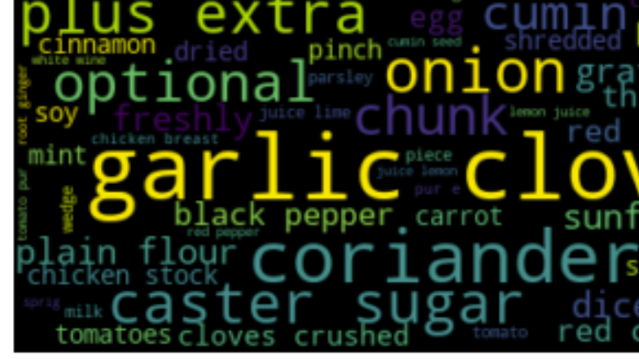
Methods
Natural Language Processing
Cleaning done using:
Regular Expression
Tokenization
Distinguish each word
Stop-word removal
Natural Language Processing Tool Kit
Common words like “and, you, I, or, etc”
Custom
Common cooking measurements
Models
Naive Bayes
SVM
Logistic Regression

Slide 10
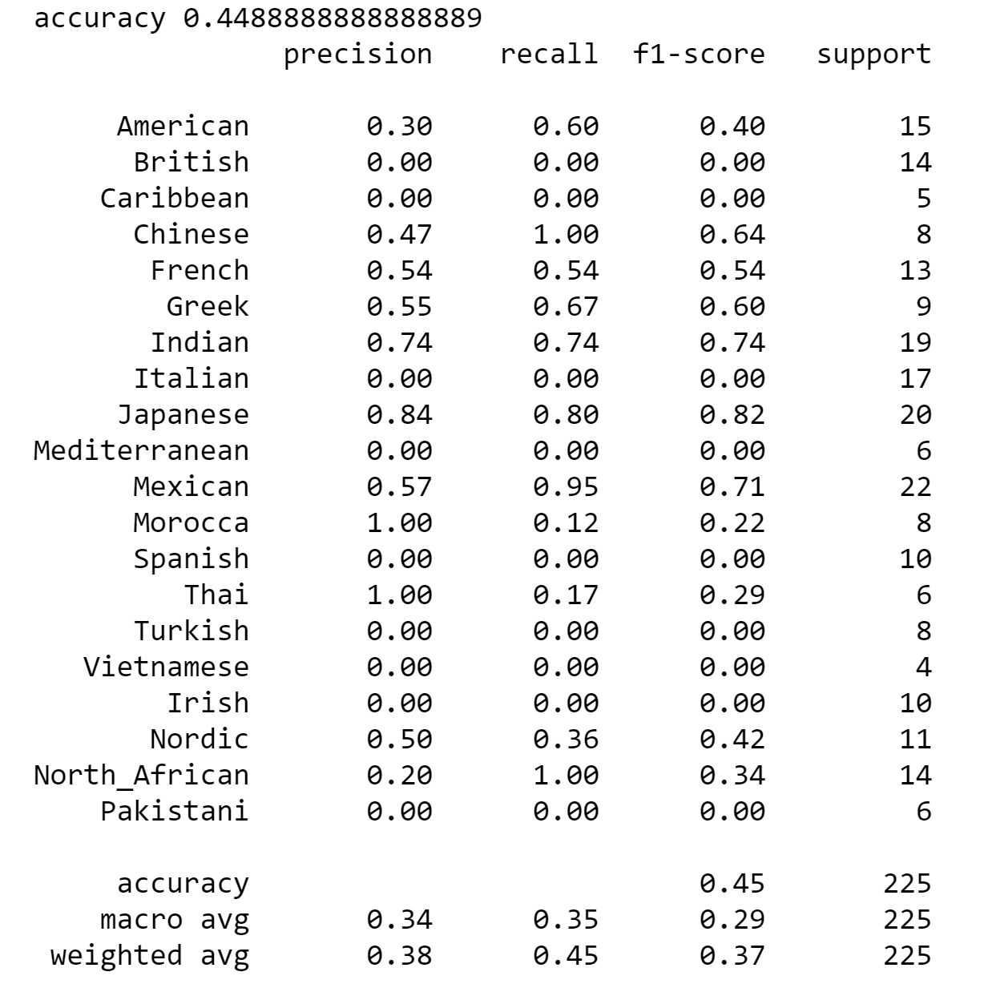
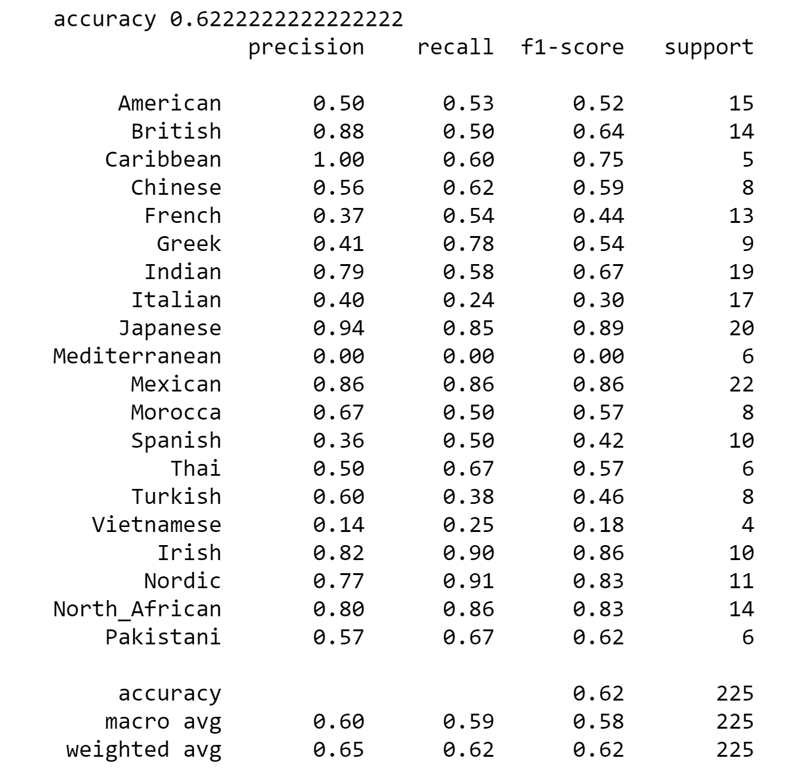
Results
Naïve Bayes
Logistic Regression

Slide 11
Conclusion
Further cleaning will help the model
Model struggled at classifying Vietnamese cuisines
Generate more insights to see why

Slide 12
Next Steps
More data analysis and insights
Feature engineering
Common words
Patterns
StreamLit
Neural Networks
Implement Natural Language Geteration with the use of Markovify
generate app that can provide a cuisine recipe given your inputted on-hand ingredients

