Slide 1

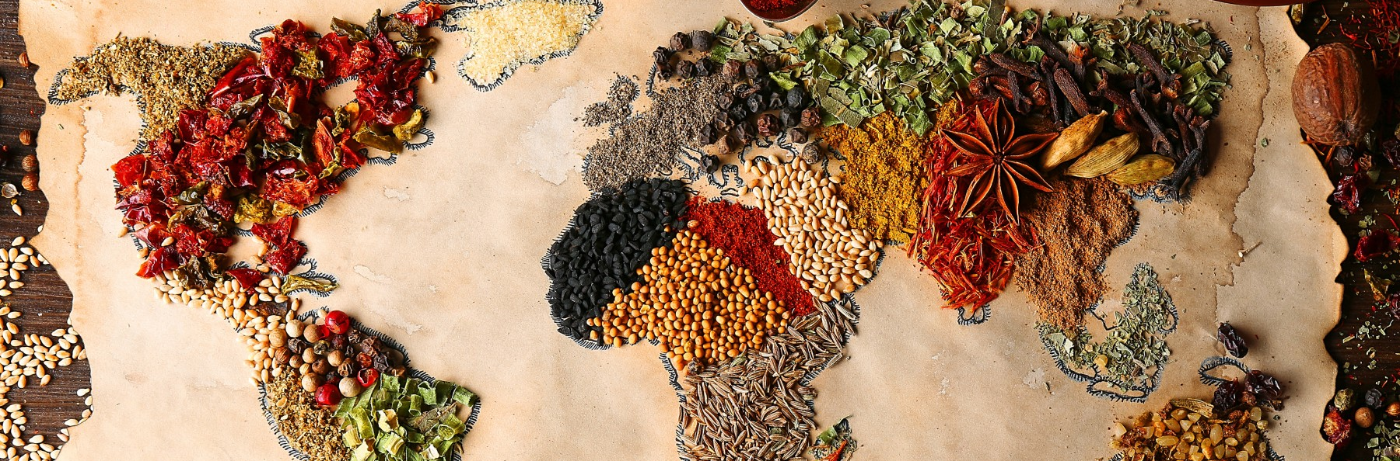
Cuisine Classification
By: Ijeoma N. Akamnonu

Slide 2
Summary
Natural Language Processing
model trained to classify 20 cuisine types.
Best model used Support Vector Machines with Stochastic Gradient Descent
Highest accuracy used lemmed tokens: 64%
More data less problems… maybe

Slide 3
Term Clarification
A Cuisine is a style of cooking associated to a specific region of the world
A Recipe is the instructions on how to create a specific cuisine
Ingredients are the building blocks for a recipe

Slide 4
Why Should You Be Interested?
Everybody eats!
Amateur chefs and at home cooks can cook too
General curiosity and ease of access (Next Steps)
Restaurant Inclusivity
Enhancing the menu
Gain popularity among multiple cuisine cultures
Recipe generation for more exposure (Next Steps)

Slide 5
We Will Go Through…
Business Problem & Understanding
Data Collection & Methods
Results
Conclusions
Next Steps

Slide 6
Why Should A Business Be Interested?
Build a model that can accurately classify a cuisine based on key words in a given recipe.
Gain insights and make patterns between different cuisines through classification
Use those insights and patterns to generate novel, possibly delicious recipes

Slide 7


Data Collection
Web scraped 729 recipes from GoodFood.com, a British Broadcasting Corporation affiliated website
Concatenated 171 more recipes using 4 more cuisines from pre-existing data scraped from BBC Food.
900 recipes in total
20 Cuisines

Slide 8
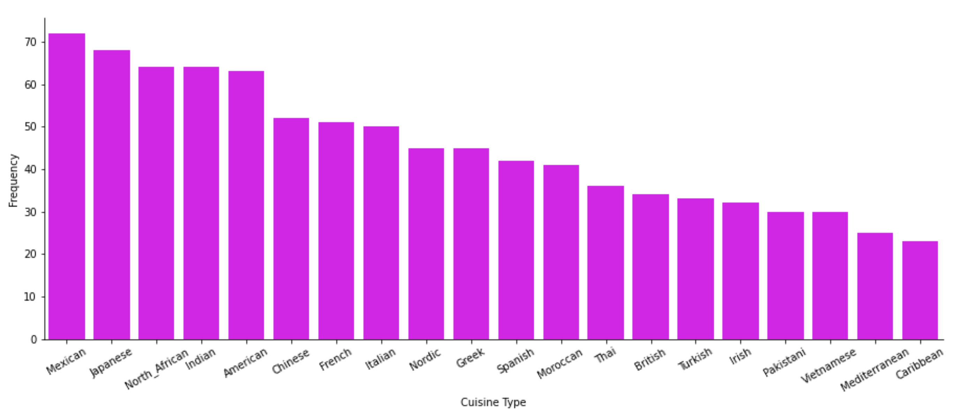
Overall Dataset Distribution

Slide 9
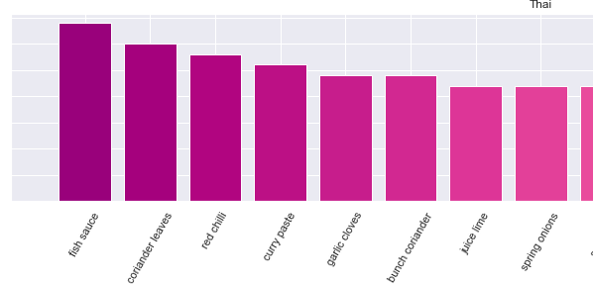
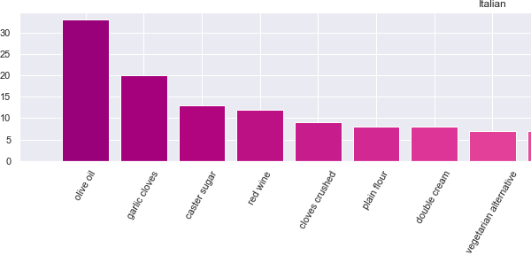
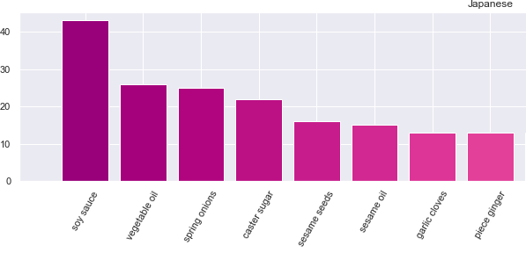
Some Interesting Finds
Model may rely on specific key ingredients, depending on the cuisine:
Thai
Fish sauce
coriander
Italian
Olive oil
parmesan cheese
Japanese
Soy sauce
Sesame

Slide 10
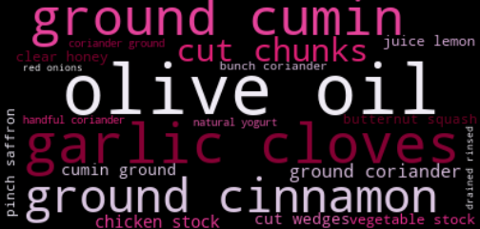
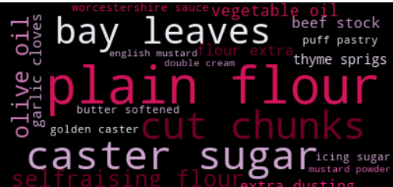
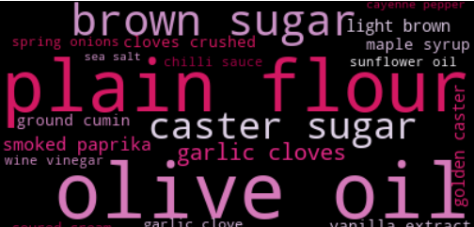
WordClouds
Moroccan Cuisines
Cut chunks
Olive Oil
British Cuisines
Plain flour
Cut chunks
American Cuisines
Olive oil
Plain flour

Slide 11
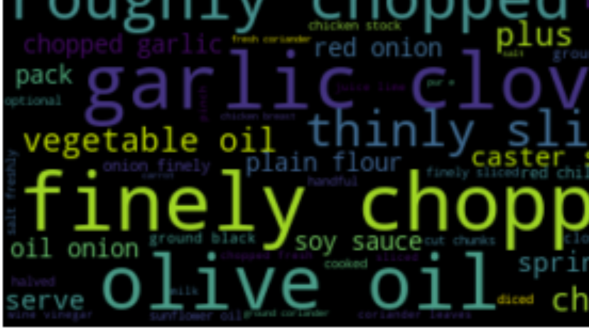
Methods
Natural Language Processing
Natural Language Processing Tool Kit
Cleaning done using:
Sci-Kit Learn
Regular Expression
Tokenization
Distinguish each word
Stop-word removal
NLTK
Common words like “and, you, I, or, etc”
Custom
Common cooking measurements like “finely, roughly, chopped, etc”
Models
Target = Cuisine
Data = Ingredients
Random Forest
Naive Bayes
SVM
Logistic Regression

Slide 12
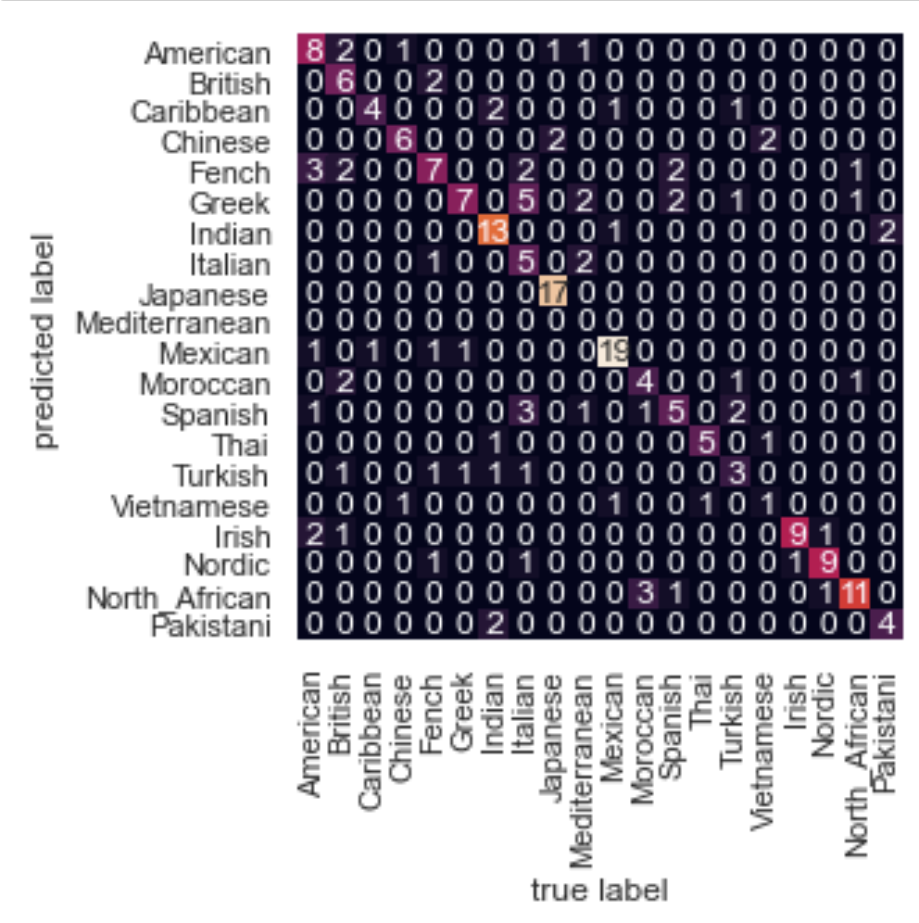
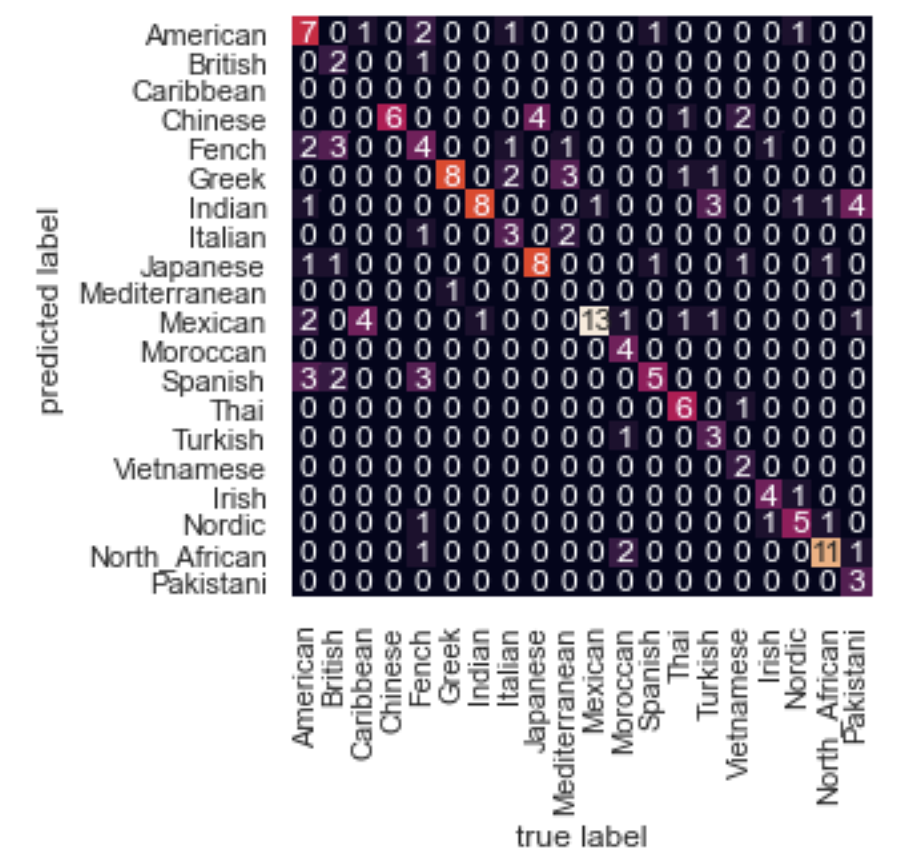
Results
Accuracy: 0.64
Macro average (F1-Score): 0.58
metrics for each label
unweighted
Weighted average(F1-Score): 0.63
Quite a few misclassifications
Greek
Some classification hits
Japanese
Mexican
North African
SVM
Random Forest

Slide 13
Conclusion
The model would greatly benefit from Principal Component Analysis
Model struggled at classifying the less abundant cuisines
Give the model more vocabulary to pinpoint as a beacon from classification
Lemming produced a better model than stemming or other
Increased maximum iterations increases accuracy
Meaningful feature engineering
Stemming may have produced less meaningful words

Slide 14
Next Steps
EDA, EDA, EDA
Feature engineering
Common words
Patterns
Implementation of Grid Search to optimize parameters
Streamlit
Neural Networks
Implement Natural Language Generation with the use of Markovify
generate app that can provide a cuisine recipe given your inputted on-hand ingredients

Slide 15



Thank You!
Linkedin: Ijeoma Akamnonu
GitHub: @aamoeji04
Email: inakamno@buffalo.edu

