Slide 1
Pneumonia Image Classification
Alexandra Bruno & Ijeoma Akamnonu
February 1, 2021

Slide 2
Summary
In this presentation we will be discussing the modeling process of building a convolutional neural network to predict whether chest x-rays in children show signs of pneumonia
For our analysis we prioritized our recall and accuracy metrics due to our business problems

Slide 3
Outline
Business Problem
Data and Methods
Results
Conclusions
Further Improvements

Slide 4
Business problem
Build a model that can classify whether a given patient has pneumonia, given a chest x-ray image.

Slide 5
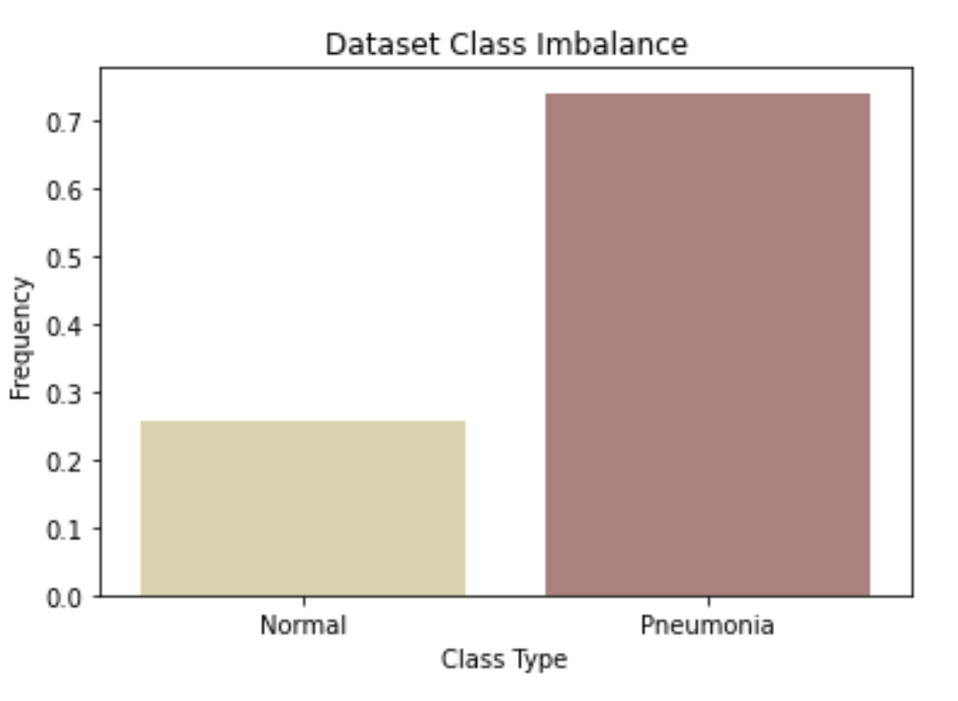
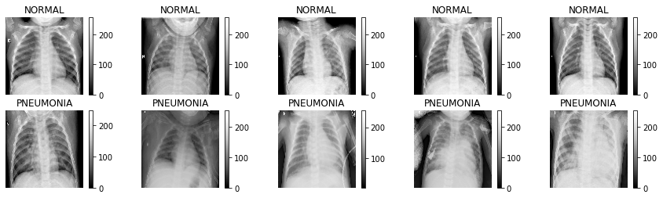
Data 1
Kaggle dataset
5,232 chest x-ray images
1349 Normal Images
3883 Pneumonia Images
Including viral and bacterial infections
Class imbalance present

Slide 6
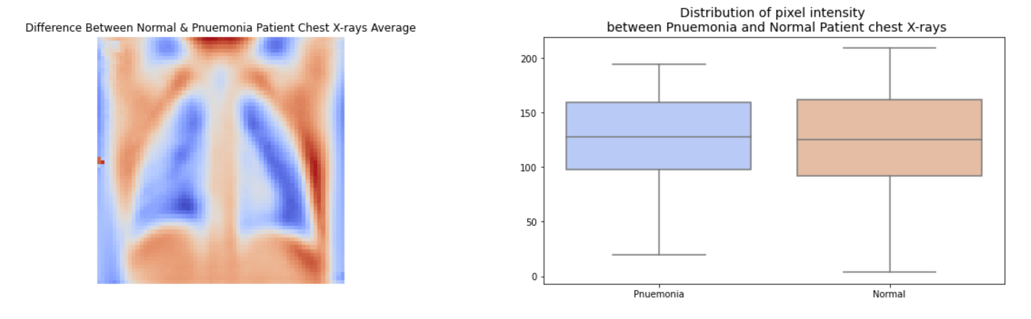
Data 2
Average distribution of pixel intensity, normal vs pneumonia
Pneumonia isolated in the lungs
Cloudy
Normal images have higher intensity
Prominent anatomy development

Slide 7
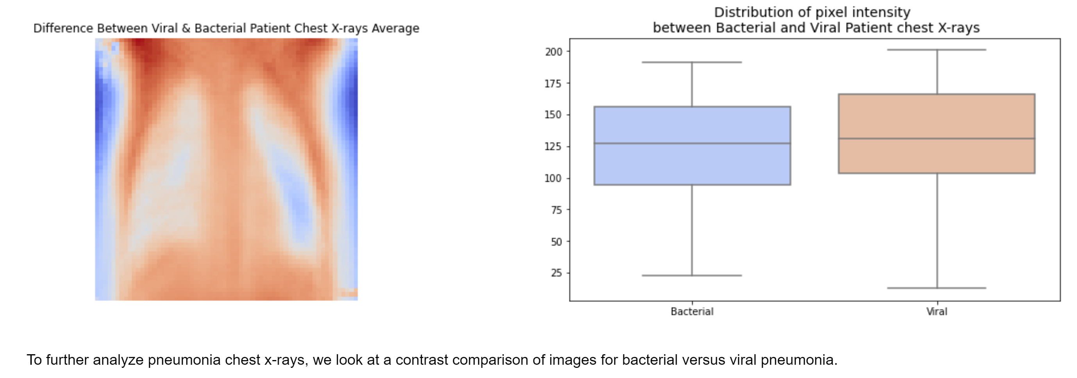
Data 3
Average distribution of pixel intensity, bacterial vs viral
Viral higher overall intensify
Bacterial somewhat significant in the lungs
Aligns with symptoms on bacterial respiratory infection

Slide 8
Methods
We ran three different CNN models with varying parameters
Added padding, increased image size, added number of layers with convolutions in ascending to descending order
Increased the pixel size to 256x256, grey scaled the images
The final model consists of 5 convolutional and maxpooling layers, 2 dropout layers, 1 flattening and densely connected layer
We chose to use an Adam optimizer

Slide 9
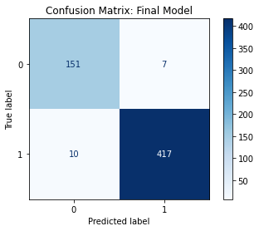
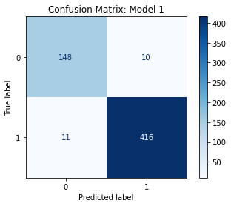

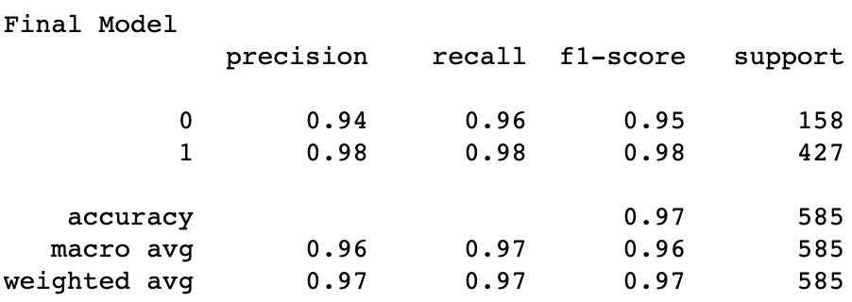
Results

Slide 10
Conclusions
Our model is better at predicting the majority class – but that is okay
Adding additional layers did help to improve our overall accuracy

Slide 11
Further Improvements
Experiment with further hyperparameters to improve recall and accuracy scores
Try and reduce the total amount of time the model takes to train without sacrificing predictive power
Implementing PCA
Generate more intentional features

Slide 12
Thank you!
Ijeoma Akamnonu
Email: inakamno@buffalo.edu
GitHub: https://github.com/aamoeji04
Alexandra Bruno
Email: alexandrabruno7898@gmail.com
GitHub: https://github.com/al-codes-now

