Slide 1
Building Blockchain D-apps (Decentralized Applications ) using Ethereum, .Net and Angular.
Aamol Gote

Slide 2

Marquee Sponsor

Slide 3








Platinum Sponsors
Gold Sponsors
Silver Sponsors

Slide 4
About ME
My Blog - https://mytechnetknowhows.wordpress.com/
Linked In - http://www.linkedin.com/in/aamolgote
GitHub - https://github.com/aamolgote/
https://github.com/aamolgote/codecampynyc2018
Twitter - @mytechnetnohows

Slide 5
Agenda
Blockchain, D-Apps and Smart Contracts
Dev tools
Architecture of Demo D-App(End State).
Setting Up Private Ethereum chain
Sample Smart contract (Asset transfer), solidity.
Demo
Code (API’s)

Slide 6
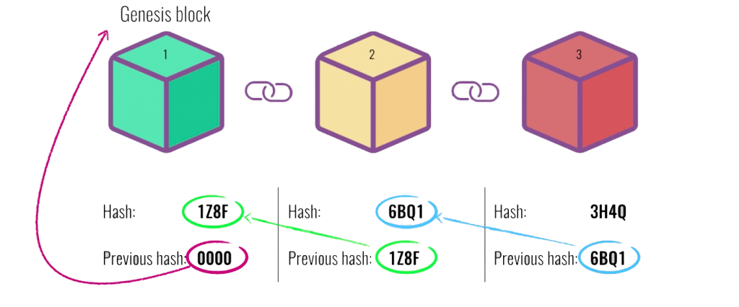
Blockchain
What is Blockchain
Technology that relies on cryptography to store data in distributed ledger
Every block contains a hash of the previous block
Distributed data store
Immutability of data stored.
Storing of data is based on agreements between all parties
**Genesis block
It is first block for the chain
It is created using the genesis state file or genesis.json
Blockchain 101 Visual Demo Video
Blockchain 101 Visual Demo

Slide 7





D-Apps(Decentralized Applications)
Decentralized applications (D-Apps) are applications that run on a P2P network of computers rather than some kind of hosting service.
D-Apps are a ‘blockchain enabled’, where the Smart Contract is used to connect to the blockchain
D-Apps backend is immutable. Not a general data platform that can be used for any types of applications.
Typically has an off chain database
Front End
Front End
Decentralized
Applications
Traditional Web Applications
Smart Contracts
Blockchain

Slide 8
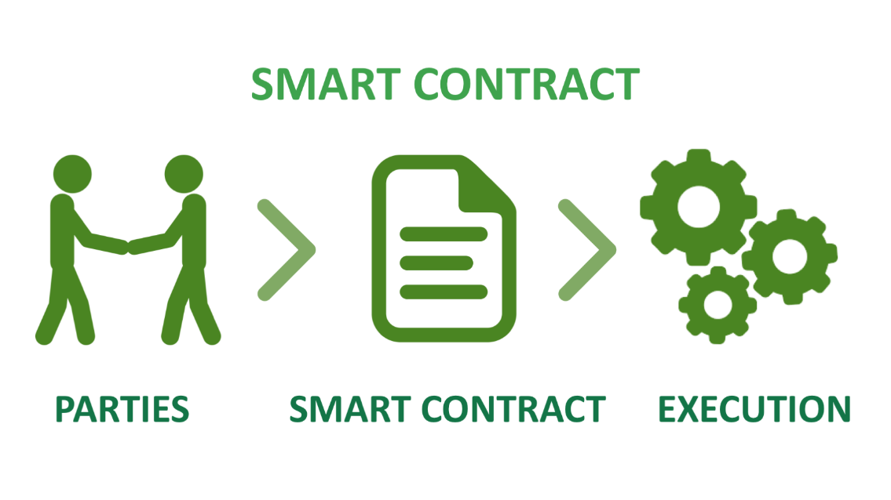
Smart Contracts
What are Smart contracts
Smart contracts are applications that run on the blockchain network. Ethereum is pioneer.
It is a computer program that implements and enforces business logic for an application.
Similar to physical contract but its digital and is represented by program
Function calls that change the state of the contract are written to the blockchain.
Works on the principle of the IFTTT logic aka the IF-THIS-THEN-THAT logic. Basically, if the first set of instructions are done then execute the next function and after that the next until you reach the end of the contract.

Slide 9

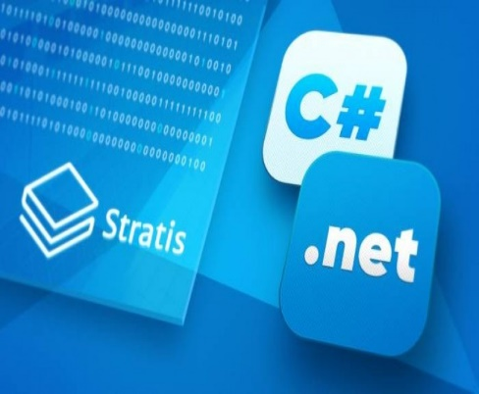
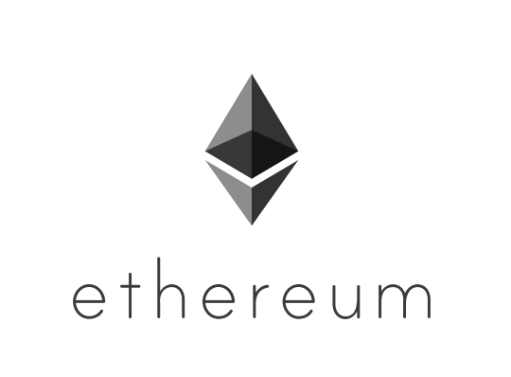
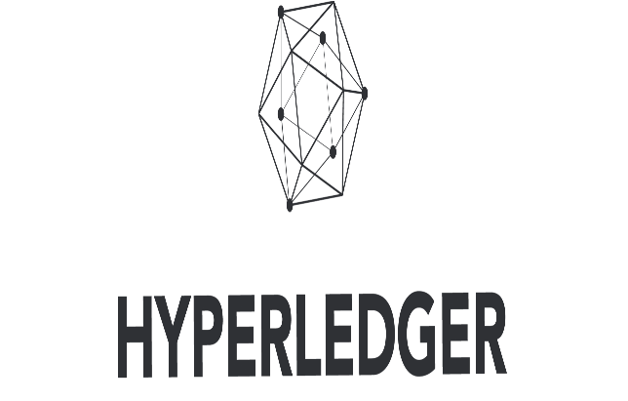
Smart Contract Platforms OPTIONS
Quorum – Fork of Ethereum, enterprise focused version of Ethereum. Backed by JP Morgan chase.
Stratis – More inclined towards C# and .NET ecosystem, you can write smart contracts in C#. In very early stages not that mature.
Supported by the Ethereum Foundation and a large community of developers worldwide.
Supported By IBM, development tools with Java and Node.JS

Slide 10
Core Smart Contract Concepts/ Limitations
Cannot have logic changes after deployment (Immutable)
Cannot call external web services or do any kind of looks ups from contract in Ethereum
Contract gets executed all the nodes on the Ethereum network.
Language is relatively new and need close code reviews before deployments.
Two types of functions on Smart contract
Write functions – These perform state changes and require Gas for the execution
Read Functions – These are free and do not require any Gas.

Slide 11

Dev tools
Ethereum Nodes
GETH – Command line interface for running full Ethereum nodes and spinning of distributed ledger.
Ethereum Client
Nethereum.web3 nuget – For interacting with distributed ledger using RPC.
Solidity (Contract oriented programming language for writing smart contract)
Visual studio plugin
Remix online editor
Standard dev tools
VS code for angular
VS for API’s
Notes:
© Copyright PresentationGo.com – The free PowerPoint template library

Slide 12
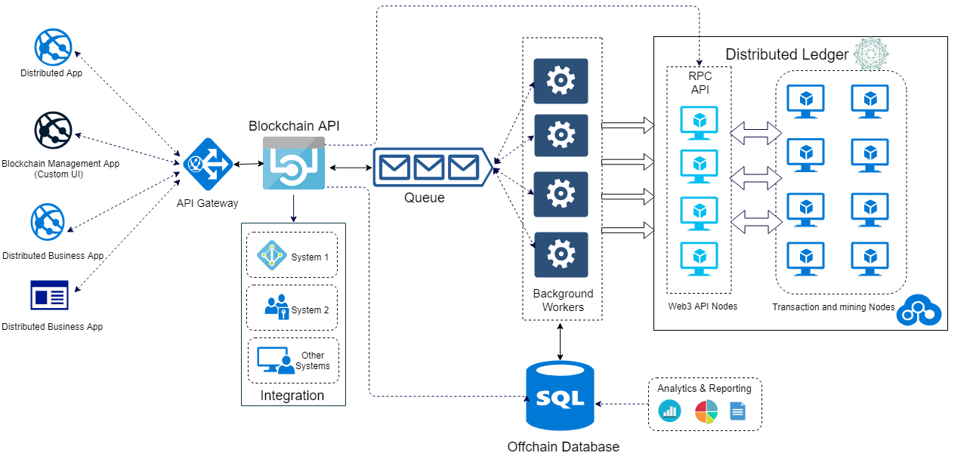
END State BAAS Architecture

Slide 13
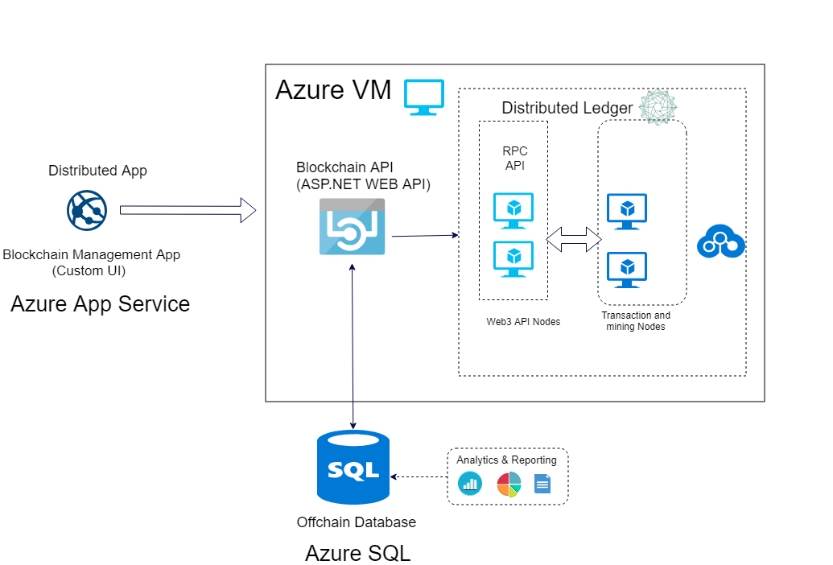
Current Demo Set Up

Slide 14
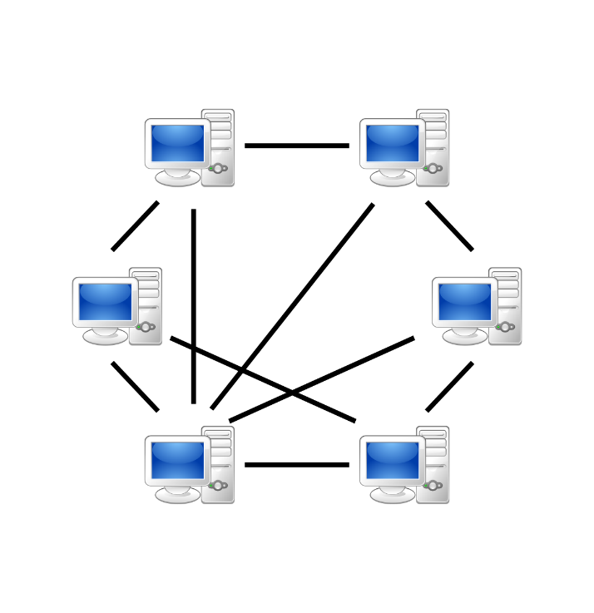
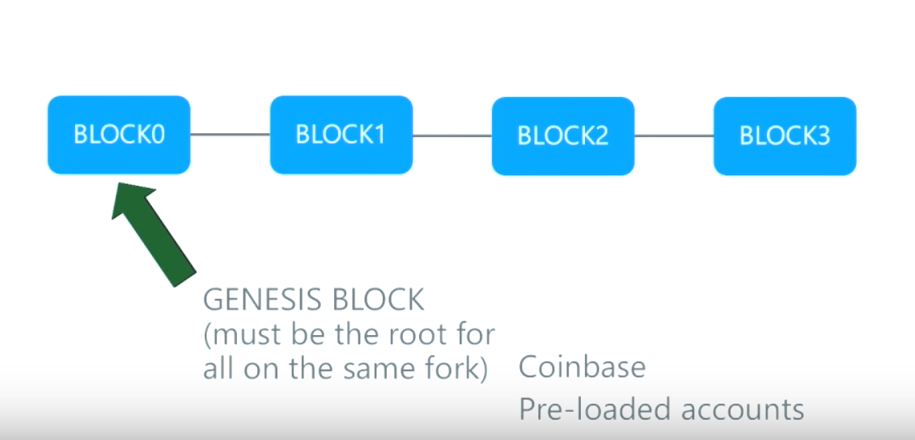
Setting Up Private Network
Genesis.json
Initialize network
Spin off various nodes (RPC, web3, mine).
Network communication across nodes and Static nodes
Each node contains full copy of blockchain db which stores a record of every transaction.
Different types of networks
Private Newtorks
Public networks
Main Network (Ether Based)
Test Networks
Ropsten
Kovan
Rinkeby

Slide 15
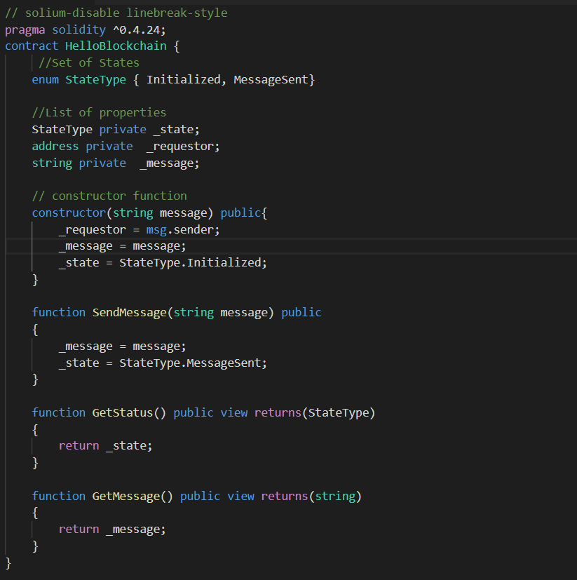
Sample SOLIDITY Contract
Online Editor - https://remix.ethereum.org
ABI – Application Binary Interface
It is the standard way to interact with contracts, both from outside the blockchain and for contract-to-contract interaction.
Metadata for interacting with Smart contracts. It defines which functions you can invoke and their associated inputs/outputs.
Smart contract is stored as byte code in blockchain under a specific address known as contract address.

Slide 16
Demo

Slide 17






Asset transfer Smart contract
Inspector Marked positive
Mark Inspected
Both Parties Accept
Buyer placed an offer
Seller Accepted
Accepted
Transferred
Make
Offer
Accept Offer
Appraiser
Marked
positive
Mark Appraised
Seller A Person who owns an asset and wants to sell an asset
Buyer A person who intends to buy an asset being sold by seller
Inspector A person who is chosen by the buyer to be the inspector of the asset being considered for buying
Appraiser A person who is chosen by the buyer to be the appraiser for the asset being considered for buying
Asset is transferred to buyer
Active – 0 | Indicates asset is available for selling/transfer
Offer Placed – 1 | Indicates buyer intention to buy
Pending Inspection – 2 | Indicates buyers request to inspector to inspect
Inspected – 3 | Indicates Inspectors approval to buy the asset under consideration
Appraised – 4 | Indicates Appraisal approval
Notional Acceptance – 5 | Indicates Appraised and Inspected
Seller Accepted – 6 | Indicates Owner’s approval
Buyer Accepted – 7 | Indicates Buyer’s approval
Accepted - 8 | Indicates both buyer and seller have agreed to the transfer.

Slide 18

Code Walk through

Slide 19
Concept of Gas
Gas is a unit that measures the amount of computational effort that it will take to execute certain operations.
Driving Car Analogy
Driving the car is the operation that you want to execute. | Equivalent to executing a function of a smart contract.
GAS | GAS
GAS Station | Miner
Money Paid to Gas Station | Miner Fees
Gas limit - The sender of the transaction must specify a gas limit before they submit it to the network. The gas limit is the maximum amount of gas the sender is willing to pay for this transaction.
Suppose, we are adding two numbers with gas limit = 120 and for that the contract must do the following actions:
Storing two numbers in a variable. Let’s say this operation costs 45 gas.
Adding two variables, let’s say this costs 10 gas.
Storing the result which again costs 45 gas.
Total Gas = 100 gas
Fee owed (miner) 1 gas = 20 Gwei is
(100 * 20 Gwei) = 0.000002 ETH.
The 20 unused gas is returned back to the sender
If an operation runs out of gas the operation generator must STILL pay the miners the fee for their computational costs and the operation gets added to the blockchain (even if it has not been executed).

Slide 20


Slide 21


