Slide 1
Building Blockchain Dapps (Decentralized Applications ) using Ethereum, .Net and Angular.
Notes:
© Copyright PresentationGo.com – The free PowerPoint template library

Slide 2
Agenda
Blockchain and Smart Contracts
Dev tools
Demo implementation/architecture.
Setting Up Private Ethereum chain
Sample Smart contract (Asset transfer), solidity.
Demo
Code walk through
Notes:
© Copyright PresentationGo.com – The free PowerPoint template library

Slide 3
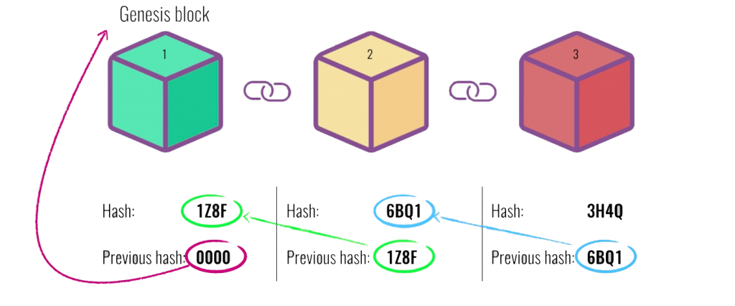
Blockchain
What is Blockchain
Technology that relies on cryptography to store data in distributed ledger
Every block contains a hash of the previous block and a new added only after all previous hashes are recomputed
Distributed data store
Immutability of data stored.
Storing of data is based on agreements between all parties
**Genesis block
It is first block for the chain
It is created using the genesis state file or genesis.json
Blockchain 101 Visual Demo Video
Blockchain 101 Visual Demo
Notes:
© Copyright PresentationGo.com – The free PowerPoint template library

Slide 4

Dev tools
Ethereum Nodes
GETH – Command line interface for running full Ethereum nodes and spinning of distributed ledger.
Ethereum Client
Nethereum.web3 nuget – For interacting with distributed ledger using RPC.
Solidity (Contract oriented progamming language for writing smart contract)
Visual studio plugin
Remix online editor
Standard dev tools
VS code for angular
VS for API’s
Notes:
© Copyright PresentationGo.com – The free PowerPoint template library

Slide 5
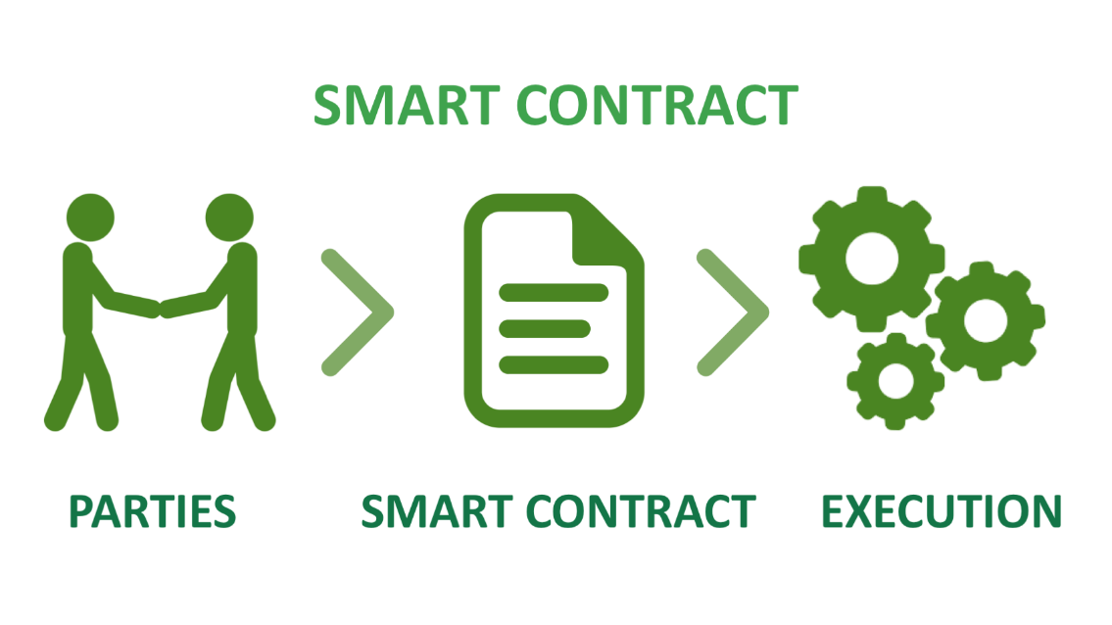
Smart Contracts
What are Smart contracts
Smart contracts are applications that run on the Ethereum network.
It is a computer program that implements and enforces business login for an application.
Similar to physical contract but its digital and is represented by program
Function calls that change the state of the contract are written to the blockchain.
Works on an ‘If-Then’ principle

Slide 6
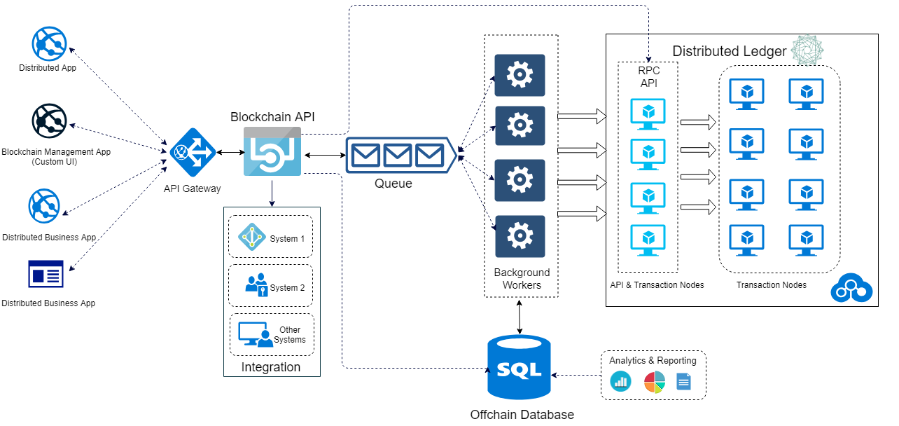
Demo BAAS Architecture

Slide 7
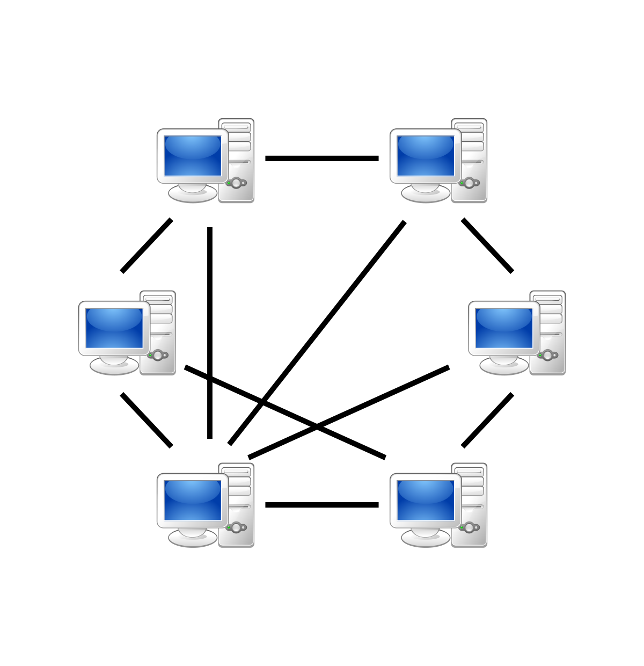
Setting Up Private Network
Genesis.json
Initialize network
Spin off various nodes (RPC, web3, mine)
Network communication across nodes and Static nodes

Slide 8
Sample SOLIDITY Contract

