Slide 1
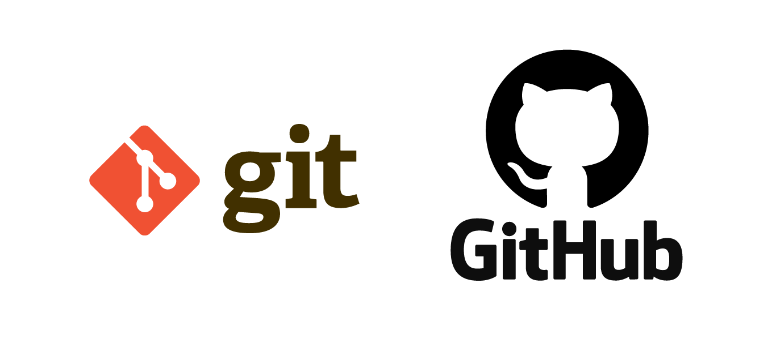
Git and GitHub Workshop
Amol Gote
Vikas Mendhe
Charles Wagner

Slide 2

Agenda
Version Control
Git V/S GitHub
Create GitHub Repo
Set Up Environment
Branches, Pull Request
Forks – Open-Source Contributions
Git Tools
Best Practices
Miscellaneous Items
Hand On Project

Slide 3

1. Version Control Systems (VCS)
Introduction
Why version control is required.
Different types of version control systems

Slide 4
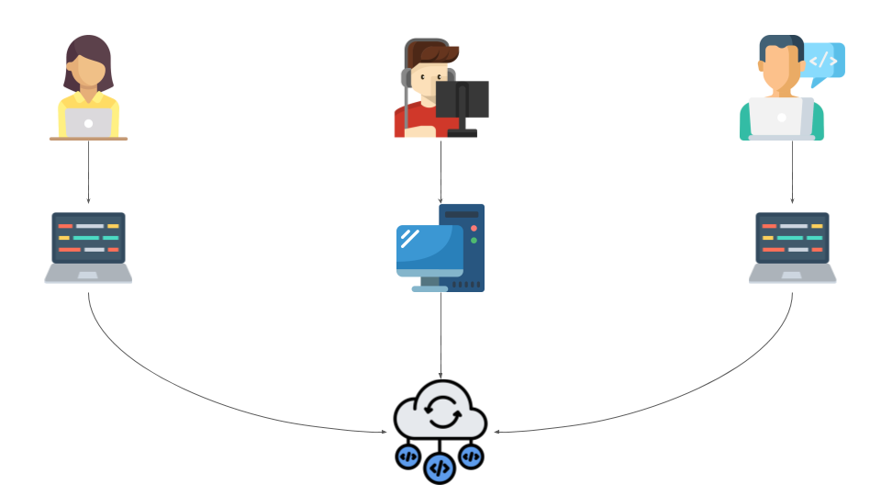
Introduction to Version Control System
VCS are tools used to track changes in software development and other collaborative projects. They allow multiple versions of files to be managed and accessed over time.
They facilitate collaboration among project team members by enabling concurrent work and contributions on different project parts without overwriting each other's changes.

Slide 5
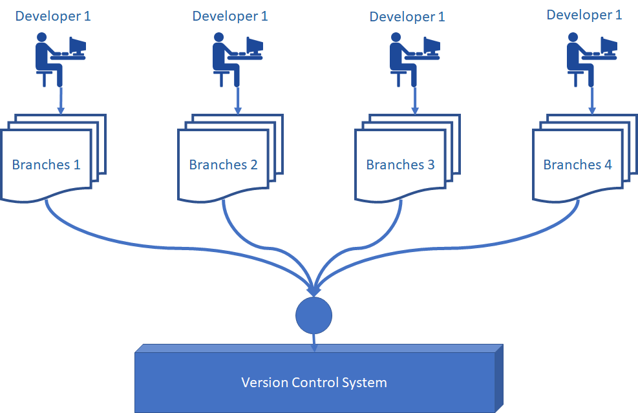
Why Version control is required
History and Accountability
Collaboration
Undo Mistakes
Compare Changes
Backup and Restore
Advance topics
Branching and Merging
Workflow Management
Facilitates Continuous Integration and Delivery (CI/CD)
Notes:
History and Accountability: It keeps a comprehensive history of every file change and who made it, enhancing accountability and enabling change tracing.
Collaboration: Allows multiple people to work on the same project simultaneously without conflicts, smoothly merging changes from different contributors.
Branching and Merging: This enables the creation of branches for developing new features or fixing bugs independently. The branches can then be merged back into the main project, ensuring stability and continuous integration.
Undo Mistakes: Offers the ability to revert to previous versions of the project, safeguarding against the risk of losing work or introducing errors.
Compare Changes: This makes it possible to compare changes over time, see who introduced an issue and when, and review the project’s progression.
Workflow Management: Supports various workflows, such as feature-based branching, Gitflow, or Forking, providing flexibility in how projects are managed and developed.
Backup and Restore: This function acts as a backup mechanism. In case of hardware failure or loss, the repository can be cloned from the remote server, ensuring that work is not lost.
Facilitates Continuous Integration and Delivery (CI/CD): Integrates with tools for automated testing, building, and deployment, enabling modern DevOps practices and continuous delivery of quality software.

Slide 6
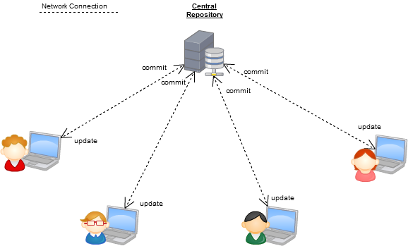
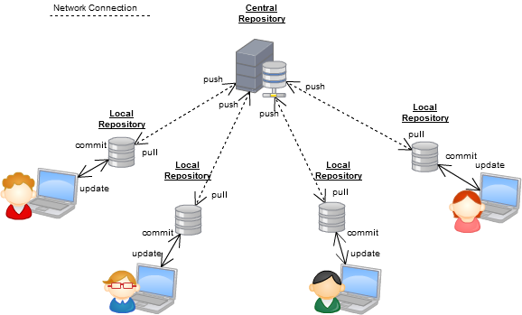
Different types of Version Control Systems
Centralized VCS (CVCS): All team members work on a single central repository. Popular examples include Subversion (SVN), TFVC (Team Foundation Version Control), and Concurrent Versions System CVS. While it simplifies the collaboration model, it introduces a single point of failure.
Distributed VCS (DVCS): Every contributor has a full copy of the repository, including its history. Examples include Git and Mercurial. DVCS allows for more flexible workflows and resilience against repository corruption or loss.

Slide 7
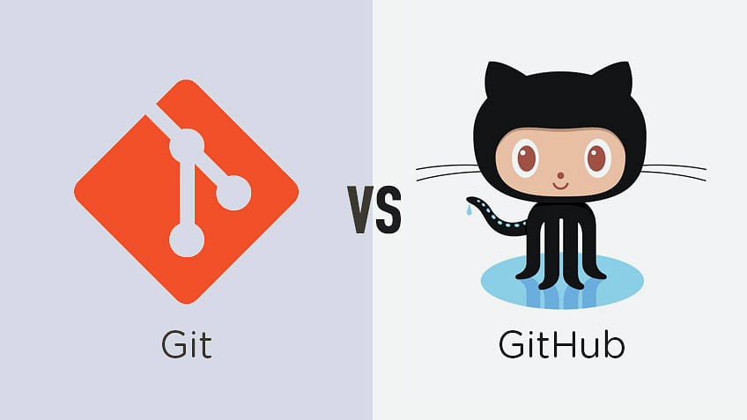
2. Git and GitHub
Differences
Advantages of Git and GitHub

Slide 8
Git, GitHub - Differences
Git is the tool that individuals use to track different versions of their code, manage branches, and handle merging.
GitHub is the platform that hosts Git repositories online. It adds a layer of collaboration, review, and additional features to Git's functionality.
GitHub is a platform for anyone from anywhere to build anything, anything that you think the world needs
Complementary Relationship: While Git can be used without GitHub, GitHub requires Git for version control. GitHub enhances Git's capabilities with a collaborative and user-friendly interface.
Notes:
Git
Distributed Version Control System: Tracks and manages changes to code.
Local Operations: Primarily operates on the developer's machine, enabling offline work.
Branching and Merging: Offers powerful tools for branch creation and merging, facilitating various workflows.
Performance: Efficient with large repositories and histories, excelling in speed for common operations.
Open Source: Free and open-source, widely adopted for flexibility and control.
Requires Installation: This must be installed on each developer's computer.
GitHub
Cloud-based Hosting Service: Provides online hosting for Git repositories, facilitating collaboration.
Pull Requests and Code Review: This section introduces the concept of pull requests for changes, enhancing collaboration and review.
Issue Tracking: Built-in tools for tracking bugs, tasks, and enhancements.
GitHub Actions: Automates workflows directly within GitHub repositories, including CI/CD.
Web Interface: Offers a user-friendly web interface for repository management, reducing the need for command-line operations.
Community and Collaboration: Encourages open-source development with features like forking, starring, and social networking aspects.
Free and Paid Plans: Offers various plans, including free accounts with public repositories and paid plans for private repositories and additional features.

Slide 9
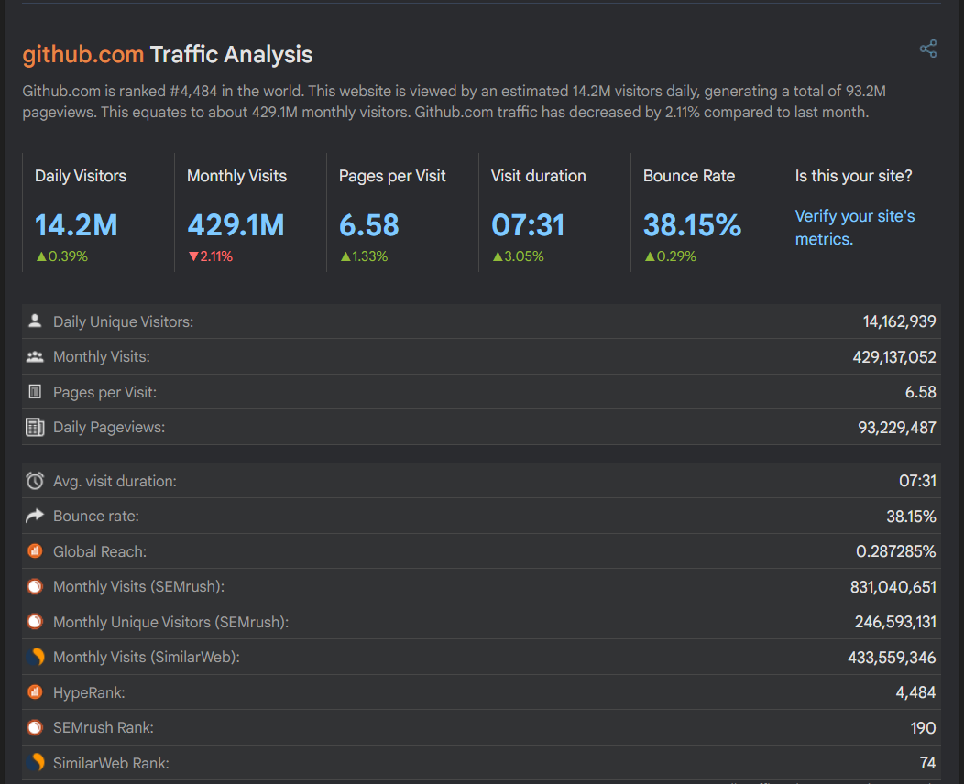
GitHub - Stats
100 million developers utilizing the platform as of 2023
Platform hosted over 372 million repositories, including 28 million that are public.
413 million contributions open-source contributions made in 2022
Programming languages used on GitHub, JavaScript, Python, and Java top the list.
Over 90 percent of Fortune 100 companies use GitHub.

Slide 10
Git and GitHub Advantages
Distributed Architecture
Performance
Branching and Merging
Data Integrity:
Workflow Flexibility
Community and Collaboration
Integration with Tools and Services
Pull Requests and Code Review
Open-Source Initiatives
Notes:
Git and GitHub offer several advantages over other Version Control Systems (VCS), both centralized and distributed. These advantages have contributed to Git's widespread adoption and GitHub's popularity as a collaborative platform. Here's an overview of the key benefits:
Git: Advantages Over Other VCS
Distributed Architecture: Unlike centralized VCSs like SVN or CVS, Git is distributed. This means each developer has a full copy of the entire repository, including its history. This allows work to continue even when not connected to a network and provides a robust backup system.
Performance: Git offers superior performance metrics in terms of speed for most operations, such as commit, branch creation, merging, and more, compared to many other version control systems.
Branching and Merging: Git's branching model is powerful and lightweight. It allows developers to easily and quickly create, switch between, merge, and delete branches. This facilitates various development workflows, including feature branching, Gitflow, and more.
Data Integrity: Git uses a data model that ensures the cryptographic integrity of every part of the project. Each file and commit is checksummed and then referred to by its checksum. Thus, changing the contents of any file or directory is impossible without Git detecting it.
Staging Area: Git has a unique feature called the staging area or index, which allows developers to format and review commits before completing them. This promotes granular commits and cleaner, more manageable histories.
Flexibility: Git supports various workflows, from the basic centralized workflow to highly complex workflows tailored to a project's needs. This flexibility makes it suitable for projects of all sizes and complexities.
GitHub: Advantages Over Other Collaboration Platforms
Community and Collaboration: GitHub has built a massive community around open-source projects. It’s a VCS and a collaborative platform that facilitates social coding by providing features like pull requests, issues, project boards, wikis, and more.
Integration with Tools and Services: GitHub integrates seamlessly with many development tools and services, from continuous integration/continuous deployment (CI/CD) pipelines to code analysis tools, enhancing productivity and automation.
GitHub Actions: Provides CI/CD capabilities directly within GitHub, allowing for automation of workflows, from testing and building code to deploying applications, all configured through YAML files in the repository.
Documentation and Issue Tracking: GitHub makes it easy to document projects and track issues directly alongside the code, encouraging an open and efficient problem-solving environment.
Pull Requests and Code Review: GitHub's pull request system streamlines code review and collaboration. Developers can discuss changes, request reviews, and make further commits before changes are merged into the main codebase.
Open-Source Exposure: For open-source projects, GitHub provides exposure and a platform for attracting contributors. It's become the de facto place for hosting open-source projects, allowing them to grow and thrive.
While other platforms and VCS have their own set of advantages, the combination of Git's powerful features and GitHub's collaborative ecosystem has set a high standard in the realm of version control and project collaboration.

Slide 11

3. Create a GitHub Repo
Sign Up
New Repository

Slide 12
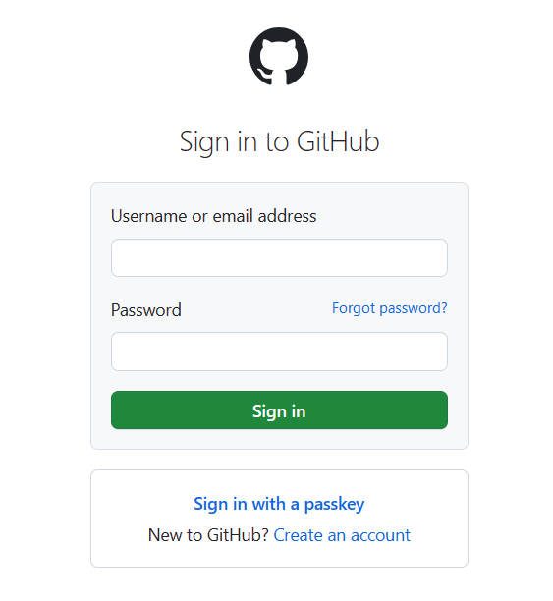
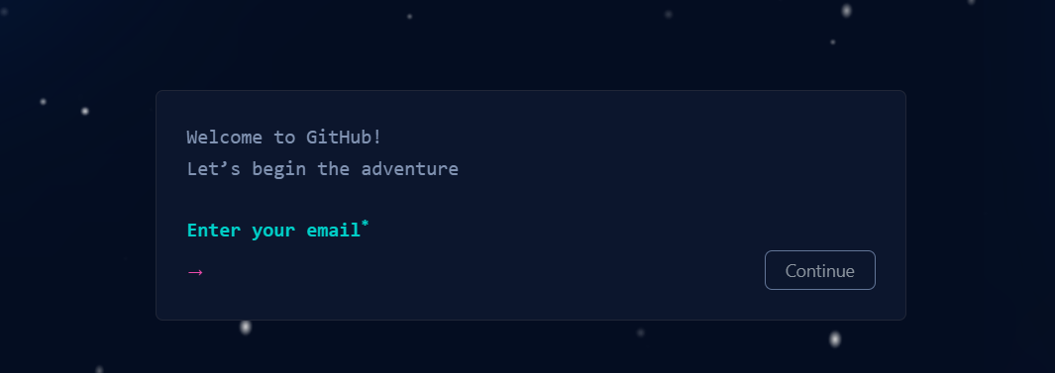
Create a GitHub Repo - Sign Up
Ensure you have a GitHub account. If not, sign up at github.com.
Log in to your GitHub account.

Slide 13
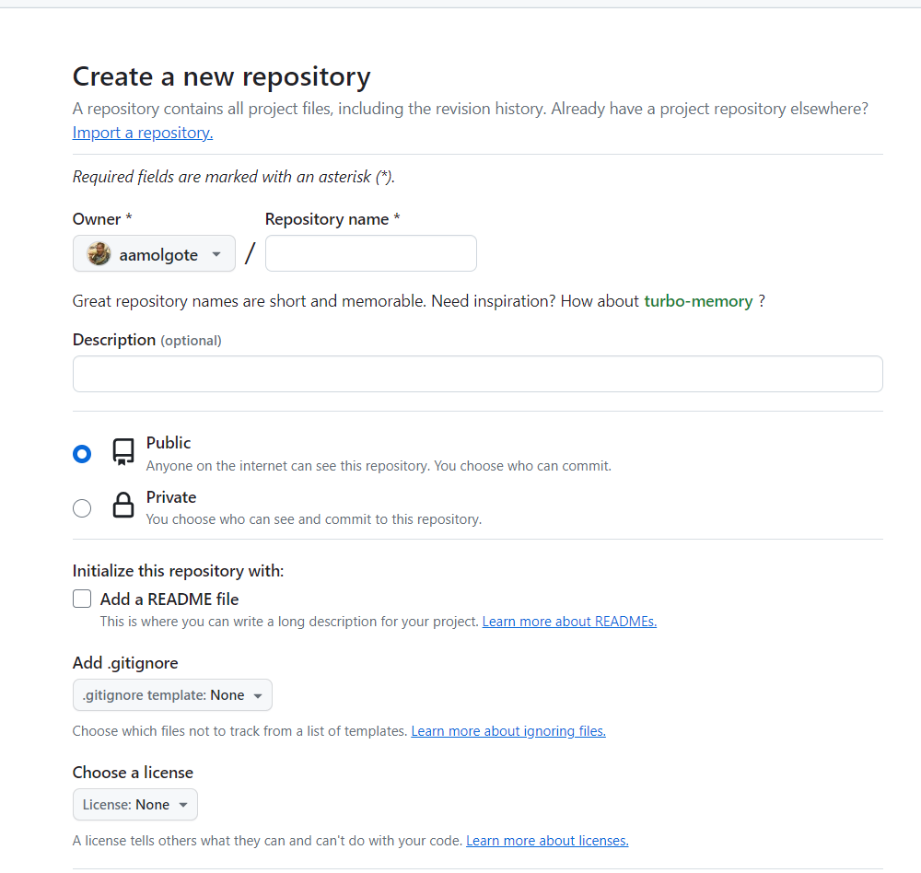
Create a GitHub Repo – New Repository
On the GitHub homepage, look for the "+" icon in the top right corner. Click it and select "New repository" from the dropdown menu.
Alternatively, you can navigate directly to Create a new repository.
Repository Name
Visibility (Public Free)
Initialize this repository with Readme
Add .gitignore

Slide 14
4. Set Up Environment
Local Dev Set Up
Clone Repository
Git Commit

Slide 15
Set Up Environment – Local Dev Set Up
Git Bash – Download
Clone Repository
Commit Change
Notes:
git clone https://github.com/aamolgote/resttemplateinterceptor
cd resttemplateinterceptor/
git checkout -b feature/issue-fix-1 main
git checkout main
git checkout -b feature/issue-fix-2 main
git checkout main
git checkout feature/issue-fix-1
# Make Changes to FileRepository Interface
git commit -a -m “Added Comment"
git push --set-upstream origin feature/issue-fix-1
git checkout main
git checkout feature/issue-fix-2
# Make Changes to FileRepository Interface
git commit -a -m “Added Comment"
git push --set-upstream origin feature/issue-fix-2
git remote prune origin
git branch --v | grep "\[gone\]" | awk '{print $1}' | xargs git branch –D
git pull

Slide 16
Set Up Environment – Git Commit
Key Aspects of a Git Commit
Snapshot of Changes
Immutable Record
Unique Identifier
Commit Message
Authorship
Importance of Commits
History and Accountability
Collaboration
Rollback
Notes:
Key Aspects of a Git Commit
Snapshot of Changes: When you commit, Git takes a snapshot of the files as they are and stores a commit object representing that snapshot. It's like taking a photo; if the files change in the future, you can always refer back to the commit to see what they look like at that moment.
Immutable Record: Each commit is an immutable record of the project’s changes at a specific time. Once a commit is created, it cannot be altered without affecting the project's history, ensuring the integrity of your project's history.
Unique Identifier: Every commit is identified by a unique SHA-1 hash. This hash is a 40-character string that acts as a fingerprint for that specific set of changes. Git uses this identifier to track the commit across branches and repositories.
Commit Message: Each commit is accompanied by a commit message, a brief description written by the user explaining the changes made in that commit. Good commit messages are crucial for maintaining a readable and navigable project history.
Authorship: Each commit stores information about its author and committer, including their name and email address. This information is useful for tracking who made which changes and when.
Why Commits Are Important
History and Accountability: Commits provide a detailed project history, allowing developers to track progress, understand decisions made at previous points, and hold contributors accountable for their changes.
Collaboration: In collaborative projects, commits are essential for managing contributions from multiple developers. They allow teams to merge changes, resolve conflicts, and review each other's work effectively.
Rollback: If a new change introduces a bug or breaks the project, commits allow you to revert it to a previous state, minimizing downtime and debugging efforts.

Slide 17

5. Branches and Pull Requests
Branches
What is a Pull Request
Create a Pull Request
Importance of Pull Requests

Slide 18
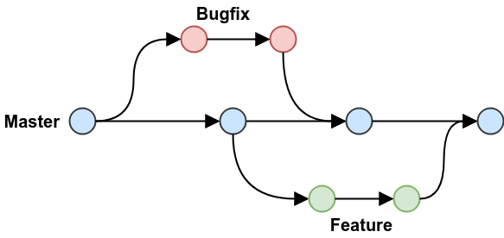
Branches
Isolation of Changes
Safe Experimentation
Parallel Development
Simplified Collaboration
Focused Contributions
Pull Requests for Code Review
Efficient Merge and Rollback
Easier Merge Conflicts Resolution
Rollback Capabilities
Notes:
What is a Branch?
A branch represents a separate line of development within a repository. It allows you to diverge from the main line of work, typically referred to as the main branch (formerly known as master), so you can work on new features or fixes without affecting the main project.
Isolation of Changes
Safe Experimentation: Branches provide an isolated environment for trying new ideas or implementing features without affecting the main codebase. This isolation facilitates risk-taking and innovation since the primary codebase remains unaffected by the changes until they are ready to be merged.
Parallel Development: Different features or fixes can be developed simultaneously across multiple branches. This approach significantly speeds up the development process, as teams can work on different aspects of the project simultaneously.
Simplified Collaboration
Focused Contributions: Using branches, multiple contributors can work on the same project without stepping on each other's toes. Each contributor works on a separate branch, ensuring their changes are isolated until they're ready to be shared.
Pull Requests for Code Review: GitHub utilizes branches for pull requests, a key feature for collaboration. When a developer wants to merge their branch into the main branch, they create a pull request, facilitating code review, discussion, and approval before changes are integrated.
Efficient Merge and Integration
Easier Merge Conflicts Resolution: Working in branches makes it easier to identify and resolve merge conflicts in a controlled manner, typically when merging a feature branch back into the main development line. It's clearer what changes are coming in and why conflicts might exist.
Rollback Capabilities: If something goes wrong, branches offer the capability to rollback changes by simply switching back to a stable branch. This safety net ensures that stable versions of the project are always available.

Slide 19

PRs – What is Pull Request
Definition: A pull request is a feature in version control systems, notably in GitHub, that allows developers to notify team members about changes they've pushed to a branch in a repository. It is essentially a request to review and pull in your contribution to the project's main or base branch.
Mechanism: After pushing changes to a branch in a repository, a developer submits a pull request to the original repository. This action initiates a review process where project collaborators can discuss, review, and eventually accept or reject the proposed changes.
Purpose: The primary aim of a pull request is to facilitate code review and discussion around the code before integrating it into the main project, ensuring quality and functionality.

Slide 20
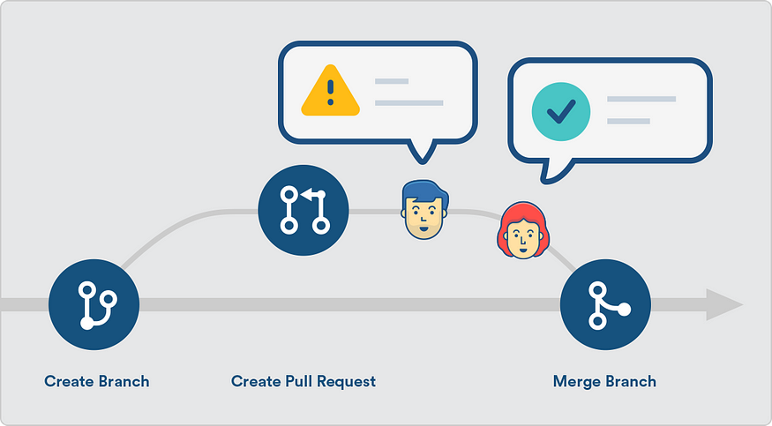
PRs – How to Create Pull Request
Ensure a Separate Branch for Changes
Commit Changes to the Branch
Push the Branch to the Remote Repository
Initiate the Pull Request on GitHub
Describe Your Changes
Submit the Pull Request
Notes:
Ensure a Separate Branch for Changes:
Always work on a separate branch rather than the main project branch. This isolation allows for focused changes and easier code management.
Commit Changes to the Branch:
Perform your work and commit the changes to your branch. Use descriptive commit messages to outline what each commit accomplishes.
Push the Branch to the Remote Repository:
Use the git push command to push your branch and its commits to your GitHub repository.
Initiate the Pull Request on GitHub:
Navigate to the repository on GitHub. You'll likely see a prompt to create a pull request for your new branch. Click on "Compare & pull request" to start the process.
Describe Your Changes:
Fill in a detailed title and description for your pull request. Explain why you made the changes, what they entail, and any other relevant information for reviewers.
Submit the Pull Request:
Once you've filled in the details, submit the pull request. It will then be available for review by the project maintainers or collaborators.

Slide 21
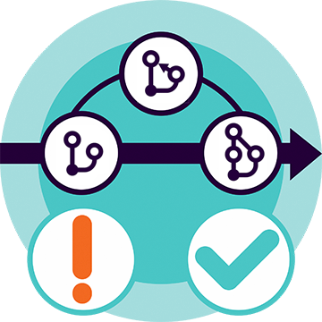
PRs – Importance of Pull Requests
Facilitates Code Review
Encourages Collaboration
Tracks Changes
Integrates Continuous Integration (CI) Practices
Improves Project Transparency
Notes:
Facilitates Code Review: Pull requests are essential for code review, allowing for feedback and suggestions before merging changes, which leads to higher code quality and fewer bugs.
Encourages Collaboration: They foster collaboration among team members by providing a platform for discussing proposed changes, sharing insights, and making collective decisions.
Tracks Changes: Pull requests create a documented history of the project's changes, including what was changed, by whom, and why, which is invaluable for project management and tracking.
Integrates Continuous Integration (CI) Practices: Many projects use pull requests alongside continuous integration tools, which automate the process of testing code changes, ensuring that new code doesn't break existing functionality before merging.
Improves Project Transparency: They improve transparency in project development, allowing all team members to stay informed about the ongoing changes and project evolution.

Slide 22

6. Forks
What are forks
Working with Forks
Open-Source Contributions

Slide 23
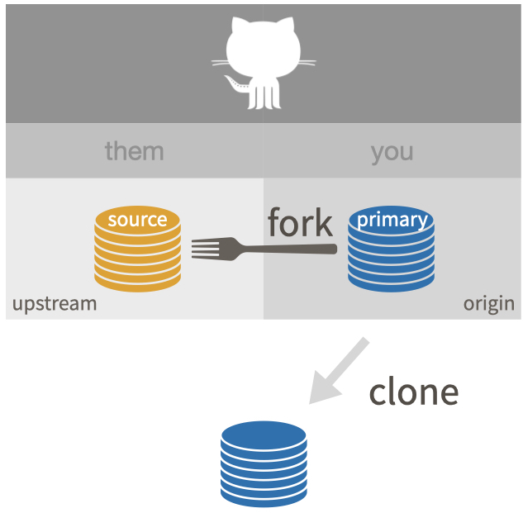
Forks – What are Forks?
Identify GitHub Repository to Fork
Fork the Repository
Clone Your Fork
Notes:
Find a Repository to Fork: Navigate to the GitHub page of the repository you wish to fork.
Fork the Repository: Click the "Fork" button in the top-right corner of the repository page. This creates a copy of the repository in your GitHub account.
Clone Your Fork: To work on your fork locally, clone it to your computer using the git clone command with your fork's URL.

Slide 24
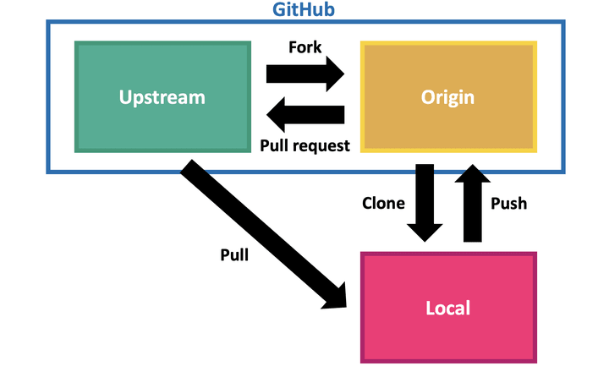
Forks – Working with Forks
Syncing with the Upstream Repository
Making Changes
Sending Pull Requests
Forks and Branches
Notes:
Syncing with the Upstream Repository: Keeping your fork syncing with the original repository is important. This section shows how to add the original repository as an upstream remote and pull changes from it to your local copy.
Making Changes: Encourage experimenting and making changes in the fork. This can include fixing bugs, adding features, or updating documentation.
Sending Pull Requests: Guide on creating pull requests from your fork to the original repository. This involves pushing your changes to your GitHub fork and opening a pull request to the upstream repository.
Stay Up-to-Date: Regularly sync your fork with the upstream repository to avoid merge conflicts.
Contribute Meaningfully: When contributing to open-source projects, make sure your changes are meaningful and follow the project's contribution guidelines.
Engage with the Community: Use issues and pull requests to engage with the community, asking for feedback or discussing potential changes.
Forks are generally used for independent project development or external contributions, whereas branches are used for internal team development within the same repository. When working with branches, the goal is to merge back into the main project, maintaining a single, unified codebase. With forks, while you may contribute back to the original project, you're also maintaining a separate, parallel version of the project.

Slide 25

Forks – Open-Source Contributions
Essential Tool for Collaboration
Enables Wide Participation
Independence in Contribution
Facilitates Code Review and Integration
Promotes Project Growth
Community Engagement
Contribution Recognition
Learning and Skill Development
Notes:
Essential Tool for Collaboration: Forks provide a personal copy of a project for individual experimentation, development, and contribution without affecting the original codebase.
Enables Wide Participation: Anyone can contribute to open-source projects by forking repositories, making changes, and submitting those changes back to the original project through pull requests.
Independence in Contribution: Forks allow contributors to work independently on their version of the project, enabling diverse ideas and solutions to emerge from the community.
Facilitates Code Review and Integration: Pull requests from forks encourage a thorough review process, ensuring that contributions are vetted for quality and compatibility before they are merged.
Promotes Project Growth: By lowering barriers to entry, forks empower a broader community to contribute, driving innovation and accelerating the development of open-source projects.
Community Engagement: Forking a project and contributing back showcases a developer's engagement with the open-source community, fostering collaboration and knowledge sharing.
Contribution Recognition: Contributions made through forks are tracked on GitHub, allowing contributors to showcase their work and impact on the open-source ecosystem.
Learning and Skill Development: Engaging with open-source projects through forks offers a valuable learning experience, helping developers to improve their coding skills, understand new technologies, and grasp best practices in software development.

Slide 26
7. Git Tools
Command Line Git-Bash
Desktop App
Git Kraken
Source Tree
IDE Integration

Slide 27

8. Best Practices
Commit Early, Commit Often
Write Meaningful Commit Messages
Use Branching Extensively
Embrace Pull Requests for Collaboration
Keep the History Clean and Understandable
Regularly Sync with the Remote Repository
Use .gitignore
Backup and Redundancy
Notes:
1. Commit Early, Commit Often
Granular Commits: Encourage making small, frequent commits that capture a single logical change. This practice makes it easier to understand the history of changes and isolate issues.
Benefits: Facilitates pinpointing issues with git bisect, simplifies merging and rebasing, and provides a detailed project history.
2. Write Meaningful Commit Messages
Structure: Start with a brief summary line (50 characters or less), followed by a detailed description if necessary, explaining the what, why, and how of the commit.
Conventions: Use the imperative mood for the summary line. Example: "Add feature X" rather than "Added feature X".
Clarity: Ensure the message is clear and provides enough context for others (and your future self) to understand the reasoning behind the changes.
3. Use Branching Extensively
Feature Branches: Create branches for new features, bug fixes, or experiments. This keeps the main branch stable and allows for parallel development.
Branch Naming: Use descriptive names for branches (e.g., feature/user-authentication, bugfix/login-error).
4. Embrace Pull Requests for Collaboration
Code Review: Use pull requests to review and discuss code before merging changes. This ensures code quality and fosters team collaboration.
Documentation: Pull requests provide documentation of the changes made and the rationale behind them.
5. Keep the History Clean and Understandable
Rebasing: Use git rebase to integrate changes from the main branch into your feature branch. This keeps the project history linear and easier to follow.
Avoid Rewriting Public History: Never use git rebase on shared branches unless it's part of a planned project workflow.
6. Regularly Sync with the Remote Repository
Fetch and Pull: Regularly fetch and pull changes from the remote repository to stay up-to-date with the team's progress and avoid merge conflicts.
7. Use .gitignore
Exclude Unnecessary Files: To keep the repository clean, use a .gitignore file to exclude temporary files, logs, dependencies, and other non-source files.
8. Backup and Redundancy
Remote Repositories: For backup and collaboration purposes, ensure that the project is regularly pushed to a remote repository like GitHub, GitLab, or Bitbucket.

Slide 28

9. Miscellaneous
.git Folder – Purpose, Content, Importance
.gitignore – Purpose, How it Works, Best Practices
README.md – Overview, Content, Significance
GitHub Issues
Notes:
.git Folder
Definition: The .git folder is a hidden directory in your Git repository. It contains all the necessary repository metadata and objects that Git needs to track changes and maintain the history of your project.
Contents: Inside the .git folder, you'll find several other directories and files that hold information about the repository's configuration, hooks, objects (like blobs, trees, and commits), references to heads, tags, and remote repositories, as well as the index file for staging changes.
Importance: This folder is crucial to Git. Deleting it would essentially remove the project's history and revert it to just a folder with files, no longer a Git repository. It's also usually not included in the project's source code as it's meant for Git's internal use.
.gitignore
Purpose: The .gitignore file tells Git which files or directories to ignore in a project. Typically, these are files you don't want to track or share, such as personal IDE settings, build outputs or system-specific files.
How It Works: Entries in the .gitignore file can include filenames, directory names, wildcard patterns, and more. Files that are already tracked by Git are not affected by .gitignore. You must first untrack them with git rm --cached.
Best Practices: Common practices include ignoring compiled code, logs, system files, personal IDE config files, and dependencies that can be installed with a package manager. It’s often helpful to start with a standard .gitignore provided for specific programming languages or environments, which can be found in collections on GitHub.
Markdown files, typically with the .md extension, are plain text files that use the Markdown language. Markdown allows you to write using an easy-to-read, easy-to-write plain text format, which then converts to structurally valid HTML (or other formats) for viewing in web browsers or other platforms.
README.md
Overview: The README.md file is the first file GitHub displays when someone opens your repository. Written in Markdown, it is the introduction and provides essential information about the project.
Contents: It should include the project title, a brief description, installation instructions, usage examples, development notes, how to run tests, contribution guidelines, license information, and contact info for the maintainers or contributors.
Significance: A well-written README.md is crucial because it's often the first entry point for anyone encountering your repository and can be the difference between someone deciding to use, ignore, or contribute to the project.
GitHub Issues
GitHub Issues are a tracking tool within GitHub repositories that developers use to track ideas, enhancements, tasks, or bugs for work on GitHub.
Each issue can act as a discussion forum for the ongoing development of a particular problem or idea associated with the repository.

Slide 29

Quiz - 1
What is a commit in Git?
A. A command to switch between branches
B. A snapshot of your repository at a particular point in time
C. A request to merge one branch into another
D. A way to clone a repository
Answer: B

Slide 30

Quiz - 2
What is the primary difference between Git and GitHub?
A. Git is a version control system, while GitHub is a cloud-based hosting service for Git repositories.
B. Git is used for local development, while GitHub is used for online storage only.
C. There is no difference; they are just different names for the same tool.
D. GitHub is a version control system, while Git is a code collaboration tool.
Answer: A

Slide 31

Quiz - 3
How can you contribute to an open-source project hosted on GitHub that you do not have write access to?
A. Directly commit your changes to the main branch
B. Send an email to the project maintainer with your proposed changes
C. Fork the repository, make your changes, and submit a pull request
D. It's not possible to contribute without write access
Answer: C

Slide 32

Quiz - 4
When collaborating on a project using Git and GitHub, what is the purpose of a branch?
A. To serve as a backup for the main project
B. To mark the release points of the software
C. To isolate development work without affecting the main project
D. To track the issues in the software
Answer: C

Slide 33

Quiz - 5
When you clone a repository in Git, what do you receive?
A. Only the latest version of the files in the repository
B. The entire repository history and all branches
C. A copy of the repository at a specific branch
D. A compressed archive of the repository's current state
Answer: B

Slide 34

10. Hands On Project
Create a GitHub Account
Create Repository
Clone Repository and create Branch
Commit Changes and Raise PR
Raise Pull Request
Merge Pull Request
Fork Repository, Raise PR

Slide 35

Ask – Star the project
My Open Source Project
Request For Star
Link - https://github.com/iCreateWorks/esigning

Slide 36

Thank you
LinkedIn
https://www.linkedin.com/in/aamolgote
https://www.linkedin.com/in/vikas-mendhe-69260012
ADP List (Mentoring)
https://adplist.org/mentors/amol-gote
aamolgote@gmail.com
Notes:
https://www.youtube.com/watch?v=pBy1zgt0XPc&t=17s

