Slide 1
Data Basics

Slide 2
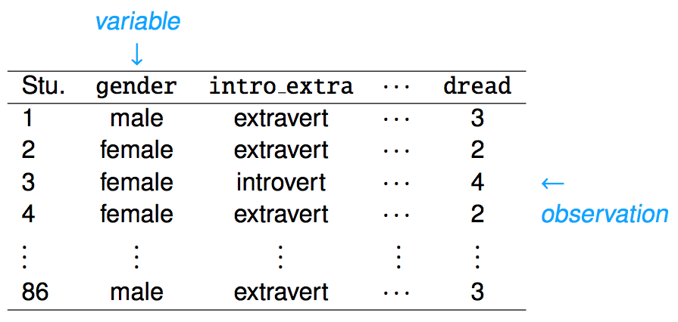
Data matrix
Data collected on students in a statistics class on a variety of variables:

Slide 3
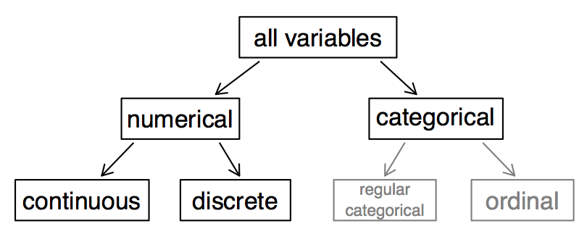
Types of variables

Slide 4
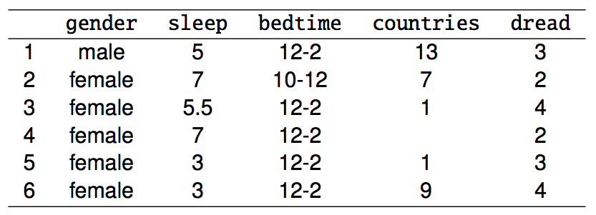
Types of variables (cont.)
gender: categorical
sleep: numerical, continuous
bedtime: categorical, ordinal
countries: numerical, discrete
dread: categorical, ordinal - could also be used as numerical

Slide 5
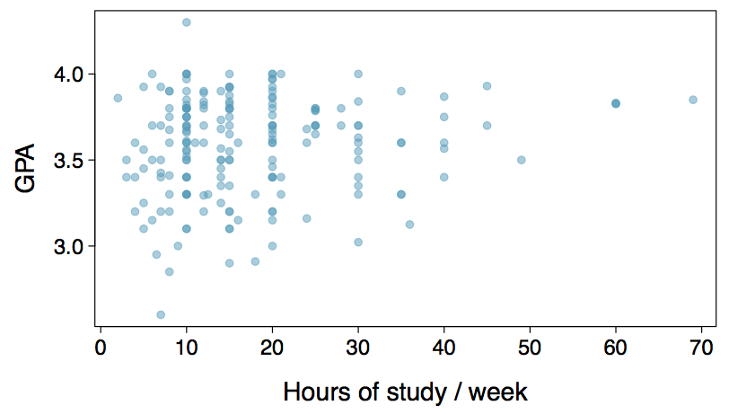
Relationships among variables
Does there appear to be a relationship between the hours of study per week and the GPA of a student?
Can you spot anything unusual about any of the data points?
There is one student with GPA > 4.0, this is likely a data error.
Notes:
Thanks to Nelson Gomez for catching a typo on this slide!

Slide 6
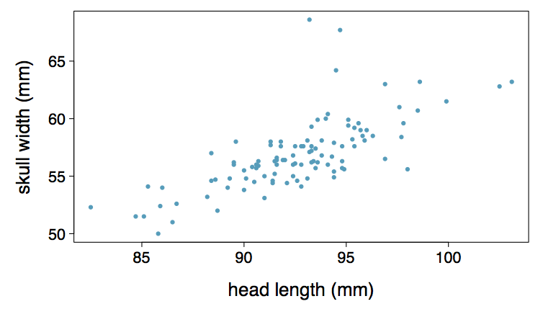
Practice
Based on the scatterplot on the right, which of the following statements is correct about the head and skull lengths of possums?
(a) There is no relationship between head length and skull width,
i.e. the variables are independent.
(b) Head length and skull width are positively associated.
(c) Skull width and head length are negatively associated.
(d) A longer head causes the skull to be wider.
(e) A wider skull causes the head to be longer.

Slide 7
Practice
Based on the scatterplot on the right, which of the following statements is correct about the head and skull lengths of possums?
(a) There is no relationship between head length and skull width,
i.e. the variables are independent.
(b) Head length and skull width are positively associated.
(c) Skull width and head length are negatively associated.
(d) A longer head causes the skull to be wider.
(e) A wider skull causes the head to be longer.

Slide 8
Associated vs. independent
When two variables show some connection with one another, they are called associated variables.
Associated variables can also be called dependent variables and vice-versa.
If two variables are not associated, i.e. there is no evident connection between the two, then they are said to be independent.

Slide 9
Overview of Data Collection Principles

Slide 10
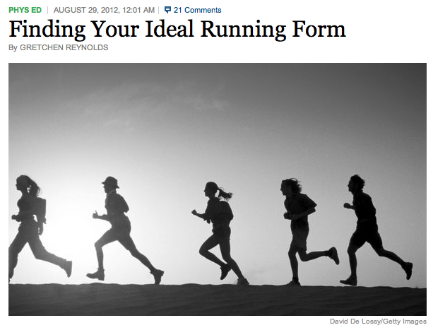
Populations and Samples
Research Question: Can people become better, more efficient runners on their own, merely by running?
Population of Interest: All people
http://well.blogs.nytimes.com/2012/08/29/finding-your-ideal-running-form
Sample: Group of adult women who recently joined a running group
Population to which results can be generalized: Adult women, if the data are randomly sampled

Slide 11
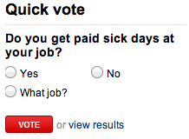
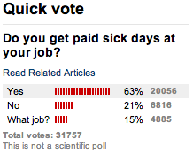
Sampling bias
Non-response: If only a small fraction of the randomly sampled people choose to respond to a survey, the sample may no longer be representative of the population.
Voluntary response: Occurs when the sample consists of people who volunteer to respond because they have strong opinions on the issue. Such a sample will also not be representative of the population.
Convenience sample: Individuals who are easily accessible are more likely to be included in the sample.

Slide 12

Explanatory and Response Variables
To identify the explanatory variable in a pair of variables, identify which of the two is suspected of affecting the other:
Labeling variables as explanatory and response does not guarantee the relationship between the two is actually causal, even if there is an association identified between the two variables. We use these labels only to keep track of which variable we suspect affects the other.

Slide 13
Observational studies and sampling strategies

Slide 14
What type of study is this, observational study or an experiment?
“Girls who regularly ate breakfast, particularly one that includes cereal, were slimmer than those who skipped the morning meal, according to a study that tracked nearly 2,400 girls for 10 years. [...] As part of the survey, the girls were asked once a year what they had eaten during the previous three days.”
This is an observational study since the researchers merely observed the behavior of the girls (subjects) as opposed to imposing treatments on them.
What is the conclusion of the study?
There is an association between girls eating breakfast and being slimmer.
Who sponsored the study?
General Mills.

Slide 15
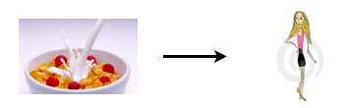

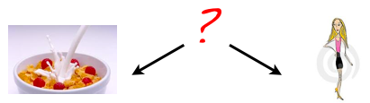
3 Possible Explanations
1. Eating breakfast causes girls to be thinner.
2. Being thin causes girls to eat breakfast.
3. A third variable is responsible for both. What could it be? An extraneous variable that affects both the explanatory and the response variable and that make it seem like there is a relationship between the two are called confounding variables.
Images from: http:// www.appforhealth.com/ wp-content/ uploads/ 2011/ 08/ ipn-cerealfrijo-300x135.jpg,
http:// www.dreamstime.com/ stock-photography-too-thin-woman-anorexia-model-image2814892.

Slide 16
Prospective vs.
Retrospective Studies
A prospective study identifies individuals and collects information as events unfold.
Example: The Nurses Health Study has been recruiting registered nurses and then collecting data from them using questionnaires since 1976.
Retrospective studies collect data after events have taken place.
Example: Researchers reviewing past events in medical records.

Slide 17
Obtaining Good Samples
Almost all statistical methods are based on the notion of implied randomness.
If observational data are not collected in a random framework from a population, these statistical methods -- the estimates and errors associated with the estimates -- are not reliable.
Most commonly used random sampling techniques are simple, stratified, and cluster sampling.

Slide 18
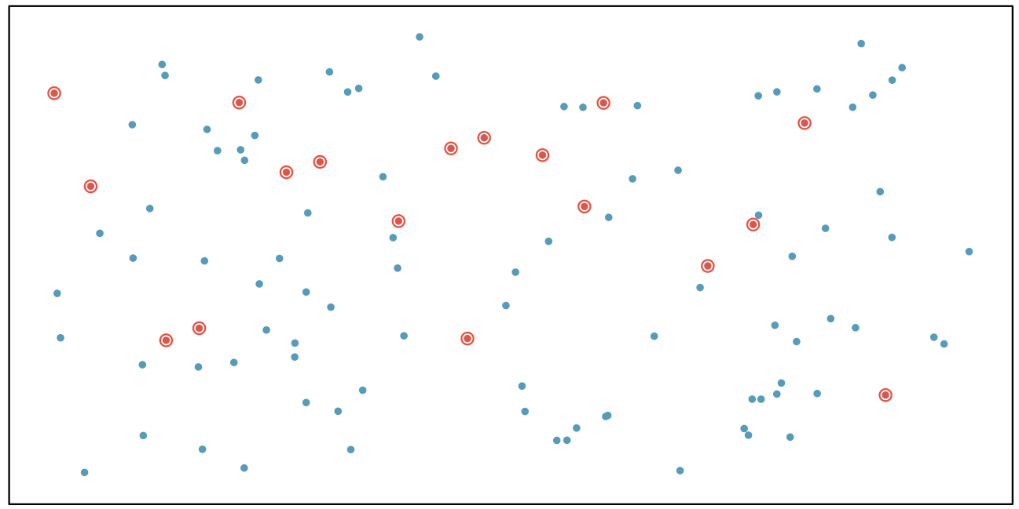
Simple Random Sample
Randomly select cases from the population, where there is no implied connection between the points that are selected.

Slide 19
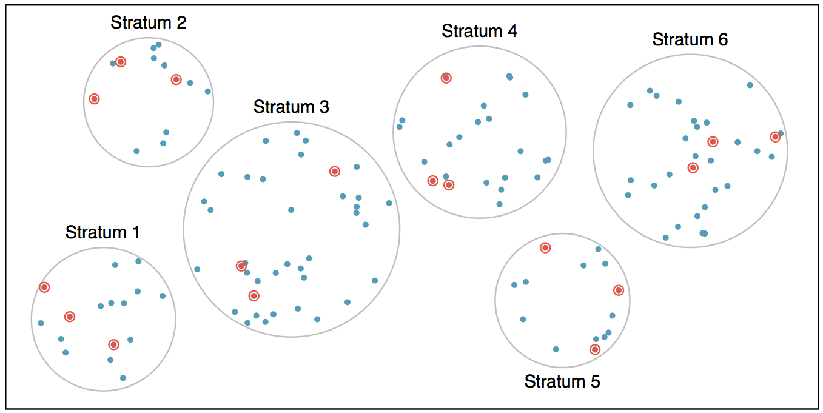
Stratified Sample
Strata are made up of similar observations. We take a simple random sample from each stratum.

Slide 20
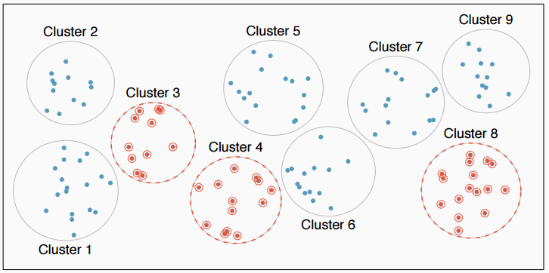
Cluster Sample
Clusters are usually not made up of homogeneous observations. We take a simple random sample of clusters, and then sample all observations in that cluster. Usually preferred for economical reasons.

Slide 21
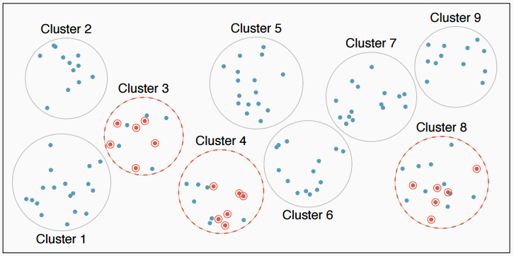
Multistage Sample
Clusters are usually not made up of homogeneous observations. We take a simple random sample of clusters, and then take a simple random sample of observations from the sampled clusters

