Slide 1
Experiments

Slide 2
Principles of experimental design
Control: Compare treatment of interest to a control group.
Randomize: Randomly assign subjects to treatments, and randomly sample from the population whenever possible.
Replicate: Within a study, replicate by collecting a sufficiently large sample. Or replicate the entire study.
Block: If there are variables that are known or suspected to affect the response variable, first group subjects into blocks based on these variables, and then randomize cases within each block to treatment groups.

Slide 3
Practice
A study is designed to test the effect of light level and noise level on exam performance of students. The researcher also believes that light and noise levels might have different effects on males and females, so wants to make sure both genders are equally represented in each group. Which of the below is correct?
There are 3 explanatory variables (light, noise, gender) and 1 response variable (exam performance)
There are 2 explanatory variables (light and noise), 1 blocking variable (gender), and 1 response variable (exam performance)
There is 1 explanatory variable (gender) and 3 response variables (light, noise, exam performance)
There are 2 blocking variables (light and noise), 1 explanatory variable (gender), and 1 response variable (exam performance)

Slide 4
Practice
A study is designed to test the effect of light level and noise level on exam performance of students. The researcher also believes that light and noise levels might have different effects on males and females, so wants to make sure both genders are equally represented in each group. Which of the below is correct?
There are 3 explanatory variables (light, noise, gender) and 1 response variable (exam performance)
There are 2 explanatory variables (light and noise), 1 blocking variable (gender), and 1 response variable (exam performance)
There is 1 explanatory variable (gender) and 3 response variables (light, noise, exam performance)
There are 2 blocking variables (light and noise), 1 explanatory variable (gender), and 1 response variable (exam performance)

Slide 5
Difference Between Blocking and Explanatory Variables
Factors are conditions we can impose on the experimental units.
Blocking variables are characteristics that the experimental units come with, that we would like to control for.
Blocking is like stratifying, except used in experimental settings when randomly assigning, as opposed to when sampling.

Slide 6
More Experimental Design Terminology...
Placebo: fake treatment, often used as the control group for medical studies
Placebo effect: experimental units showing improvement simply because they believe they are receiving a special treatment
Blinding: when experimental units do not know whether they are in the control or treatment group
Double-blind: when both the experimental units and the researchers who interact with the patients do not know who is in the control and who is in the treatment group

Slide 7
Practice
What is the main difference between observational studies and experiments?
Experiments take place in a lab while observational studies do not need to.
In an observational study we only look at what happened in the past.
Most experiments use random assignment while observational studies do not.
Observational studies are completely useless since no causal inference can be made based on their findings.

Slide 8
Practice
What is the main difference between observational studies and experiments?
Experiments take place in a lab while observational studies do not need to.
In an observational study we only look at what happened in the past.
Most experiments use random assignment while observational studies do not.
Observational studies are completely useless since no causal inference can be made based on their findings.

Slide 9
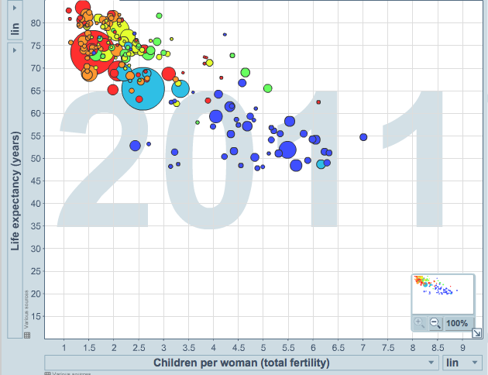
Scatterplot
Scatterplots are useful for visualizing the relationship between two numerical variables.
Do life expectancy and total fertility appear to be associated or independent?
Was the relationship the same throughout the years, or did it change?
They appear to be linearly and negatively associated: as fertility increases, life expectancy decreases.
The relationship changed over the years.
http://www.gapminder.org/world

Slide 10
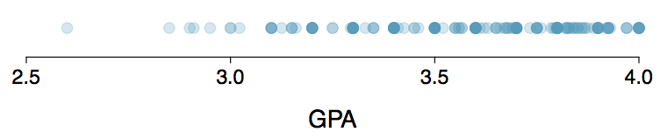
Dot Plots
Useful for visualizing one numerical variable. Darker colors represent areas where there are more observations.
How would you describe the distribution of GPAs in this data set? Make sure to say something about the center, shape, and spread of the distribution.

Slide 11
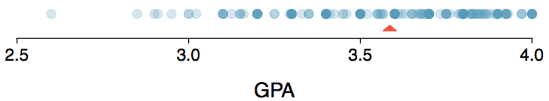
Dot Plots & Mean
The mean, also called the average (marked with a triangle in the above plot), is one way to measure the center of a distribution of data.
The mean GPA is 3.59.

Slide 12

Mean
The sample mean, denoted as x̄, can be calculated as
where x₁, x₂, ..., x_{n} represent the n observed values.
The population mean is also computed the same way but is denoted as µ. It is often not possible to calculate µ since population data are rarely available.
The sample mean is a sample statistic, and serves as a point estimate of the population mean. This estimate may not be perfect, but if the sample is good (representative of the population), it is usually a pretty good estimate.

Slide 13
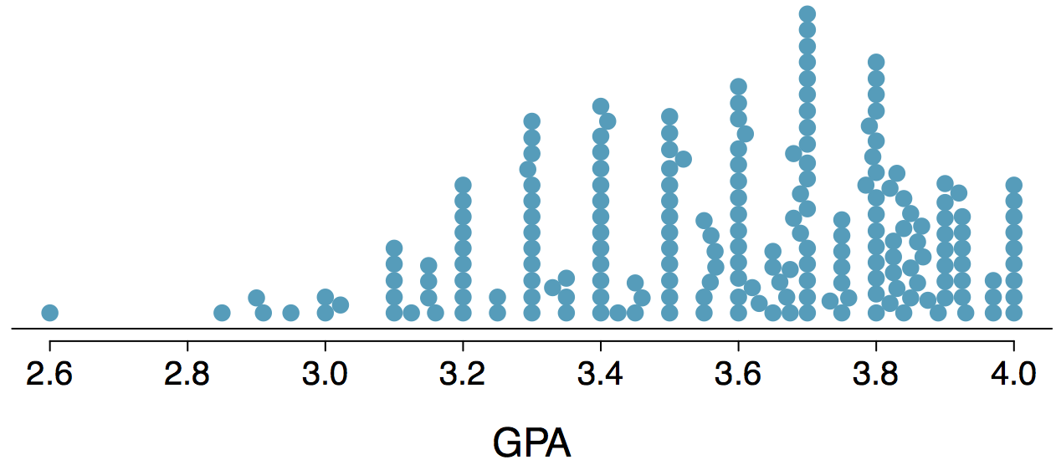
Stacked Dot Plot
Higher bars represent areas where there are more observations, makes it a little easier to judge the center and the shape of the distribution.

Slide 14
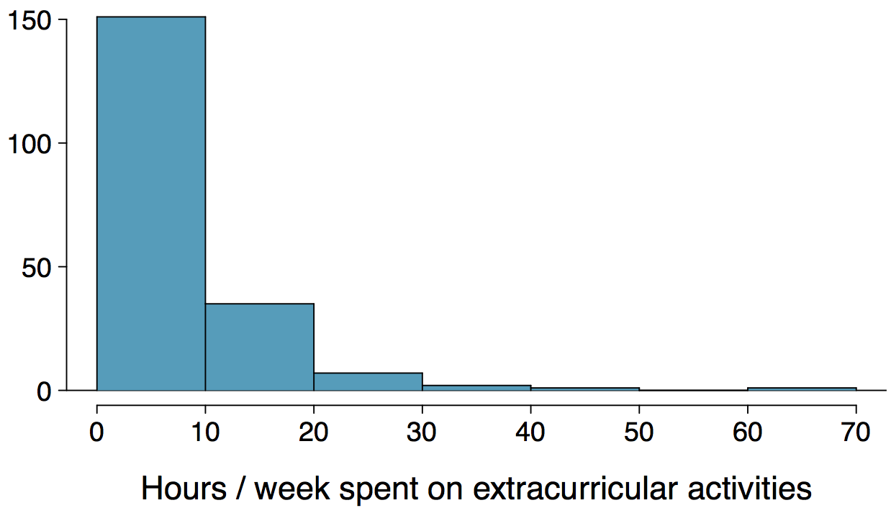
Histograms - Extracurricular Hours
Histograms provide a view of the data density. Higher bars represent where the data are relatively more common.
Histograms are especially convenient for describing the shape of the data distribution.
The chosen bin width can alter the story the histogram is telling.

Slide 15
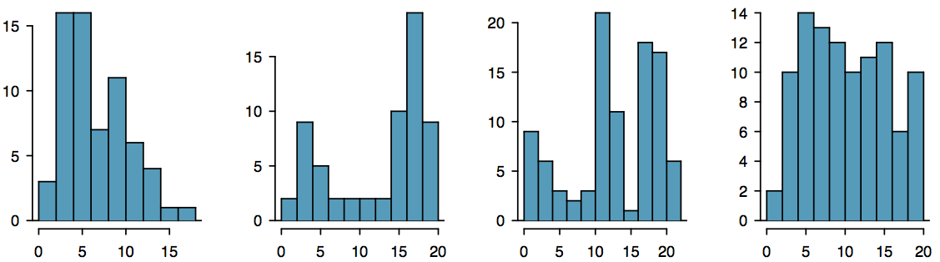
Shape of a Distribution: Modality
Does the histogram have a single prominent peak (unimodal), several prominent peaks (bimodal/multimodal), or no apparent peaks (uniform)?
Note: In order to determine modality, step back and imagine a smooth curve over the histogram -- imagine that the bars are wooden blocks and you drop a limp spaghetti over them, the shape the spaghetti would take could be viewed as a smooth curve.

Slide 16
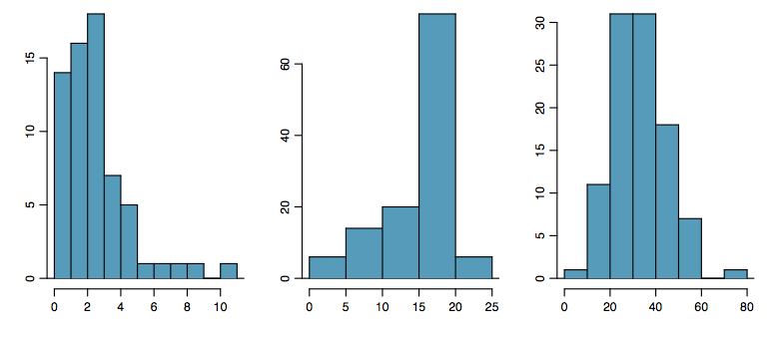
Shape of a Distribution: Skewness
Is the histogram right skewed, left skewed, or symmetric?
Note: Histograms are said to be skewed to the side of the long tail.

Slide 17
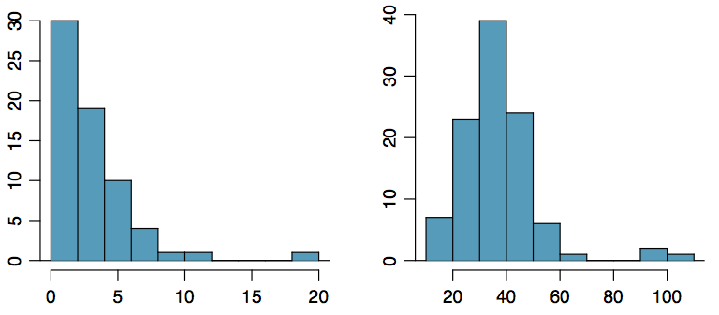
Shape of a Distribution:
Unusual Observations
Are there any unusual observations or potential outliers?

Slide 18
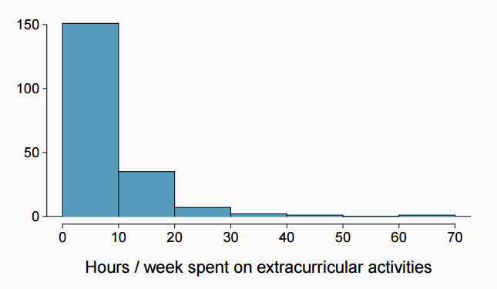
Extracurricular activities
How would you describe the shape of the distribution of hours per week students spend on extracurricular activities?

Slide 19
Extracurricular activities
How would you describe the shape of the distribution of hours per week students spend on extracurricular activities?
Unimodal and right skewed, with a potentially unusual observation at 60 hours/week.

Slide 20
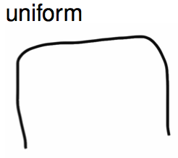
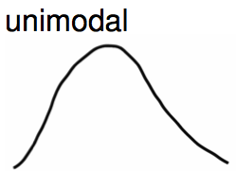
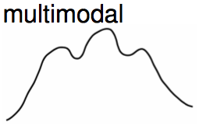
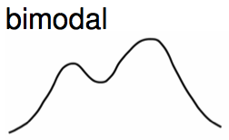
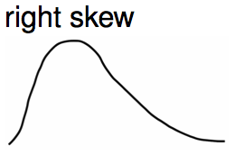
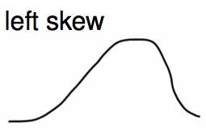
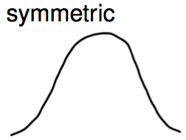
Commonly observed shapes of distributions
Modality
Skewness

Slide 21


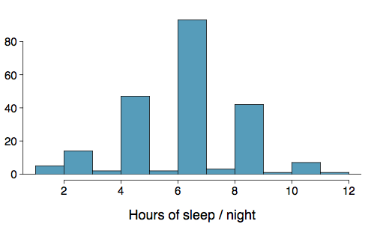
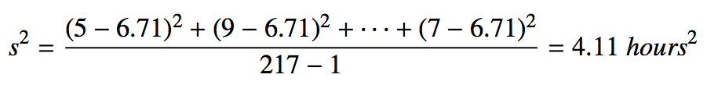
Variance
Variance is roughly the average squared deviation from the mean.
The sample mean is and the sample size is n = 217.
The variance of amount of sleep students get per night can be calculated as:

Slide 22
Variance (cont.)
Why do we use the squared deviation in the calculation of variance?
To get rid of negatives so that observations equally distant from the mean are weighed equally.
To weigh larger deviations more heavily.

Slide 23

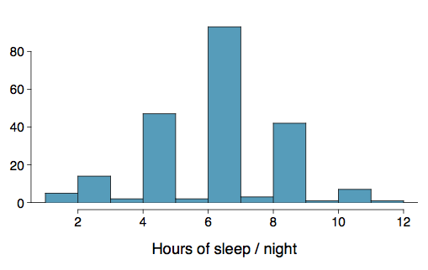

Standard Deviation
The standard deviation is the square root of the variance, and has the same units as the data.
The standard deviation of amount of sleep students get per night can be calculated as:
We can see that all of the data are within 3 standard deviations of the mean.

Slide 24
Percentiles and Quartiles
Percentiles divide the data in one hundred groups.
The n^{th} percentile is the data value such that n percent of the data lies below that value.
For large data sets, the median is the 50th percentile.
The median of the lower half of the data is the 25th percentile and is called the first quartile (Q1).
The median of the upper half of the data is the 75th percentile and is called the third quartile (Q3).

Slide 25

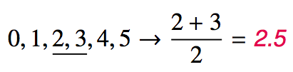
Median
The median is the value that splits the data in half when ordered in ascending order.
If there are an even number of observations, then the median is the average of the two values in the middle.
Since the median is the midpoint of the data, 50% of the values are below it. Hence, it is also the 50th percentile.

Slide 26
Q1, Q3, and IQR
The 25th percentile is also called the first quartile, Q1.
The 50th percentile is also called the median.
The 75th percentile is also called the third quartile, Q3.
Between Q1 and Q3 is the middle 50% of the data. The range these data span is called the interquartile range, or the IQR.
IQR = Q3 - Q1

Slide 27
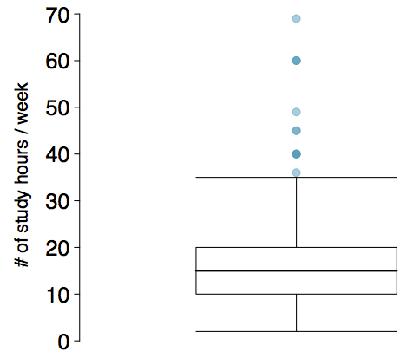
Box Plot
The box in a box plot represents the middle 50% of the data, and the thick line in the box is the median.

Slide 28
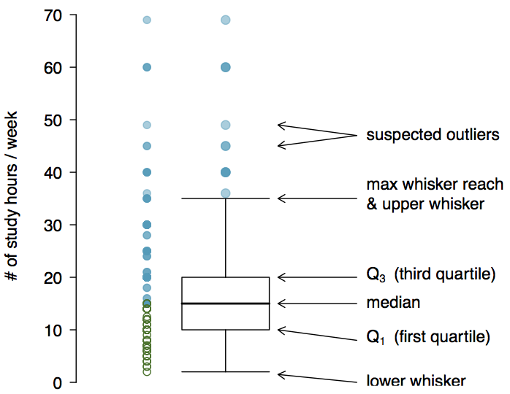
Anatomy of a Box Plot

Slide 29
Whiskers and Outliers
Whiskers of a box plot can extend up to 1.5 x IQR away from the quartiles.
max upper whisker reach = Q3 + 1.5 x IQR
max lower whisker reach = Q1 - 1.5 x IQR
IQR: 20 - 10 = 10
max upper whisker reach = 20 + 1.5 x 10 = 35
max lower whisker reach = 10 - 1.5 x 10 = -5
A potential outlier is defined as an observation beyond the maximum reach of the whiskers. It is an observation that appears extreme relative to the rest of the data.

Slide 30
Outliers (cont.)
Why is it important to look for outliers?
Identify extreme skew in the distribution.
Identify data collection and entry errors.
Provide insight into interesting features of the data.

Slide 31
Robust Statistics
Median and IQR are more robust to skewness and outliers than mean and SD. Therefore,
for skewed distributions it is often more helpful to use median and IQR to describe the center and spread
for symmetric distributions it is often more helpful to use the mean and SD to describe the center and spread

Slide 32
Robust Statistics
Median and IQR are more robust to skewness and outliers than mean and SD. Therefore,
for skewed distributions it is often more helpful to use median and IQR to describe the center and spread
for symmetric distributions it is often more helpful to use the mean and SD to describe the center and spread
If you would like to estimate the typical household income for a student, would you be more interested in the mean or median income?

Slide 33
Robust Statistics
Median and IQR are more robust to skewness and outliers than mean and SD. Therefore,
for skewed distributions it is often more helpful to use median and IQR to describe the center and spread
for symmetric distributions it is often more helpful to use the mean and SD to describe the center and spread
If you would like to estimate the typical household income for a student, would you be more interested in the mean or median income?
Median

Slide 34
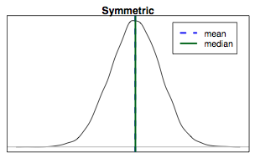
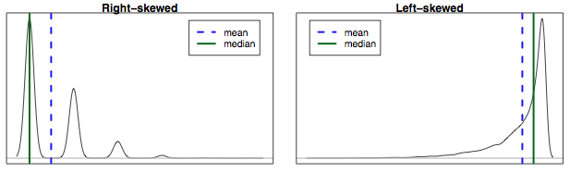
Mean vs. Median
If the distribution is symmetric, center is often defined as the mean: mean ~ median
If the distribution is skewed or has extreme outliers, center is often defined as the median
Right-skewed: mean > median
Left-skewed: mean < median

Slide 35
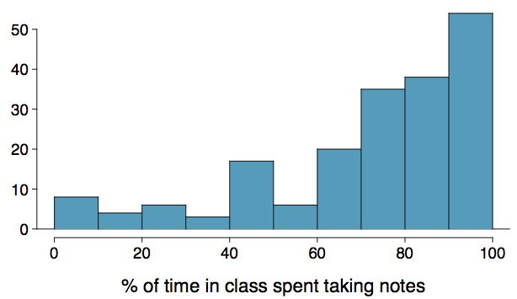
Practice
Which is most likely true for the distribution of percentage of time actually spent taking notes in class versus on Facebook, Twitter, etc.?
median: 80%
mean: 76%
mean > median
(b) mean ~ median
(c) mean < median (d) impossible to tell

Slide 36
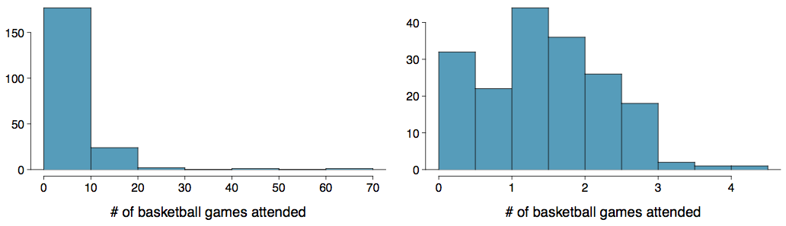
Extremely Skewed Data
When data are extremely skewed, transforming them might make modeling easier. A common transformation is the log transformation.
The histograms on the left shows the distribution of number of basketball games attended by students. The histogram on the right shows the distribution of log of number of games attended.

Slide 37
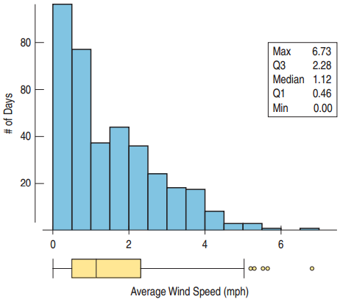
Wind Speeds in the Hopkins Memorial Forest
Typical speed < 1 mph
A small number of high wind days
One very windy day > 6 mph
IQR ~ 1.82 mph
May be interesting to compare winter (Oct. – March) with summer (April – Sept.)

Slide 38
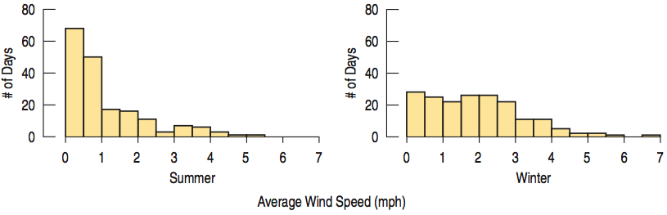
Comparing Seasons
Summer is unimodal and skewed right.
Winter is less skewed and nearly uniform.

Slide 39
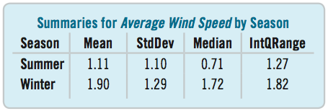
Comparing Seasons (Continued)
Winter is substantially windier than summer.
Both the standard deviation and the IQR show that winter wind speeds are more variable compared to summer

Slide 40
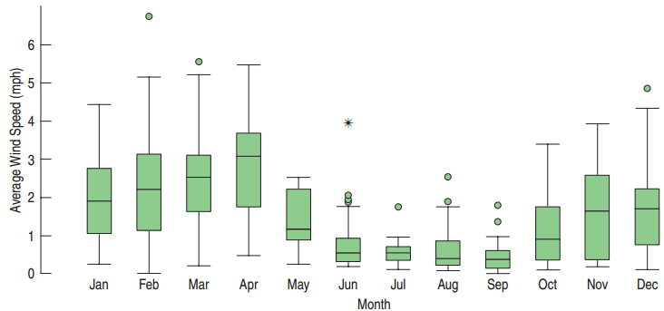
Using Boxplots for Comparisons
Are some months windier than others?
Compare April and July.
Notice many outliers over the year with this view.

Slide 41
Considering
Categorical Data

Slide 42
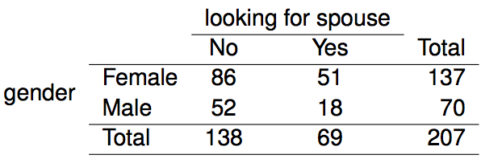
Contingency Tables
A table that summarizes data for two categorical variables is called a contingency table.
The contingency table below shows the distribution of students' genders and whether or not they are looking for a spouse while in college.

Slide 43
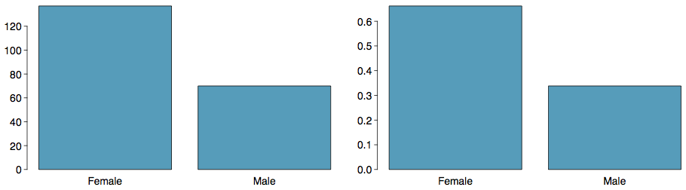
Bar Plots
A bar plot is a common way to display a single categorical variable. A bar plot where proportions instead of frequencies are shown is called a relative frequency bar plot.
How are bar plots different than histograms?
Bar plots are used for displaying distributions of categorical variables, while histograms are used for numerical variables. The x-axis in a histogram is a number line, hence the order of the bars cannot be changed, while in a bar plot the categories can be listed in any order (though some orderings make more sense than others, especially for ordinal variables.)

Slide 44
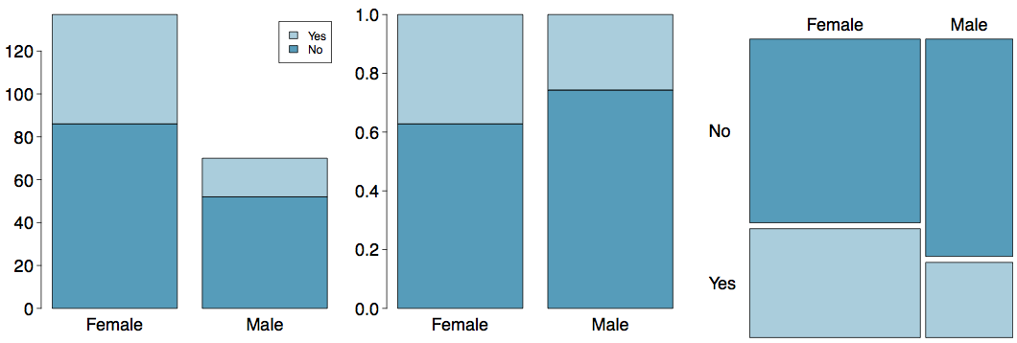
Segmented Bar and Mosaic Plots
What are the differences between the three visualizations shown below?

Slide 45
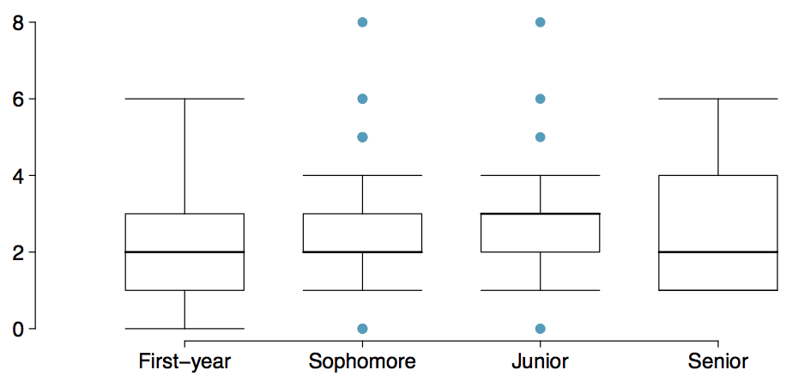
Comparing Numerical Data
Across Groups
Does there appear to be a relationship between class year and number of clubs students are in?

