Slide 1
Evaluating the
normal approximation

Slide 2
Anatomy of a normal probability plot
Data are plotted on the y-axis of a normal probability plot, and theoretical quantiles (following a normal distribution) on the x-axis.
If there is a linear relationship in the plot, then the data follow a nearly normal distribution.
Constructing a normal probability plot requires calculating percentiles and corresponding z-scores for each observation, which is tedious. Therefore we generally rely on software when making these plots.

Slide 3
Z- Scores
z-score is the number of standard deviations from the mean a data point is. But more technically it's a measure of how many standard deviations below or above the population mean a raw score is. A z-score is also known as a standard score and it can be placed on a normal distribution curve.

Slide 4
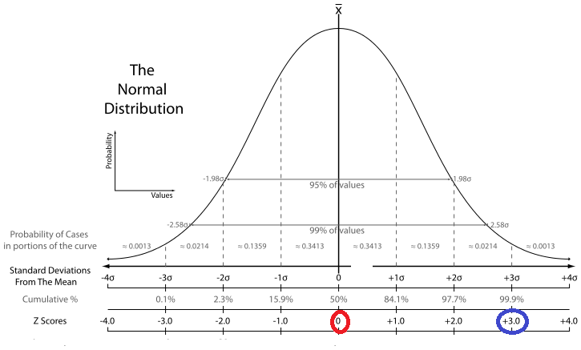
Z-scores

Slide 5
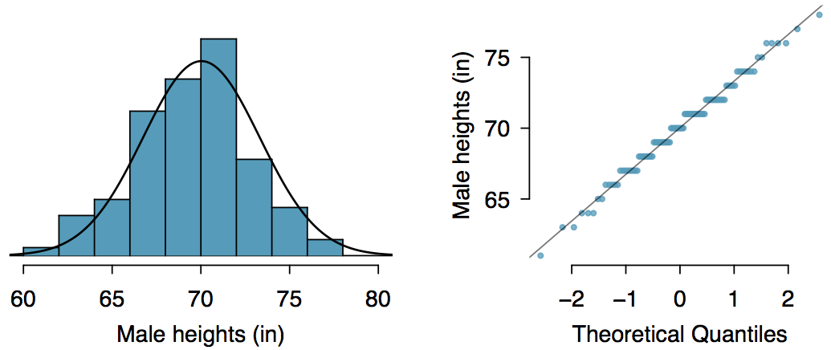
Normal probability plot
A histogram and normal probability plot of a sample of 100 male heights.

Slide 6
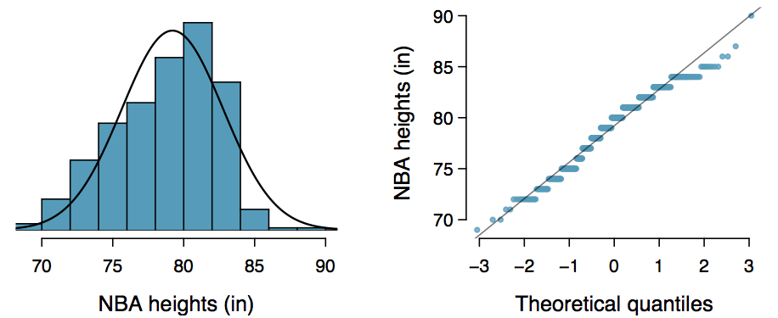
Practice
Below is a histogram and normal probability plot for the NBA heights from the 2008-2009 season. Do these data appear to follow a normal distribution?

Slide 7
Practice
Below is a histogram and normal probability plot for the NBA heights from the 2008-2009 season. Do these data appear to follow a normal distribution?
Why do the points on the normal probability have jumps?

Slide 8
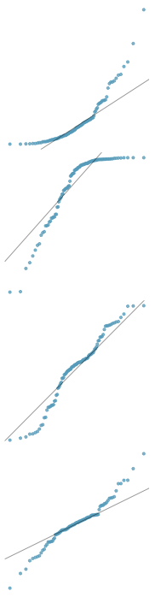
Normal probability plot and skewness
Right skew - Points bend up and to the left of the line.
Left skew - Points bend down and to the right of the line.
Short tails (narrower than the normal distribution) - Points follow an S shaped-curve.
Long tails (wider than the normal distribution) - Points start below the line, bend to follow it, and end above it.

Slide 9
Variability in Estimates

Slide 10
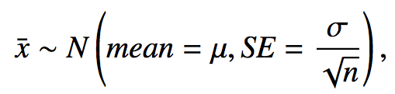
Central Limit Theorem
The distribution of the sample mean is well approximated by a normal model:
where SE is represents standard error, which is defined as the standard deviation of the sampling distribution. If σ is unknown, use s.
It wasn't a coincidence that the sampling distribution we saw earlier was symmetric, and centered at the true population mean.
We won't go through a detailed proof of why SE = σ / √n, but note that as n increases SE decreases.
As the sample size increases we would expect samples to yield more consistent sample means, hence the variability among the sample means would be lower.

Slide 11
CLT - conditions
Certain conditions must be met for the CLT to apply:
Independence: Sampled observations must be independent. This is difficult to verify, but is more likely if
random sampling / assignment is used, and
if sampling without replacement, n < 10% of the population.

Slide 12
CLT - conditions
Certain conditions must be met for the CLT to apply:
Independence: Sampled observations must be independent. This is difficult to verify, but is more likely if
random sampling / assignment is used, and
if sampling without replacement, n < 10% of the population.
Sample size / skew: Either the population distribution is normal, or if the population distribution is skewed, the sample size is large.
the more skewed the population distribution, the larger sample size we need for the CLT to apply
for moderately skewed distributions n > 30 is a widely used rule of thumb
This is also difficult to verify for the population, but we can check it using the sample data, and assume that the sample mirrors the population.

Slide 13
Confidence Intervals

Slide 14
Confidence interval
Confidence interval, a general formula
point estimate ± z* x SE
z* x SE = margin of error!

Slide 15
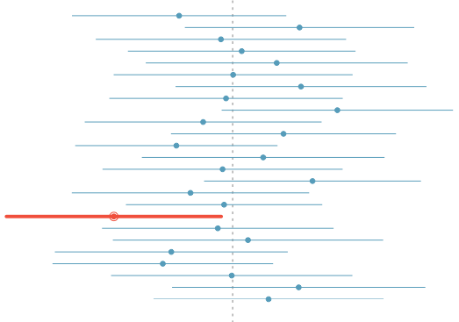
What does 95% confident mean?
Suppose we took many samples and built a confidence interval from each sample using the equation point estimate ± 2 x SE.
Then about 95% of those intervals would contain the true population mean (µ).
The figure shows this process with 25 samples, where 24 of the resulting confidence intervals contain the true average number of exclusive relationships, and one does not.

Slide 16
Width of an interval
If we want to be more certain that we capture the population parameter, i.e. increase our confidence level, should we use a wider interval or a smaller interval?

Slide 17
Hypothesis Testing

Slide 18

Hypothesis testing for a population mean
1. Set the hypotheses
H₀: µ = null value
H_{A}: µ < or > or ≠ null value
2. Calculate the point estimate
3. Check assumptions and conditions
Independence: random sample/assignment, 10% condition when sampling without replacement
Normality: nearly normal population or n ≥ 30, no extreme skew -- or use the t distribution (Ch 5)
4. Calculate a test statistic and a p-value
5. Make a decision, and interpret it in context
If p-value < α, reject H₀, data provide evidence for H_{A}
If p-value > α, do not reject H₀, data do not provide evidence for H_{A}

Slide 19
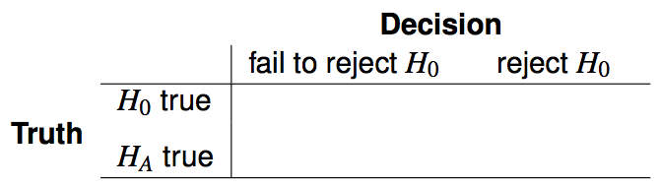


Decision errors
There are two competing hypotheses: the null and the alternative. In a hypothesis test, we make a decision about which might be true, but our choice might be incorrect.
A Type 1 Error is rejecting the null hypothesis when H₀ is true.
A Type 2 Error is failing to reject the null hypothesis when H_{A} is true.

Slide 20
Examining the Central Limit Theorem

Slide 21
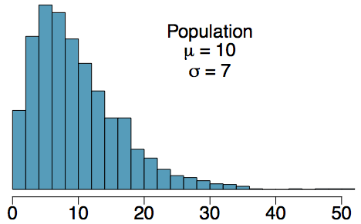
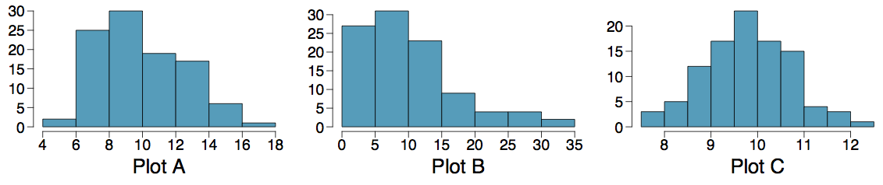
Practice
Four plots: Determine which plot (A, B, or C) is which.
At top: distribution for a population (µ = 10, σ = 7),
a single random sample of 100 observations from this population,
a distribution of 100 sample means from random samples with size 7, and
a distribution of 100 sample means from random samples with size 49.
A - (3); B - (2); C - (4)
A - (2); B - (3); C - (4)
A - (3); B - (4); C - (2)
A - (4); B - (2); C - (3)

Slide 22
Practice
Four plots: Determine which plot (A, B, or C) is which.
At top: (1) distribution for a population (µ = 10, σ = 7),
(2) a single random sample of 100 observations from this population,
(3) a distribution of 100 sample means from random samples with size 7
(4) a distribution of 100 sample means from random samples with size 49.
A - (3); B - (2); C - (4)
A - (2); B - (3); C - (4)
A - (3); B - (4); C - (2)
A - (4); B - (2); C - (3)

Slide 23
Sample Size and Power

Slide 24
Finding a sample size for a certain margin of error
A group of researchers wants to test the possible effect of an epilepsy medication taken by pregnant mothers on the cognitive development of their children. As evidence, they want to estimate the IQ scores of three-year-old children born to mothers who were on this particular medication during pregnancy. Previous studies suggest that the standard deviation of IQ scores of three-year-old children is 18 points. How many such children should the researchers sample in order to obtain a 96% confidence interval with a margin of error less than or equal to 4 points?
We know that the critical value associated with the 96% confidence level: z* = 2.05.
The minimum number of children required to attain the desired margin of error is 85.1. Since we can't sample 0.1 of a child, we must sample at least 86 children (round up, since rounding down to 85 would yield a slightly larger margin of error than desired).

Slide 25
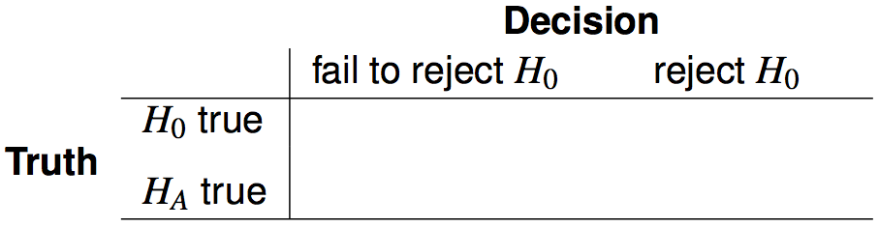




Hypothesis testing possibilities
Type 1 error is rejecting H₀ when you shouldn't have, and the probability of doing so is α (significance level)
Type 2 error is failing to reject H₀ when you should have, and the probability of doing so is β (a little more complicated to calculate)
Power of a test is the probability of correctly rejecting H₀, and the probability of doing so is 1 - β
In hypothesis testing, we want to keep α and β low, but there are inherent trade-offs.

Slide 26
Example - Blood Pressure
Blood pressure oscillates with the beating of the heart, and the systolic pressure is defined as the peak pressure when a person is at rest. The average systolic blood pressure for people in the U.S. is about 130 mmHg with a standard deviation of about 25 mmHg.
We are interested in finding out if the average blood pressure of employees at a certain company is greater than the national average, so we collect a random sample of 100 employees and measure their systolic blood pressure. What are the hypotheses?
H₀: µ = 130
H_{A}: µ > 130
We'll start with a very specific question -- “What is the power of this hypothesis test to correctly detect an increase of 2 mmHg in average blood pressure?”

Slide 27
Calculating power
The preceding question can be rephrased as “How likely is it that this test will reject H₀ when the true average systolic blood pressure for employees at this company is 132 mmHg?”
Hint: Break this down into two simpler problems
Problem 1: Which values of x̄ represent sufficient evidence to reject H₀?
Problem 2: What is the probability that we would reject H₀ if x̄ had come from N(mean = 132, SE = 25 / √100 = 2.5), i.e. what is the probability that we can obtain such an x̄ from this distribution?
Determine how power changes as sample size, standard deviation of the sample, α, and effect size increases.

Slide 28
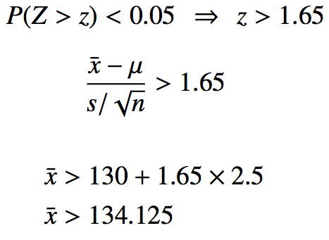
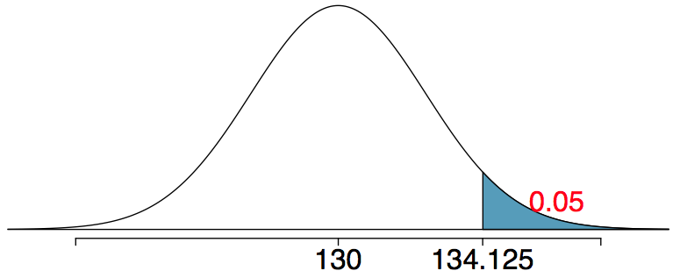
Problem 1
Which values of x̄ represent sufficient evidence to reject H₀? (Remember H₀: µ = 130, H_{A}: µ > 130)
Any x̄ > 134.125 would be sufficient to reject H₀ at the 5% significance level.

Slide 29
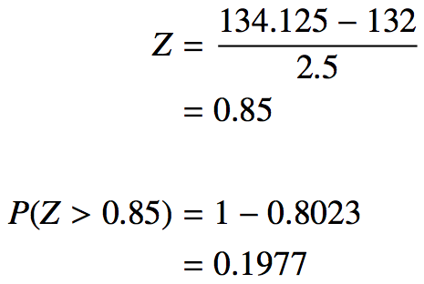
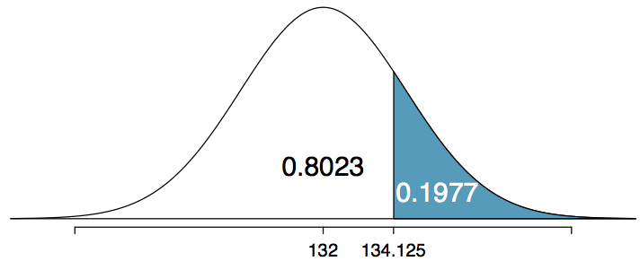
Problem 2
What is the probability that we would reject H₀ if x̄ did come from N(mean = 132, SE = 2.5).
This is the same as finding the area above x̄ = 134.125 if x̄ came from N(132, 2.5).
The probability of rejecting H₀: µ = 130, if the true average systolic blood pressure of employees at this company is 132 mmHg, is 0.1977 which is the power of this test.
Therefore, β = 0.8023 for this test.

Slide 30
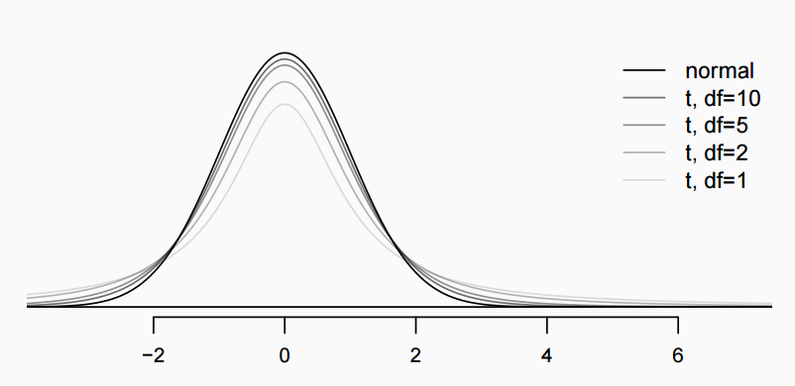
The 𝒕 distribution
Always centered at zero, like the standard normal (𝓏) distribution
Has a single parameter: degrees of freedom (df).
What happens to the shape of the 𝒕 distribution as df increases?

Slide 31



Inference using the 𝒕-distribution
If 𝞼 is unknown, use the 𝒕-distribution with
Conditions:
independence of observations (often verified by a random sample, and if sampling without replacement, n < 10% of population)
no extreme skew
Hypothesis Testing:
Confidence interval:

Slide 32
Difference in two means

Slide 33

Recap: Inference using difference of two small sample means
If σ₁ or σ₂ is unknown, difference between the sample means follow a 𝙩-distribution with
Conditions:
independence within groups (often verified by a random sample, and if sampling without replacement, n < 10% of population) and between groups
no extreme skew in either group
Hypothesis testing:
Confidence interval:

Slide 34
Comparing means with ANOVA

Slide 35
ANOVA
ANOVA is used to assess whether the mean of the outcome variable is different for different levels of a categorical variable
H₀ : The mean outcome is the same across all categories,
𝜇₁ = 𝜇₂ = … = 𝜇_{k},
where 𝜇_{i} represents the mean of the outcome for observations in category i
H_{A} : At least one mean is different than others

Slide 36
𝔃/𝘵 test vs. ANOVA - Purpose
𝔃/𝘵 test
Compare means from two groups to see whether they are so far apart that the observed difference cannot reasonably be attributed to sampling variability
H₀ : 𝜇₁ = 𝜇₂
ANOVA
Compare the means from two or more groups to see whether they are so far apart that the observed differences cannot all reasonably be attributed to sampling variability
H₀ : 𝜇₁ = 𝜇₂ = … = 𝜇_{k}

Slide 37


𝔃/𝘵 test vs. ANOVA - Method
𝔃/𝘵 test
Compute a test statistic (a ratio)
ANOVA
Compute a test statistic (a ratio)
Large test statistics lead to small p-values
If the p-value is small enough H₀ is rejected, we conclude that the population means are not equal

Slide 38

Inference for one proportion
Population parameter: p, point estimate: p̂
Conditions
independence - random sample and 10% condition
at least 10 successes and failures - if not → randomization
Standard error:
for CI: use p̂
for HT: use p₀

Slide 39


Recap - comparing two proportions
Population parameter: (p₁ - p₂), point estimate: (p̂₁ - p̂₂)
Conditions:
independence within groups - random sample and 10% condition met for both groups
independence between groups
at least 10 successes and failures in each group - if not → randomization (Section 6.4)
for CI: use p̂₁ and p̂₂
for HT:
when H₀: p₁ = p₂: use
when H₀: p₁ - p₂ = (some value other than 0): use p̂₁ and p̂₂ - this is pretty rare

Slide 40
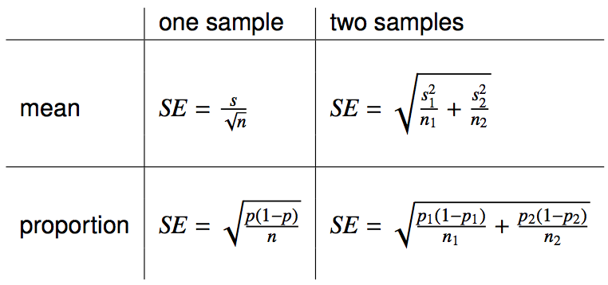
Reference - standard error calculations

