Slide 1
Sample Size and Power

Slide 2
Finding a sample size for a certain margin of error
A group of researchers wants to test the possible effect of an epilepsy medication taken by pregnant mothers on the cognitive development of their children. As evidence, they want to estimate the IQ scores of three-year-old children born to mothers who were on this particular medication during pregnancy. Previous studies suggest that the standard deviation of IQ scores of three-year-old children is 18 points. How many such children should the researchers sample in order to obtain a 96% confidence interval with a margin of error less than or equal to 4 points?
We know that the critical value associated with the 96% confidence level: z* = 2.05.
The minimum number of children required to attain the desired margin of error is 85.1. Since we can't sample 0.1 of a child, we must sample at least 86 children (round up, since rounding down to 85 would yield a slightly larger margin of error than desired).

Slide 3
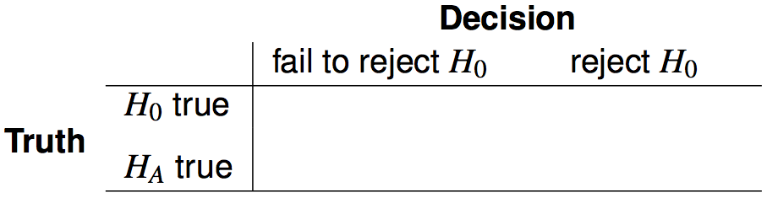




Hypothesis testing possibilities
Type 1 error is rejecting H₀ when you shouldn't have, and the probability of doing so is α (significance level)
Type 2 error is failing to reject H₀ when you should have, and the probability of doing so is β (a little more complicated to calculate)
Power of a test is the probability of correctly rejecting H₀, and the probability of doing so is 1 - β
In hypothesis testing, we want to keep α and β low, but there are inherent trade-offs.

Slide 4
Example - Blood Pressure
Blood pressure oscillates with the beating of the heart, and the systolic pressure is defined as the peak pressure when a person is at rest. The average systolic blood pressure for people in the U.S. is about 130 mmHg with a standard deviation of about 25 mmHg.
We are interested in finding out if the average blood pressure of employees at a certain company is greater than the national average, so we collect a random sample of 100 employees and measure their systolic blood pressure. What are the hypotheses?
H₀: µ = 130
H_{A}: µ > 130
We'll start with a very specific question -- “What is the power of this hypothesis test to correctly detect an increase of 2 mmHg in average blood pressure?”

Slide 5
Calculating power
The preceding question can be rephrased as “How likely is it that this test will reject H₀ when the true average systolic blood pressure for employees at this company is 132 mmHg?”
Hint: Break this down into two simpler problems
Problem 1: Which values of x̄ represent sufficient evidence to reject H₀?
Problem 2: What is the probability that we would reject H₀ if x̄ had come from N(mean = 132, SE = 25 / √100 = 2.5), i.e. what is the probability that we can obtain such an x̄ from this distribution?
Determine how power changes as sample size, standard deviation of the sample, α, and effect size increases.

Slide 6
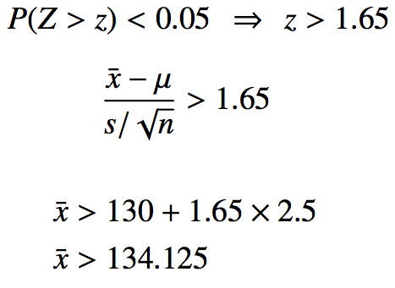
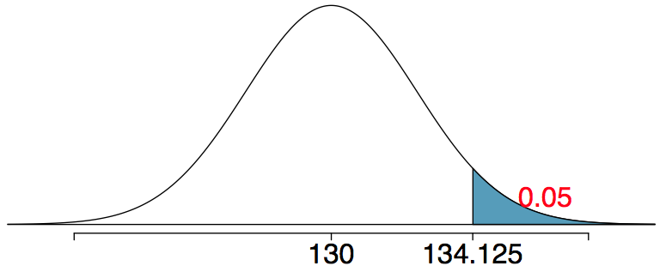
Problem 1
Which values of x̄ represent sufficient evidence to reject H₀? (Remember H₀: µ = 130, H_{A}: µ > 130)
Any x̄ > 134.125 would be sufficient to reject H₀ at the 5% significance level.

Slide 7
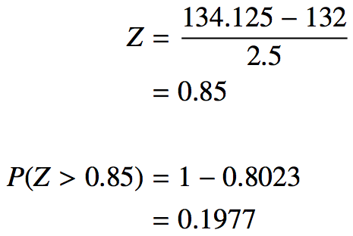
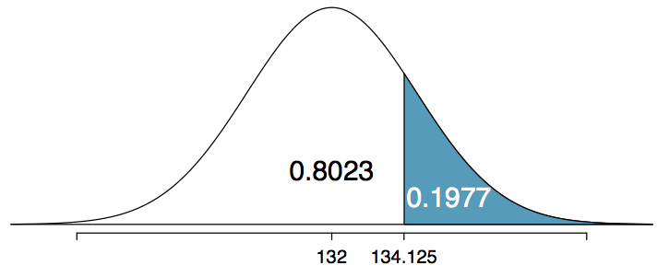
Problem 2
What is the probability that we would reject H₀ if x̄ did come from N(mean = 132, SE = 2.5).
This is the same as finding the area above x̄ = 134.125 if x̄ came from N(132, 2.5).
The probability of rejecting H₀: µ = 130, if the true average systolic blood pressure of employees at this company is 132 mmHg, is 0.1977 which is the power of this test.
Therefore, β = 0.8023 for this test.

Slide 8
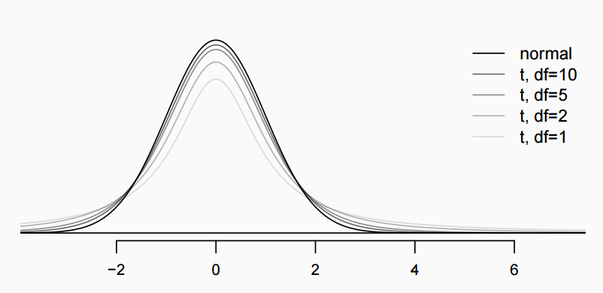
The 𝒕 distribution
Always centered at zero, like the standard normal (𝓏) distribution
Has a single parameter: degrees of freedom (df).
What happens to the shape of the 𝒕 distribution as df increases?

Slide 9



Inference using the 𝒕-distribution
If 𝞼 is unknown, use the 𝒕-distribution with
Conditions:
independence of observations (often verified by a random sample, and if sampling without replacement, n < 10% of population)
no extreme skew
Hypothesis Testing:
Confidence interval:

Slide 10
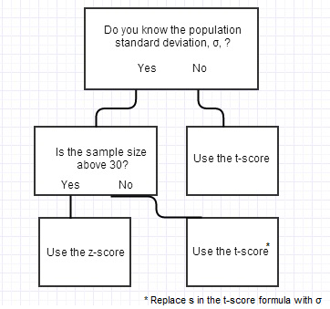
𝒕-score or z-score?
The flow

Slide 11
Difference in two means

Slide 12

Inference using difference of two small sample means
If σ₁ or σ₂ is unknown, difference between the sample means follow a 𝙩-distribution with
Conditions:
independence within groups (often verified by a random sample, and if sampling without replacement, n < 10% of population) and between groups
no extreme skew in either group
Hypothesis testing:
Confidence interval:

Slide 13
Comparing means with ANOVA

Slide 14
ANOVA
ANOVA is used to assess whether the mean of the outcome variable is different for different levels of a categorical variable
H₀ : The mean outcome is the same across all categories,
𝜇₁ = 𝜇₂ = … = 𝜇_{k},
where 𝜇_{i} represents the mean of the outcome for observations in category i
H_{A} : At least one mean is different than others

Slide 15
ANOVA – ( see also example Table 5.27)
Is batting performance related to player position in MLB?
The big question: Is the variability in the sample means so large that it seems unlikely to be from chance alone? We have tools to check it out:
MSG : measure of the between groups variability
MSE: measure of the variability within each group
Use the ratio of F=MSG/MSE to confirm the null hypothesis or not.

Slide 16
𝔃/𝘵 test vs. ANOVA - Purpose
𝔃/𝘵 test
Compare means from two groups to see whether they are so far apart that the observed difference cannot reasonably be attributed to sampling variability
H₀ : 𝜇₁ = 𝜇₂
ANOVA
Compare the means from two or more groups to see whether they are so far apart that the observed differences cannot all reasonably be attributed to sampling variability
H₀ : 𝜇₁ = 𝜇₂ = … = 𝜇_{k}

Slide 17


𝔃/𝘵 test vs. ANOVA - Method
𝔃/𝘵 test
Compute a test statistic (a ratio)
ANOVA
Compute a test statistic (a ratio)
Large test statistics lead to small p-values
If the p-value is small enough H₀ is rejected, we conclude that the population means are not equal

Slide 18

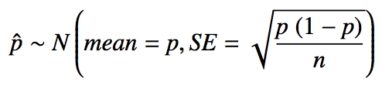
Sample proportions are also nearly normally distributed
Central limit theorem for proportions
Sample proportions will be nearly normally distributed with mean equal to the population mean, p, and standard error equal to
But of course this is true only under certain conditions…
independent observations, at least 10 successes and 10 failures
_________
Note: If p is unknown (most cases), we use p̂ in the calculation of the standard error.

Slide 19

Inference for one proportion
Population parameter: p, point estimate: p̂
Conditions
independence - random sample and 10% condition
at least 10 successes and failures - if not → randomization
Standard error:
for CI: use p̂
for HT: use p₀

Slide 20

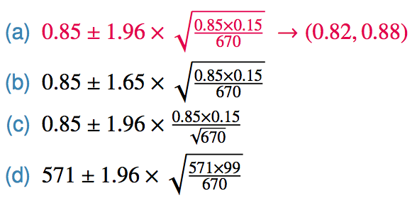
Practice
We are given that n = 670, p̂ = 0.85, we also just learned that the standard error of the sample proportion is
Which of the below is the correct calculation of the 95% confidence interval?

Slide 21



Choosing a sample size
How many people should you sample in order to cut the margin of error of a 95% confidence interval down to 1%.

Slide 22
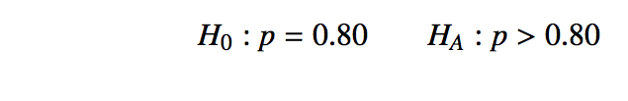

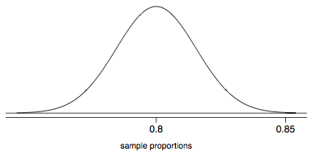


Practice
The GSS found that 571 out of 670 (85%) of Americans answered the question on experimental design correctly. Do these data provide convincing evidence that more than 80% of Americans have a good intuition about experimental design?
Since the p-value is low, we reject H₀. The data provide convincing evidence that more than 80% of Americans have a good intuition on experimental design.

Slide 23


Recap - comparing two proportions
Population parameter: (p₁ - p₂), point estimate: (p̂₁ - p̂₂)
Conditions:
independence within groups - random sample and 10% condition met for both groups
independence between groups
at least 10 successes and failures in each group - if not → randomization (Section 6.4)
for CI: use p̂₁ and p̂₂
for HT:
when H₀: p₁ = p₂: use

Slide 24
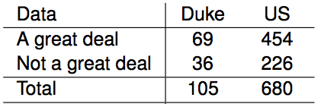




Sample proportions are also nearly normally distributed
Construct a 95% confidence interval for the difference between the proportions of Duke students and Americans who would be bothered a great deal by the melting of the northern ice cap (p_{Duke} - p_{US}).

Slide 25
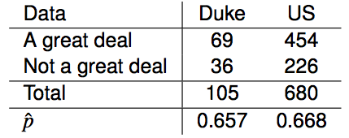
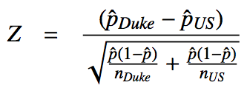
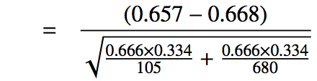
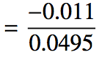
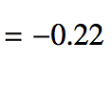
CI vs. HT for proportions
Do these data suggest that the proportion of all Duke students who would be bothered a great deal by the melting of the northern ice cap differs from the proportion of all Americans who do? Calculate the test statistic, the p-value, and interpret your conclusion in context of the data.

Slide 26
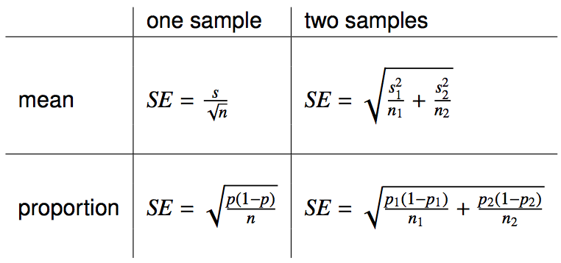
Reference - standard error calculations
When working with proportions,
if doing a hypothesis test, p comes from the null hypothesis
if constructing a confidence interval, use p̂ instead

Slide 27
Chi-Square test of GOF

Slide 28
Setting the hypotheses
Do data provide convincing evidence of an inconsistency between the observed and expected counts?
H₀: There is no inconsistency between the observed and the expected counts. The observed counts follow the same distribution as the expected counts.
H_{A}: There is an inconsistency between the observed and the expected counts. The observed counts do not follow the same distribution as the expected counts.

Slide 29
Evaluating the hypotheses
To evaluate these hypotheses, we quantify how different the observed counts are from the expected counts.
Large deviations from what would be expected based on sampling variation (chance) alone provide strong evidence for the alternative hypothesis.
This is called a goodness of fit test since we're evaluating how well the observed data fit the expected distribution.

Slide 30

Anatomy of a test statistic
The general form of a test statistic is
This construction is based on
identifying the difference between a point estimate and an expected value if the null hypothesis was true, and
standardizing that difference using the standard error of the point estimate.
These two ideas will help in the construction of an appropriate test statistic for count data.

Slide 31
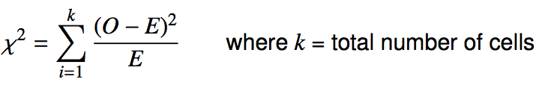
Chi-square statistic
When dealing with counts and investigating how far the observed counts are from the expected counts, we use a new test statistic called the chi-square (χ²) statistic.
χ² statistic

Slide 32
Why square?
Squaring the difference between the observed and the expected outcome does two things:
Any standardized difference that is squared will now be positive.
Differences that already looked unusual will become much larger after being squared.

Slide 33
Degrees of freedom for a goodness of fit test
When conducting a goodness of fit test to evaluate how well the observed data follow an expected distribution, the degrees of freedom are calculated as the number of cells (k) minus 1. df = k - 1

Slide 34
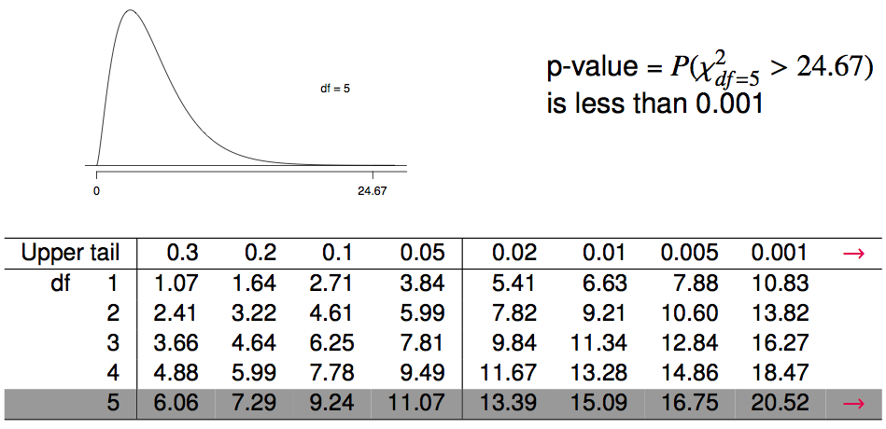
Finding a p-value for a chi-square test
The p-value for a chi-square test is defined as the tail area above the calculated test statistic.

Slide 35
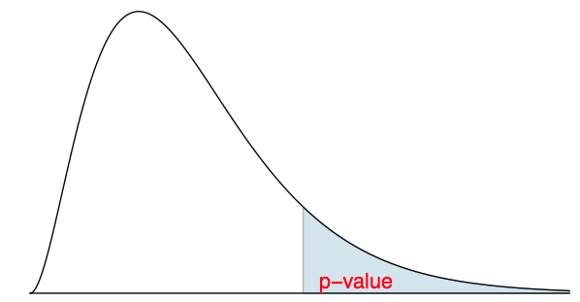
Recap: p-value for a chi-square test
The p-value for a chi-square test is defined as the tail area above the calculated test statistic.
This is because the test statistic is always positive, and a higher test statistic means a stronger deviation from the null hypothesis.

Slide 36
Conditions for the chi-square test
Independence: Each case that contributes a count to the table must be independent of all the other cases in the table.
Sample size: Each particular scenario (i.e. cell) must have at least 5 expected cases.
df > 1: Degrees of freedom must be greater than 1.

Slide 37
Chi-Square Test of Independence

Slide 38
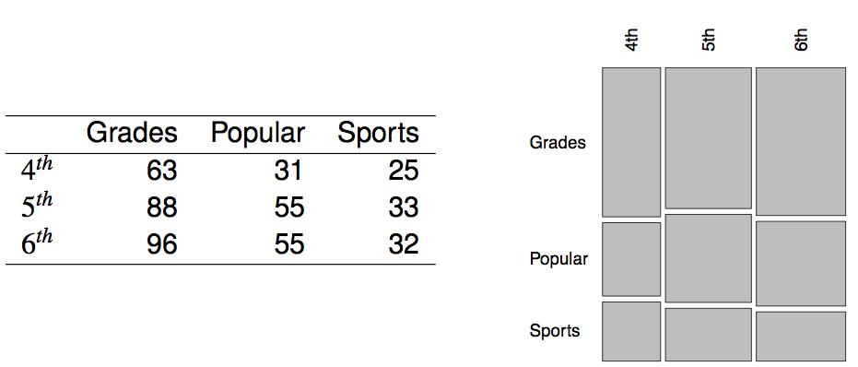
Popular kids
In the dataset popular, students in grades 4-6 were asked whether good grades, athletic ability, or popularity was most important to them. A two-way table separating the students by grade and by choice of most important factor is shown below. Do these data provide evidence to suggest that goals vary by grade?

Slide 39
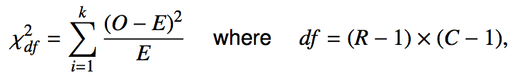
Chi-square test of independence
The hypotheses are:
H₀: Grade and goals are independent. Goals do not vary by grade.
H_{A}: Grade and goals are dependent. Goals vary by grade.
The test statistic is calculated as
where k is the number of cells, R is the number of rows, and C is the number of columns.
_______________
Note: we calculate df differently for one-way and two-way tables.
The p-value is the area under the χ²_{df} curve, above the calculated test statistic.

Slide 40

Expected counts in two-way tables

Slide 41
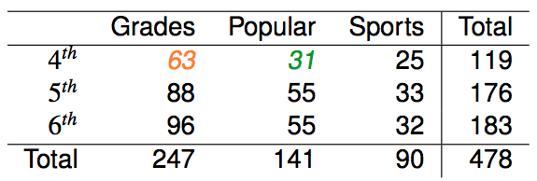

Expected counts in two-way tables

Slide 42
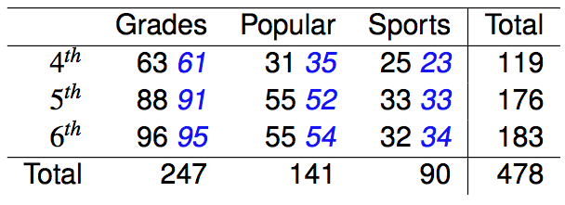

Calculating the test statistic in two-way tables
Expected counts are shown in blue next to the observed counts.

Slide 43
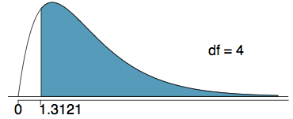
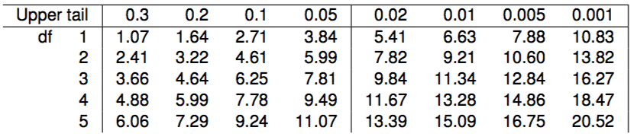
Calculating the p-value
Which of the following is the correct p-value for this hypothesis test?
χ²_{df} = 1.3121 df = 4
more than 0.3
between 0.3 and 0.2
between 0.2 and 0.1
between 0.1 and 0.05
less than 0.001

Slide 44
Conclusion
Do these data provide evidence to suggest that goals vary by grade?
H₀: Grade and goals are independent. Goals do not vary by grade.
H_{A}: Grade and goals are dependent. Goals vary by grade.
Since the p-value is large, we fail to reject H₀.The data do not provide convincing evidence that grade and goals are dependent. It doesn't appear that goals vary by grade.

